Slide 1
Affordable Automated Blood Grouping Machine
Revolutionizing Diagnostics with Microfluidic Technology

Slide 2





This is Us
Asutosh Chouhan
Agamjot K Choudhary
Namit Singh
Jatin Santosh Naik
Ayushman Das

Slide 3
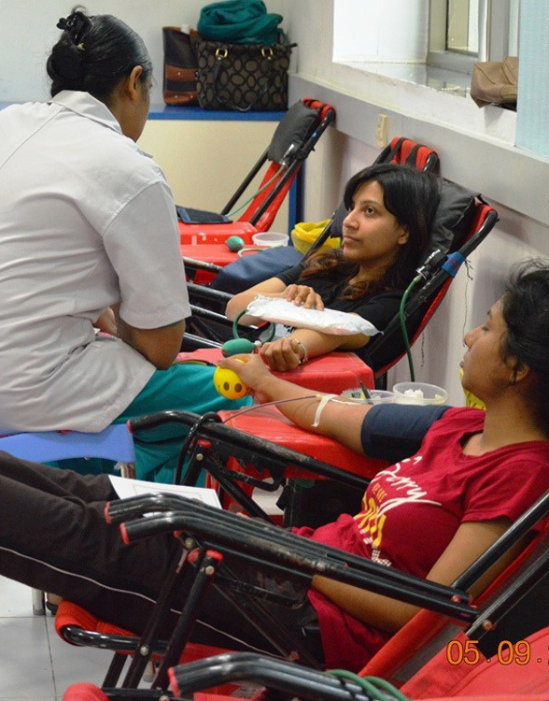
Problem Statement : Developing a low cost, automatic blood grouping machine for quick, efficient and resource limited applications.
For faster emergency response.
Low Cost.
Reducing the possibility of human errors.
Rapid screening in public health initiatives.
Our Driving Force

Slide 4
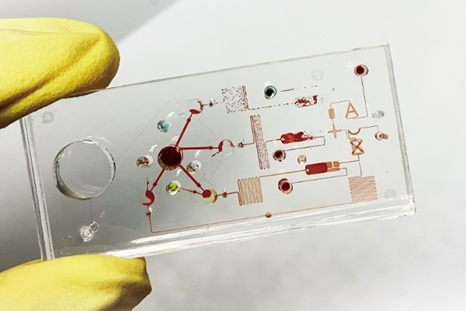
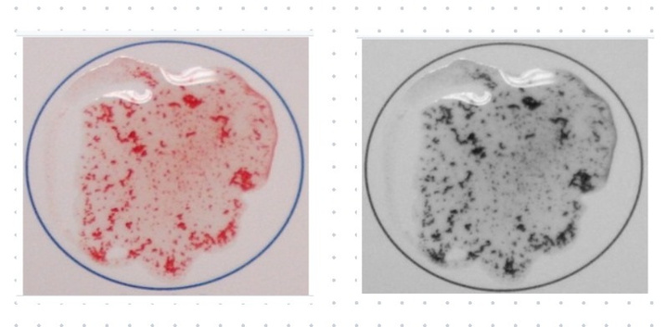
Proposed Solution
Microfluidic Chip Technology
Uses microfluidic chips to handle small volumes of blood and reagents.
Ensures precise mixing and reaction conditions.
Automation
Fully automates the blood grouping process, reducing the need for skilled technicians.
Manages fluid flow and reaction automatically.
Optical Detection
Integrates sensors or cameras to detect agglutination reactions.
Provides rapid and accurate blood type identification.

Slide 5
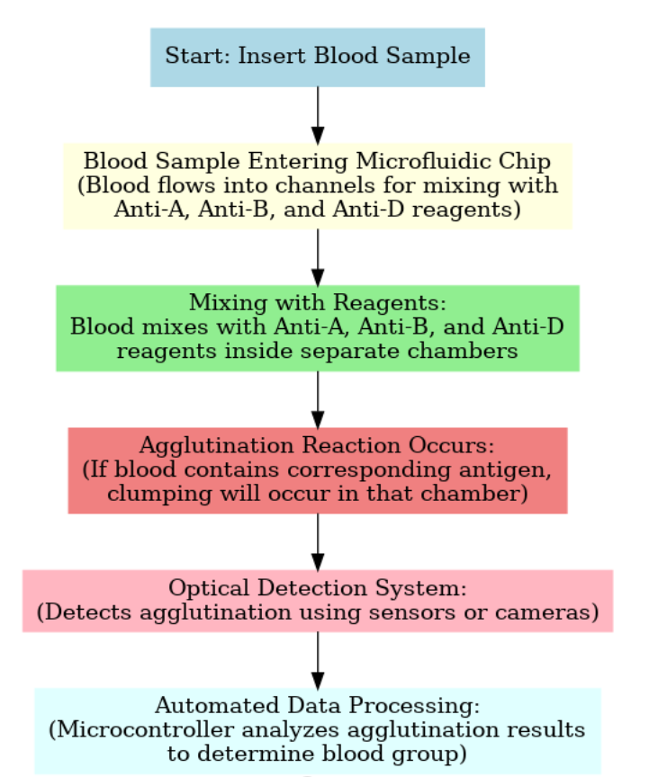
Flow of Function

Slide 6

Impact and Scalabilty
We are making this microfludic chip for the world. It will revolutionalize blood grouping over the globe, by
Affordability: we can print these microfludics chips on a very afforadable rate .
These chips can provide reliable blood typing where excess to traditional laboratory is limited.
Enhancing diagnostic efficiency by quicker analysis , facilitating timely decision making .

Slide 7

Future Enhancements
Integration with Other Diagnostic Tools: Discuss potential additions, such as hemoglobin testing.
Mobile Connectivity and Data Analysis: Talk about the possibility of adding Bluetooth or Wifi for app integration and data storage.
User Friendly Experience Improvements: Mention potential upgrades like touchscreen interfaces and built-in tutorials.

Slide 8
Thank
You!

