Slide 1
MediZen
Final Presentation
November 21, 2019

Slide 2
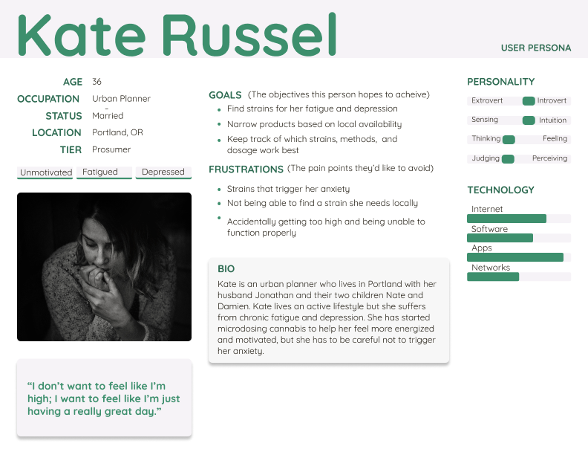
Target Audience
Notes:
This is our target user Kate. Kate struggles with severe stress and anxiety on a daily basis. She has started micro-dosing cannabis in order to treat her ailments, but has difficulty finding the strain and dosage that would allow her to focus on her work without triggering her anxiety.

Slide 3
To Begin….. The problem that we set out to solve
We aimed to create an app to help a cannabis consumer (especially a new consumer) find what is likely the best strain to achieve the effects that the consumer desires.
An available cannabis strain data set was used to build a machine learning model for generating strain selection recommendations.

Slide 4
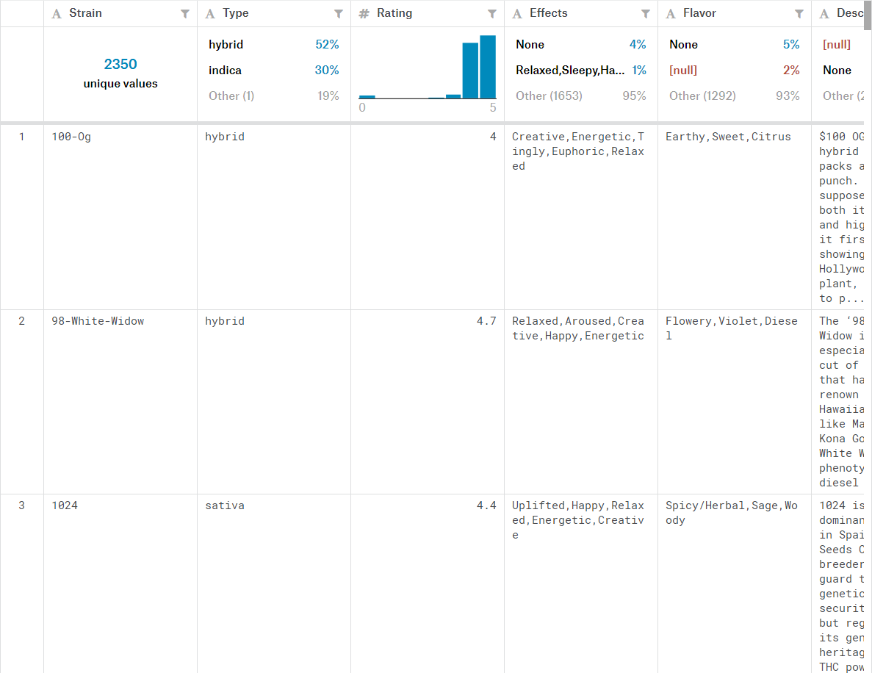
Summary of Data Set From the Source
Notes:
This is the first view of the data set downloaded from Kaggle and sourced from Leafly.
The strain descriptions do not contain information relevant to the effects.
The ratings are highly skewed to the upper end of the five point scale and thus provide limited discriminatory power

Slide 5
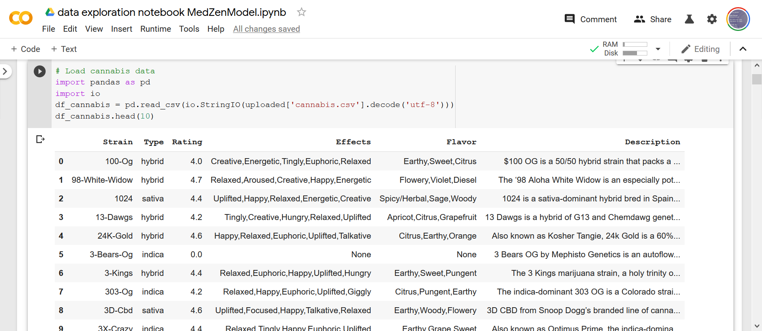
Looking at the Complete Feature Set
Notes:
The only numeric data in the source data is Ratings.
Effects and Flavors consist of collections of words, the order of which has no significance

Slide 6
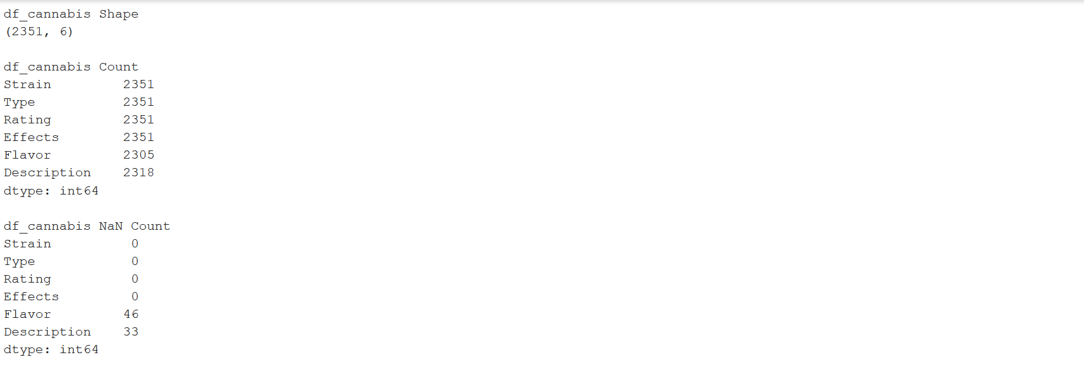
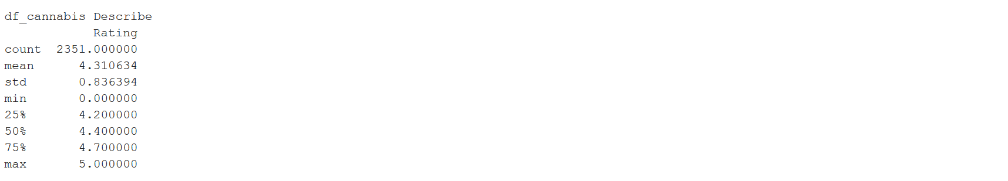
Characteristics of the Data Set

Slide 7
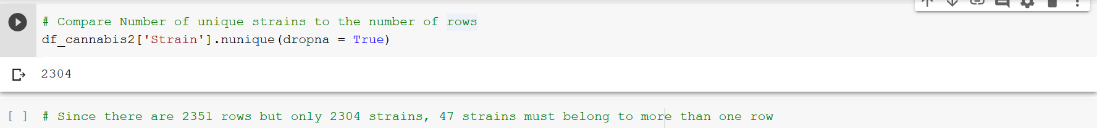
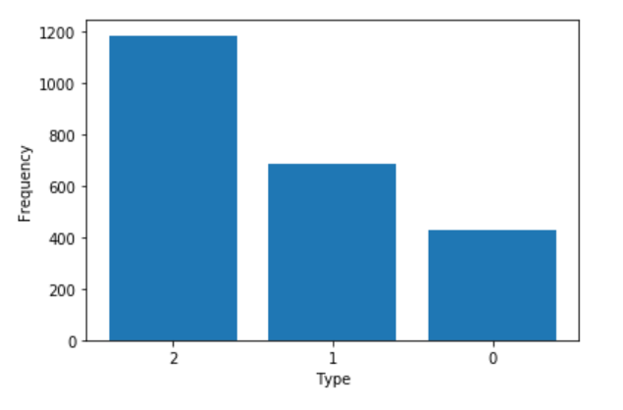
Looking at Strains and Types
There are 2351 rows but there are only 2304 unique strains
There are three types, 51%
of which are hybrid

Slide 8
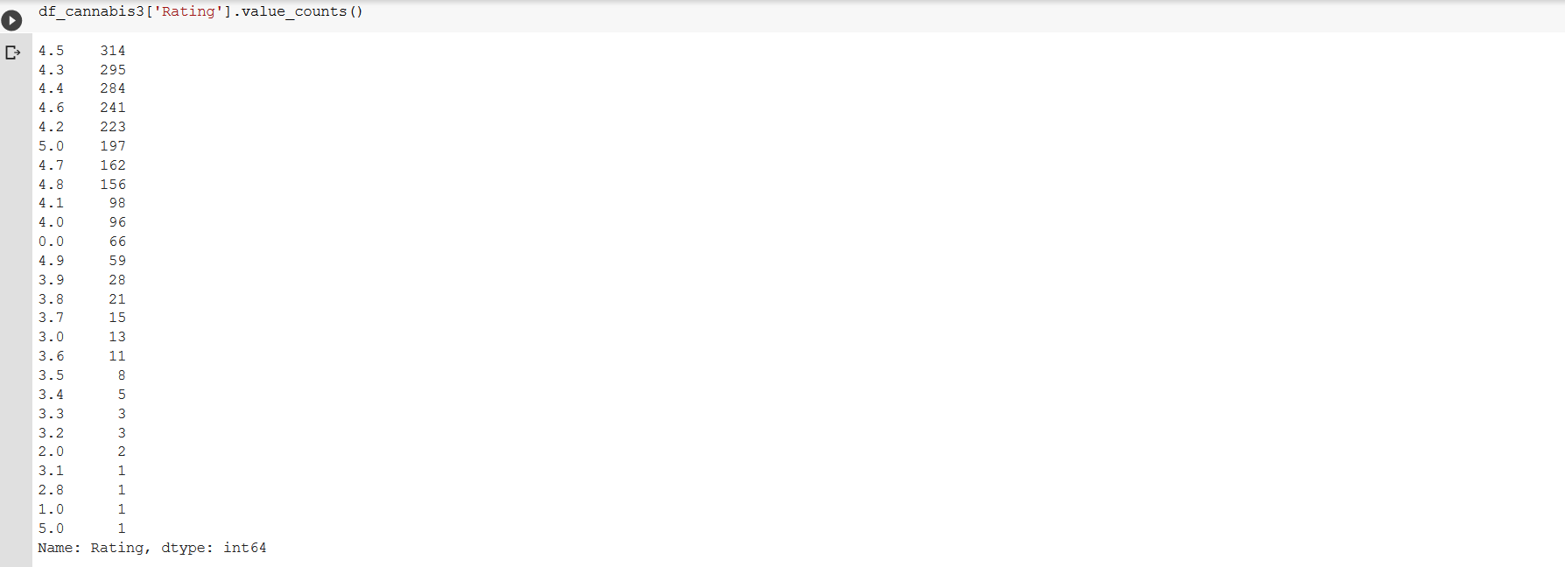
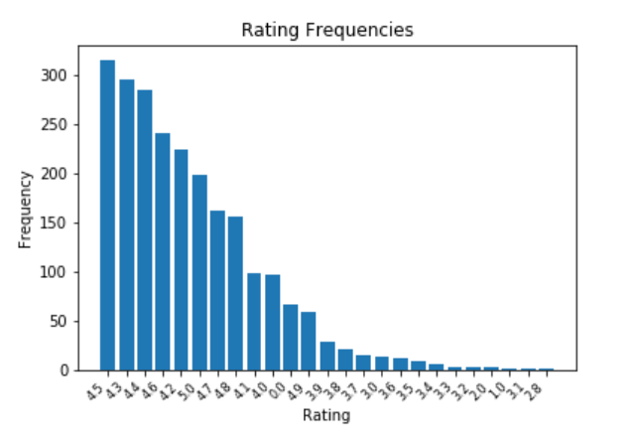
Looking at Ratings
Ratings: 25 out of 50 possible values; 92.3% from 4.0 to 5.0 on 5 point scale

Slide 9
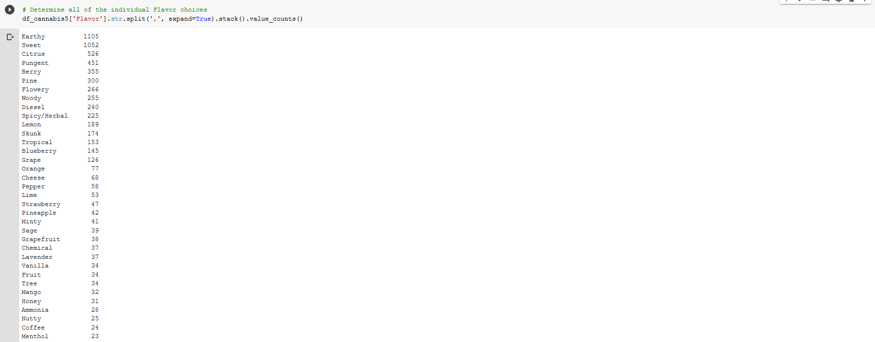
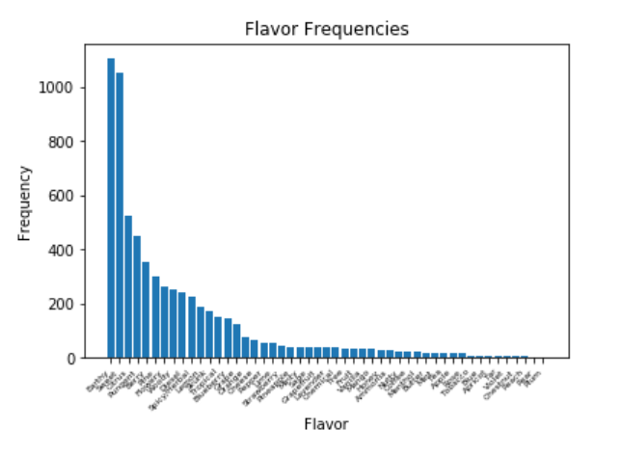
Looking at Individual Flavors
There are 49 individual flavors; 73% of choices are in the top 10 choices
Notes:
There are 49 individual flavors

Slide 10
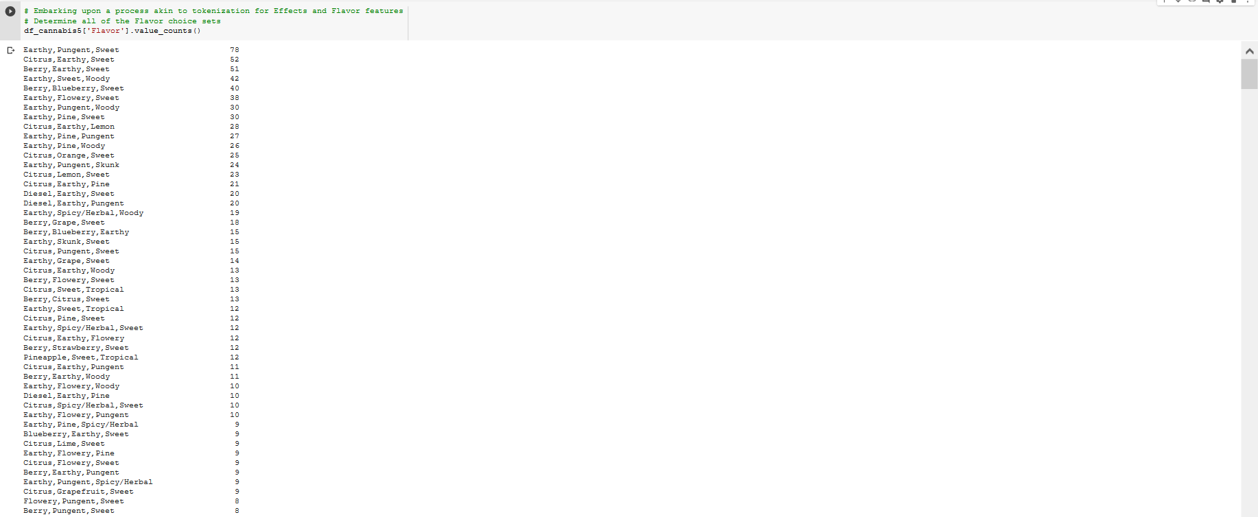
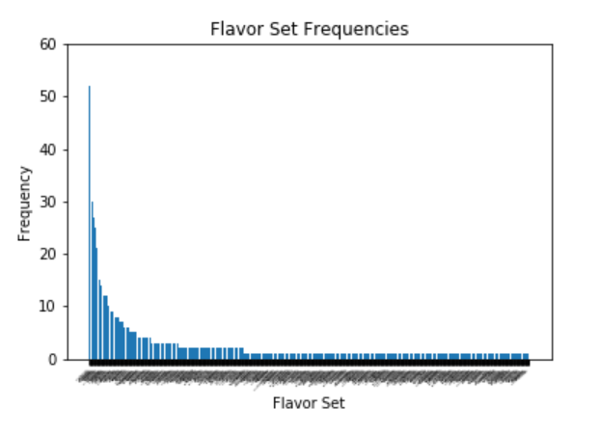
Looking at Flavor Sets
There are 800 flavor sets of 112,955 possible; 94% of sets have 3 flavors
Notes:
There are 800 total flavor combinations with: 749 have three flavors, 35 have only two flavors, 16 have only one flavor
With 49 flavors, possible flavor combinations: 110,554 three flavors, 2352 two flavors, and 49 one flavor
0.677% 1.488% 32.653%

Slide 11
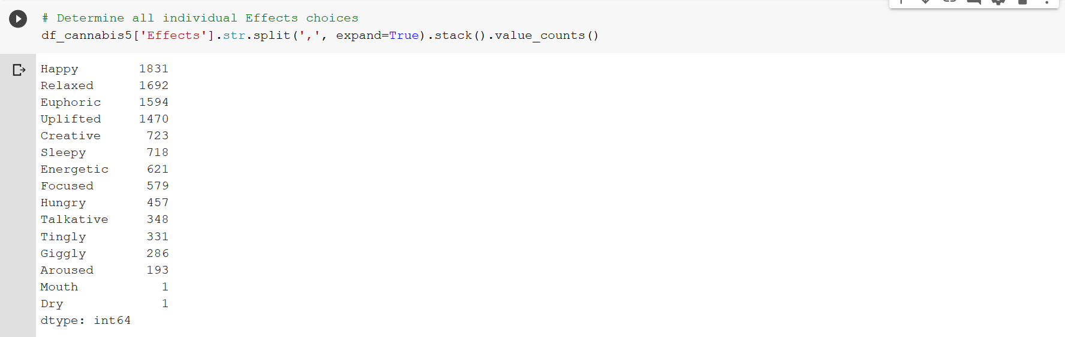
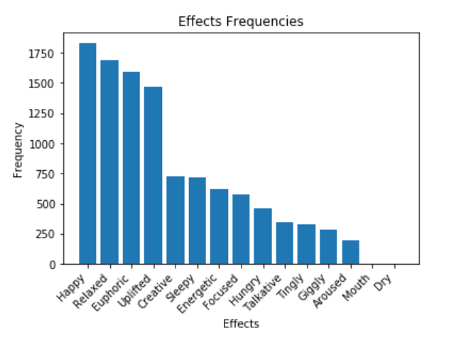
Looking at Individual Effects
There are 15 individual effects with 61% of choices involving the top 4 choices
Notes:
There are 15 effects

Slide 12
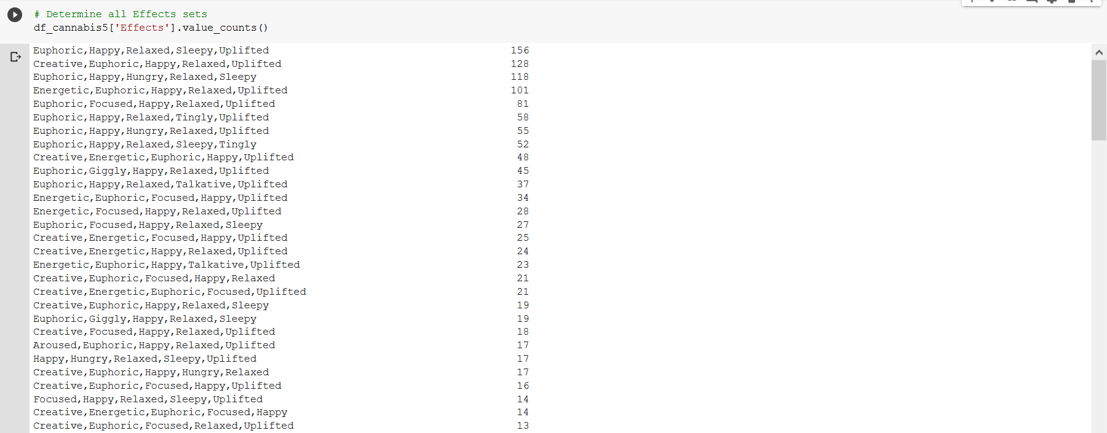
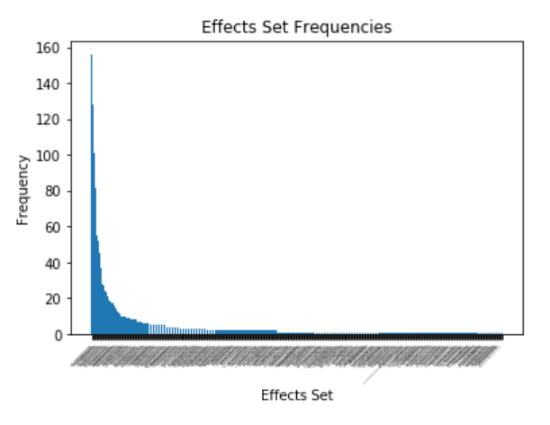
Looking at Effect Sets
There are 458 effect sets of 396,075 possible; 90% of sets have 5 effects
Notes:
There are 458 total effect combinations with: 414 have five effects, 20 have only four effects, 13 have only three effects, 7 have only two effects, 4 have only one effect
With 15 effects, possible effect combinations: 360,360 five effects, 32,760 four effects, 2,730 three effects, 210 two effects, and 15 one effect. 0.115% 0.061% 0.476% 3.333%
26.667%

Slide 13
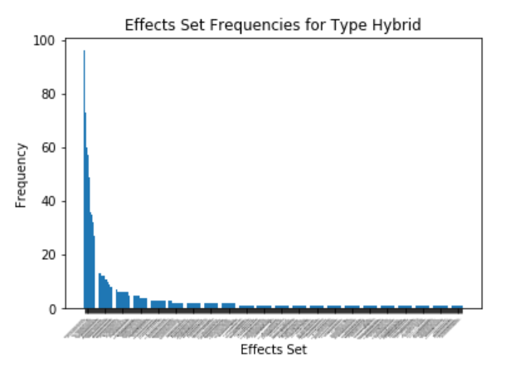
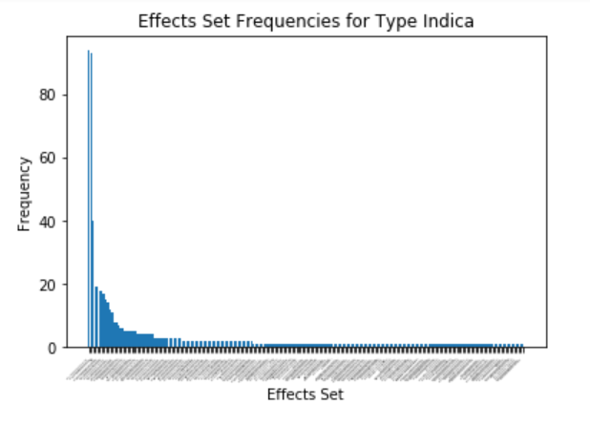
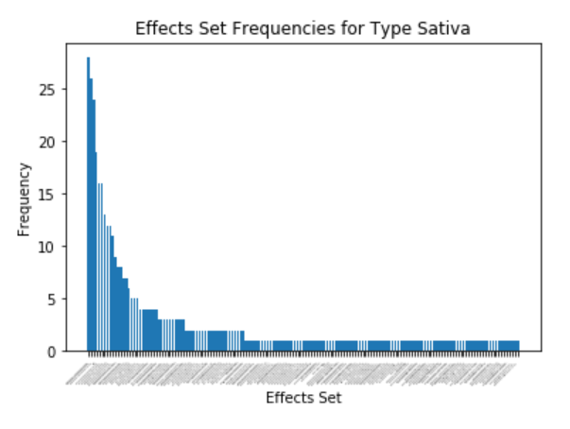
Comparing Effects Set Profile of Types
Notes:
It is difficult to differentiate the profiles of Effects Sets among the three Types

Slide 14
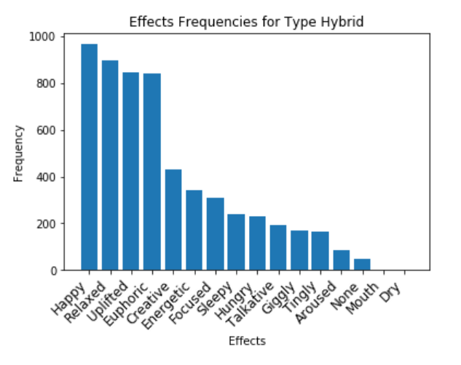
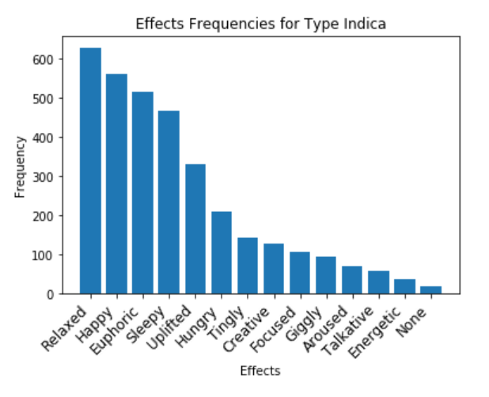
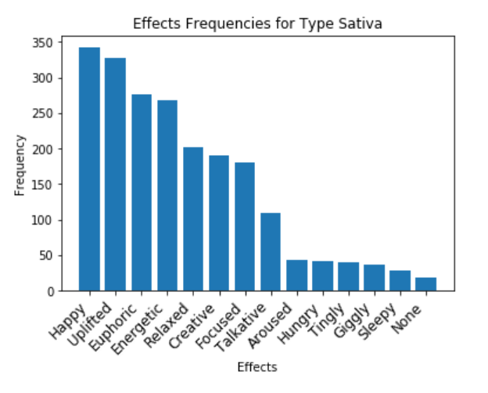
Comparing Effects Profile of Types
Notes:
Comparison among types is much easier when breaking out individual Effects. Happy ranks high for all three types, as do euphoric and uplifted. These Effects have relatively high frequencies among all types. Giggly, tingly, and aroused have relatively low frequencies among all types. Effects creative, sleepy, and energetic are effects which rank very differently among Types.

