Slide 1

Health innovation classes
Project 6 - St Luc Bouge - Patients discharge
François Meli Ngueunkeung : 67202000
Jabrane Mouhtadi : 42202300
Maurine Poncelet - 54262100
Lhéo Rary - 20252100

Slide 2
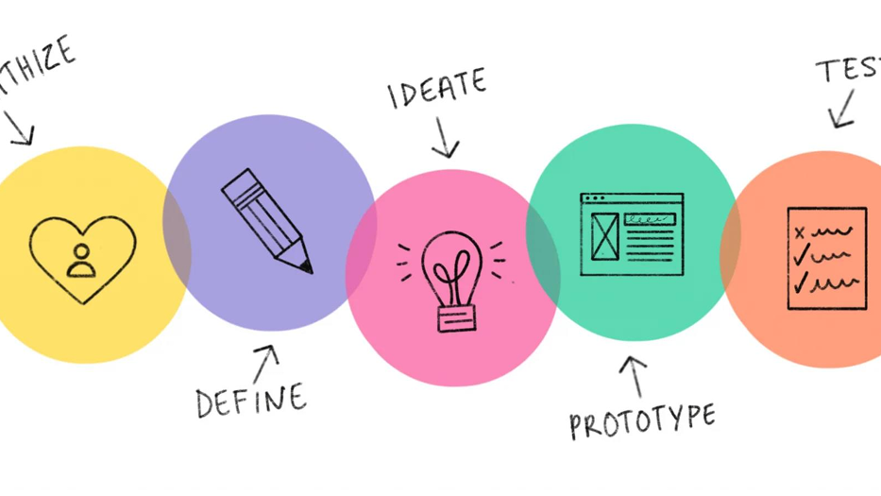
Introduction
ST LUC BOUGES - PATIENT DISCHARGE MANAGEMENT AND PROCESS OPTIMIZATION

Slide 3
1. Understanding the problem
Identifying stakeholders
Empathy map
Hospital visit and staff interview

Slide 4
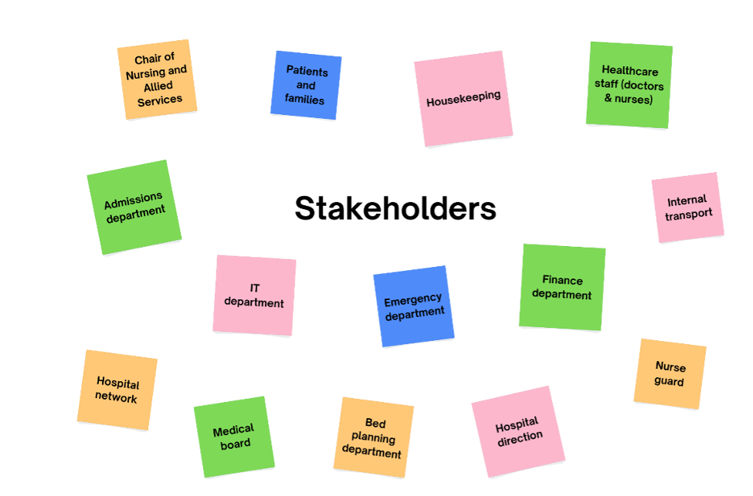

Slide 5
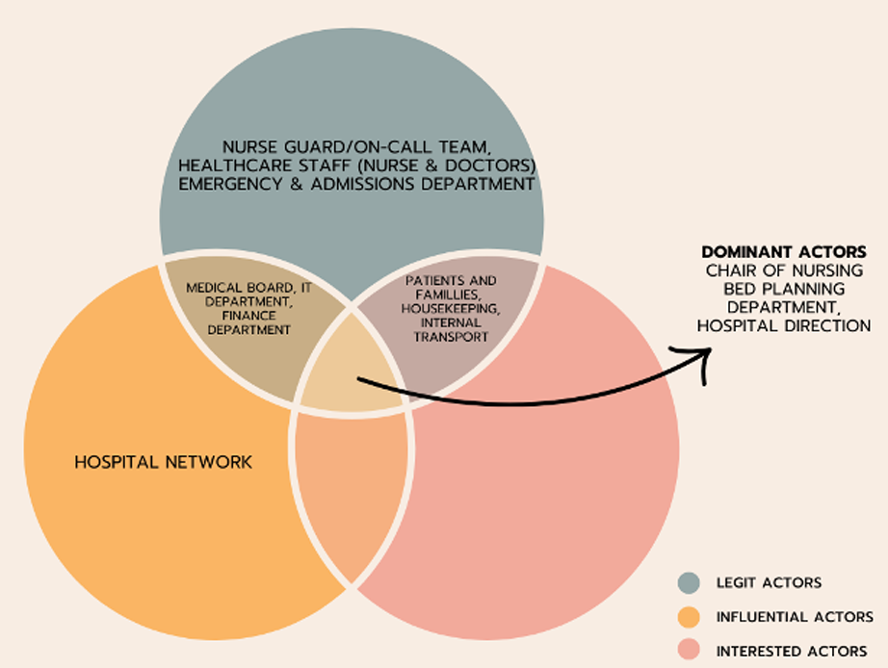

Slide 6
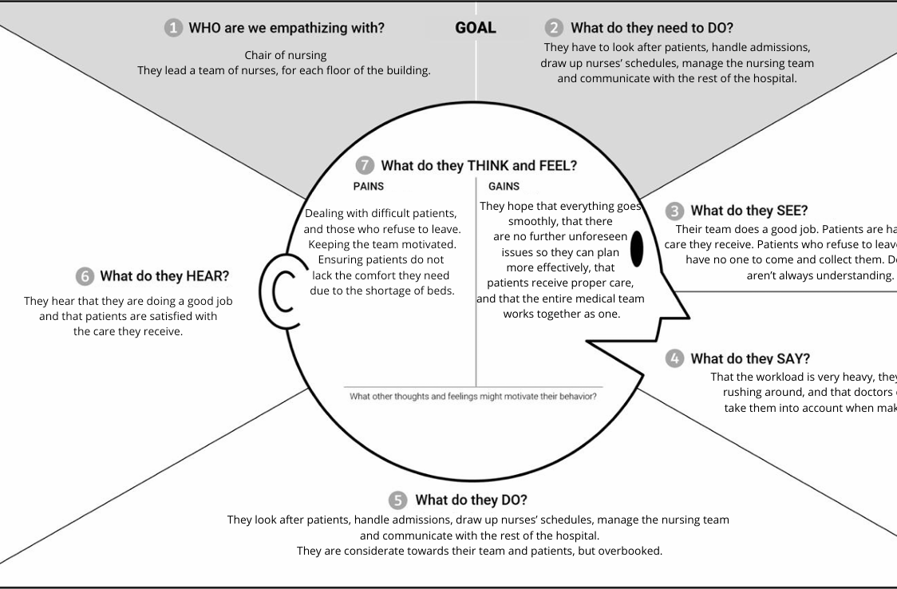
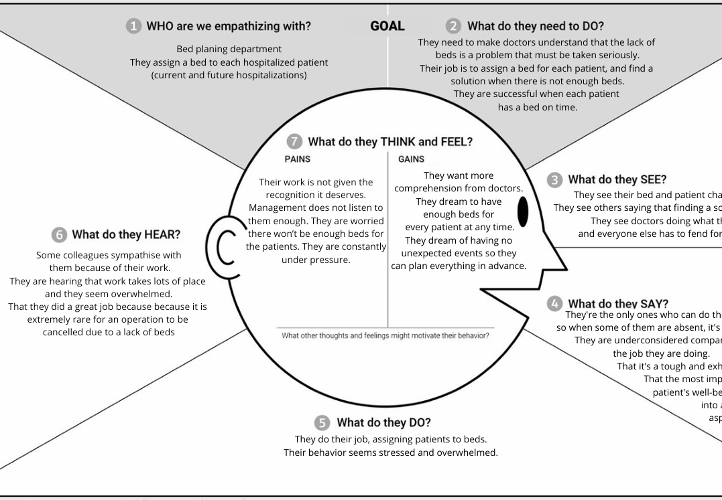
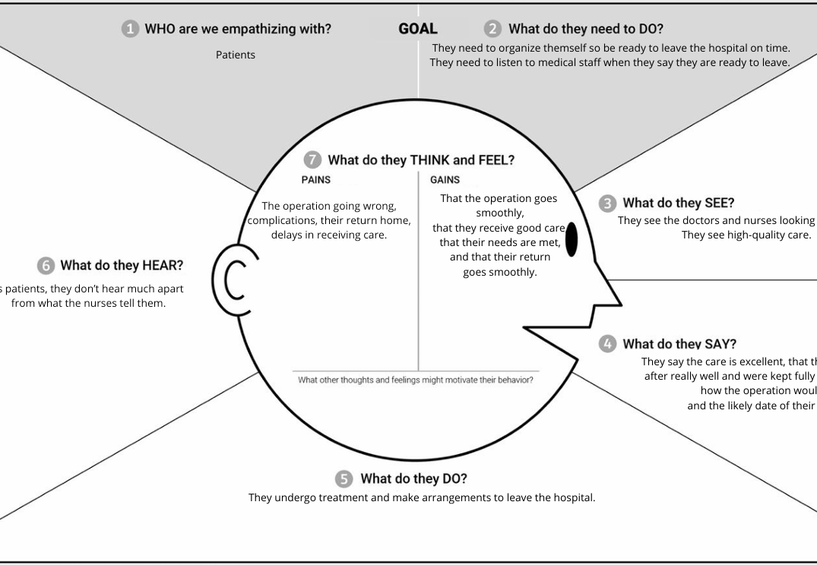
Empathy Maps
3 empathies maps diagram faithful to our project

Slide 7
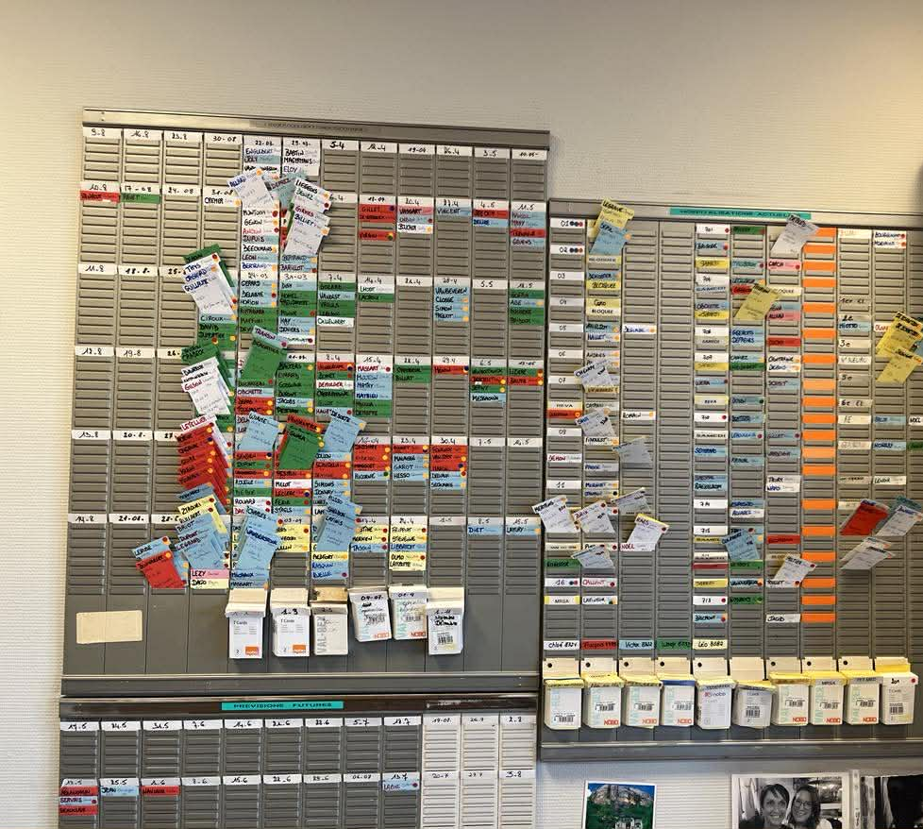
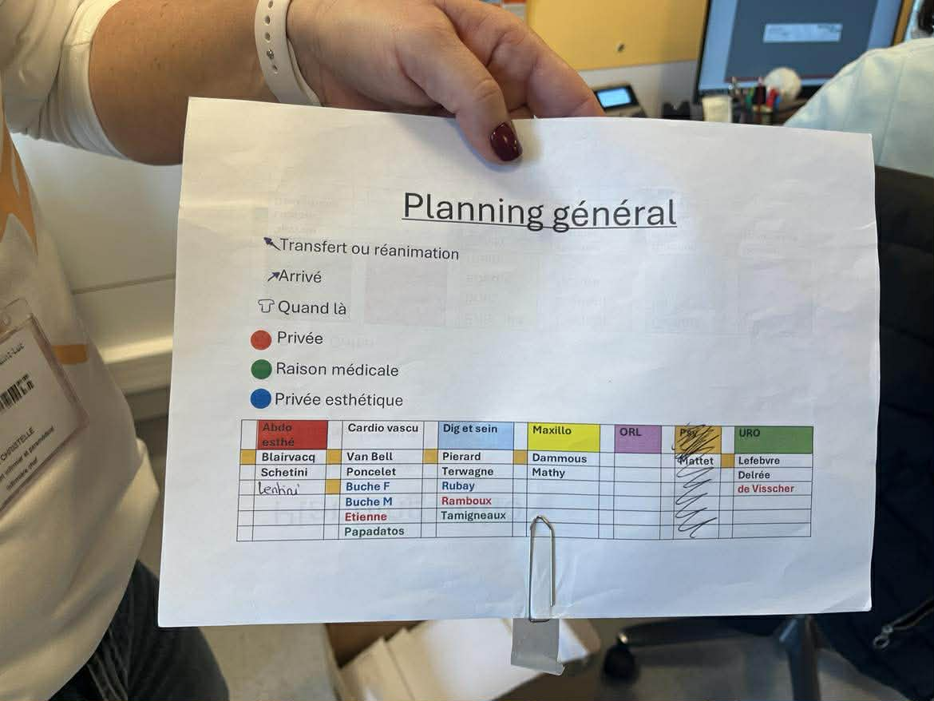
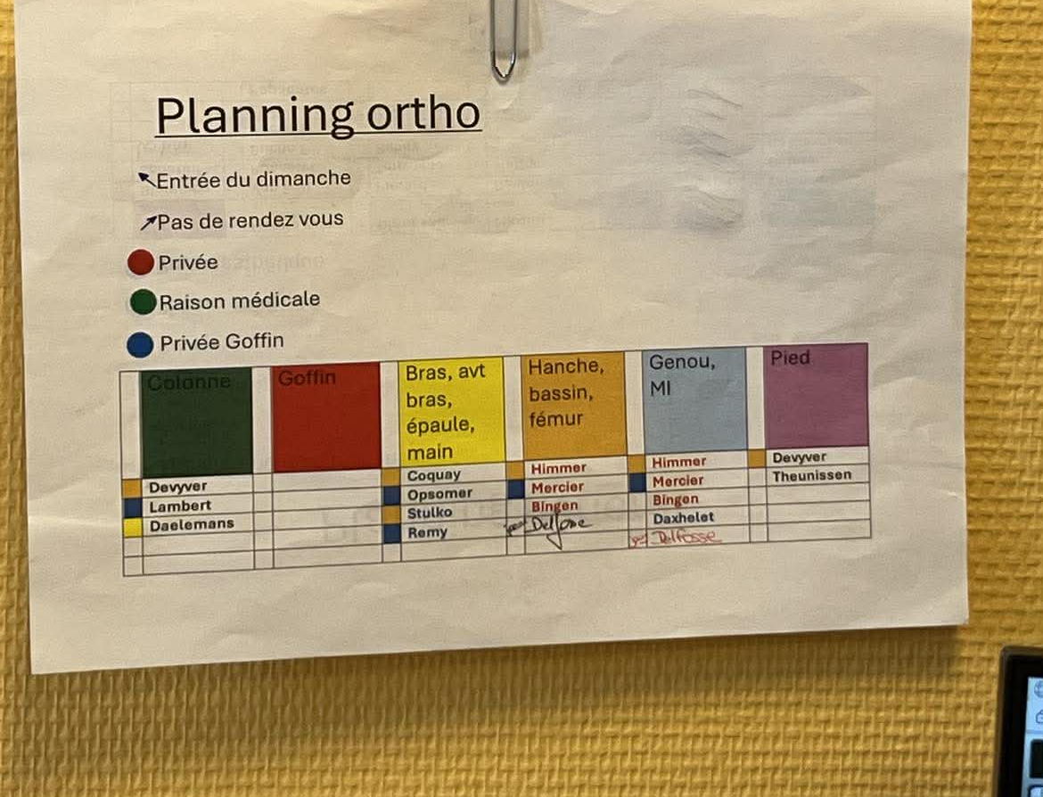
Visit

Slide 8
2.Define the problem
Phase of Divergence and Convergence
How might we ?
"How might we optimize and harmonize patient discharge timing and bed allocation across units so that beds are freed early enough in the day to be reused, while maintaining quality of care and respecting each unit’s clinical and organizational constraints?"

Slide 9
Final definition of our problem
Upstream
How might we better predict the length of stay and improve communication with patients about their care pathway, in order to anticipate hospital discharge earlier and more accurately?
During
How might we harmonize scheduling practices across units through a shared and adaptable procedure, so that planning can still be completed smoothly even when one or more key staff members are absent?
Downstream
How might we organize an intermediate solution after discharge so that patients can be relocated quickly, allowing rooms to be freed earlier while maintaining the quality and continuity of care?

Slide 10
3. Ideation
Ideation for each subproblem
Divergence followed by convergence
Different brainstorming methods

Slide 11
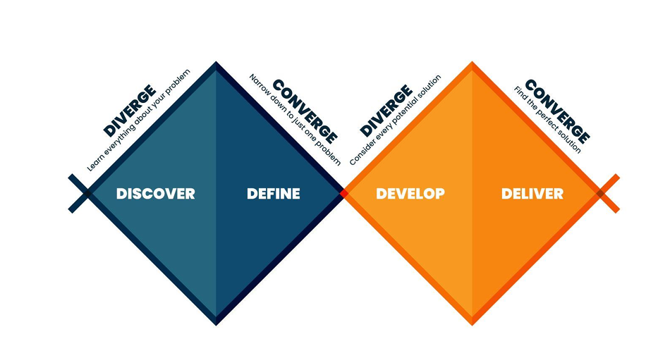

Slide 12
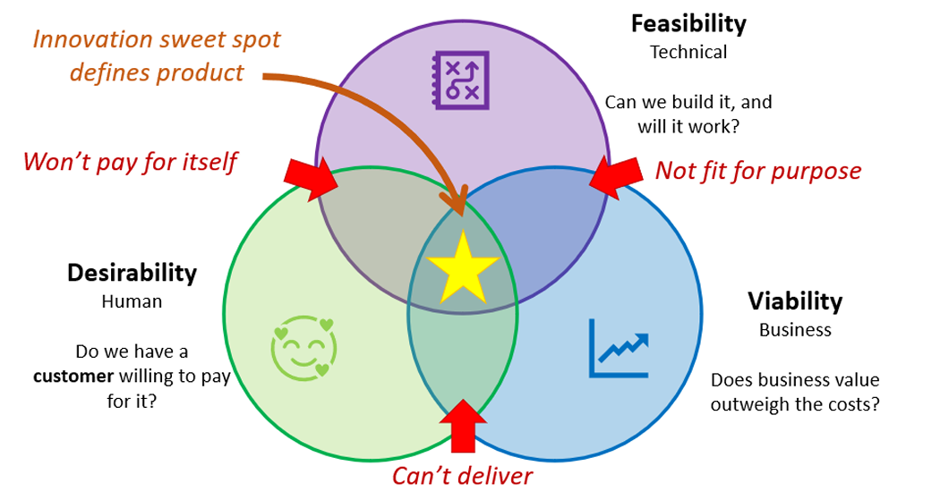
UPSTREAM
Morphological analysis
1. Inputs for anticipation
2. Prediction approach
3. Communication channel
4. Update timing
Convergence with the DFV model

Slide 13
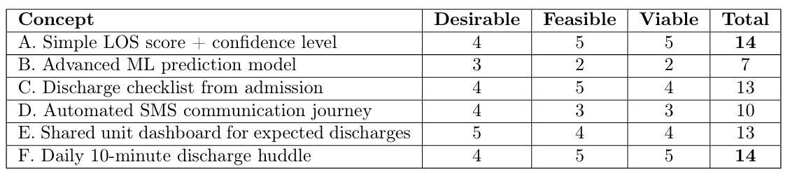
Concept upstream final
Early Discharge Prediction and Communication Platform
Three integrated components:
1. 1. Early prediction upon admission: estimated discharge date + confidence level.
2. Daily update routine: brief team meeting to confirm/adjust planned discharges.
3. 3. Standardized communication with the patient: clear updates on key milestones in the planned care pathway (2 days before, 1 day before, and on the day of discharge).

Slide 14

During
Structured Brainstorming
Divergence: Generate as many ideas as possible
No judgment
Convergence via DFV
Consolidate ideas into a single concept
=> Create templates and a shared planning process

Slide 15
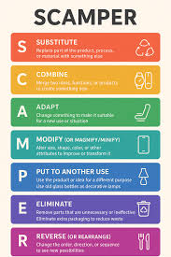
Downstream
SCAMPER Method
Helps explore new avenues
Generates many ideas
Clusters similar ideas
Convergence with DFV
=> 3 main ideas: A post-discharge waiting room, improving digital coordination, and reorganizing the discharge process

Slide 16
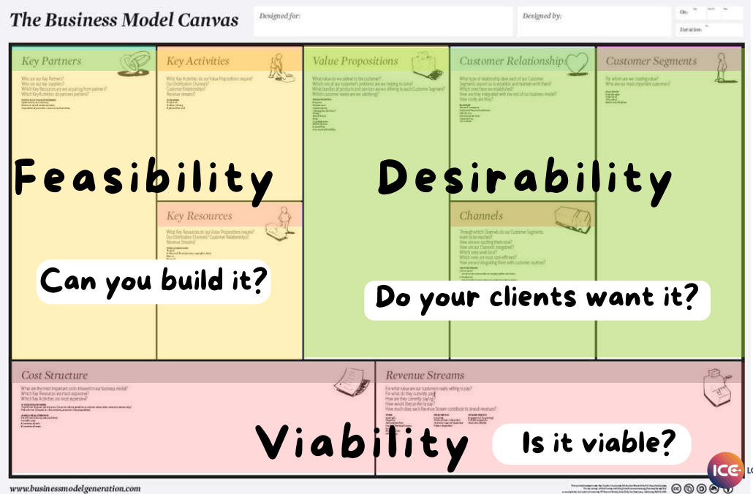
4.BMC
Get a quick overview of the solution as a whole
Identify any inconsistencies or gaps in an idea
Compare the three solutions with one another to see which is the most viable from a big-picture perspective

Slide 17
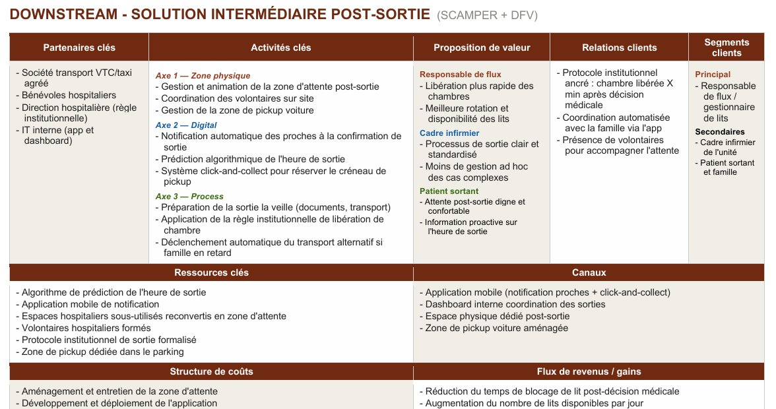

Slide 18
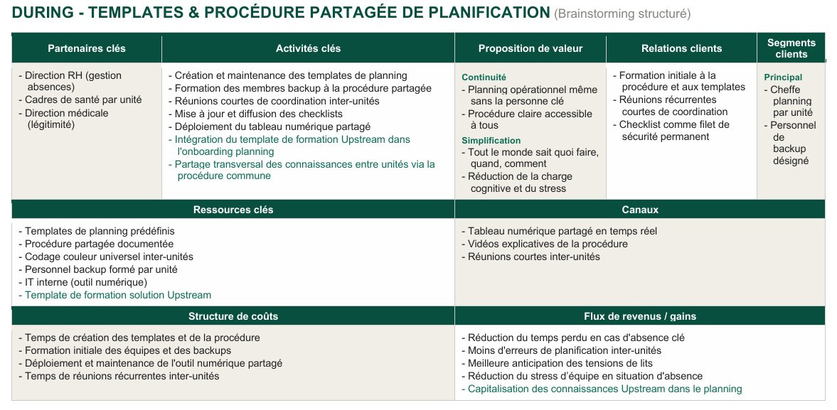

Slide 19
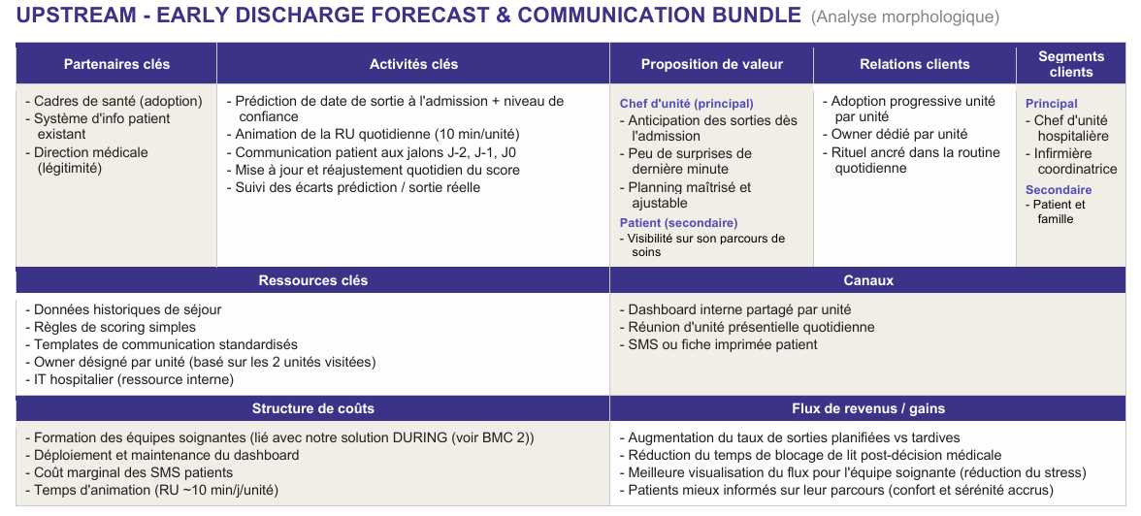

Slide 20
Post-BMC decision
Financial aspect (downstream
solution)
Regulatory constraints
Target segment based on thesolution
Revenue source
Hospital preference
Cost structure
UPSTREAM

Slide 21
5. Prototyping
Upstream : a platform to assist with bed planning
The most promising solution for the hospital => our focus in the project
Several iterations with various feedback from staff
Final version: https://lord-melflam.github.io/saint-luc-bouges-g6-upstream-prototypes/
During : During: Document detailing a training program
Downstream : Post-discharge waiting room
Insufficient budget

Slide 22
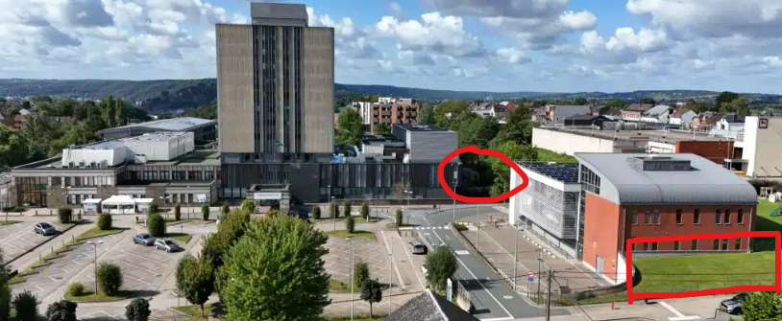
Location

Slide 23
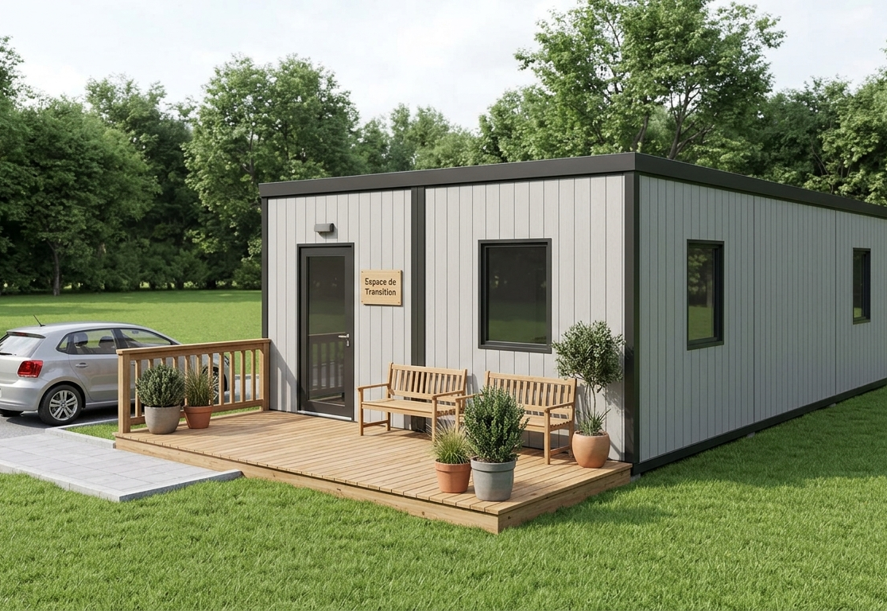
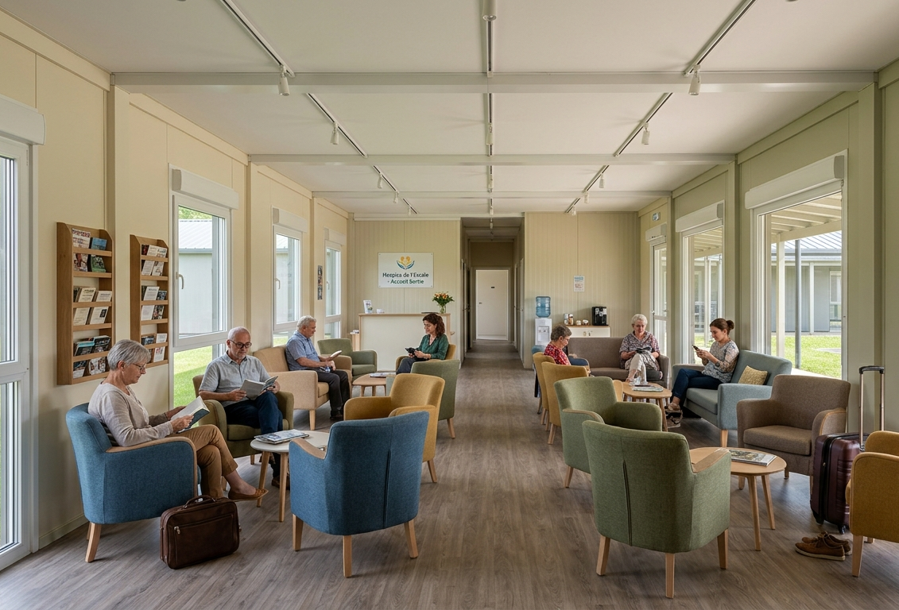
Iteration 1
Drop-off zone nearby

Slide 24
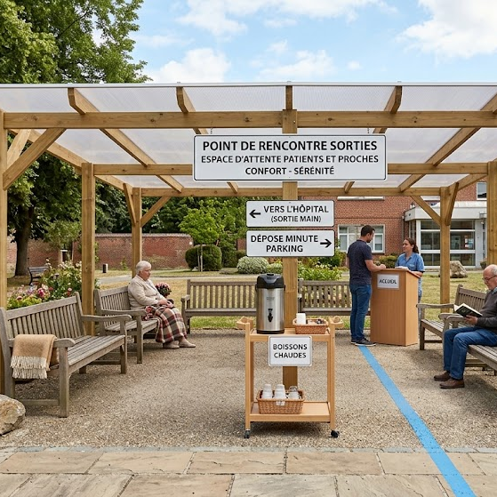
Iteration 2
Outdoor waiting area
Smaller budget
Comfort amenities (benches,
blankets, drinks)
Drop-off zone nearby

Slide 25
6. Testing
Interest in our solution for the future
Tests conducted with hospital staff
Post-test feedback to improve the platform
Platform validated

Slide 26
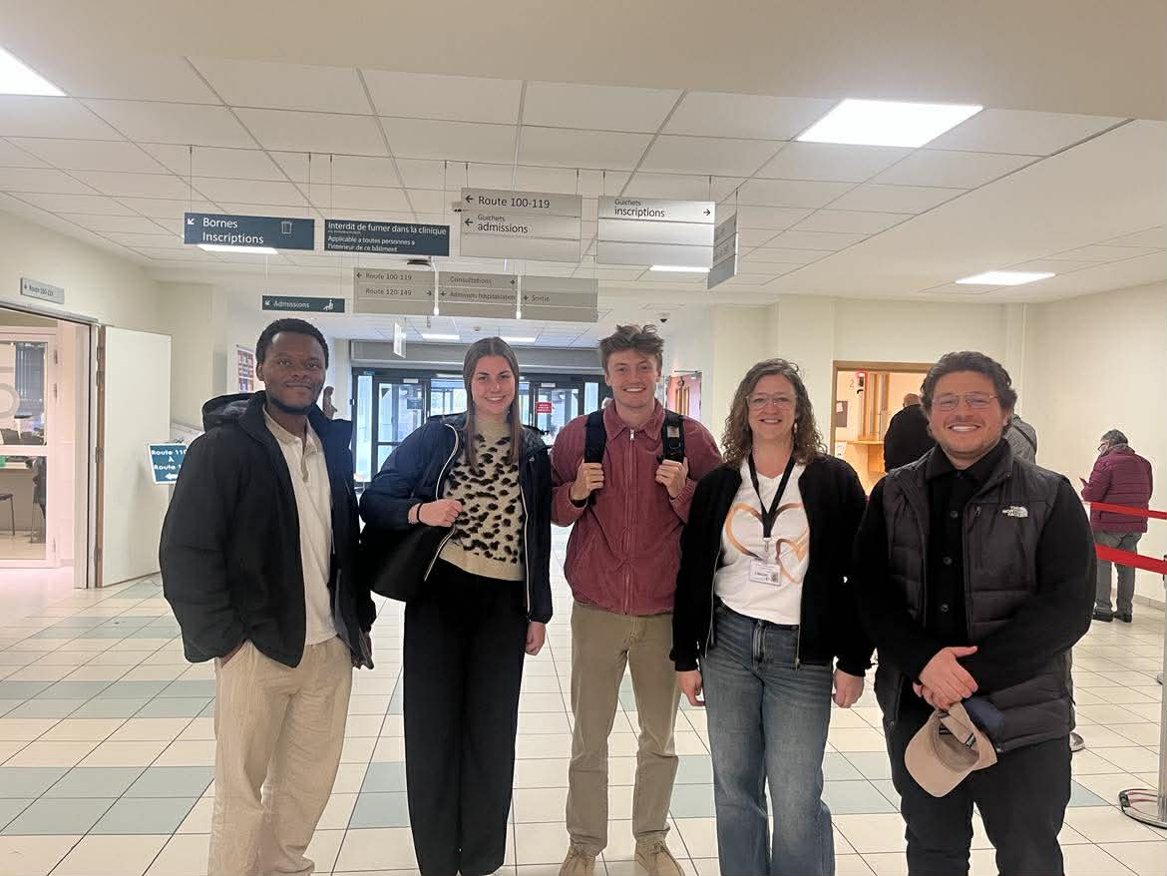
7. Conclusion
Real-world problems to solve (in the field)
Learning for the future
A rewarding project
Interesting interdisciplinary work

