Slide 1
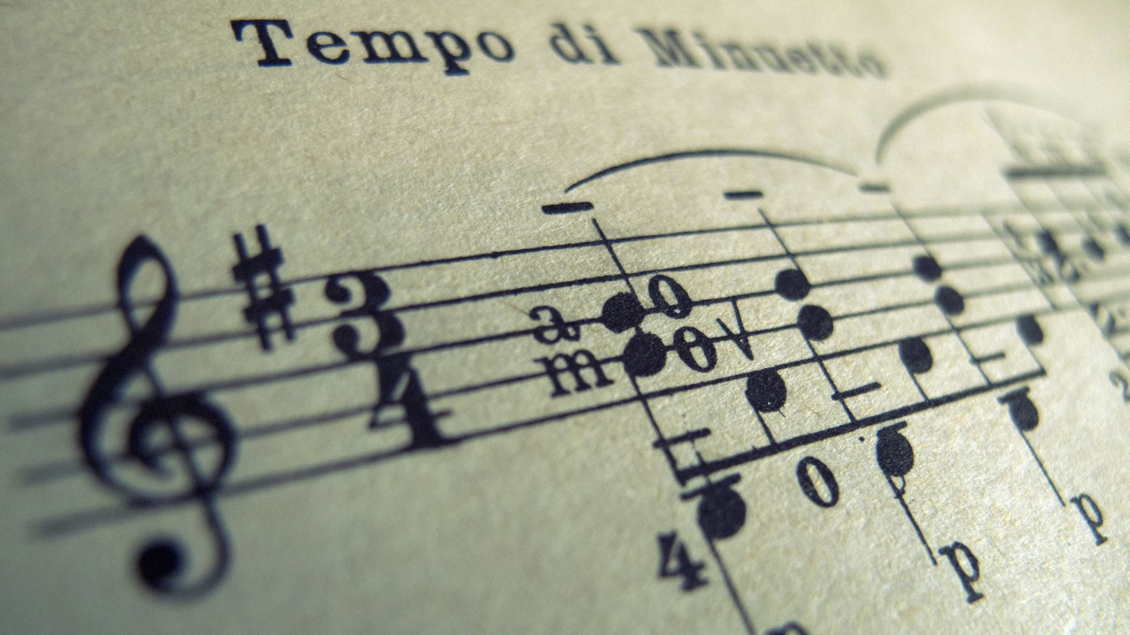
Be The Music
By Ryan Farrell & Sinclair DeYoung

Slide 2
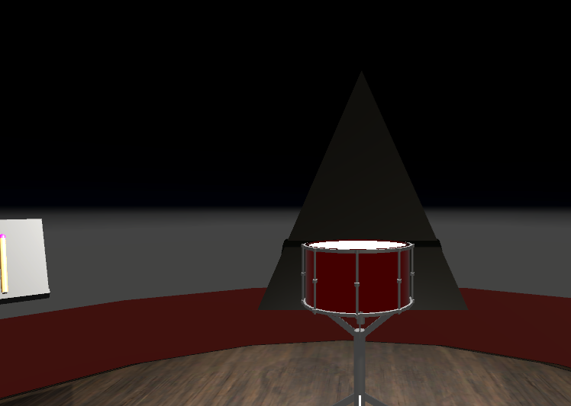
What is Be The Music
VR rhythm game inspired by Guitar Hero/Beat Saber
Players use drumsticks to hit incoming notes
Immersive musical experience in virtual reality

Slide 3

Core Gameplay
1. Notes spawn and travel toward player
2. Players hit notes with correct drumstick
3. Scoring based on timing accuracy
4. Combo multiplier system
Note Types
Left-hand notes (Light-Green) → Left drumstick
Right-hand notes (Red-Purple) → Right drum

Slide 4
One Scene, Complete Experience
All gameplay in a single, seamless VR environment
No loading screens or scene transitions
Immediate gameplay from start to finish
Why Single-Scene?
• Better VR immersion (no breaks in presence) • Faster load times • Simplified development workflow • Smooth user experience

Slide 5
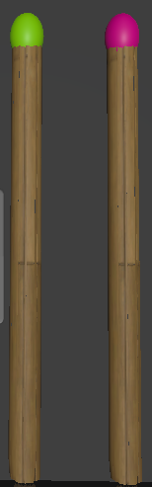
Core Game Mechanics
Gameplay Loop
1. Start in menu → Press VR button 2. Countdown (3-2-1-GO!) 3. Notes spawn → Travel to drums 4. Hit with correct stick → Score points 5. Song ends → Show results 6. Return to menu (same scene)

Slide 6
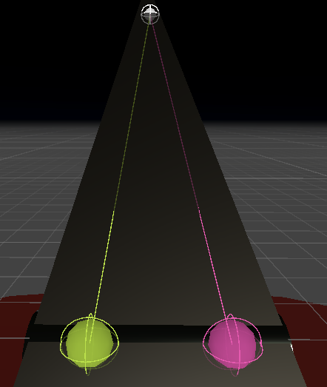
Challenges & Solutions
Challenge 1: State Management • Problem: Multiple "screens" in one scene • Solution: Central GameStateManager with events Challenge 2: Performance • Problem: Everything loaded at once • Solution: Object pooling + selective activation Challenge 3: VR Comfort • Problem: Player disorientation • Solution: Clear visual zones + audio cues Challenge 4: Hit Accuracy • Problem: VR tracking latency • Solution: Generous hit windows + prediction
Challenge 5: Lack of Assets • Problem: Lack of public free assets and 3d modelling knowledge. • Solution: Manually creating scene objects with Unity primitives.

Slide 7
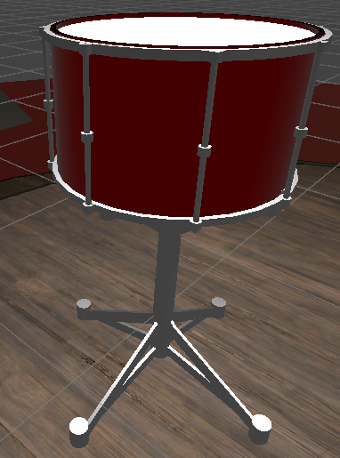
Potential Enhancements:
Song Editor - Create custom patterns
Advanced Visuals - Dynamic environments
More Instruments - Expand beyond drums or more drums

Slide 8
Questions?

