Slide 1

SUSTAINABILITY.
BY QUANTUM BITS

Slide 2
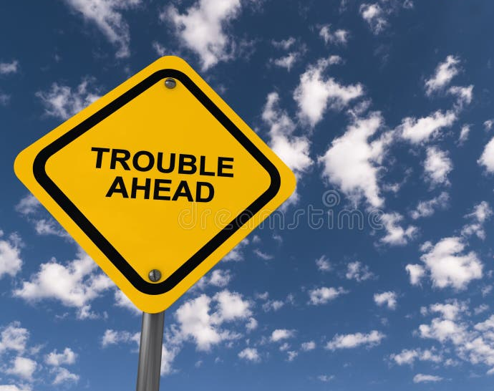
Problem 1
Food waste is one of the most prevalent global challenges. Around 1.3 billion tones of food is wasted annually. In India, 23 million tones of food cereals, 12 million tones of fruits and 21 million tones of vegetables are lost each year
This Photo by Unknown author is licensed under CC BY.

Slide 3
Problem 2
We don't know the energy consumption
pattern of past few years and we can't predict
the requirement of energy in future
years ,so how can we plan to use
the renewable energy sources?
This Photo by Unknown author is licensed under CC BY.

Slide 4
Problem 3
In today’s world , air pollution is a big problem. Instantaneous climate change is directly related to this.
How can we predict a suitable solution to reduce air pollution of a particular place?
This Photo by Unknown author is licensed under CC BY.

Slide 5

Solution to Problem 1

Slide 6

Food Demand Prediction with ML MODEL
By leveraging predictive modeling, the platform offers a solution for restaurants to estimate demand accurately. This empowers them to manage their food inventory efficiently, reducing the likelihood of excess food going to waste.

Slide 7

Food Sharing Platform
1)Restaurants can register with restaurant id, name, center id. The platform provides a dedicated space for restaurants to list details about surplus food, including availability, pickup times, and location.
2)Simultaneously, individuals can request specific types of food or general assistance.
3)Social Contributors or NGOs who want to donate good quality food to beggars , poor people or street animals ,they can buy surplus food at discounted price.
4)Map from where restaurants can set their location, excess food amount, discount offer on that food. Users can access that update and take the food.
5)Feedback page : Based on Quality of food and Restaurants are selling excess food in least price or not.

Slide 8
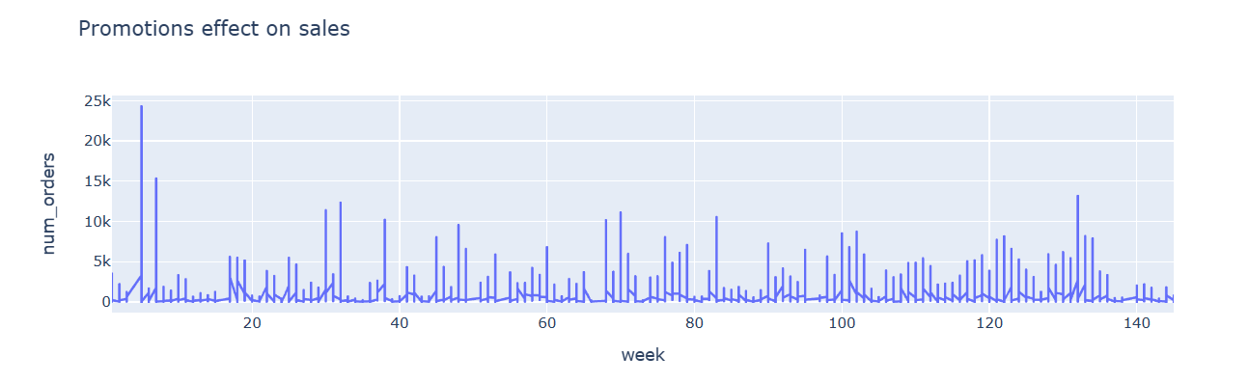
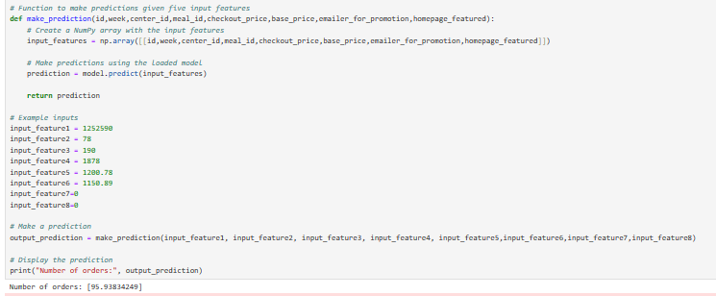
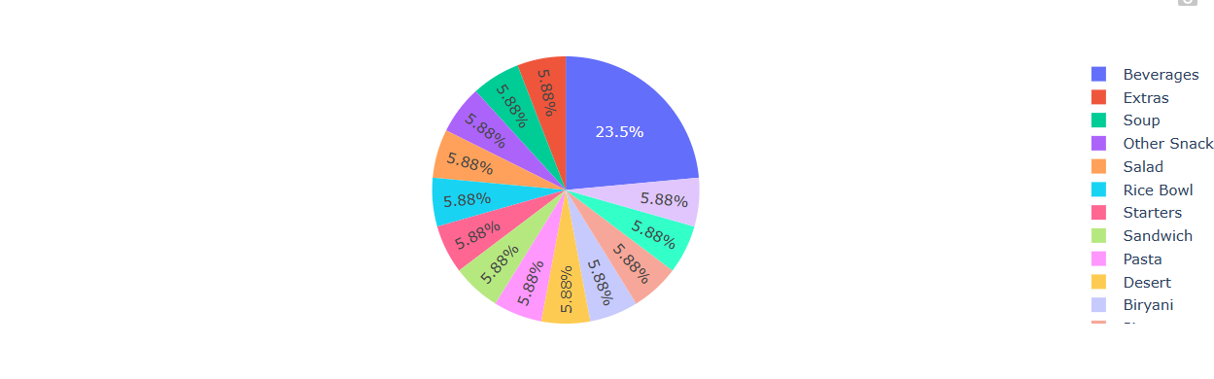
Working of the ML Model
PIE CHART OF SURPLUS AMOUNT PERCENTAGE FOR EACH FOOD
Food Demand Prediction(Weekly Number of Orders)

Slide 9
Solution to Problem 2

Slide 10
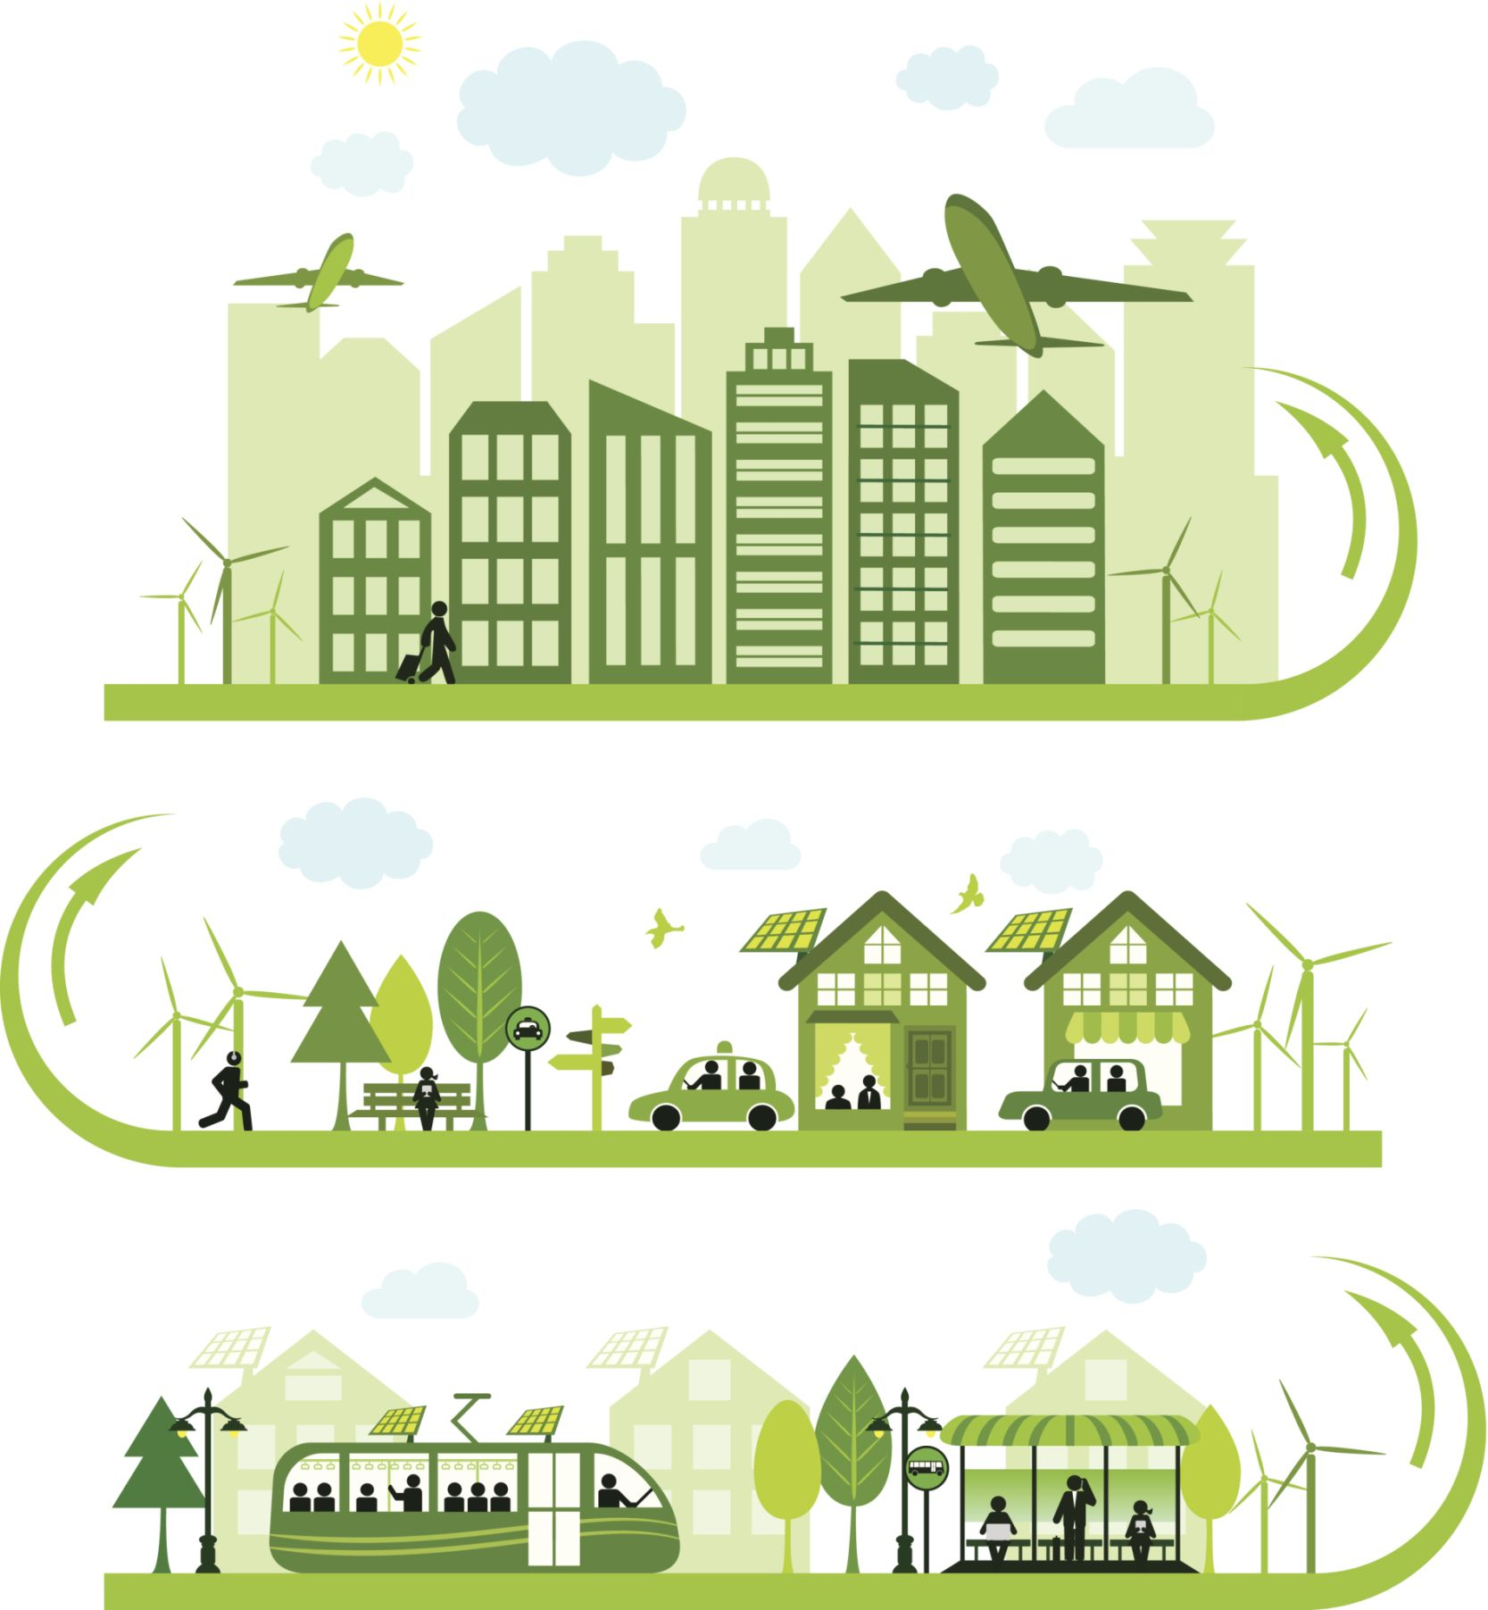
SMART ENERGY MANAGEMENT
1
2
3
Smart energy control centers of various companies can login in the website to understand energy consumption , supply or demand to plan how to use renewable and non renewable energy sources in future.
Renewable energy suppliers can login and provide any type of renewable energy(thermal , biofuel etc.)at reasonable cost.
A ML model to analyze energy consumption in previous years and predict energy demand in future years.

Slide 11
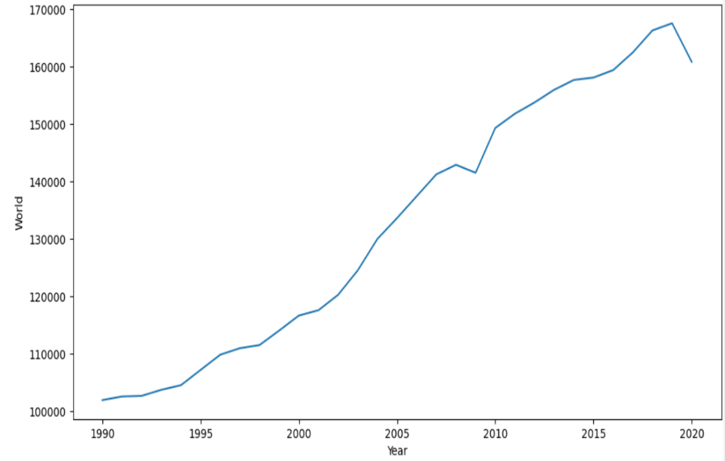
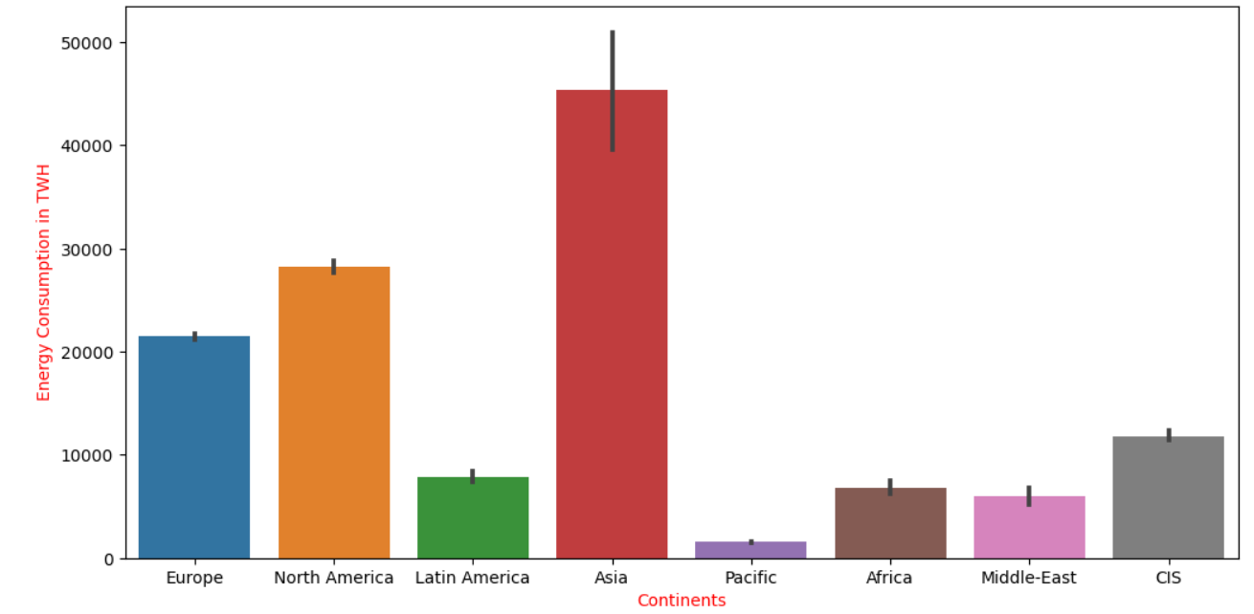
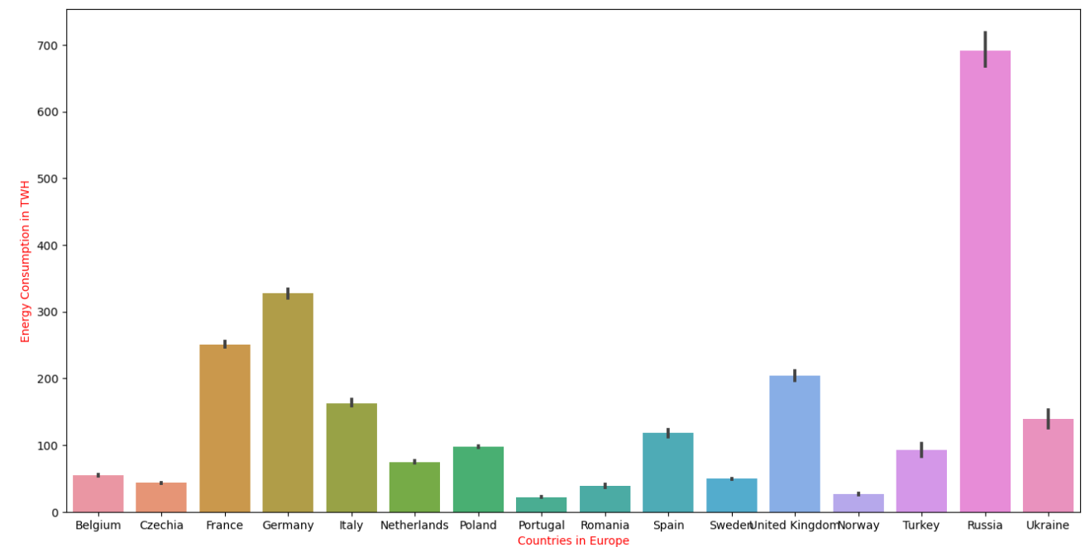
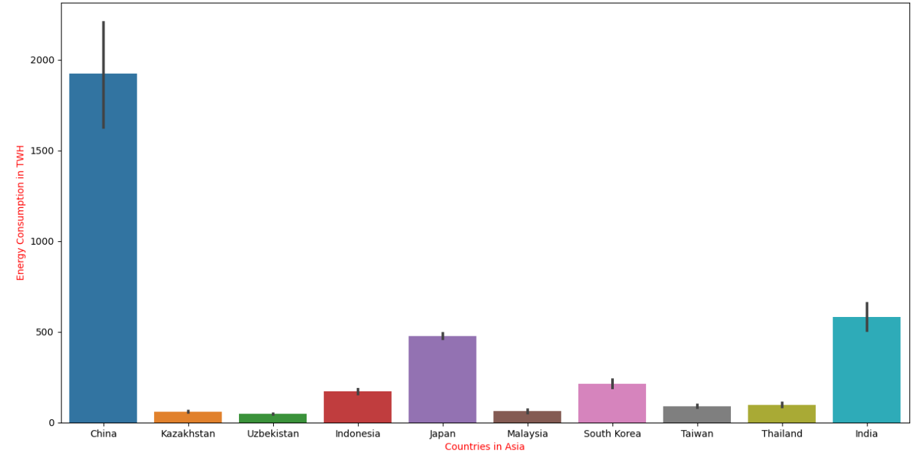
Working of the ML Model
Energy Consumption in World(1990-2020)
Continent wise energy consumption graph
Energy consumption of countries in ASIA
Energy consumption of countries in Europe

Slide 12
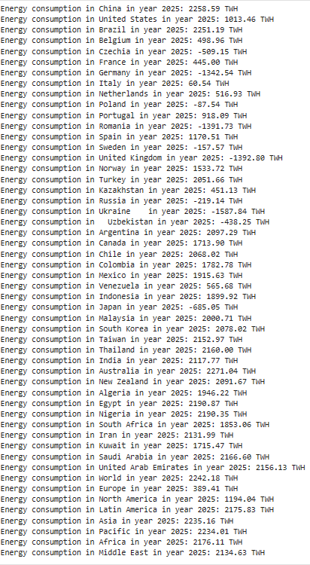
Working of the ML Model
Energy Consumption prediction of future years:
Example – 2025
C
O
U
N
T
R
I
E
S
World and Continents

Slide 13
Solution to Problem 3

Slide 14
AIR POLLUTION REDUCTION MANAGEMENT
The in-charge of a city can login to our website and check the AQI value of the city.
Our website can become an fingertip solution for the authority.
The authority can also give feedback in the concerned section.
Lets breathe in clean air.
Further it suggests the authority what measures to be taken.
It predicts the AQI value and Category.
The ML model takes city, country and individual pollution parameters as input.

Slide 15
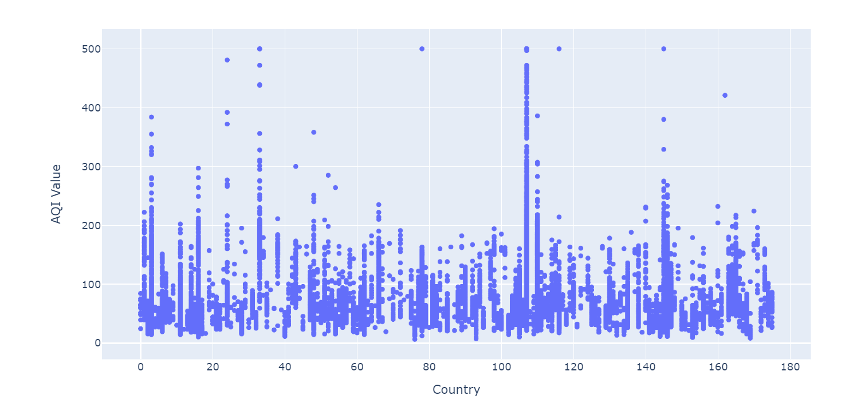
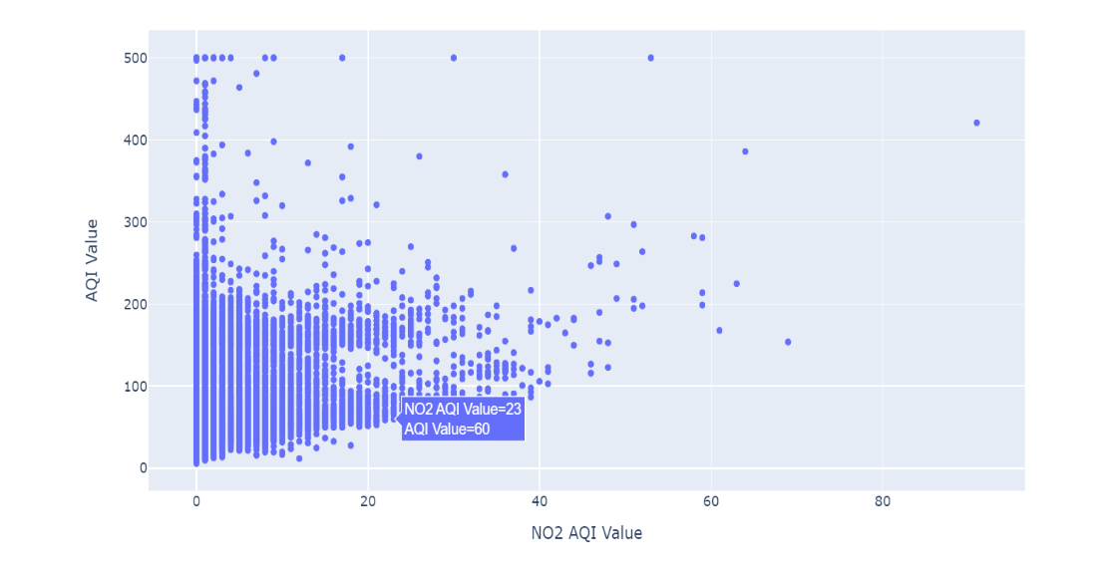
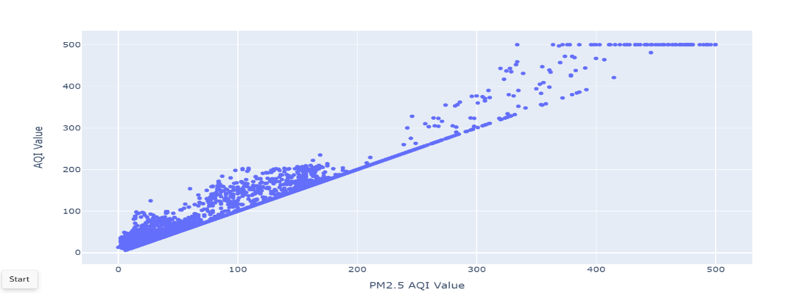
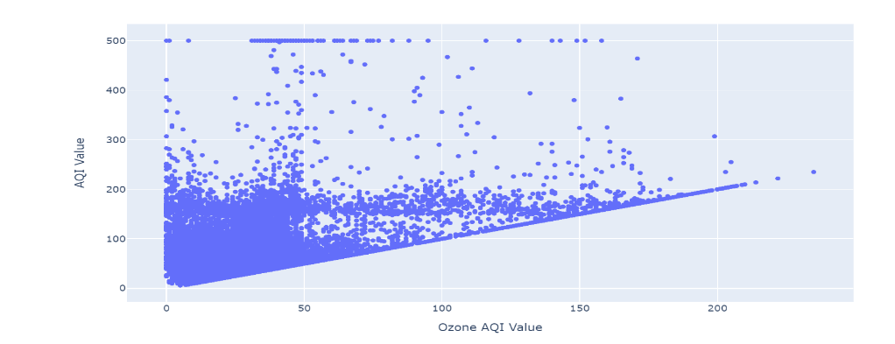
GRAPHS:

Slide 16
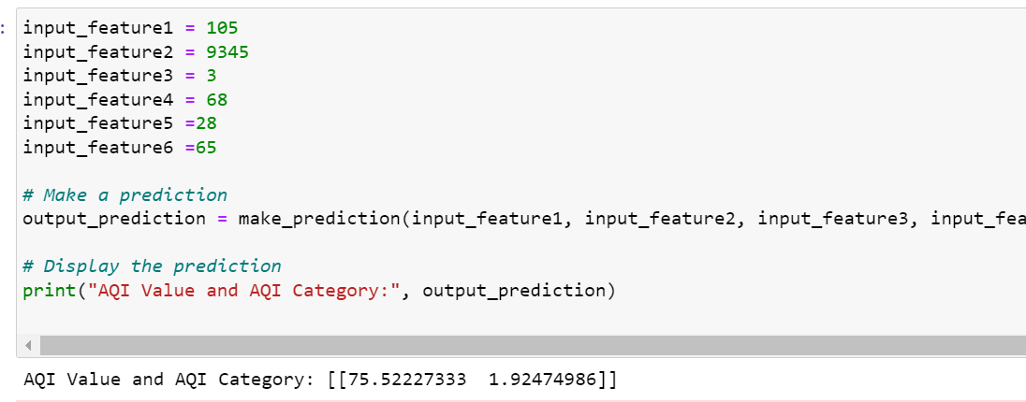
MODEL:
A air quality dataset is taken from Kaggle.
Random forest regressor model is used to train the model.
If user gives the input of city code, country code , AQI values of CO,NO2,PM2,OZONE ,it predicts the total AQI value and AQI category of that city.

Slide 17
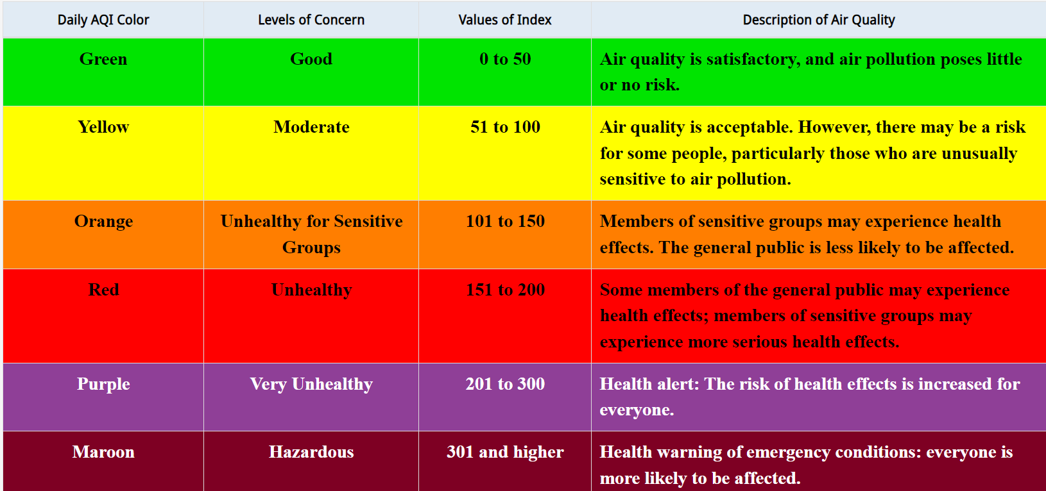

Slide 18
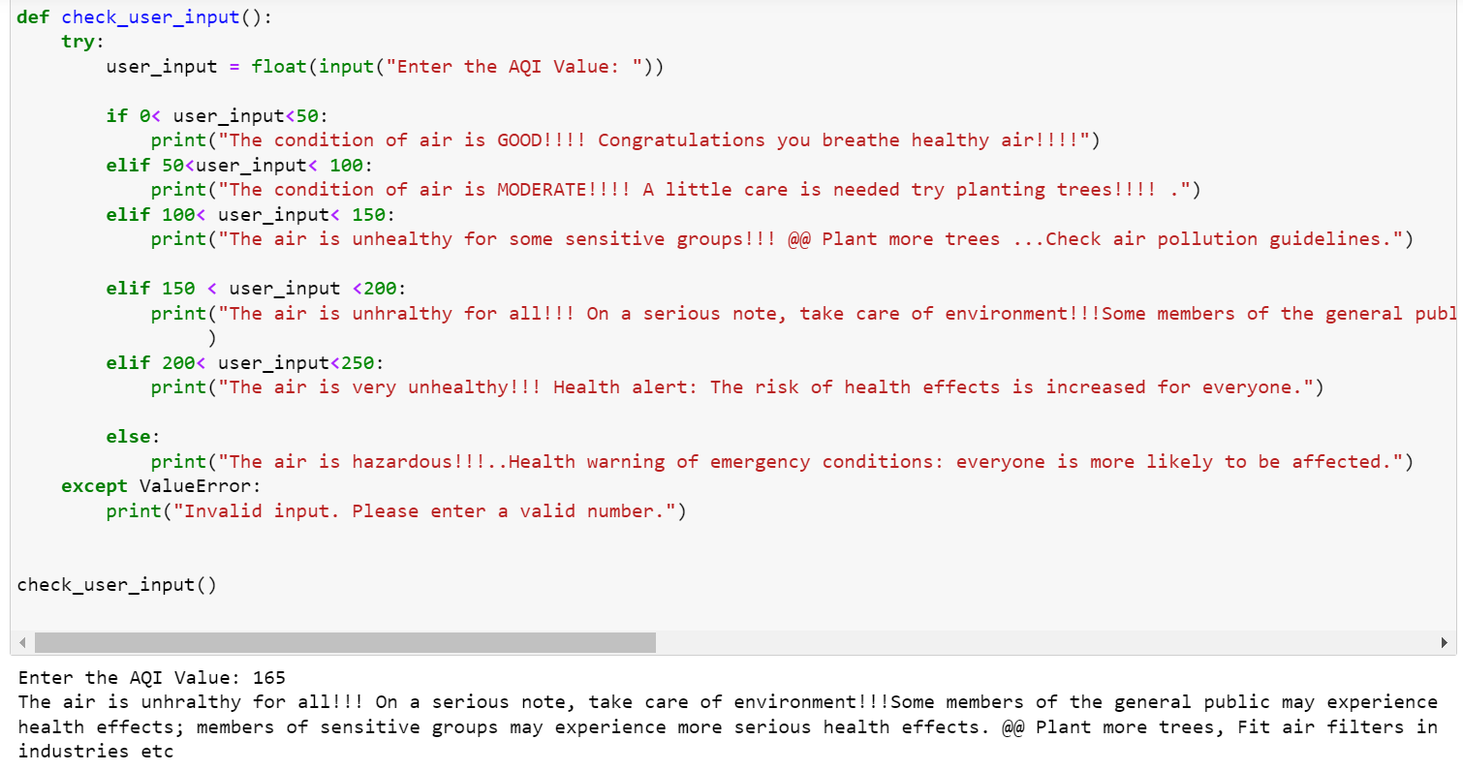

Slide 19


FUTURE PLANS
Communication platform where restaurants and people can actually communicate to buy food, renewable energy suppliers and control centers can communicate.
Partnership with NGOs, shelter and community organizations to promote the culture of food sustainability.
Expand the market of renewable energy users ,predict failures of wind mill, solar panel ,turbines with the help of AI through real time datasets.
Add more nuances of sustainability in our prototype.

Slide 20
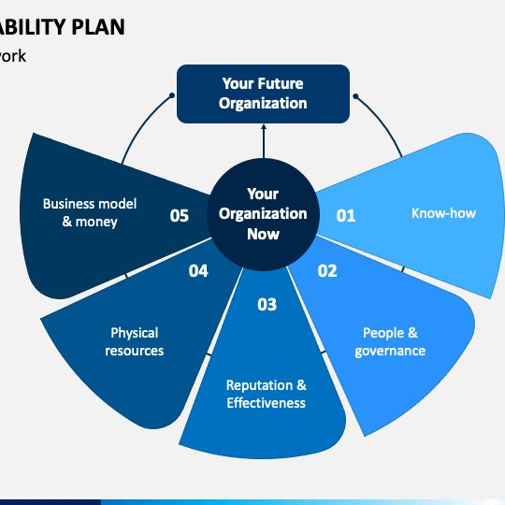
SCALABILITY
BUSINESS SCALABILITY
1)USER ADOPTION : strategies for marketing and outreach to attract a larger user base and increase the number of USERS.
2)PARTNERSHIPS: partnerships with local government agencies, non-profit organizations , other stakeholders to expand the impact of your initiative.
3)MONETIZATION: Consider revenue streams, such as premium features for restaurants LIKE sponsorships, or partnerships with food-related brands, Some premium prediction features for energy control centers and premium air quality prediction features.
4)GEOGRAPHICAL COVERAGE: We CAN Expand the project to cover a larger geographic area.

Slide 21

TECH SCALABILITY
1) Infrastructure:
The scalability of our prototype should be web hosting and server infrastructure. Our considered solutions are like AWS, Google Cloud, or Azure for flexible and scalable hosting options.
2) Scalable ML Models:
We have to build strategies for scaling the machine learning model as the user base grows.
3)Security
Measures:
Emphasize the importance of robust security measures to protect user data and maintain trust. We have to make plans for regular security audits and updates.
1) Infrastructure:
The scalability of our prototype should be web hosting and server infrastructure. Our considered solutions are like AWS, Google Cloud, or Azure for flexible and scalable hosting options.

Slide 22

THANK YOU
A small step towards sustainable future.

