Slide 1
Evaluating Security Tooling in the Age of AI
A demo of the annotated-slides pipeline
Notes:
Welcome! This opening narration is click-state zero of slide one.
---
This second paragraph appears on the *next* click, and the first one dims - just like the [original page](https://www.cs.princeton.edu/~arvindn/talks/icml-2026-annotated-slides/).

Slide 2
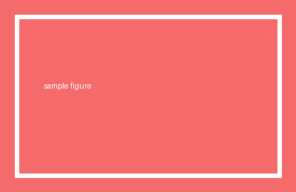
What the converter handles
• Selectable, positioned text
• Exported images
• Colors, bold, italic, links
See amitsealami.com
Notes:
One segment, **bold works**, `code works`.
---
Second click on slide two.
---
Third click on slide two.

Slide 3
A small table
Tool | Precision | Recall
DemoSAST | 0.91 | 0.62

