Slide 1

Rockbusters Purchases

Slide 2
Table of Contents
Average Customer Purchases
Top 10 Countries
Top 10 Cities in Philippines
Top 5 Customers

Slide 3
Average Customer Purchases
Rockbuster wants to compete with the big dogs. To expand and be competitive, we need to know what our strengths are and what to improve.
Data shows each customer’s rental duration by days, for each movie.
Minimum | 3
Maximum | 7
Average | 4.98

Slide 4
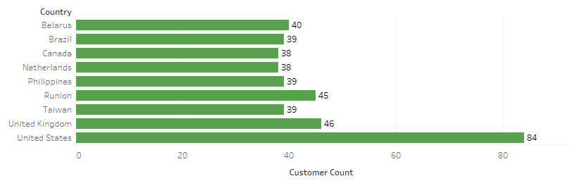
Top 10 Countries

Slide 5
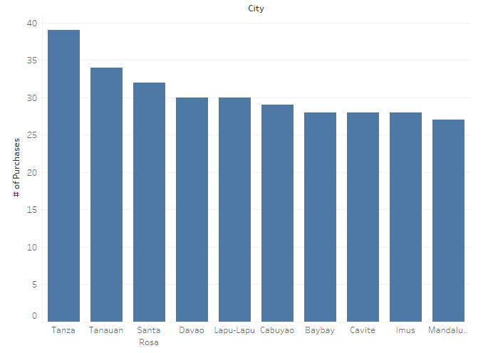
Top 10 Cities in Philippines
Of the 39 customers in the Philippines, the chart shows the total number of purchases by city.

Slide 6
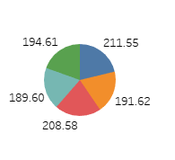
Top 5 Customers
Purchases | Name | Country
211.55 | Hunt | Runion
191.62 | Kennedy | Netherlands
208.58 | Seal | United States
189.60 | Shaw | Belarus
194.61 | Snyder | Brazil

Slide 7
Appendix

Slide 8
URL to Tableau Public
https://public.tableau.com/app/profile/ash.turner/viz/RockbusterTop5Customers_17022316841490/PieChartof5Customers?publish=yes

