Slide 1


Fundamentals of Robotics project
Group K
Authors:
Conti Filippo [218297]
Gianuzzi Nicola [209309]
Meneghin Mattia [210561]
University of Trento

Slide 2
Fundamentals of Robotics project
Project Overview
Proposal 1: A number of objects are stored without any specific order on a stand located within the workspace of a robotic manipulator. This one is an anthropomorphic arm, with a spherical wrist and a three-fingered gripper as end-effector. The objects can belong to different classes but have a known geometry ( STL files). The goal of the project is to pick the objects using the UR5 manipulator in sequence and to position them on a different stand according to a specified order. A calibrated 3D sensor is used to locate the different objects and to detect their
mutual position in the initial stand. The project is organised as a sequence of assignments of increasing complexity.
University of Trento

Slide 3
Fundamentals of Robotics project
Tool used
Programming Languages used
ROS noetic
Locosim
Python
Gazebo & Rviz
C++
Catkin
Bash
Yolov5 & Pytorch
University of Trento

Slide 4
Fundamentals of Robotics project
Structure of the Project
Based on the assignments we decided to split the tasks into 4 packages:
Environment
Spawner Lego
Motion
Planner
Movement
Vision
Vision.py
RecogniseLego
RecogniseArea
University of Trento

Slide 5
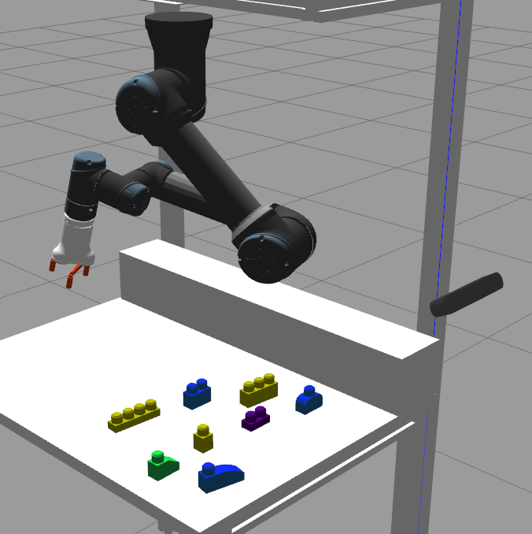
Fundamentals of Robotics project
1 Environment
This module is in charge of launch all the environment. It will open Gazebo and Rviz using the didactic framework Locosim.
In this way the UR5 is ready to do the tasks that will be assigned from the planner module. This module is mostly done by the author of this framework, we edit the models in the worlds folder in order to customize the world
different version of the lego models
from 1.4 to 1.6
Mesh on the table with the object silhouette
Custom lego.world
University of Trento

Slide 6
Fundamentals of Robotics project
1.1 Spawn Lego
Generates the lego objects on the table
Possibility to set position, orientation and distances between objects)
Capability to select the assignment number and also special features
Parameters:
No parameter
-a[assignment] where [assignment] = {1, 2, 3, 4} (e.g. -a2)
-s1 (beta)
Wait for some external spawn commands (for testing)
-s2 (beta)
Spawns lego and removes them after a certain delay
Used to take pictures
University of Trento

Slide 7
Fundamentals of Robotics project
2.1 Planner
Communicates with the vision module
vision publisher → planner subscriber
Get info about the object detected through legoFound.msg
(e.g. Coordinates, orientation, class)
3 available commands from vision
0 - No Command
1 - Detect
2 - Quit
With a given class, it defines the final coordinates
University of Trento

Slide 8
Fundamentals of Robotics project
2.2 Movement
Communicates with the planner module
planner publisher → Movement subscriber
It receives the legoTask.msg from the Planner and gets the info about:
command to execute without caring about the class
most frequent is the 0: catch_obj
Initial coordinates
Diameter gripping and the final object position [optional]
Inside the movement.cpp there are basic instructions to move the UR5 robot referring to a library called Kinetics
University of Trento

Slide 9
Fundamentals of Robotics project
Movement commands from the planner module
0 - No Command
1 - Test
2 - Wait
3 - Move
4 - Grasp
5 - Ungrasp
6 - Default position
7 - Fast catch
8 - Catch
University of Trento

Slide 10
Fundamentals of Robotics project
2.3 Kinetics
Kinetics is the library that contains all the primitive instructions in order to calculate angles, spatial displacement, matrix and all the mathematical functions related.
It includes the necessary classes and functions for dense matrix operations, it provides a wide range of functionalities, including matrix algebraic operations.
University of Trento

Slide 11
Fundamentals of Robotics project
2.5 Acknowledgement system
It allows you to choose the operating mode
Since the communication between two different modules is done through messages with a certain command IDs, each of these is defined in order to give back a variable called send_ack.
If you want an execution results back to the caller module
send_ack must be equal to 1.
It enforces the called module to complete the requested command and send back the results via event message.
If you just need the execution without caring about its completions,
leave "send_ack" equal to 0
University of Trento

Slide 12
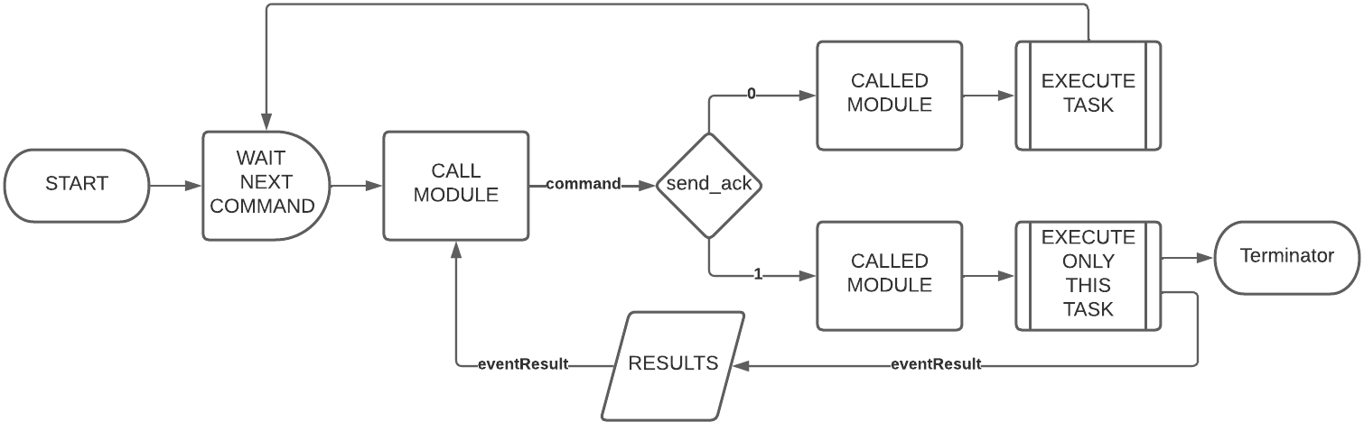
Fundamentals of Robotics project
2.5 Acknowledgement system flow
University of Trento

Slide 13
Fundamentals of Robotics project
2.5 Secure communication system
University of Trento

Slide 14
Fundamentals of Robotics project
3 Vision
In charge of practice the deep learning to create an “artificial neural network” that can learn and make intelligent decisions on its own
The goal is to make ZED-Camera able to recognize the 11 different models (legos) starting from a dataset (pool of ~2500 images).
Tool used:
MakeSense AI Get annotations
Roboflow Create and refine the dataset
Yolov5 (Ultralytics) in Colab Train
Pythorch Test in practice
University of Trento

Slide 15
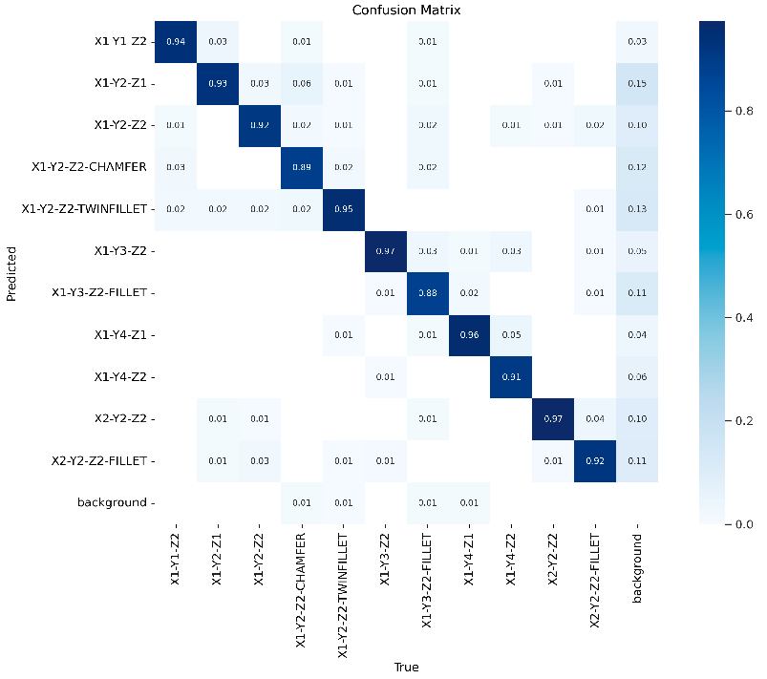
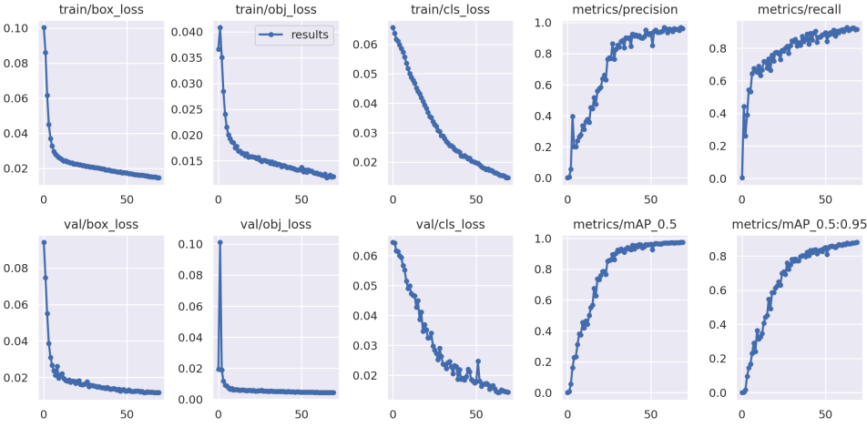
Fundamentals of Robotics project
3 Vision Results
University of Trento

Slide 16
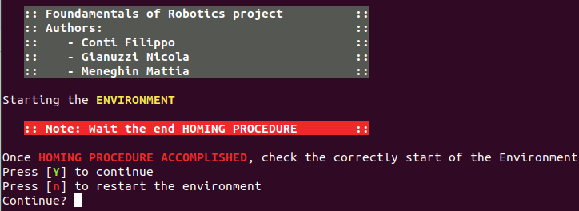
Fundamentals of Robotics project
Run The Project
Move into the repository folder, then catkin_ws
cd Robotics_ICE23_UNITN/catkin_ws/
Build the packages
catkin_make install
Run the start.sh script using
bash ~/Robotics_ICE23_UNITN/start.sh
Note: Necessary to wait the accomplishment of the homing procedure in the “environment” terminal
University of Trento

Slide 17
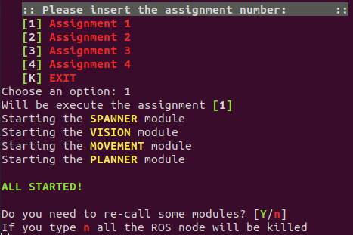
Fundamentals of Robotics project
Run The Project
Select the number of the assignment or EXIT
Then you can
re-call some modules in case of failures typing Y
Quit correctly, killing all ROS nodes typing n
University of Trento

Slide 18
Fundamentals of Robotics project
Results
University of Trento

