Slide 1
PROJECT outline
You can ALWAYS add more,
but this is the minimum!!
TITLE, HUD (design)
CHARACTER (figure)
ENVIRONMENT (landscape)
REQUIRED:
Title Screen or Box Art
Interface/Inventory (HUD over gameplay, or separate inventory or character setup screen)
Turnaround of main character (basic front, ¾, side, plus expression or action pose)
One (or more) Screenshots/Mockups of gameplay; for example:
Action/Battle/Event (showing special effect)
Hazard/Puzzle/Trap/Challenge
Win/Reward/Loss/Defeat
EXTRA CREDIT:
Turnaround of additional characters
Vehicles or other important elements
Incidental objects (weapon, tool, costume, etc)
Extra ”Screenshots”
Remember to include examples of the original!!
Notes:
This is a basic template / flow for presenting your project

Slide 2
original art
TITLE SCREEN : before/after
NEW
ART
Notes:
Feel free to lay pages out in an interesting way. Keep in mind the PRINCIPLES of design!!!

Slide 3



EXAMPLE original characters
The Yet To Be Determined
The Good
The Bad

Slide 4
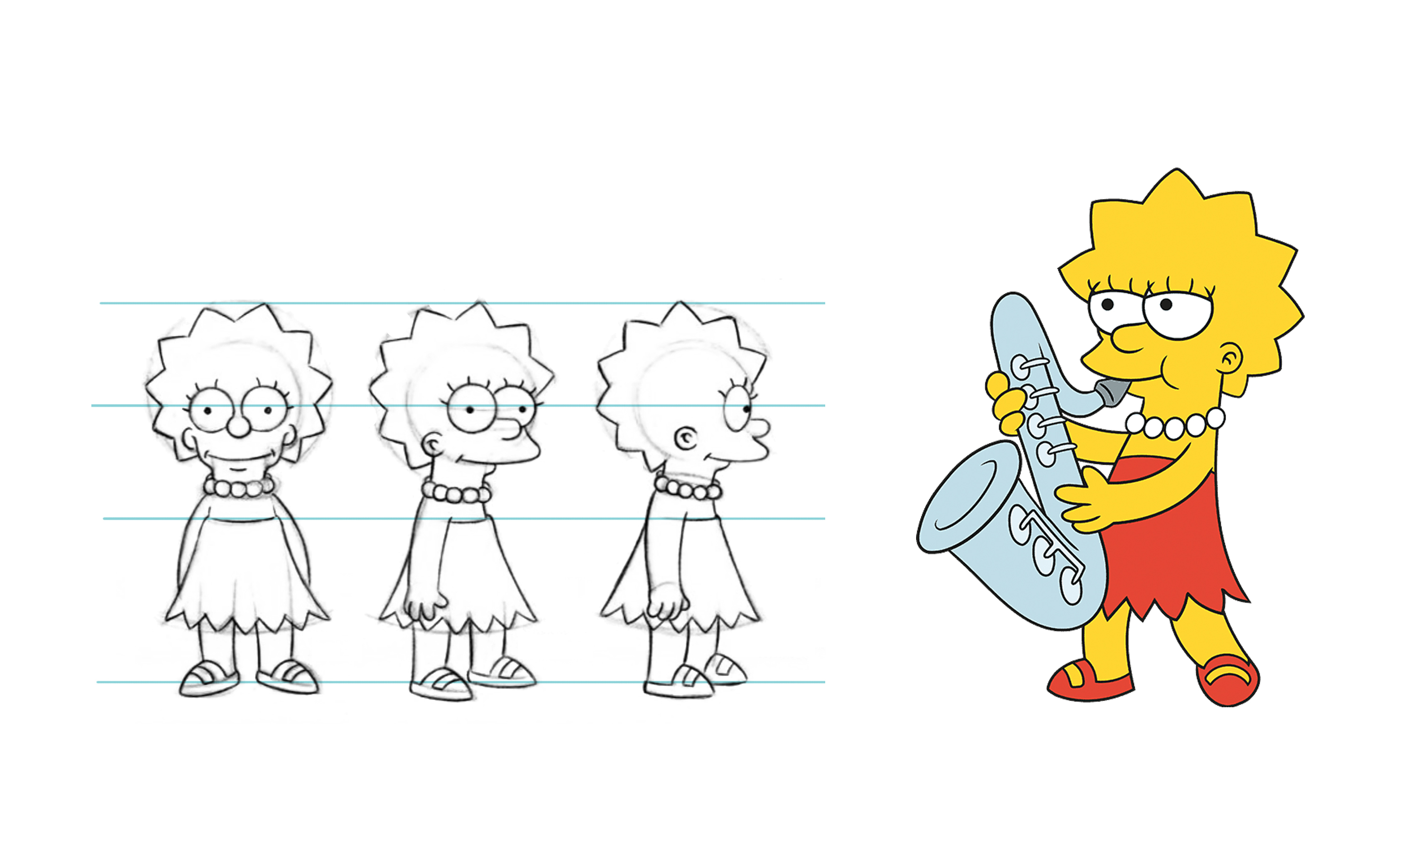
Protagonist

Slide 5
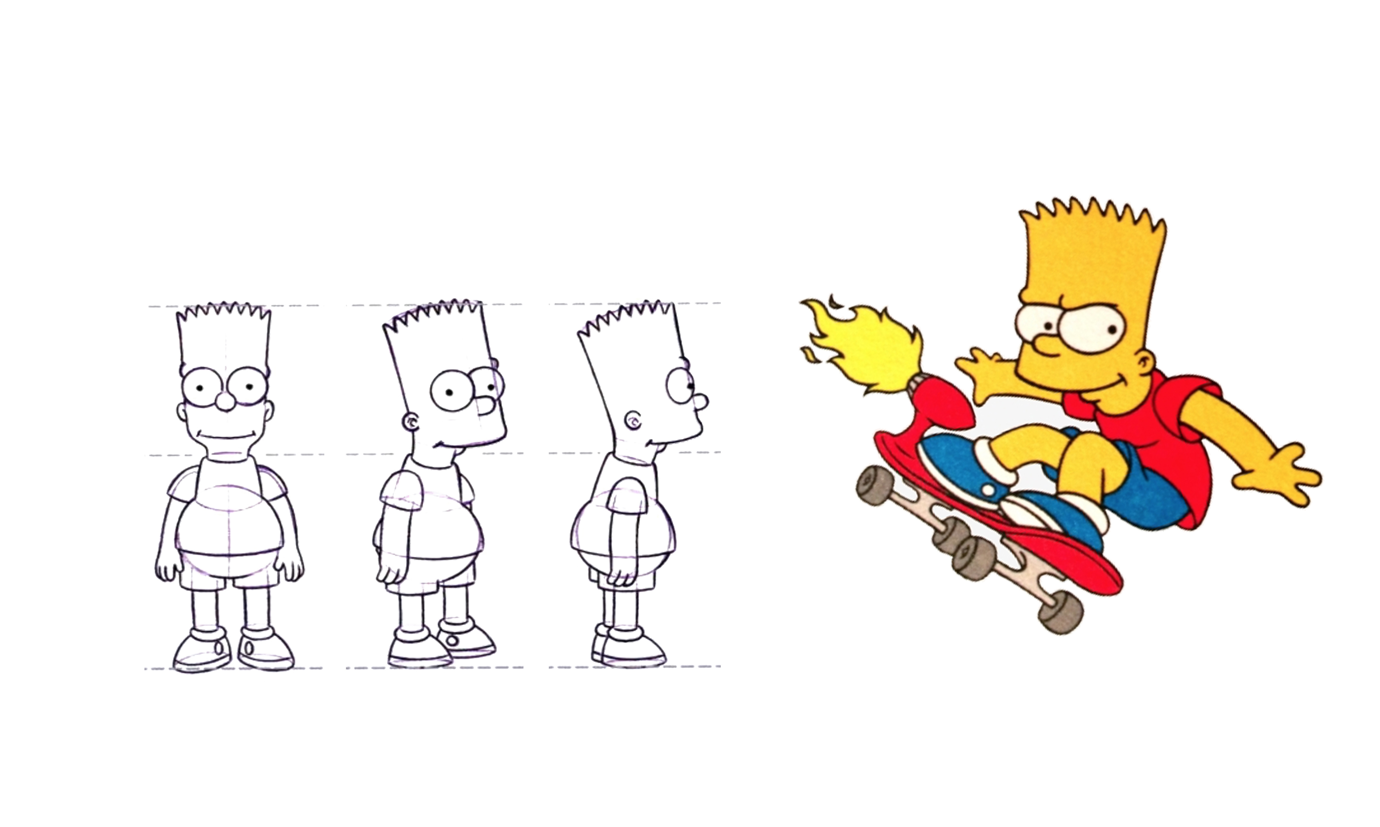
Antagonist

Slide 6
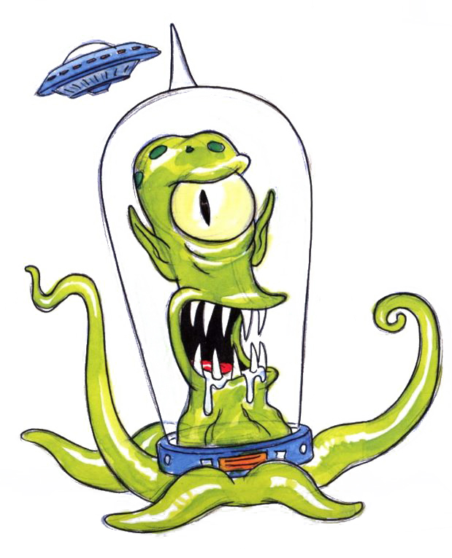
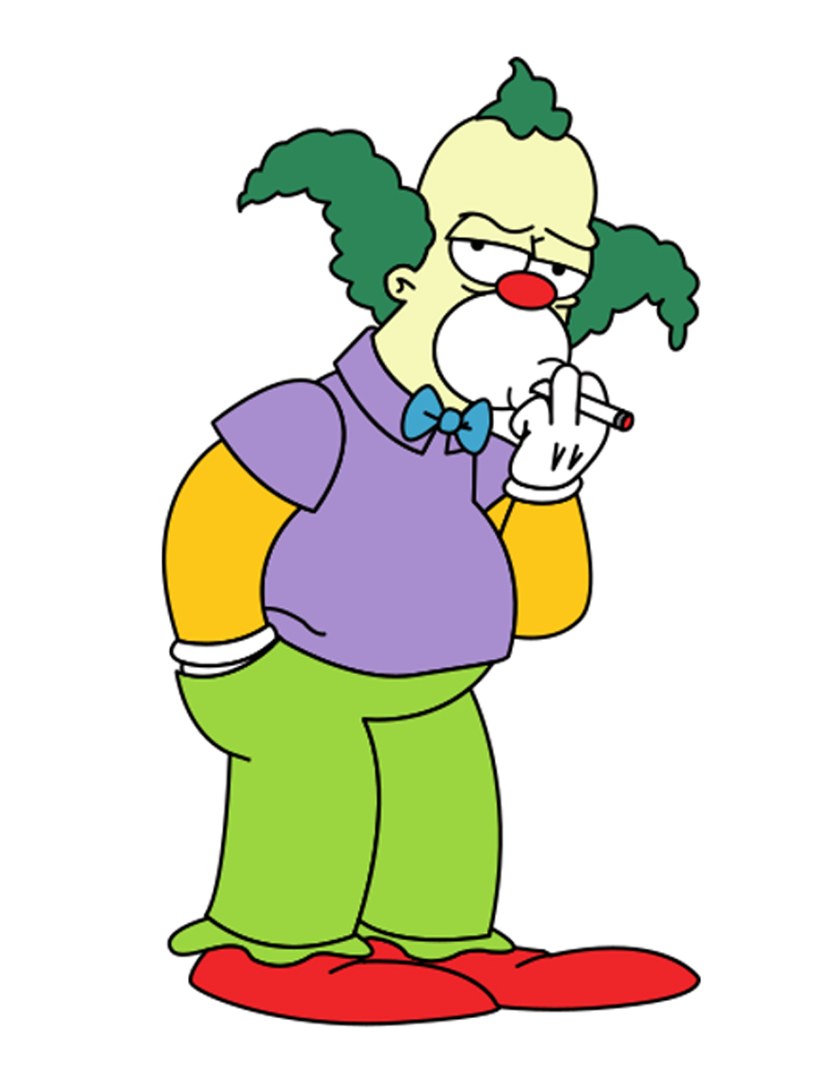

any additional character images

Slide 7

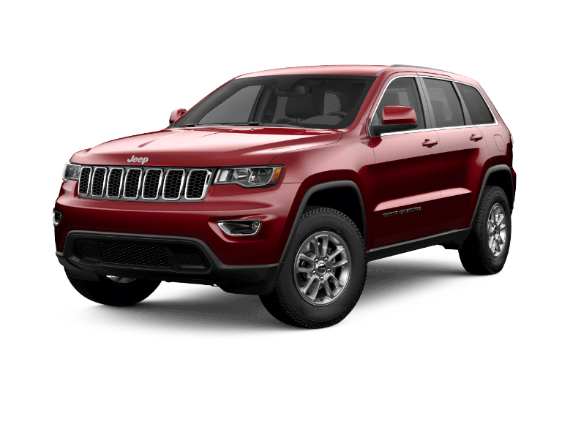
(extra credit) Vehicle or other Important Object(s)

Slide 8
Props
One or more pictures of props, costumes, tools, or anything else that is of interest in the remake!
"original"
"after"
"before"
"re-imagined"

Slide 9
HUD, inventory, or other interface screens
[original]
[re-imagined]

Slide 10
Original in-game (or equivalent) examples

Slide 11
[Reimagined ingame mockup]
Notes:
You can include before and after for these (can be draw-overs), or make them up entirely from scratch.

Slide 12
Synopsis – credits – inspiration – or anything else that seems relevant to your process and experience.

