Slide 1
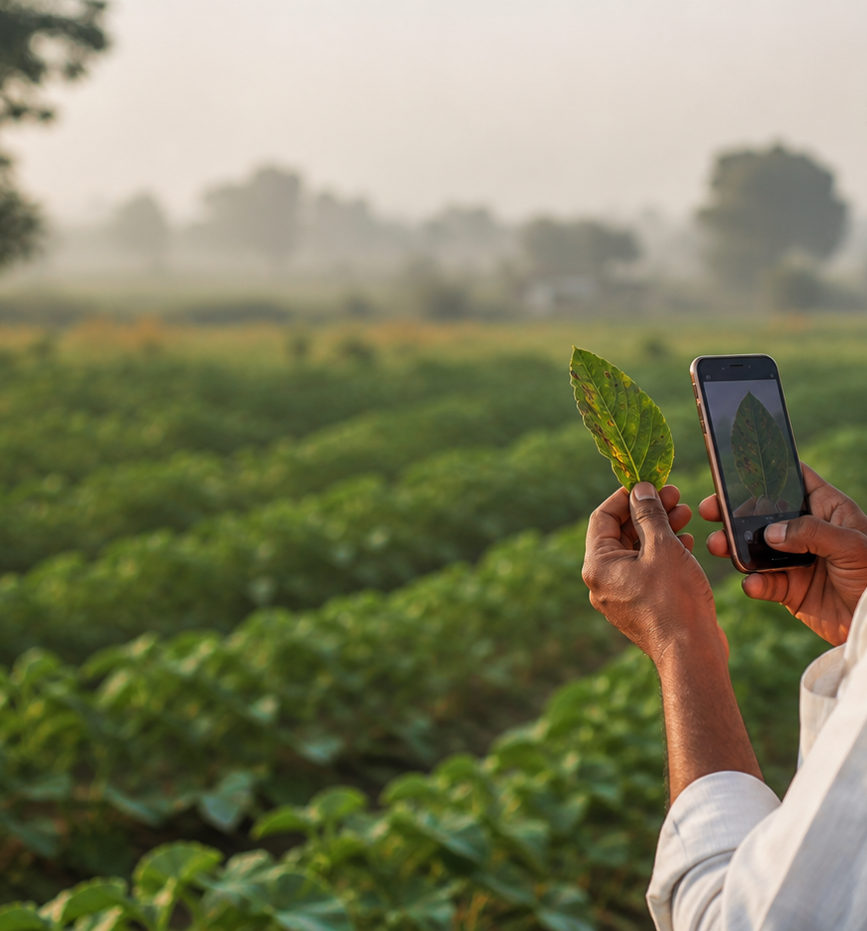
OPEN PORTFOLIO PROJECT • CROP HEALTH
Wellfarm
Explainable crop-health intelligence for field decisions and regional exploration.
Built by Shivam Tamboli
Farmer fieldbook + regional insights
Live weather and GPS context
Open, non-commercial portfolio project
PHOTO → VISUAL INDICATION → WEATHER CONTEXT → PRIVATE HISTORY
Notes:
[Sources]
- README.md
- docs/product-requirements.md
[/Sources]

Slide 2
02 PRODUCT EXPERIENCE
One scan becomes a useful field record
Wellfarm combines a farmer workflow with privacy-aware regional exploration—without external case submission.
Capture clearly. Explain uncertainty. Add context. Save locally. Explore patterns.
Farmer fieldbook
Regional insights
Transparent intelligence
Photograph symptoms → choose crop details → receive a ranked visual indication → save a private record.
Explore crop, condition, severity, weather, geography, and time using coarse locations and clear provenance.
Live weather, model output, local records, and sample regional data stay visibly distinct throughout the product.
DESIGN PRINCIPLE Every signal keeps its provenance, uncertainty, and privacy boundary visible.
Wellfarm • Portfolio overview
02
Notes:
[Sources]
- platform/replit/artifacts/wellfarm/src/App.tsx
- docs/product-requirements.md
[/Sources]

Slide 3
03 TECHNICAL ARCHITECTURE
Capture → classify → contextualize → learn, with boundaries
A modular architecture keeps live, model-generated, local, and sample data visibly separate.
1
2
3
4
5
6
Capture
Classify
Explain
Context
Save
Explore
Photo + crop + approximate GPS location
Ranked labels, confidence, model version
Plain-language result and safe next steps
Live weather for the detected area
Local API record and scan history
Privacy-reduced regional patterns
CURRENT ENGINEERING SURFACE
React web app • Express API • local database • EfficientNetV2-S pipeline • Open-Meteo • Gemini explanations • regional analytics
Wellfarm • Portfolio overview
03
Notes:
[Sources]
- docs/architecture.md
- services/vision/README.md
- services/api/README.md
[/Sources]

Slide 4
04 IMPLEMENTATION STATUS
A real product build, with honest data boundaries
The repository separates working software, sample analytical views, and model work still in progress.
WORKING NOW
NEXT ENGINEERING MILESTONES
Product: farmer scan journey, GPS place label, live weather, local scan history
Platform: React client, Express API, typed contracts, database layer
Portfolio data: deterministic sample records for regional exploration
Data: audit labels, remove duplicates, document licenses, lock source-aware splits
Model: train and evaluate EfficientNetV2-S with calibration and rejection tests
Product: strengthen persistence, accessibility, multilingual coverage, and deployment
MAIN RISKS → BUILT-IN RESPONSES
Misclassification
Unsafe action
Privacy
Confidence, unsupported-image states, and cautious language
Non-prescriptive guidance and explicit uncertainty
Approximate location and no external submission workflow
Wellfarm • Portfolio overview
04
Notes:
[Sources]
- docs/roadmap.md
- data/README.md
- SECURITY.md
[/Sources]

Slide 5
05 PORTFOLIO CAPABILITIES
Three surfaces show the system end to end
Wellfarm demonstrates product design, applied ML, backend engineering, and responsible data communication in one coherent build.
FARMER EXPERIENCE
INTELLIGENCE LAYER
ENGINEERING DEPTH
Field-first interaction
Explainable context
Model + data pipeline
Camera upload, crop details, GPS-derived place label, live weather context, clear uncertainty, and scan history.
Condition confidence, severity logic, weather context, and regional comparisons with provenance on every signal.
Source-aware dataset preparation, deterministic splits, a midweight vision target, typed APIs, and modular services.
Proof: responsive scan journey + local records
Proof: transparent result + pattern views
Proof: tested dataset preparation pipeline
DESIGNED TO GROW • modular services • versioned contracts • replaceable adapters • explicit provenance
Wellfarm • Portfolio overview
05
Notes:
[Sources]
- README.md
- services/vision/tests
- packages/contracts/README.md
[/Sources]

Slide 6
06 REPOSITORY AND ROADMAP
Evidence in the repo, not claims on a slide
The product is grounded in versioned requirements, architecture, data schemas, tests, and explicit scope decisions.
PRIMARY PROJECT REFERENCES
CURRENT PROJECT TRUTH
Product: README.md + docs/product-requirements.md
System: docs/architecture.md + packages/contracts
Data: data/README.md + source-aware split scripts
Delivery: docs/roadmap.md + component READMEs
Quality: SECURITY.md + automated dataset tests
BUILT
Farmer flow • GPS/place label • live weather • local history
IN PROGRESS
Curated datasets • midweight model training • evaluation
OUT OF SCOPE
External case submission • institutional operations • commerce
Build honestly. Learn in public.
NEXT MILESTONE → train and evaluate the midweight vision model on curated, source-aware splits
Wellfarm • Portfolio overview
06
Notes:
[Sources]
- README.md
- docs/architecture.md
- docs/roadmap.md
- SECURITY.md
[/Sources]

