Slide 1
Employee Payroll Management System
BCSE302L Database Systems | Course Project – Review I: Problem Analysis & Database Design
<Student Name> · <Register Number> Guide: <Faculty Name>
Notes:
Introduce the project: a cloud-hosted PostgreSQL (Supabase) database with a web admin panel that automates monthly payroll.

Slide 2
Spreadsheet payroll is error-prone and unauditable
1
2
3
4
Manual calculation
Duplicate & inconsistent data
No rule enforcement
No history or reports
HRA, DA, PF, tax and loss-of-pay are worked out by hand every month.
The same employee or department is typed into many sheets.
Nothing stops a duplicate payslip, a negative salary or self-approved leave.
Hard to answer: what did the Sales department cost last month?
Problem statement: design a centralised, consistent database that stores employee, attendance, leave and salary-structure data, and computes each employee’s monthly gross and net salary (including loss-of-pay), with business rules enforced by constraints and triggers instead of manual checks.

Slide 3
Objectives and users of the system
Objectives
HR Administrator
1
Single source of truth for employees, departments and designations
Record attendance and leave; compute loss-of-pay automatically
Configurable allowances and deductions (fixed or % of basic)
Generate the whole month’s payroll and itemised payslips in one step
Enforce integrity with PK/FK, CHECK, UNIQUE, DEFAULT and triggers
Web admin panel connected to the database
Departments, designations, employees, attendance
Payroll Officer
2
Salary components, monthly payroll run, payments
Reporting Manager
3
Approves or rejects leave of their team
Employee
4
Views payslips and attendance; applies for leave

Slide 4
Requirements cover the full monthly payroll cycle
1
2
3
4
5
6
Org setup
Employees
Attendance
Leave
Payroll run
Payment & reports
Departments, designations, pay grades, department head
Personal, PAN and bank details; manager; status
Daily check-in/out; one row per employee per day
Apply → manager approves → attendance updated
LOP, allowances, deductions, gross and net pay
Mark paid, payslip, department cost reports
In scope
Employee master data, attendance, leave, salary components, payroll generation, payslips, payment records, management reports.
Out of scope
Real bank transfers, full income-tax regime calculation, recruitment, appraisals, biometric hardware. TDS is a simple % deduction.

Slide 5
Seven entities hold the payroll data
EMPLOYEE
PK: emp_id
LEAVE_REQUEST
PK: leave_id
name (first, last), email, phone, gender, dob, age*, joining date, PAN, bank a/c, IFSC, status
leave_type, start/end date, no_of_days*, reason, status, applied_on
DEPARTMENT
PK: dept_id
SALARY_COMPONENT
PK: component_id
dept_name, location, created_on
name, type (Allowance/Deduction), calc_method (Fixed/%), value, is_taxable
DESIGNATION
PK: desig_id
PAYROLL
PK: payroll_id
title, pay_grade, basic_salary, annual_leave_quota
pay period (month, year), working/LOP days, basic, allowances, deductions, gross*, net*, status, payment
ATTENDANCE
PK: attendance_id
* derived attribute
att_date, check_in, check_out, status, hours_worked*

Slide 6
Nine relationships, including recursive, 1:1 and M:N
Relationship | Entities | Cardinality | Meaning
WORKS_IN | Department – Employee | 1 : N | Every employee is in one department
HEADS | Employee – Department | 1 : 1 | A department has at most one head
HOLDS | Designation – Employee | 1 : N | Every employee has one designation
REPORTS_TO | Employee – Employee | 1 : N | Recursive: manager ↔ subordinates
MARKS | Employee – Attendance | 1 : N | Daily attendance rows
APPLIES | Employee – Leave_Request | 1 : N | Employee applies for leave
APPROVES | Employee – Leave_Request | 1 : N | Manager approves leave
RECEIVES | Employee – Payroll | 1 : N | One payroll per employee per month
INCLUDES | Payroll – Salary_Component | M : N | Payslip line items, attribute: amount

Slide 7
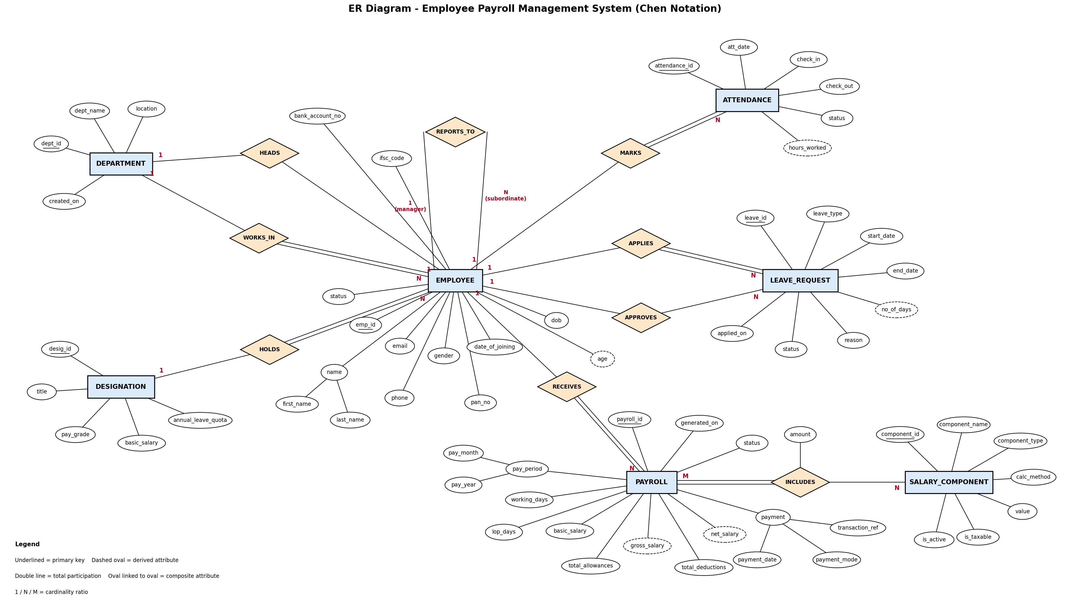
ER diagram (Chen notation)
Notes:
Walk through: EMPLOYEE at the centre. Double lines show total participation (every employee must be in a department and have a designation). REPORTS_TO is recursive. INCLUDES is M:N with attribute amount. Dashed ovals are derived (age, hours_worked, no_of_days, gross/net salary).

Slide 8
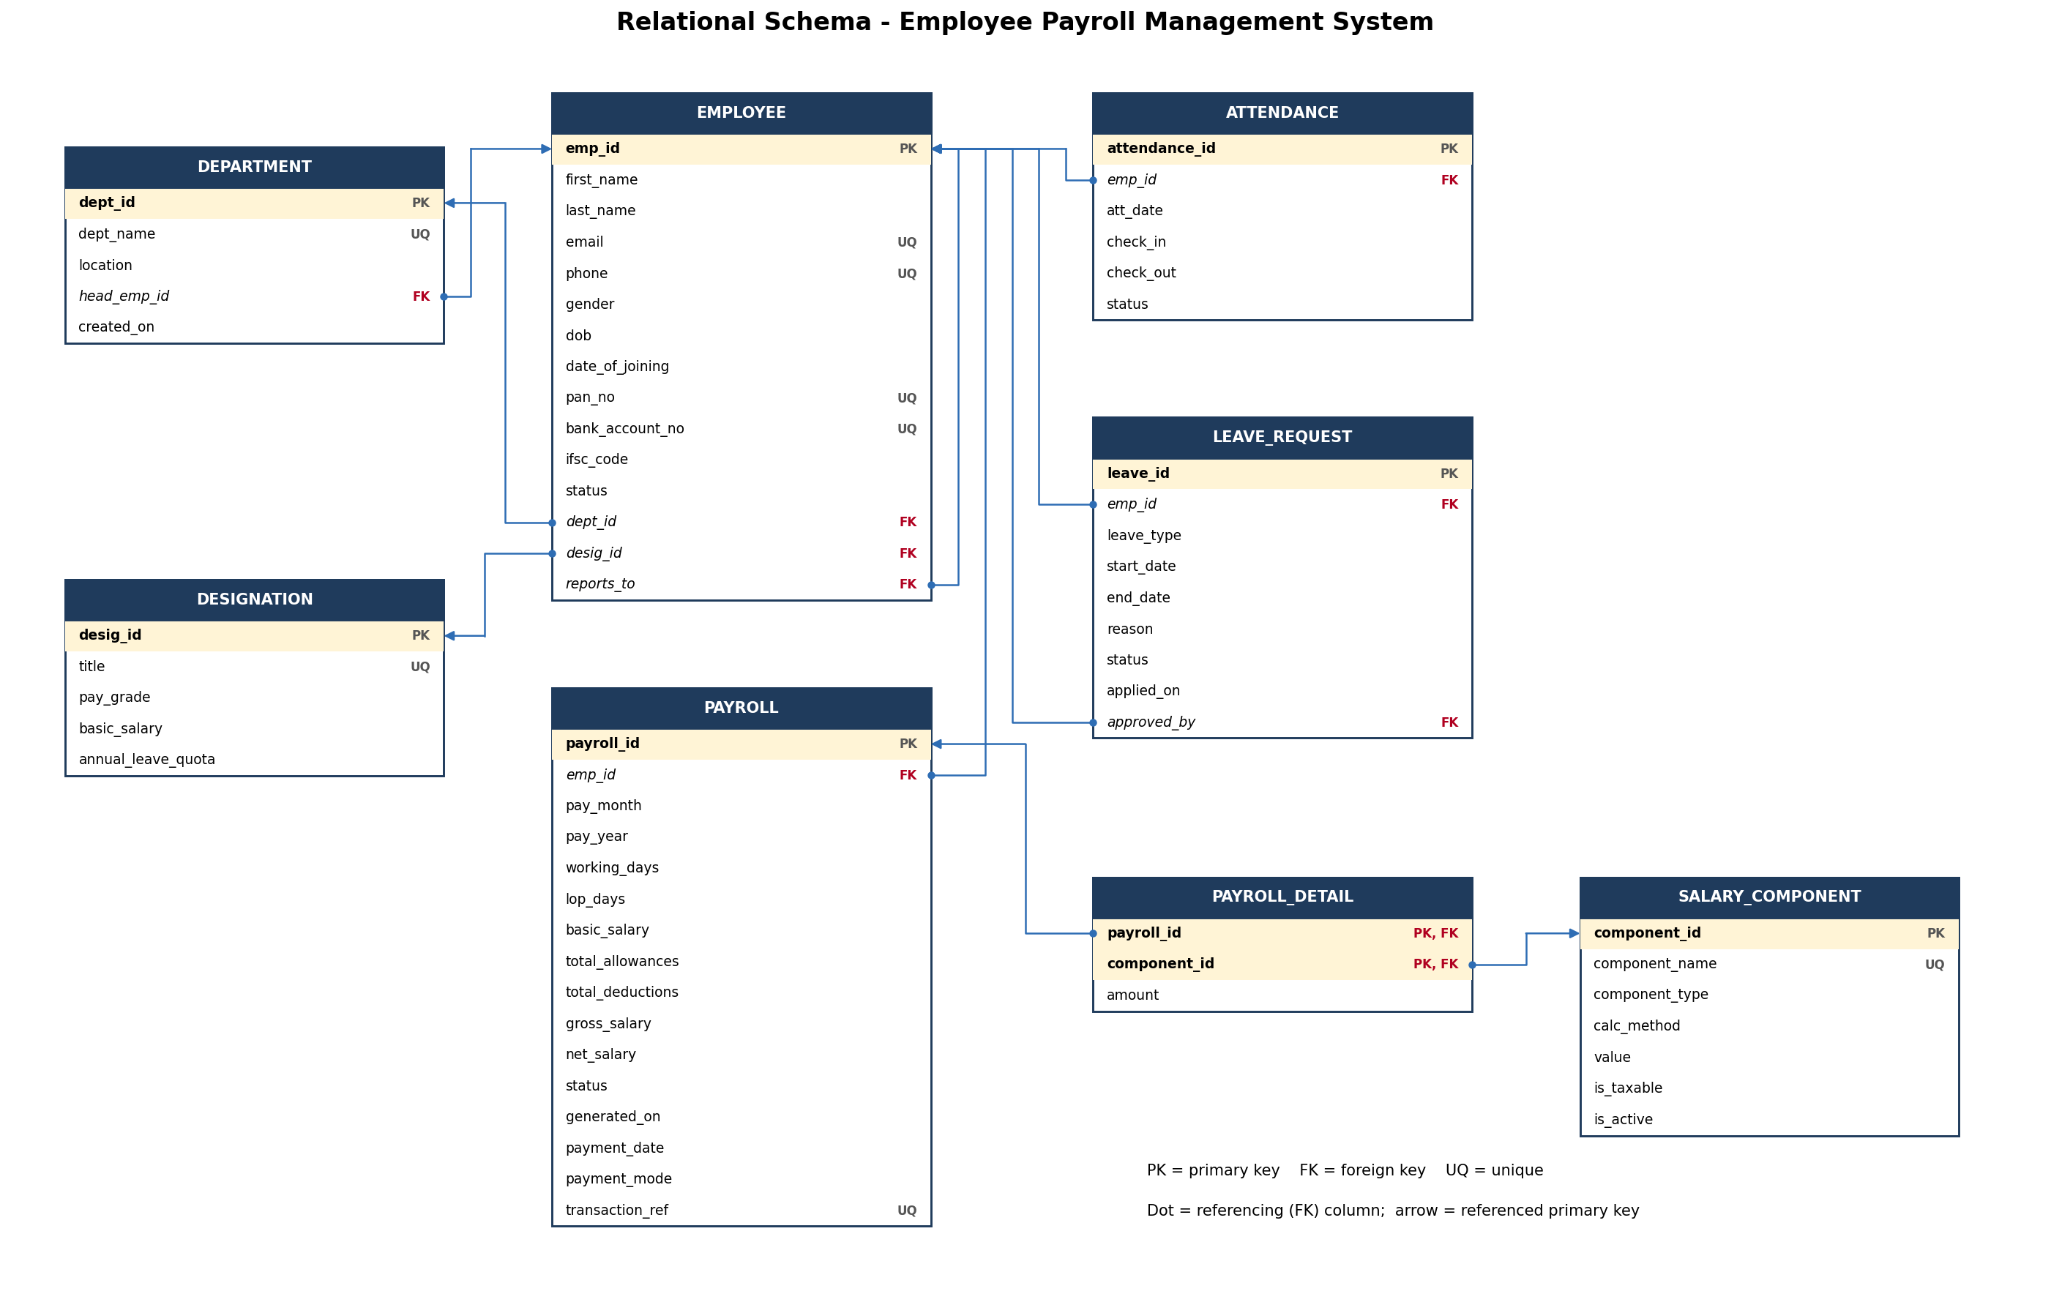
Relational schema: 8 tables with PK/FK links

Slide 9
How the ER model became tables
1
Strong entities → tables
2
Composite → simple columns
7 entities became 7 tables with SERIAL surrogate primary keys.
name → first_name, last_name; pay period → pay_month, pay_year.
3
1:N → FK on the N side
4
Recursive → self FK
employee.dept_id, employee.desig_id, attendance.emp_id, payroll.emp_id …
employee.reports_to references employee.emp_id.
5
1:1 → FK + UNIQUE
6
M:N → new table
department.head_emp_id (UNIQUE): each department has at most one head.
payroll_detail(payroll_id, component_id, amount) with a composite PK.
All tables are in 3NF. Gross and net salary are stored on purpose as a monthly snapshot, so old payslips stay correct when salary rules change.

Slide 10
Business rules enforced inside the database
UNIQUE
CHECK
DEFAULT / NOT NULL
FK actions
One attendance row per employee per day
One payroll per employee per month
Unique email, phone, PAN, bank a/c
PAN, IFSC and phone formats (regex)
end_date ≥ start_date; check_out > check_in
LOP days ≤ working days; net salary ≥ 0
Employee at least 18 at joining
status = 'Active' / 'Pending' / 'Generated'
date_of_joining, applied_on = CURRENT_DATE
All identity and salary fields NOT NULL
Payroll history: RESTRICT delete
Attendance & leave: CASCADE
Manager / approver: SET NULL

Slide 11
Architecture: web admin panel on Supabase PostgreSQL
User operation
SQL / PL/pgSQL
DB processing
Update / retrieval
Result
Admin fills a form in the web panel
supabase-js sends the query or calls a procedure (RPC)
Constraints and triggers validate the change
Tables are changed or read
Payslip, table or report shown in the panel
Database
PostgreSQL 15 on Supabase (cloud)
Connectivity
supabase-js client / PostgREST API
Front end
HTML, CSS, JavaScript admin panel
Security
Supabase Auth + Row Level Security

Slide 12
Next: data, queries and PL/pgSQL
Review II plan
2 Procedures
3 Functions
1 Cursor
3 Triggers
generate_monthly_payroll, process_leave
fn_lop_days, fn_component_amount, fn_leave_balance
loops over active employees in the payroll run
leave → attendance, lock paid payroll, validate manager

