Slide 1
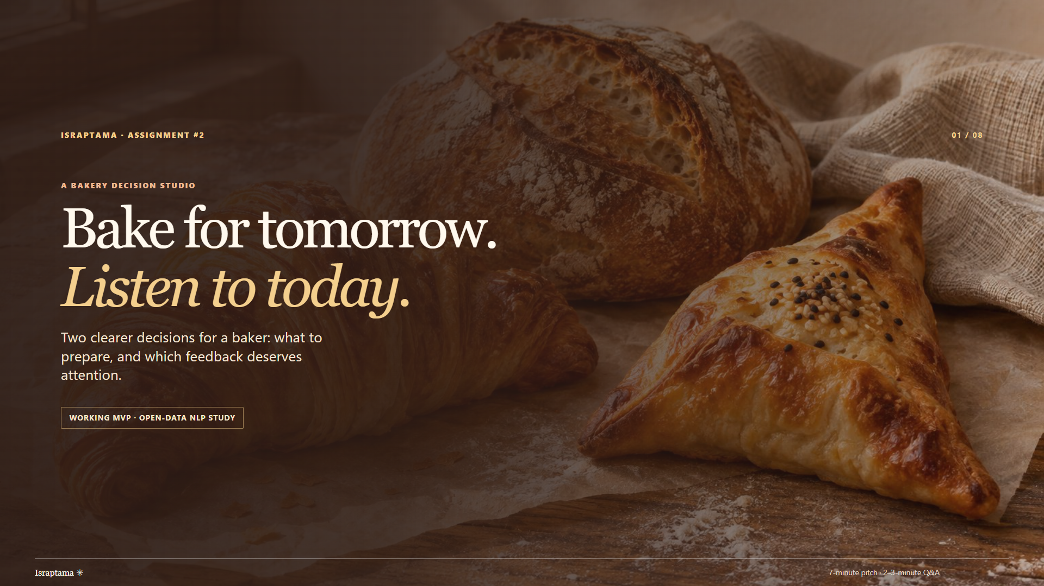
Notes:
“Imagine closing a small bakery. You know what you baked and sold today, and you have comments from customers. Tomorrow you must decide how much to prepare. You also need to notice feedback that deserves a closer look. Israptama puts these two decisions in one clear workflow. I will show the product first, then the real NLP experiment behind its feedback view, and finally what we still need to prove.”

Slide 2
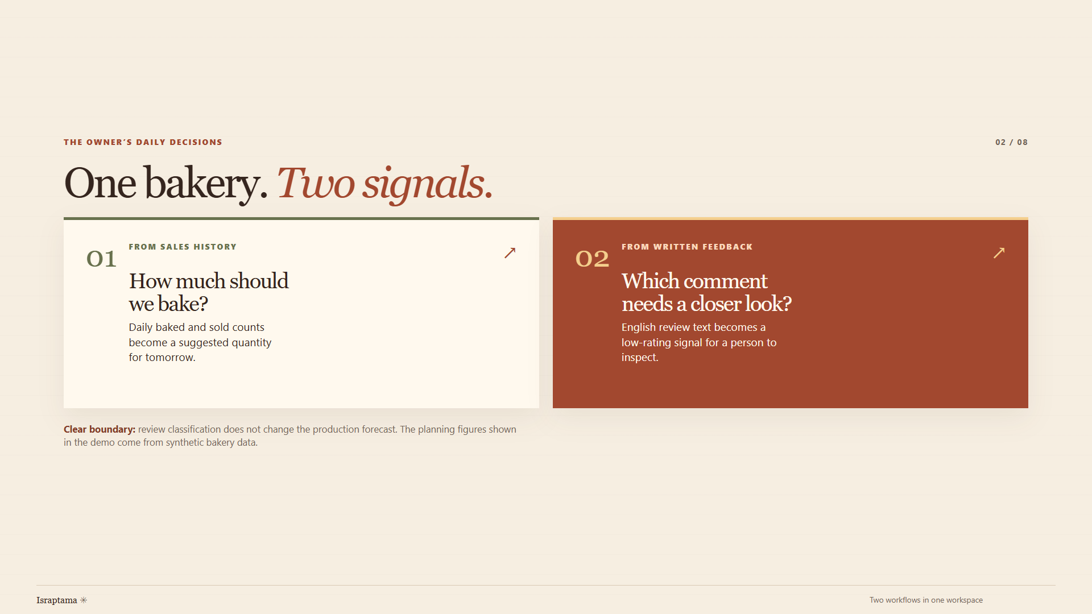
Notes:
“The first signal is numerical: daily baked and sold counts inform a suggested quantity for tomorrow. Too much stock and a sellout have different costs. The second signal is written: an English review can be flagged for a person's attention when its language resembles reviews with low ratings. The owner remains responsible for the decision. A review is qualitative feedback, not a sales count. I keep it separate from the quantity forecast because a negative sentence does not tell us how many loaves to bake.”

Slide 3
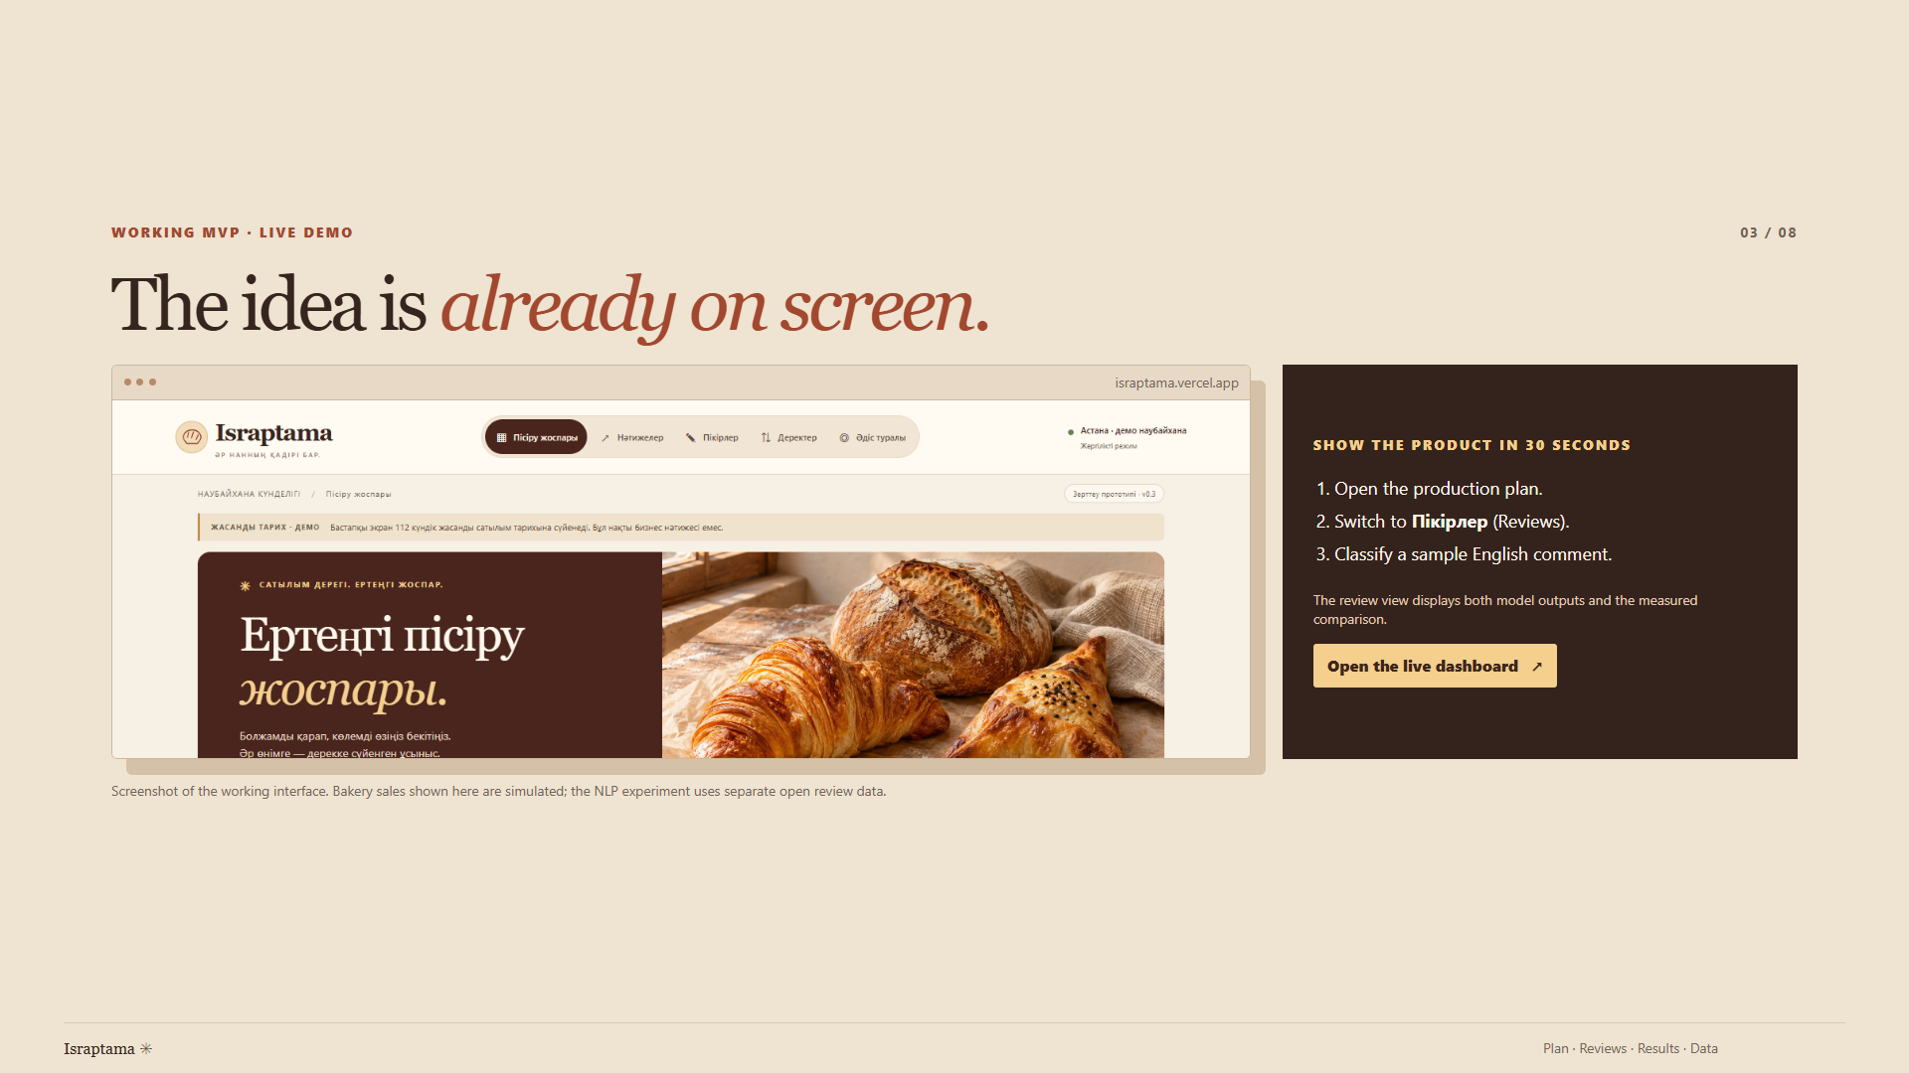
Notes:
“Here is the MVP. The production view turns baked and sold counts into tomorrow's suggested quantity, using simulated data in this demo. Now I open Пікірлер and classify a synthetic English muffin review. The two model outputs and measured comparison appear together. This is a signal for a person to inspect, and it does not alter the production plan.”
[Switch to the prepared dashboard tab; show the plan first, open Пікірлер, classify the example, point to both outputs and the measured comparison, then return to slide 4. Keep the interaction under about 25 seconds.]

Slide 4
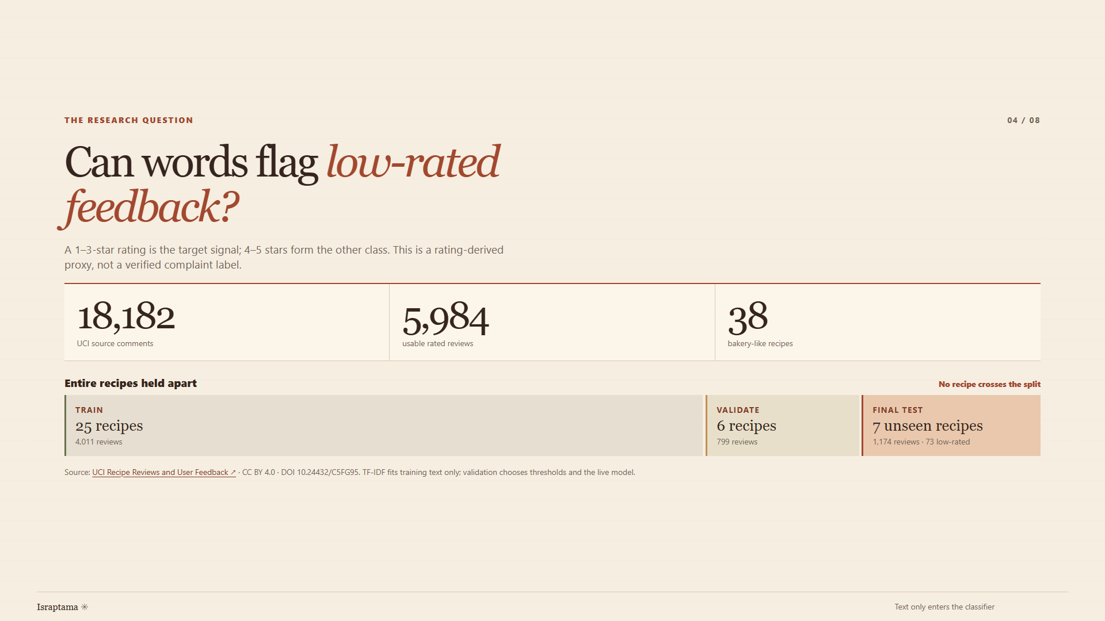
Notes:
“For the research component I used UCI's open Recipe Reviews and User Feedback dataset, licensed CC BY 4.0. It contains 18,182 comments. A fixed recipe-title rule and cleaning left 5,984 rated reviews from 38 bakery-like recipes. I predict one-to-three-star ratings versus four or five stars from review text alone. Low rating is a proxy for concerning feedback, not a verified complaint. A random comment split could put reviews of the same recipe on both sides, so I held out entire recipes: 25 recipes and 4,011 reviews for training, six and 799 for validation, and seven unseen recipes with 1,174 reviews for final testing. Only 73 test reviews are low-rated. Exact normalized duplicates were removed before the split. TF-IDF learned from training text only; validation chose the thresholds and live model before the final test. This measures transfer to unseen recipes, though seven test recipes leave uncertainty.”

Slide 5
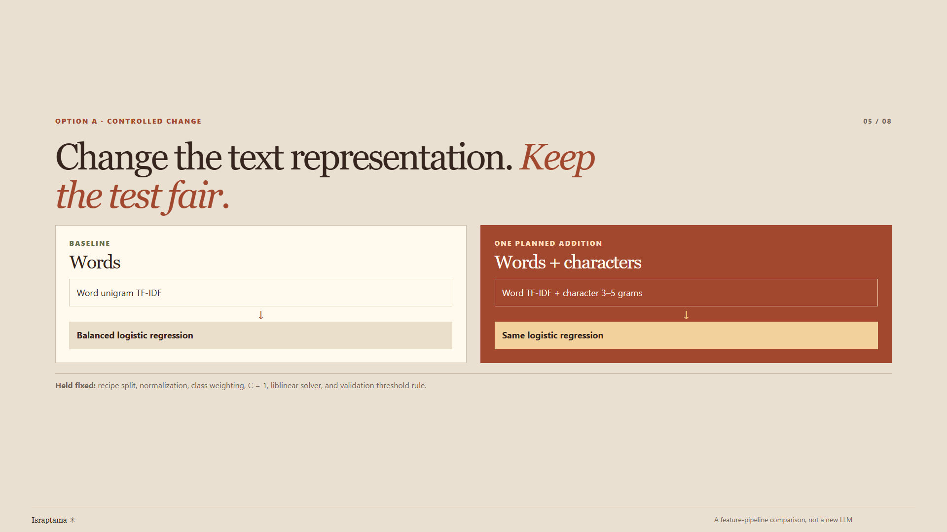
Notes:
“Option A asks for a meaningful modification and comparison. My baseline represents each review with word-unigram TF-IDF, normalizes the row, and uses class-weighted logistic regression. The candidate adds character patterns of length three to five to those word features, then uses the same normalization and classifier. The training rows, split, C value, solver, class weighting, and evaluation rule stay fixed. Character patterns might catch spelling variants or word fragments, but they can also add noise. This is a controlled change to the end-to-end feature pipeline; I am not claiming that I invented a new classifier or trained a large language model.”

Slide 6
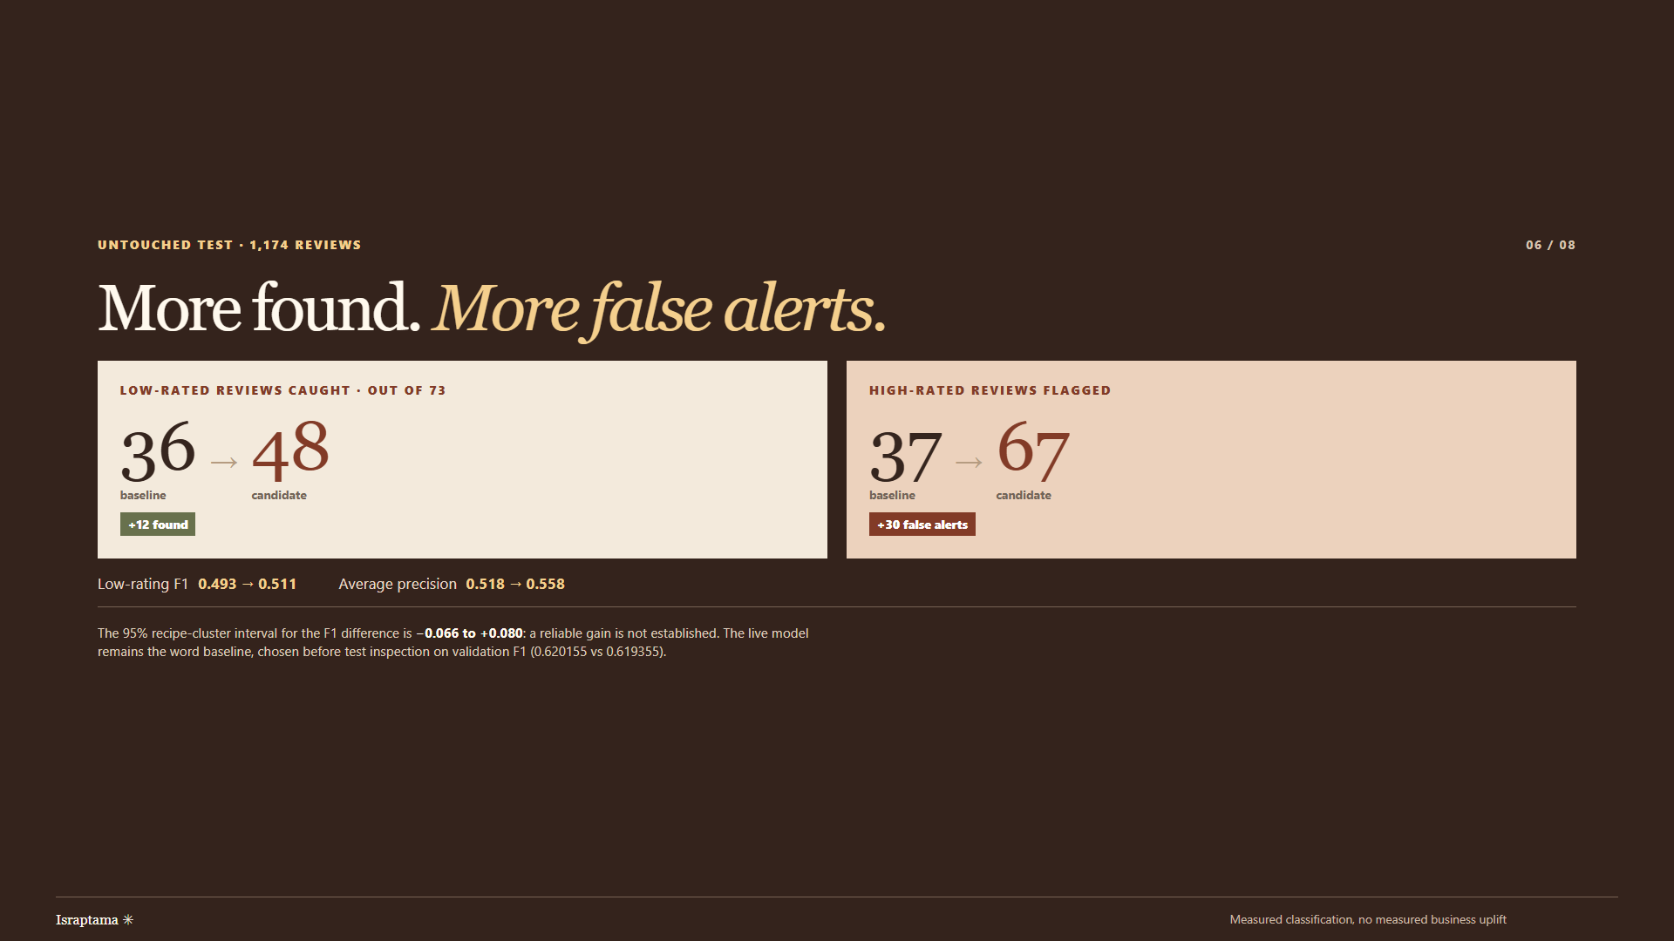
Notes:
“On the 1,174 held-out reviews, the expanded model increased low-rating F1 from 0.493 to 0.511 and average precision from 0.518 to 0.558. It caught 48 of the 73 low-rated reviews rather than 36. The cost was more false alerts: 67 rather than 37, so its precision fell from 0.493 to 0.417. That is a trade-off an owner would have to choose, not a clean win. The F1 difference is about 0.017; a recipe-cluster bootstrap gives a 95% interval from about minus 0.066 to plus 0.080. It includes zero, so I cannot claim a reliable improvement. The live headline uses the word baseline because the predeclared validation F1 rule favored it, 0.620155 versus 0.619355. I did not switch models after seeing the test result.”

Slide 7
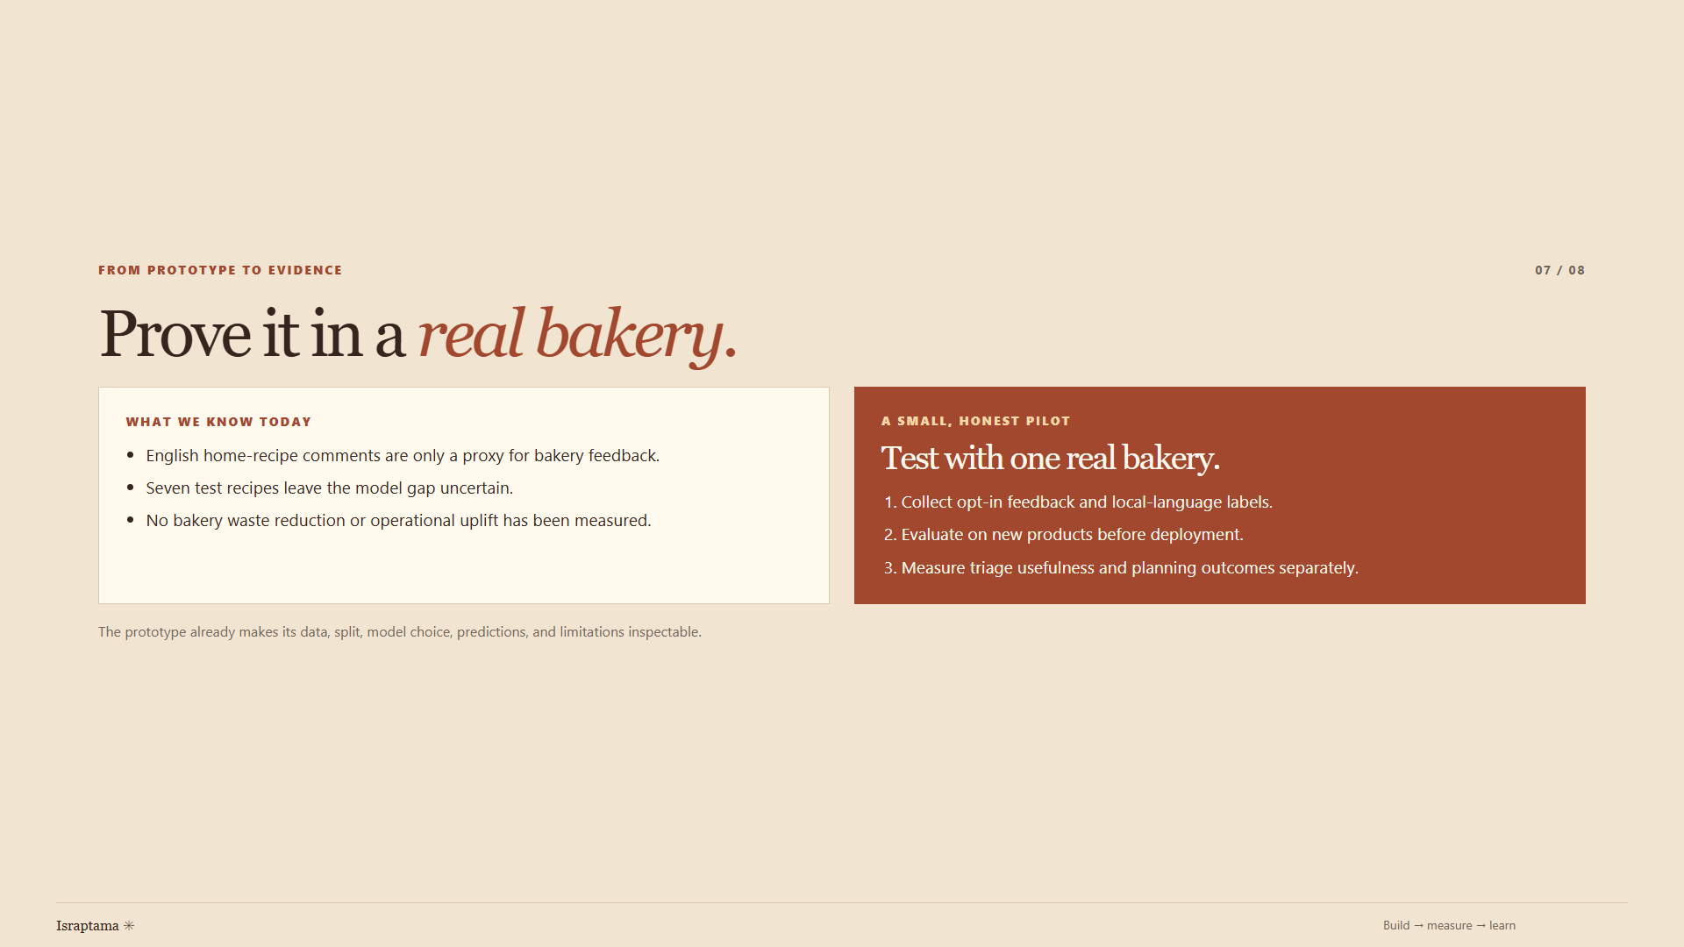
Notes:
“The result supports a working research prototype, not a claim of bakery impact. The text comes from English home-recipe comments, not retail customers, and the model has not been validated on Kazakh reviews. Seven held-out recipes make the model gap uncertain. The planning results use synthetic sales, so no real bakery waste reduction or profit gain has been measured. The next step is one willing bakery partner. With consent, I would collect enough baked-and-sold history and labelled local feedback. I would evaluate the text model on new products, then compare the planning and review workflows with the owner's current routine. Triage usefulness and planning outcomes should be measured separately. The source, split, model choice, predictions, and limitations are already inspectable.”

Slide 8
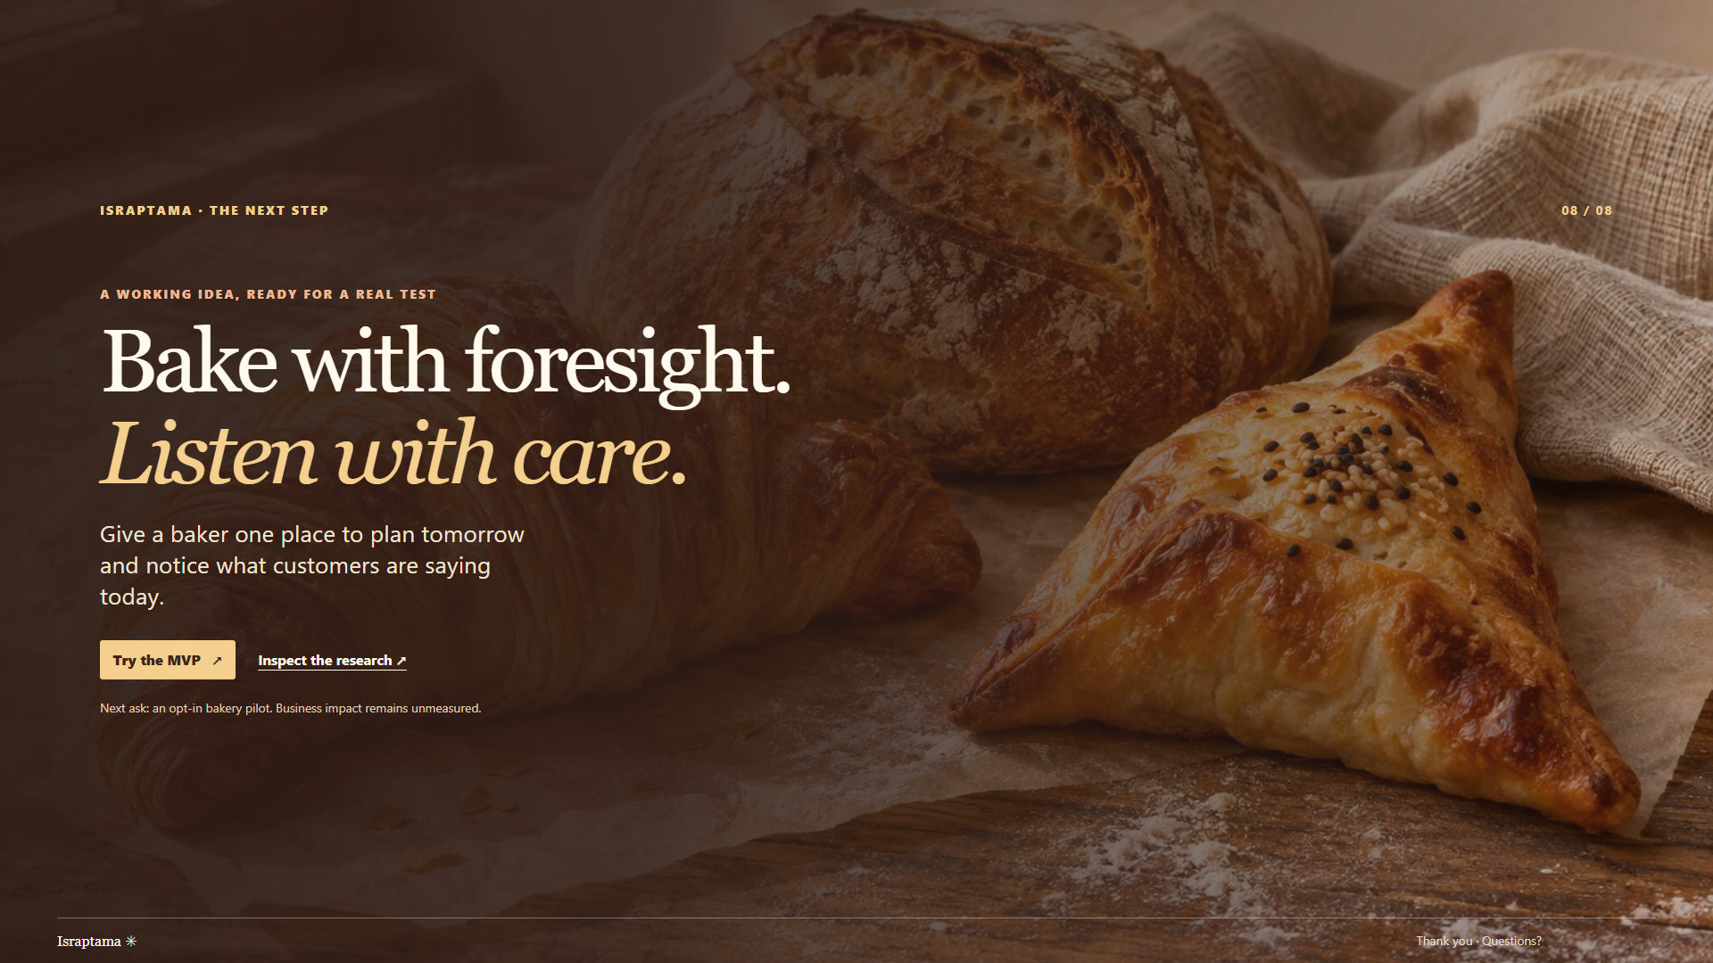
Notes:
“Israptama is ready for that honest test. It gives a baker one place to plan tomorrow and notice feedback today. My ask is a small, opt-in pilot with one bakery to learn whether those two clearer decisions help in daily work. Bake with foresight; listen with care. Thank you. I am ready to show the code or answer questions.”

