Slide 1

SYSTEM OVERVIEW
ARGUS
Local multimodal ad intelligence pipeline
Video ads become structured evidence, searchable records, campaigns, and read-only answers.
local-first
OCR + VLM
FTS + search
read-only agent
Demo arc
Upload -> inspect -> search -> ask
ARGUS system
01

Slide 2
PURPOSE
The system turns ads into searchable evidence.
A repeatable workflow converts raw media into records that can be inspected, queried, grouped, and explained.
INPUT
PIPELINE
OUTPUT
Raw ad clip
Evidence pipeline
Structured record
MP4 / MOV / WebM
frames + audio
transcript
visible text
rules + timestamps
VLM verification
category, entities
risk observations
campaigns
OCR
VLM
FTS5
Agent
RESULT
Analyst use
visible text
semantic check
keyword search
read-only tools
inspect records
compare ads
ask questions
Feeds persisted ad intelligence.
Feeds persisted ad intelligence.
Feeds persisted ad intelligence.
Feeds persisted ad intelligence.
ARGUS system
02

Slide 3
ARCHITECTURE
The frontend, API, worker, models, and database are decoupled.
Each layer has one responsibility and communicates through stable JSON, SSE, and database interfaces.
FRONTEND
API
WORKER
MODELS
DB
React UI
FastAPI
Pipeline
Local models
SQLite
Upload, Library
Search, Agent
OpenAPI surface
jobs + SSE
restartable stages
OCR / VLM
Whisper, OCR
Gemma/VLM
ads, frames, OCR
FTS index
Design principle: deterministic evidence first, VLM verification second, retrieval over persisted data.
ARGUS system
03

Slide 4
PIPELINE
Each job moves through observable processing stages.
Progress events, cached artifacts, and terminal status make the runtime easier to debug and explain.
STEP 1
STEP 2
STEP 3
STEP 4
Upload
Ingest
Evidence
VLM
Create job and store the source file.
Extract frames, audio, and transcript.
Collect OCR, timestamps, and rule matches.
Verify evidence and produce structured output.
STEP 5
STEP 6
STEP 7
STEP 8
Persist
Library
Search
Agent
Write records, evidence, entities, and indexes.
Open the completed ad record.
Find ads by keyword, filters, or similarity.
Answer read-only questions through tools.
Operational behavior: warnings and fatal errors are visible, and completed artifacts can be reused on rerun.
ARGUS system
04

Slide 5
AD RECORD
A processed ad is stored as a structured, inspectable object.
The video stays attached to timestamped evidence, extracted entities, classification output, and retrieval indexes.
SOURCE
Persisted ad record
Inspect
Video asset
Open the ad detail, review evidence, and compare model output.
original file
sampled frames
audio transcript
ad_id
stable identifier
primary_category
taxonomy label
confidence
model confidence
Retrieve
evidence[]
time + source + text
Search by keywords, filters, category, brand, or similar ads.
EVIDENCE
Timestamped facts
marketing_entities
brand, products, offers, CTAs
OCR boxes
transcript segments
rule triggers
ocr_quality
missed text and possible errors
related_ads
duplicates and campaign variants
Ask
model_outputs
raw OCR / VLM debug payloads
Use the read-only agent to answer database questions with cited ads.
ARGUS system
05

Slide 6
AD INTELLIGENCE
The output describes the ad; it does not gate or block it.
Categories, taxonomy labels, observation tags, and marketing entities are stored for analysis and retrieval.
Category + taxonomy
Observation tags
Marketing entities
Primary category, sensitive-category marker, IAB product taxonomy, and secondary labels.
Descriptive tags such as urgency, before/after claims, or social proof tactics.
Brand, advertiser, products, prices, offers, CTAs, disclaimers, badges, and format.
Evidence trail
Quality notes
Related ads
Every claim points back to a frame timestamp, OCR region, transcript segment, rule, or VLM note.
OCR quality, possible text misses, conflicts, and model uncertainty are retained for inspection.
Exact duplicates, near duplicates, and campaign variants can be linked back to the record.
The practical result: ads can be inspected, filtered, compared, and explained without relying on a single opaque model response.
ARGUS system
06

Slide 7
EVIDENCE FIRST
The VLM verifies an evidence bundle, not a blank prompt.
Frames, visible text, transcript, rules, and timestamps are preserved before the model call.
VISUAL
MODEL
Frames
VLM verifier
selected keyframes
blur and dedup filtered
category, entities
conflicts, evidence
BUNDLE
JSON
Evidence bundle
Final
chronological context
rules + metadata
selected images
category
risk tags
entities
evidence
TEXT
CHECK
Text signals
Validation
OCR + transcript
raw sources preserved
allowed labels
observed fields only
ARGUS system
07

Slide 8
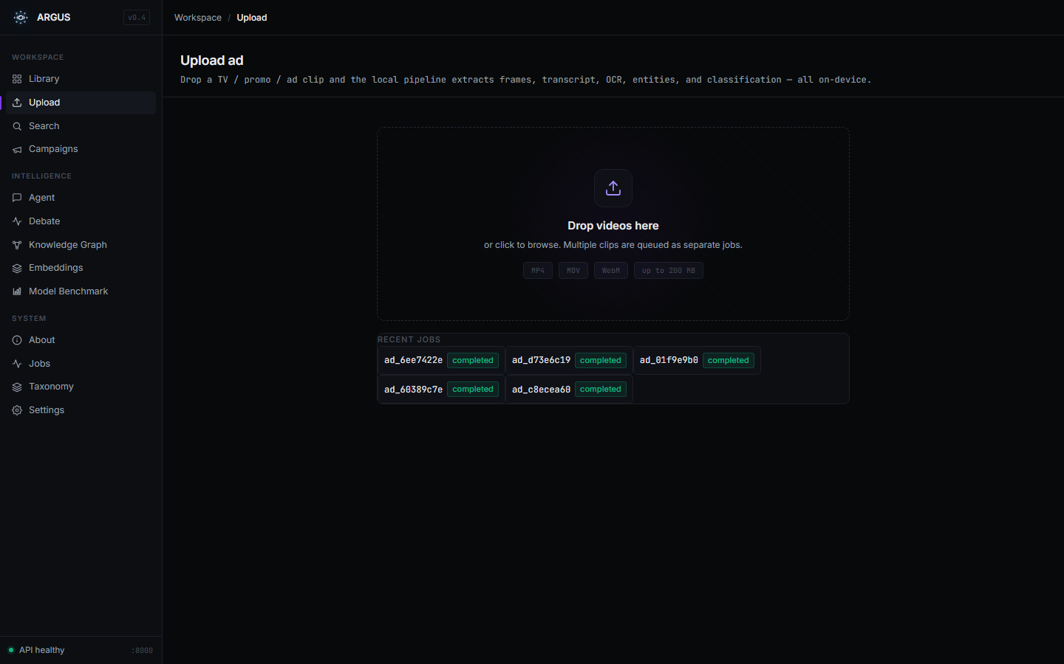
MODULE 01 - UPLOAD
Upload creates an observable pipeline job.
The first screen covers drag/drop, queue state, progress, cancel, and terminal error handling.
MP4 / MOV / WebM becomes a pipeline job.
Upload module
SSE progress shows stages and fatal errors.
Recent jobs reopen completed analyses.
Terminal logs expose runtime failures.
OK ingest: frames + audio
OK OCR: raw evidence
VLM classification
OK persist: records + index
ARGUS system
08

Slide 9
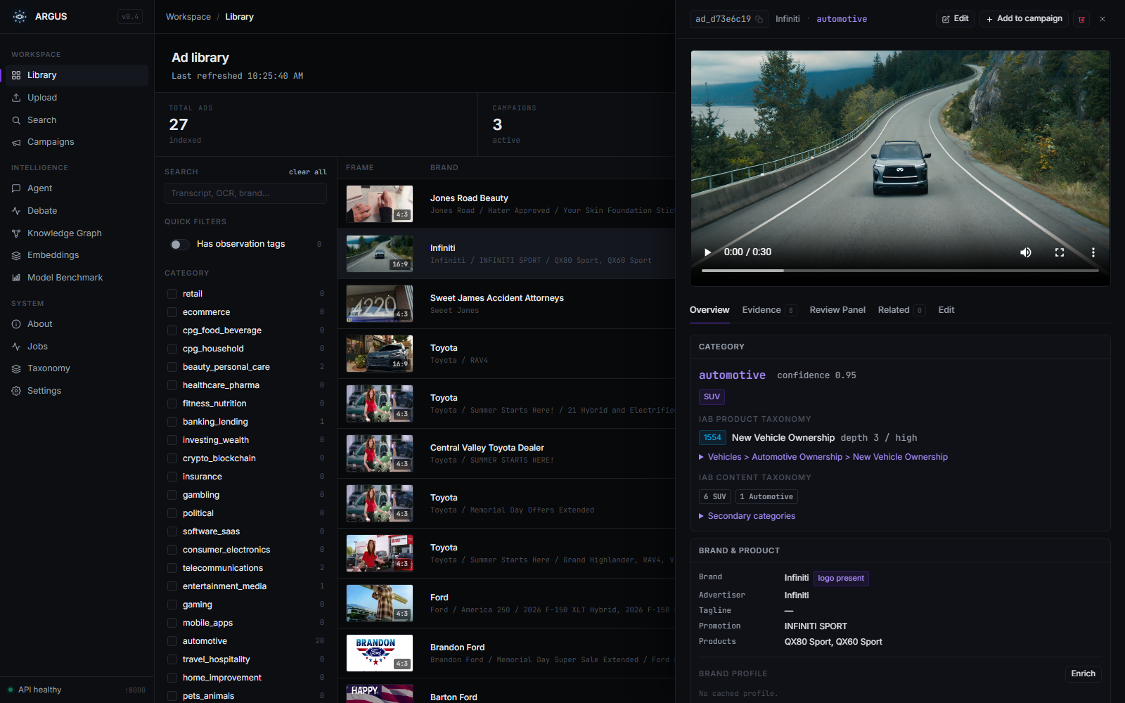
MODULE 02 - LIBRARY
Library shows persisted evidence, not only a gallery.
Each ad record carries classification, entities, OCR, transcript, frames, campaigns, and related ads.
Library detail with selected ad
Selected ad detail
The right panel keeps video, category, taxonomy, brand data, and evidence together.
Category
Taxonomy
automotive
IAB product
Confidence and secondary labels stay visible.
Product tree and depth are stored with the ad.
Evidence
Entities
timestamps
brand + product
Frames, transcript, OCR, and VLM notes remain inspectable.
Marketing fields feed search and agent answers.
Inspection shows why the classification happened, not only the final label.
ARGUS system
09

Slide 10
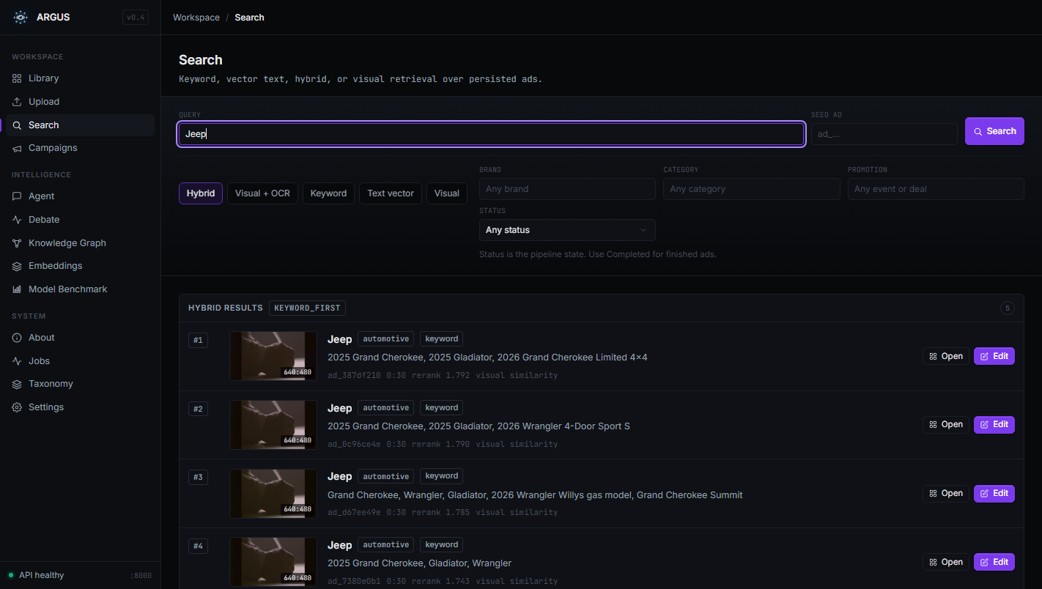
MODULE 03 - SEARCH
Search combines exact words, filters, and semantic retrieval.
Results can come from keyword matches, text retrieval, visual retrieval, or hybrid ranking.
Search results
Keyword
FTS over brand, OCR, transcript, and entities.
Filters
Category, brand, observation tags, campaign, and date.
Similarity
Find near-duplicate creatives and campaign variants.
Find disclaimers, offers, and repeated claims.
Compare ad variants across brands or campaigns.
Open the exact record behind each search result.
ARGUS system
10

Slide 11
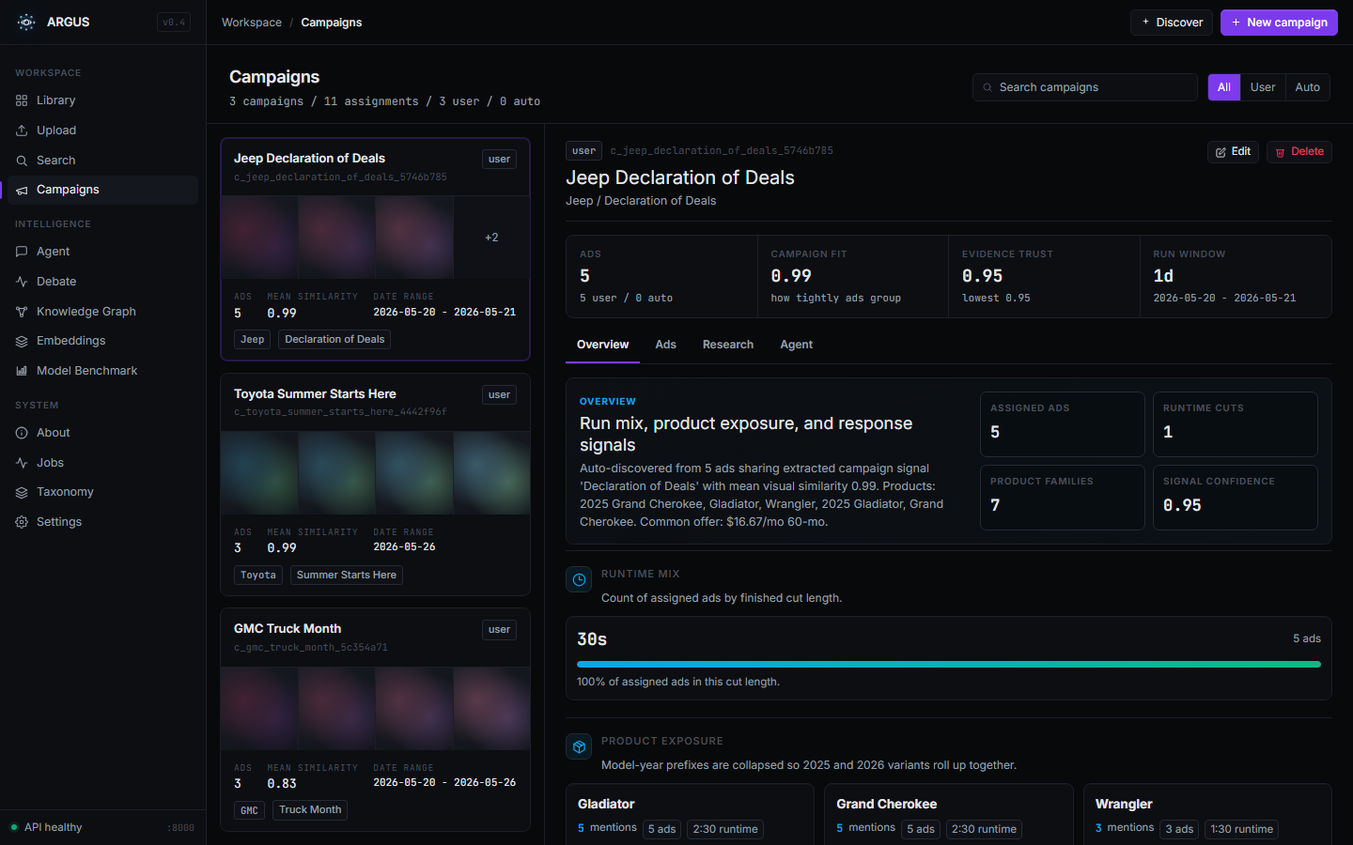
MODULE 04 - CAMPAIGNS
Campaigns group repeated ads and variants.
Exact duplicates, near-duplicate frames, and semantic similarity connect related ads.
What grouping adds
Campaigns module
Related ads appear as campaign logic: product, offer, runtime, and variant links.
Exact
Near
same upload hash
similar creative reuse
Semantic
Curated
same campaign variants
manual assignment
ARGUS system
11

Slide 12
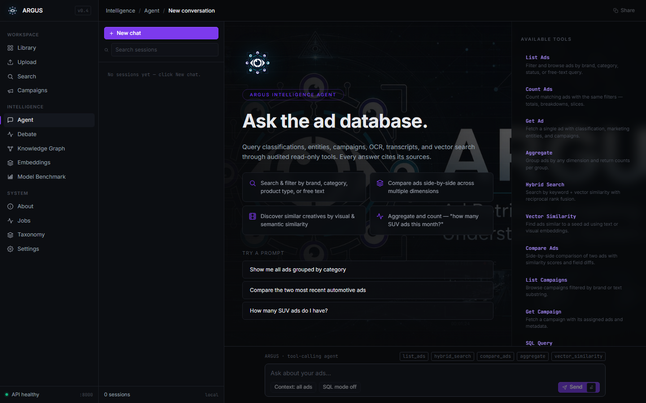
MODULE 05 - AGENT
The agent answers read-only questions over the database.
It uses tool calls for list, count, aggregate, search, and retrieval operations.
ARGUS Agent
Example questions
How many SUV ads are stored?
Show urgency and price offers.
Compare two automotive ads.
Group by category and brand.
DB
Tools
Cites
read-only
catalog
ad ids
ARGUS system
12

Slide 13
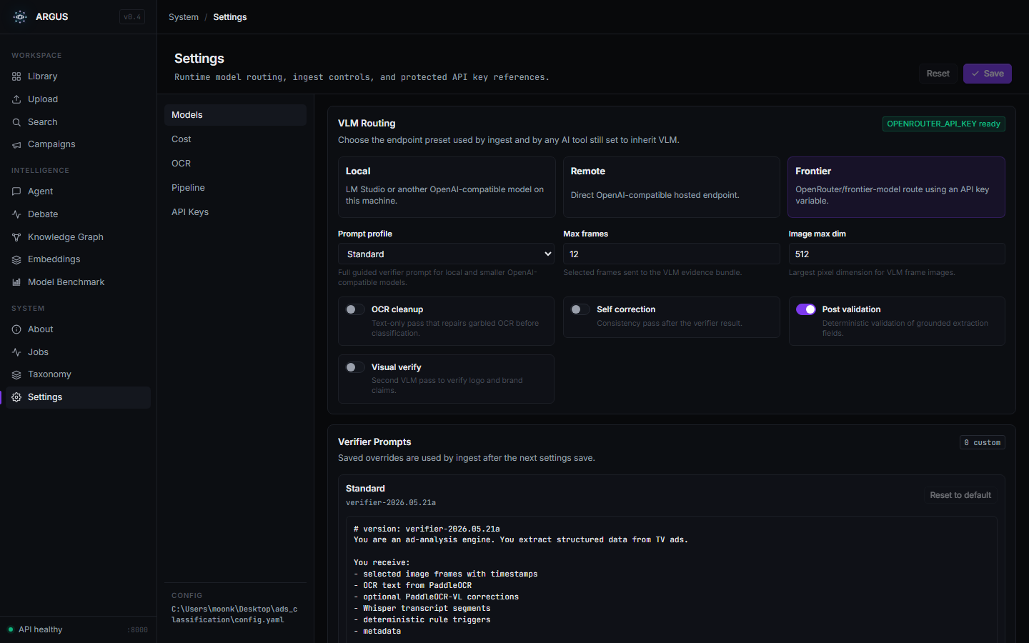
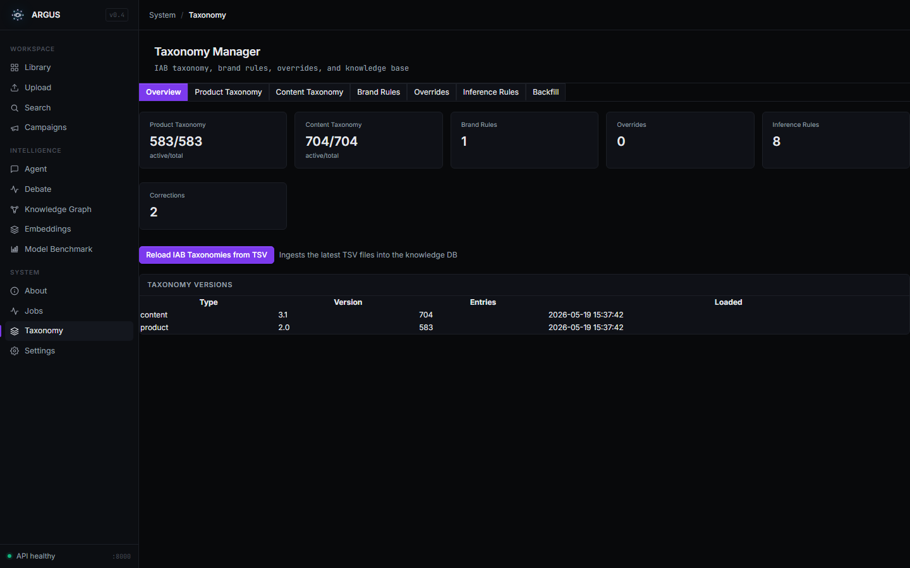
MODULE 06 - OPERATIONS
Settings, taxonomy, and jobs keep the runtime configurable.
Model routes, prompts, OCR behavior, taxonomy, and job recovery remain visible in the UI.
Settings
Taxonomy
Jobs
state cleanup
cancel/delete
failure visibility
demo recovery
Control surface
Model routing, editable prompts, OCR config, taxonomy knowledge, and job-state cleanup stay outside the code path.
ARGUS system
13

Slide 14
SYSTEM USE
After ingestion, the workflow is inspect, retrieve, compare, and ask.
The same persisted ad record powers the Library, Search, Campaigns, and Agent views.
Inspect
Retrieve
Open the record and verify evidence.
Search exact text, filters, and similar creatives.
Persisted ad record
Video, transcript, OCR, category, entities, evidence, related ads, and model outputs.
Compare
Ask
Group repeated creatives into campaigns.
Answer database questions through read-only tools.
This makes a slide-based demo practical: each view shows one concrete use of the same underlying ad intelligence record.
ARGUS system
14

Slide 15
SHOWCASE PATH
A short presentation can show upload, inspect, retrieve, group, and ask.
This keeps the explanation focused on what the system does, not setup details.
MODULE 1
MODULE 2
MODULE 3
MODULE 4
MODULE 5
1. Upload
2. Inspect
3. Search
4. Campaign
5. Agent
clip to stage progress
classification, entities, evidence
keyword, filters, retrieval
variants and similarity
plain-language query
THIS DECK COVERS
OPTIONAL NEXT SLIDES
Current demo system
When more depth is needed
local-first processing
structured evidence and entities
Library, Search, Campaigns, and Agent tools
model benchmark snapshots
sample ad comparisons
prompt presets and reset controls
ARGUS system
15

