Slide 1
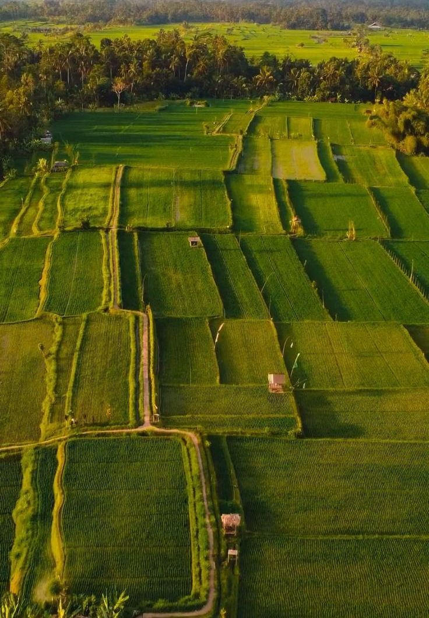
🌿 SANKALP SETU HACKATHON 2026 • TRACK #4
AgriWatch Goa
AI-Powered Crop Stress Detection &
Farm Early-Warning Platform
Predictive agro-meteorological intelligence for Goa's smallholder farmers across all 12 Talukas.
🏛️ Host & Track
Venue: Rosary College, Navelim
Track: Agriculture & Rural Innovation
👥 4-Member Team
Project: AgriWatch Goa Prototype
Focus: Low-Tech Smallholder Inclusion

Slide 2
Goa's Farmers Need Warnings Before Crop Damage Happens
Why traditional visual scouting fails smallholder Goan farmers during monsoons
🌧️ Extreme Rainfall & Weather Volatility
Monsoon Shifts: Sudden heavy rain spells saturate coastal and khazan soils, triggering rapid root asphyxiation and waterlogging.
🌱 Soil Moisture & Acidic Laterite Stress
Laterite Chemistry: Goa's naturally acidic soils (pH 4.8–5.8) lock essential micronutrients when moisture fluctuates between extremes.
🦠 Silent Disease & Pest Proliferation
The 'Too-Late' Dilemma: Pathologies like Rice Blast and Cashew Dieback multiply invisibly days before physical foliar symptoms appear.
💡 Key Takeaway: Current agricultural support is largely reactive (compensating post-loss). Farmers need predictive, localized early warnings delivered in time to save crops.

Slide 3

From Reactive Agriculture to Predictive Intelligence
Fusing meteorological telemetry, soil parameters, and AI inference into farmer advisories
📍 12 Goa Talukas
Coverage: Hyper-localized GIS mapping from Tiswadi to Canacona.
🌾 Multi-Stress AI
Predictions: Evaluates Drought, Waterlog, Pest, Disease & Heat.
Farmer Advisory
Actionable recommendations
Weather Data
Real-time forecasts & trends
🔬 Visual Leaf AI
Diagnostics: Extracts colorimetry & necrotic lesion biomarkers.
🔍 Explainable AI
Transparency: Decomposes Gini feature drivers for every alert.
Early Warning
Timely alerts on threats
Predictive
Advisory Flow
Soil & Agro-Climatic
Soil moisture & microclimate
🌐 Trilingual Engine
Vernacular: Native Konkani (देवनागरी), Hindi, and English.
📱 2G SMS Inclusion
Delivery: Accessible on basic feature phones and WhatsApp.
Leaf Analysis
Visual foliar diagnostics
Machine Learning
Pattern detection & risk
🌾 Key Takeaway: Integrated Pipeline: Telemetry Ingestion ➔ Machine Learning Inference ➔ XAI Verification ➔ Actionable Farmer Advisory

Slide 4
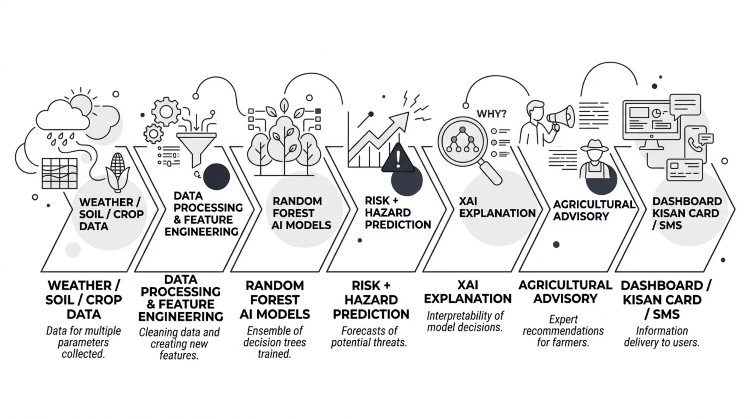
End-to-End System Architecture & Technology Stack
A modular, low-overhead pipeline from satellite telemetry ingestion to village-level delivery
🧠 Core AI & Analytics
Python 3.14 & Scikit-learn: Ensemble algorithms & data pipes.
Random Forest Models: Primary stress classifier + 6 sub-models.
StandardScaler & One-Hot: Normalized environmental telemetry.
🖥️ Interactive Dashboard
Streamlit Web Framework: Fast, reactive glassmorphic UI.
Folium GIS Mapping: Geospatial color-coded taluka markers.
Plotly Interactive Charts: Radar risk plots & XAI bar graphs.
📡 Ingestion & Multi-Channel
OpenWeatherMap Live API: Deterministic Goan simulation modes.
NumPy & PIL Colorimetry: Foliar lesion segmentation.
Twilio SMS & WhatsApp: Direct 2G farmer advisory delivery.

Slide 5
Real-Time Monitoring Across All 12 Goa Talukas
State-wide agro-climatic surveillance dashboard for Directorate of Agriculture & ZAO officers
🗺️ 12 Talukas Monitored Live
Complete Goa Coverage: Covers all North and South Goa talukas from Pernem to Canacona with pre-configured agro-climatic zones.
🌐 Interactive GIS Map & Satellites
Dual-Layer Mapping: Folium geospatial views with standard terrain maps and satellite crop canopy layers.
🟢 Risk-Based Dynamic Color Coding
Intuitive Status Tiers: Green (Normal), CadetBlue (Watch), Orange (Alert), and Red (Critical Intervention Required).
🌦️ Real-Time Environmental Telemetry
14 Parameters Evaluated: Temperature, relative humidity, 24h rainfall, dry/wet streaks, soil moisture, and soil pH.
📋 Taluka Vulnerability Watchlist
One-Click Drilldown: Instant summary cards displaying primary crops, ambient temp, soil pH, and immediate ICAR action plan.
🗣️ Trilingual Interface
Zero Language Barriers: Instant toggle between English, Konkani (गोंयची राजभास in Devanagari), and Hindi.
📊 Key Takeaway: Agriculture directors and ZAO officers can survey the entire state's agricultural risk at a glance and dispatch targeted alerts from a single centralized dashboard.

Slide 6
Digital Kisan Crop Health & Vulnerability Card (Prototype)
A prototype printable agro-meteorological advisory card bridging digital intelligence to the field
📄 What the Digital Kisan Card Delivers
👤 Farmer & Land Profile: Records farmer name, taluka, survey/parcel number, and Goan land types (Khazan, Morod, Keri).
🌦️ Meteorological Telemetry: Timestamped 24h rainfall, ambient temp, relative humidity, and consecutive wet/dry days.
🌱 Soil Health Telemetry: Goa laterite soil pH level (acidic loam) and root zone soil moisture percentage.
🤖 AI Agro-Stress Grading: Composite stress rating (Grade A to D) with active hazard classification.
🌿 ICAR-CCARI Prescriptions: Scientifically verified remediation protocol rendered in English and native Konkani.
🔲 Verification ID & QR Concept: Unique tracking serial (e.g. GOA-KISAN-2026-PON-4819) with tamper-resistant verification hash.
🏛️ Prototype Certificate Layout
Authority: Directorate of Agriculture & ICAR-CCARI Old Goa
Sample Record: Ramesh Naik | Ponda (South Goa) | Parcel S-412/3
Assessment: Rice (Paddy) — Tillering Stage | Laterite pH 5.2
AI Classification: 🟡 GRADE B (WATCH) • Stress Index: 38.4%
Prescribed Action: Adopt Alternate Wetting & Drying (AWD) water management.
Verification QR: [ 🔲 QR VERIFICATION ] • HASH: 48192026
🏛️ Key Takeaway: Prototype concept designed for future government integration: can be printed at 190+ Village Panchayat e-Gram kiosks to support PMFBY crop insurance claims and ZAO subsidy verification.

Slide 7

The AI Engine: Multi-Target Random Forest Architecture
Evaluating multi-dimensional environmental signals across Goan agriculture
🧠 Machine Learning Architecture
Multi-Target Design: 1 Primary Classifier (Overall Stress) + 6 specialized Binary Hazard Sub-Models (Drought, Waterlog, Pest, Disease, Heat, Soil pH).
Non-Linear Synthesis: Evaluates complex interactions (e.g. 50mm rain in low-lying Salcete causing blast vs. 80mm in sloped Sattari).
Engineered for Speed: Configured with n_jobs=1 for ultra-fast, in-process single-record inference under 0.05 seconds.
Hazard Predictions
7 risks + composite stress
Weather Features
Temperature, rain, humidity
Random Forest
Model
Crop Features
Growth stage, variety, health
Soil Features
Moisture, pH, texture
📊 Evaluation Benchmark Metrics
Primary Stress Classifier: 91.86% Accuracy | 96.38% Precision | 94.14% ROC-AUC
Hazard Sub-Models: Drought: 97.5% | Waterlog: 99.5% | Pest Bloom: 97.9% | Fungal Disease: 98.9%
Evaluation Dataset Note: Trained on synthetic Goa agro-climatic data (3,500 samples); real-world field validation with ICAR/ZAO is our proposed next step.
🧠 Key Takeaway: 1 Primary Classifier + 6 Binary Hazard Sub-Models evaluate non-linear multi-stress interactions across Goa in under 0.05 seconds.

Slide 8
Don't Just Predict Risk — Explain It (What-If & XAI)
Opening the black box: Decomposing exact meteorological drivers of crop stress
🧪 What-If Diagnostic Simulation Sandbox
Interactive Stress Injection: Allows agricultural officers to simulate weather disruptions and observe AI model responses in real time.
Dedicated Confirm Controls: Features explicit confirmation triggers so users tweak sliders smoothly without mid-input reload lag.
Simulated Weather Factors: 24h Rainfall (0–350mm) • Air Temperature (18–44°C) • Relative Humidity (25–100%)
Simulated Soil & Biological: Consecutive Dry/Wet Days • Soil Moisture (10–100%) • Soil pH (4.0–8.0) • Pest/Disease Pressure
🔍 Explainable AI (XAI) & Actionable Guidance
Feature Importance Attribution: Decomposes Gini decision weights so the model explicitly justifies why an alert was triggered.
No Black Box Guarantee: Officers can see which telemetry signals were most influential (e.g. Consecutive Dry Days: 0.216, Soil Moisture: 0.184).
6-Axis Spider / Radar Decomposition: Plots multi-hazard stress probabilities across Drought, Waterlog, Pest, Disease, Heat, and Soil Acidity simultaneously.
ICAR-CCARI Prescriptions: Automatically maps predicted hazards to scientific remediation protocols in English and Konkani.
🔍 Key Takeaway: Explainable AI builds trust with agricultural officers and farmers by proving which environmental telemetry signals drove the model's prediction before any advisory is dispatched.

Slide 9
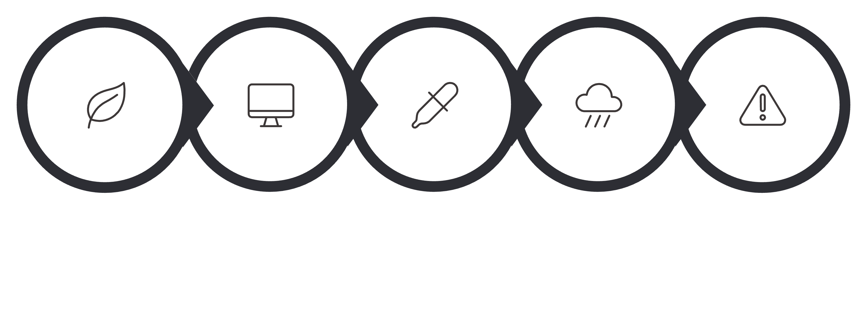
Multi-Modal Leaf Disease Scanner & Telemetry Fusion
Combining computer-vision lesion detection with live Goan microclimatic telemetry
1. Leaf Image
Field sample upload
2. Computer Vision
HSV color analysis
3. Color & Lesions
Necrosis area masking
4. Environmental Data
Microclimate fusion
5. Risk Assessment
Composite AI diagnosis
📸 Computer-Vision Leaf Analysis
Specimen Ingestion: Direct mobile upload with colorimetric RGB-to-HSV conversion.
Lesion Segmentation: Calculates foliar necrotic ratio & brown-spot clustering using NumPy & PIL.
Goan Pathologies: Calibrated for Rice Blast (भाताचेर करपा), Cashew Shoot Blight & Coconut Bud Rot.
🔬 Environmental Context Fusion
Beyond Pure Vision: Visual symptoms alone cannot distinguish harmless mud from fungal infection.
Microclimatic Heuristic: Cross-checks active spore proliferation (Humidity >85% + Temp 24–32°C).
Composite Action Plan: Combines visual indicators with taluka climate to produce trusted ICAR-CCARI treatment advice.

Slide 10
Bringing the Warning Directly to the Farmer (Digital Inclusivity)
Reaching smallholder farmers across Goa regardless of smartphone ownership or connectivity
📱 2G SMS Dispatch
Feature-Phone Ready: Concise alerts under 160 characters in native Konkani delivered to basic handsets.
💬 WhatsApp Broadcast
Village Groups: One-click pre-formatted text links for Village Panchayat farmer WhatsApp communities.
🖥️ Command Center
Officer Dashboard: Interactive Streamlit web platform with GIS maps, What-If simulation, and analytics.
🧾 Printable Kisan Card
Physical Bridge: Printable advisory certificates for walk-in farmers at Panchayat e-Gram kiosks.
🌐 Trilingual Empowerment
Native Konkani (गोंयची राजभास): Devanagari script removes all literacy and language barriers.
Hindi & English: Full state and national administrative accessibility.
🛡️ Anti-Spam Governance
15-Minute Cooldown: Intelligent rate limiter prevents bombarding farmers if sensors fluctuate.
High-Priority Queue: Guarantees critical weather hazard delivery.
📑 Timestamped Audit Trail
Administrative Records: Every dispatched alert is permanently logged to CSV with timestamps and taluka data.
Government Export: Downloadable for departmental review and subsidy verification.
🌾 Key Takeaway: A warning is useful only if it reaches the farmer. By pairing 2G SMS with native Konkani advisories, AgriWatch Goa ensures that no smallholder farmer is left behind.

Slide 11
Responsible AI: Built for Safe Public-Sector Use
Ethical AI governance, transparency, and data privacy tailored for public agriculture
🔒 Data Privacy & Minimal Collection
Minimal Data Footprint: The prototype minimizes personal-data collection, processing only environmental telemetry and anonymous parcel coordinates.
No Farmer Surveillance: Does not harvest sensitive personal credentials or financial records, ensuring strict public-sector data privacy compliance.
🔍 Full Model Explainability (XAI)
Feature Importance Attribution: Every prediction includes transparent feature-importance information (Gini impurity weights & radar plots).
No Black Box AI: Agricultural officers see exactly which environmental variables (e.g. soil moisture, dry streaks) drove the risk alert.
👨‍🌾 Human-in-the-Loop Governance
Decision Support, Not Replacement: AI provides decision support; agriculture officers and ZAO experts remain responsible for final advisory decisions.
Manual Override & Verification: Officers review, modify, or approve automated hazard warnings before bulk dispatch to village farmers.
📊 Open Transparency & Disclosure
Disclosed Training Data: Synthetic training datasets and model boundaries are explicitly disclosed to prevent false claims.
Auditable Technology Stack: Open architecture built on Scikit-learn, Python, and ICAR agronomy guidelines with full audit logging.
⚖️ Key Takeaway: The system is designed as an agricultural decision-support tool, not an autonomous decision-maker. Agricultural officers remain responsible for final validation.

Slide 12
Future Deployment: From Hackathon Prototype to Goa-Wide Platform
🌱 Phase 1 — Institutional Pilot (Months 1–3)
Pilot Deployment: Deploy at ZAO (Zonal Agricultural Offices) and agricultural institutions (ICAR-CCARI Old Goa).
Model Calibration: Field-validate synthetic models against actual Goan monsoon crop seasons.
🚀 Future Improvements & Expansion Blueprint
📡 Real Farm Sensor Data: Deploy IoT capacitive soil moisture, temperature & humidity probes in Khazan and Morod lands.
🛰️ Satellite / NDVI Integration: Integrate Sentinel-2 / Landsat multispectral imagery for regional crop canopy stress mapping.
📊 Larger Real-World Datasets: Expand from synthetic datasets to multi-year historical climate and harvest yield data across Goa.
🔬 Field Validation with Experts: Partner with ICAR-CCARI scientists and Goa Directorate of Agriculture for rigorous field verification.
🌿 Improved Disease Models: Train deep learning computer vision on larger Goan foliar datasets (Cashew Shoot Blight, Arecanut Koleroga).
🏛️ Government System Integration: Connect with PMFBY crop insurance portals and Goa Krishi Card database for automatic subsidy verification.
🏛️ Phase 2 — Community Access (Months 4–6)
Panchayat Kiosks: Integrate into 190+ Village Panchayat e-Gram kiosks across Goa.
Walk-in Services: Enable printable Kisan Cards and train Krishi Mitras for local farmer onboarding.
📱 Phase 3 — Farmer Outreach (Months 7–12)
Multi-Channel Delivery: Scale automated 2G SMS alerts, WhatsApp village broadcasts & Krishi call-centre integration.
State-Wide Coverage: Reach smallholder farmers across all 12 Talukas
🌾 Key Takeaway: “AgriWatch Goa bridges AI and agriculture by turning environmental data into early warnings that help farmers act before crop stress becomes crop loss.”

Slide 13
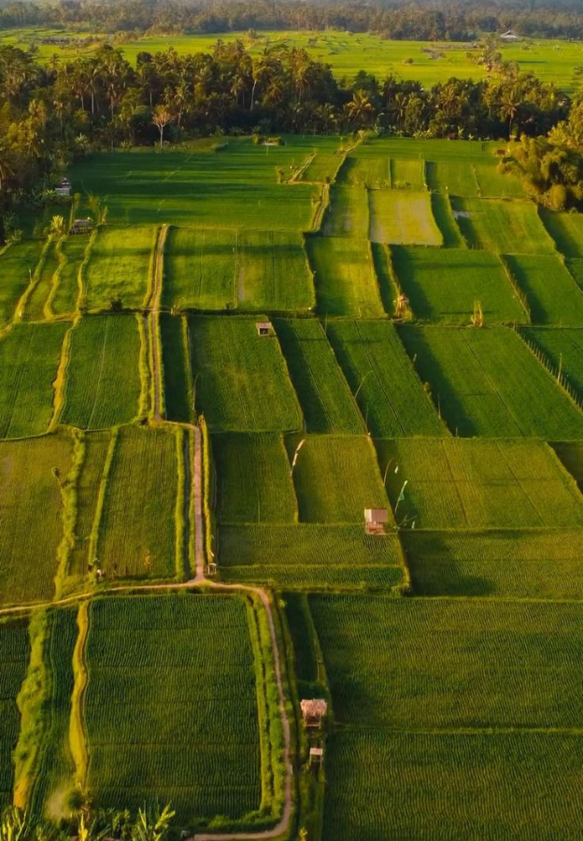
Thank You!
AgriWatch Goa — AI-Powered Crop Stress Detection & Farm Early-Warning Platform.
Predictive agro-meteorological intelligence protecting Goa's smallholder farmers before crop stress becomes crop loss.

