Slide 1
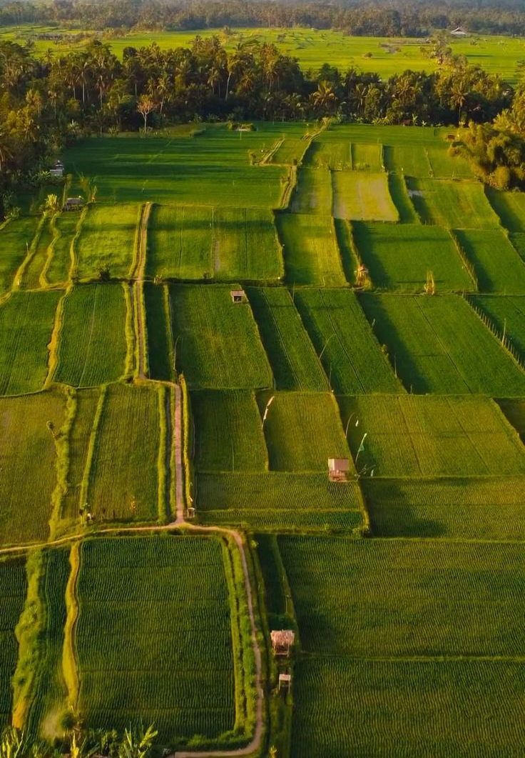
🌿 SANKALP SETU HACKATHON 2026 • TRACK #4
AgriWatch Goa
AI-Powered Crop Stress Detection &
Farm Early-Warning Platform
Predictive agro-meteorological early warnings for smallholder Goan farmers across all 12 Talukas.
🏛️ Host & Track
Venue: Rosary College, Navelim
Track: Agriculture & Rural Innovation
👥 4-Member Team
Project: AgriWatch Goa Prototype
Focus: Low-Tech Smallholder Inclusion

Slide 2
Goa's Farmers Need Warnings Before Crop Damage Happens
Why traditional visual scouting fails Goan farmers during extreme monsoon shifts
🌧️ Extreme Rainfall & Weather Volatility
Monsoon Shifts: Sudden downpours rapidly flood low-lying khazan lands, suffocating root systems.
🌱 Soil Moisture & Acidic Laterite Stress
Acidic Soils: Goa's laterite soil (pH 4.8–5.8) locks key nutrients during extreme wet/dry fluctuations.
🦠 Silent Disease & Pest Proliferation
Silent Pathogens: Rice Blast & Cashew Dieback multiply days before visible foliar symptoms appear.
💡 Key Takeaway: Post-loss relief is too late. Farmers need hyper-local early warnings to protect standing crops.

Slide 3

From Reactive Agriculture to Predictive Intelligence
Fusing weather telemetry, soil health, and ML models into actionable farmer alerts
📍 12 Goa Talukas
Coverage: Hyper-local GIS surveillance across all 12 Goan talukas.
🌾 Multi-Stress AI
Predictions: Simultaneously predicts drought, flooding, pests, disease & heat stress.
Farmer Advisory
Actionable recommendations
Weather Data
Real-time forecasts & trends
🔬 Visual Leaf AI
Diagnostics: Extracts foliar HSV colorimetry and necrotic lesion ratios.
🔍 Explainable AI
Transparency: Exposes exact Gini feature drivers and radar profiles for every alert.
Early Warning
Timely alerts on threats
Predictive
Advisory Flow
Soil & Agro-Climatic
Soil moisture & microclimate
🌐 Trilingual Engine
Vernacular: Available in Konkani (देवनागरी), Hindi, and English.
📱 2G SMS Inclusion
Delivery: Reaches basic phones via 2G SMS and village WhatsApp groups.
Leaf Analysis
Visual foliar diagnostics
Machine Learning
Pattern detection & risk
🌾 Key Takeaway: Integrated Flow: Telemetry Ingestion ➔ ML Inference ➔ XAI Validation ➔ Farmer Advisory

Slide 4
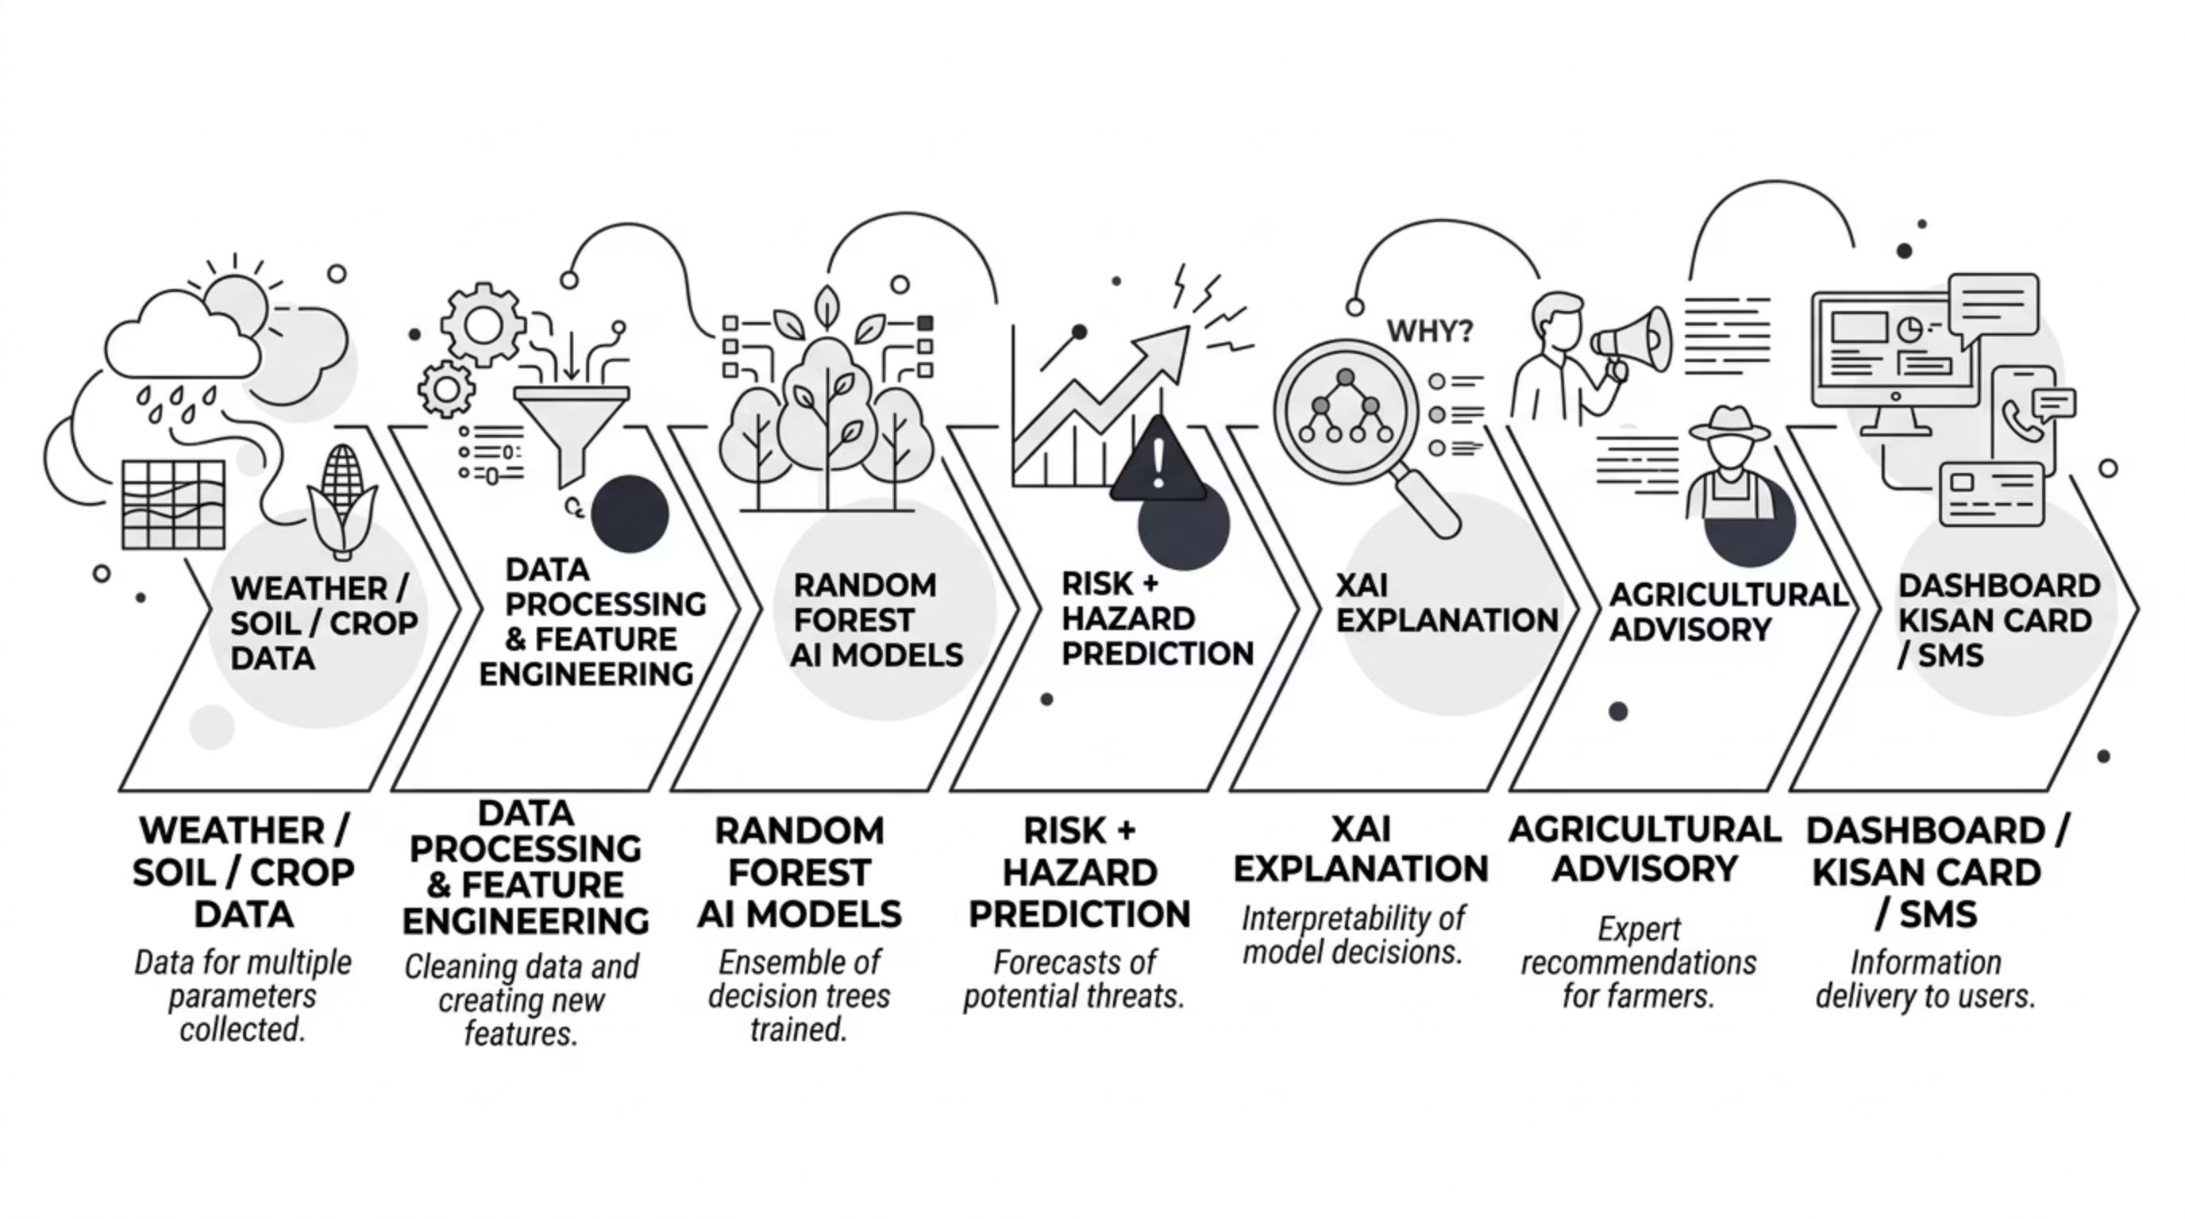
End-to-End System Architecture & Technology Stack
A lightweight pipeline connecting satellite data to village-level farmer delivery
🧠 Core AI & Analytics
Core Engine: Python 3.14 & Scikit-learn Random Forest ensemble pipeline.
Models: 1 composite stress classifier + 6 specialized hazard sub-models.
Preprocessing: StandardScaler & One-Hot pipelines for rapid telemetry normalization.
🖥️ Interactive Dashboard
Dashboard UI: Reactive Streamlit web console with real-time controls.
GIS Mapping: Folium taluka risk markers with satellite canopy overlays.
Analytics: Plotly 6-axis risk radars and XAI feature-importance charts.
📡 Ingestion & Multi-Channel
Live Telemetry: OpenWeatherMap API with custom Goan microclimate simulation.
Vision Module: NumPy & PIL colorimetric segmentation for necrotic leaf spots.
Farmer Dispatch: Twilio SMS gateway + WhatsApp community broadcast links.

Slide 5
Real-Time Monitoring Across All 12 Goa Talukas
State-wide agro-climatic surveillance for Directorate of Agriculture & ZAO officers
🗺️ 12 Talukas Monitored Live
Complete Coverage: Surveillance across all 12 North & South Goa talukas.
🌐 Interactive GIS Map & Satellites
Dual-Layer GIS: Folium map toggles between base terrain and satellite canopy.
🟢 Risk-Based Dynamic Color Coding
Risk Tiers: Green (Normal), Blue (Watch), Orange (Alert), Red (Critical).
🌦️ Real-Time Environmental Telemetry
14 Parameters: Tracks temp, humidity, 24h rain, wet/dry streaks, soil moisture, and pH.
📋 Taluka Vulnerability Watchlist
Quick Drilldown: Summary cards display taluka crop types, metrics, and ICAR advisories.
🗣️ Trilingual Interface
Trilingual Toggle: Instant 1-click switch between English, Konkani (गोंयची राजभास), and Hindi.
📊 Key Takeaway: Statewide farm risk is visible at a glance, enabling instant targeted advisories from one central console.

Slide 6
Digital Kisan Crop Health & Vulnerability Card (Prototype)
A printable agro-meteorological advisory card bridging digital intelligence to the field
📄 What the Digital Kisan Card Delivers
👤 Farmer & Land: Farmer name, taluka, parcel number, and soil type (Khazan, Morod, Keri).
🌦️ Weather Signals: 24h rainfall, ambient temp, relative humidity, and wet/dry streaks.
🌱 Soil Telemetry: Root-zone soil moisture % and laterite soil pH level.
🤖 AI Stress Grading: Composite stress index (Grade A to D) with active hazard tags.
🌿 ICAR Protocols: Remediation guidance presented in native Konkani and English.
🔲 Verification QR: Unique tracking serial ID with tamper-proof cryptographic hash.
🏛️ Prototype Certificate Layout
Authority: Directorate of Agriculture & ICAR-CCARI Old Goa
Sample Record: Ramesh Naik | Ponda (South Goa) | Parcel S-412/3
Assessment: Rice (Paddy) — Tillering Stage | Laterite pH 5.2
AI Classification: 🟡 GRADE B (WATCH) • Stress Index: 38.4%
Prescribed Action: Adopt Alternate Wetting & Drying (AWD) water management.
Verification QR: [ 🔲 QR VERIFICATION ] • HASH: 48192026
Verification QR: [ 🔲 QR VERIFICATION ] • HASH: 48192026
🏛️ Key Takeaway: Deployable via 190+ Village Panchayat e-Gram kiosks to support PMFBY crop insurance claims and subsidy audits.

Slide 7

The AI Engine: Multi-Target Random Forest Architecture
Evaluating multi-dimensional environmental signals across Goan agriculture
🧠 Machine Learning Architecture
Model Ensemble: 1 primary stress classifier + 6 binary hazard models (Drought, Waterlog, Pest, Disease, Heat, Soil pH).
Microclimates: Models topography (e.g. 50mm rain in coastal Salcete vs. 80mm in sloped Sattari).
Speed: Engineered for single-record in-memory inference in under 0.05 seconds.
Hazard Predictions
7 risks + composite stress
Weather Features
Temperature, rain, humidity
Random Forest
Model
Crop Features
Growth stage, variety, health
Soil Features
Moisture, pH, texture
📊 Evaluation Benchmark Metrics
Primary Classifier: 91.86% Accuracy | 96.38% Precision | 94.14% ROC-AUC
Hazard Sub-Models: Drought: 97.5% | Waterlog: 99.5% | Pests: 97.9% | Disease: 98.9%
Validation Plan: Trained on 3,500 synthetic samples; field calibration with ICAR/ZAO planned next.
🧠 Key Takeaway: 1 primary classifier + 6 binary hazard sub-models evaluate Goa's multi-stress factors in <0.05 seconds.

Slide 8
Don't Just Predict Risk — Explain It (What-If & XAI)
Decomposing environmental drivers of crop stress to build trust with agronomists
🧪 What-If Diagnostic Simulation Sandbox
Stress Simulation: Officers inject simulated weather anomalies to inspect real-time AI responses.
Dedicated Triggers: Explicit confirmation triggers prevent mid-input reload lag.
Weather Factors: 24h Rain (0–350mm), Temperature (18–44°C), Relative Humidity (25–100%).
Soil & Biology: Dry/Wet streaks, Soil Moisture (10–100%), pH (4.0–8.0), Pest pressure.
🔍 Explainable AI (XAI) & Actionable Guidance
Feature Attribution: Gini impurity weights reveal the primary drivers behind each alert.
Transparent Reasoning: Shows influence scores (e.g. Consecutive Dry Days: 0.216, Soil Moisture: 0.184).
6-Axis Radar Plots: Simultaneously plots drought, flooding, pests, disease, heat, and acidity.
Remediation Links: Directly maps hazards to scientific ICAR-CCARI protocols in Konkani & English.
🔍 Key Takeaway: XAI eliminates the 'black box' by proving which environmental factors drove each alert before dispatch.

Slide 9
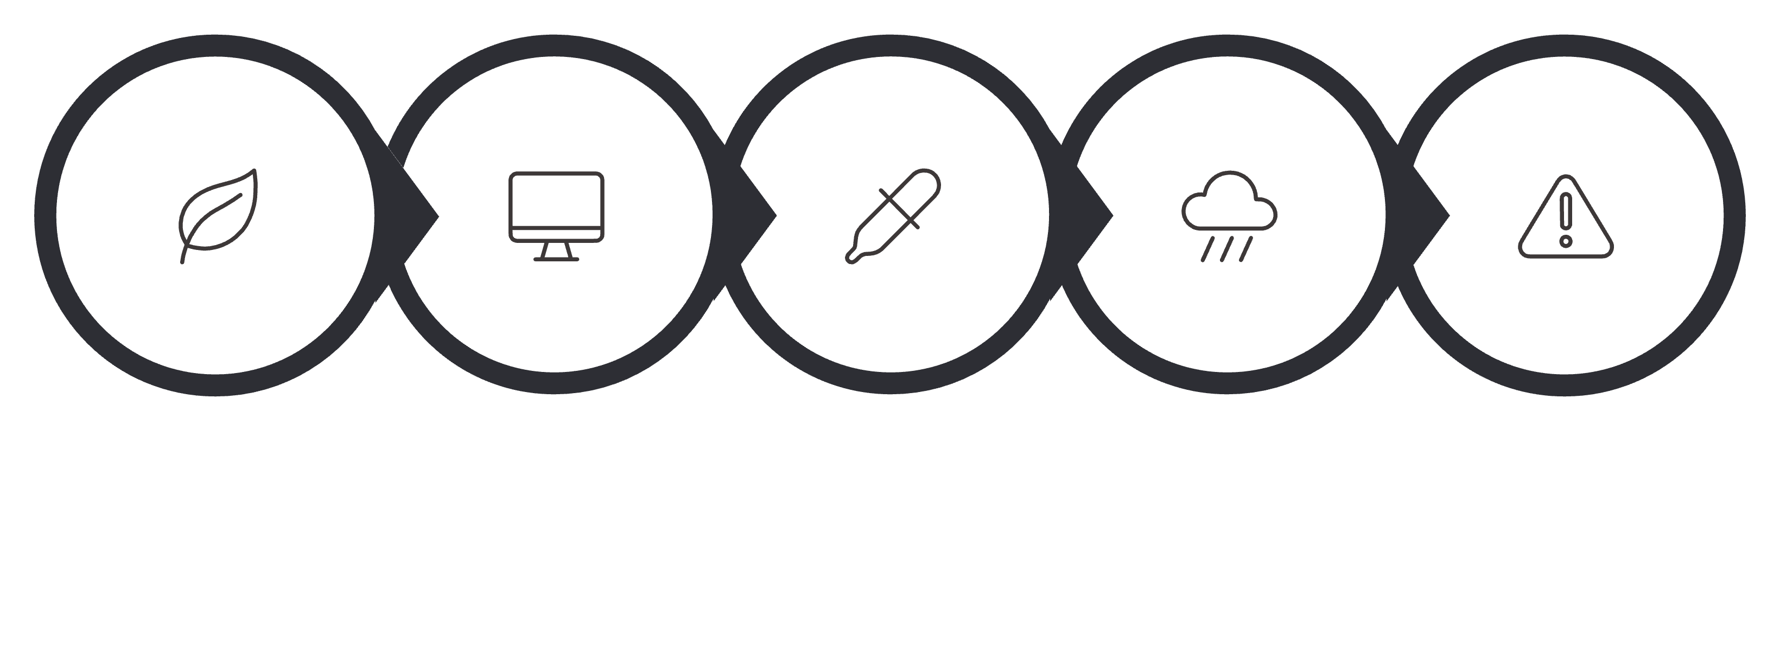
Multi-Modal Leaf Disease Scanner & Telemetry Fusion
Fusing computer-vision lesion detection with live microclimatic conditions
1. Leaf Image
Field sample upload
2. Computer Vision
HSV color analysis
3. Color & Lesions
Necrosis area masking
4. Environmental Data
Microclimate fusion
5. Risk Assessment
Composite AI diagnosis
📸 Computer-Vision Leaf Analysis
Mobile Ingestion: Direct field sample upload with RGB-to-HSV colorimetric segmentation.
Lesion Masking: Calculates necrotic leaf ratios and spot clustering via NumPy & PIL.
Goan Pathologies: Calibrated for Rice Blast (भाताचेर करपा), Cashew Blight & Coconut Bud Rot.
🔬 Environmental Context Fusion
Beyond Pure Vision: Visual symptoms alone cannot distinguish benign dirt from active fungal infection.
Microclimate Check: Cross-validates active spore proliferation (Humidity >85% + Temp 24–32°C).
Targeted Guidance: Delivers high-confidence ICAR remediation protocols tailored to the taluka.

Slide 10
Bringing the Warning Directly to the Farmer (Digital Inclusivity)
Reaching Goan smallholders regardless of smartphone ownership or internet access
📱 2G SMS Dispatch
Basic Handsets: <160 char alerts in Konkani delivered via 2G SMS to basic phones.
💬 WhatsApp Broadcast
Village Groups: 1-click pre-formatted broadcasts for Panchayat WhatsApp groups.
🖥️ Command Center
Officer Console: Interactive Streamlit platform with GIS maps and simulation.
🧾 Printable Kisan Card
Physical Bridge: Printable advisory cards for walk-in farmers at Panchayat kiosks.
🌐 Trilingual Empowerment
Native Konkani: Devanagari script removes language and literacy barriers.
State & National: Full Hindi and English administrative toggles.
🛡️ Anti-Spam Governance
15-Min Cooldown: Rate limiting prevents alert fatigue from sensor fluctuations.
Urgent Priority: Guarantees immediate delivery for critical weather emergencies.
📑 Timestamped Audit Trail
Full Logging: Every dispatched alert is permanently recorded with timestamps.
Official Export: Downloadable audit logs for government and insurance verification.
🌾 Key Takeaway: Early warnings are only useful if farmers receive them. Combining 2G SMS with Konkani ensures zero exclusion.

Slide 11
Responsible AI: Built for Safe Public-Sector Use
Ethical AI governance, transparency, and data privacy tailored for public agriculture
🔒 Data Privacy & Minimal Collection
Minimal Footprint: Processes only environmental telemetry and anonymous plot coordinates.
Zero Surveillance: Collects no personal, financial, or banking credentials.
🔍 Full Model Explainability (XAI)
Transparent Attribution: Every prediction exposes Gini impurity weights and radar breakdowns.
Zero Black Box: Officers see exactly which environmental factors triggered the alert.
👨‍🌾 Human-in-the-Loop Governance
Decision Support: AI assists rather than replaces; agricultural officers hold final authority.
Human Override: Officers review and validate hazard warnings before bulk dispatch.
📊 Open Transparency & Disclosure
Dataset Honesty: Synthetic baseline training and model limits are explicitly disclosed.
Open Governance: Built on Scikit-learn, Python, and ICAR agronomy with complete audit trails.
⚖️ Key Takeaway: Designed as an accountable decision-support tool where agricultural officers retain final validation authority.

Slide 12
Future Deployment: From Hackathon Prototype to Goa-Wide Platform
🌱 Phase 1 — Institutional Pilot (Months 1–3)
Pilot Deployment: Deploy across Zonal Agricultural Offices & ICAR-CCARI Old Goa.
Model Tuning: Calibrate synthetic models against actual Goan monsoon field data.
🚀 Future Improvements & Expansion Blueprint
📡 In-Field IoT: Capacitive moisture & microclimate probes in Khazan/Morod lands.
🛰️ Satellite NDVI: Sentinel-2 / Landsat imagery for regional canopy stress mapping.
📊 Historical Data: Integrate multi-decade Goan climate and harvest archives.
🔬 Scientific Trials: Longitudinal field trials with ICAR-CCARI and Directorate of Agriculture.
🌿 Expanded Vision: Train models for Cashew Shoot Blight & Arecanut Koleroga.
🏛️ Govt Integration: Direct links to PMFBY insurance claims and Goa Krishi Card databases.
🏛️ Phase 2 — Community Access (Months 4–6)
Panchayat Rollout: Deploy printable Kisan Cards across 190+ e-Gram kiosks.
Farmer Onboarding: Train local Krishi Mitras for village outreach.
📱 Phase 3 — Farmer Outreach (Months 7–12)
Omnichannel Scale: Automate SMS, WhatsApp broadcasts, and Krishi call-centers.
Full State Reach: Coverage for smallholder farmers across all 12 Talukas.
🌾 Key Takeaway: “AgriWatch Goa turns environmental data into early warnings — helping farmers act before crop stress becomes crop loss.”

Slide 13
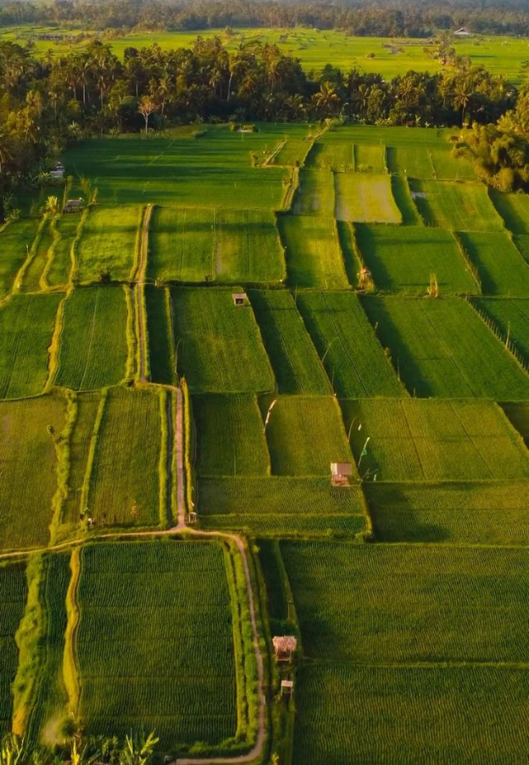
Thank You!
AgriWatch Goa — AI-Powered Crop Stress Detection & Farm Early-Warning Platform.
Predictive intelligence protecting Goa's farmers before stress becomes crop loss.

