Slide 1

🌿 SANKALP SETU HACKATHON 2026 • TRACK #4
AgriWatch Goa
AI-Powered Crop Stress Detection &
Farm Early-Warning Platform
Predictive agro-meteorological intelligence for Goa's smallholder farmers across all 12 Talukas.
🏛️ Host & Track
Venue: Rosary College, Navelim
Track: Agriculture & Rural Innovation
👥 4-Member Team
Project: AgriWatch Goa Prototype
Focus: Low-Tech Smallholder Inclusion

Slide 2
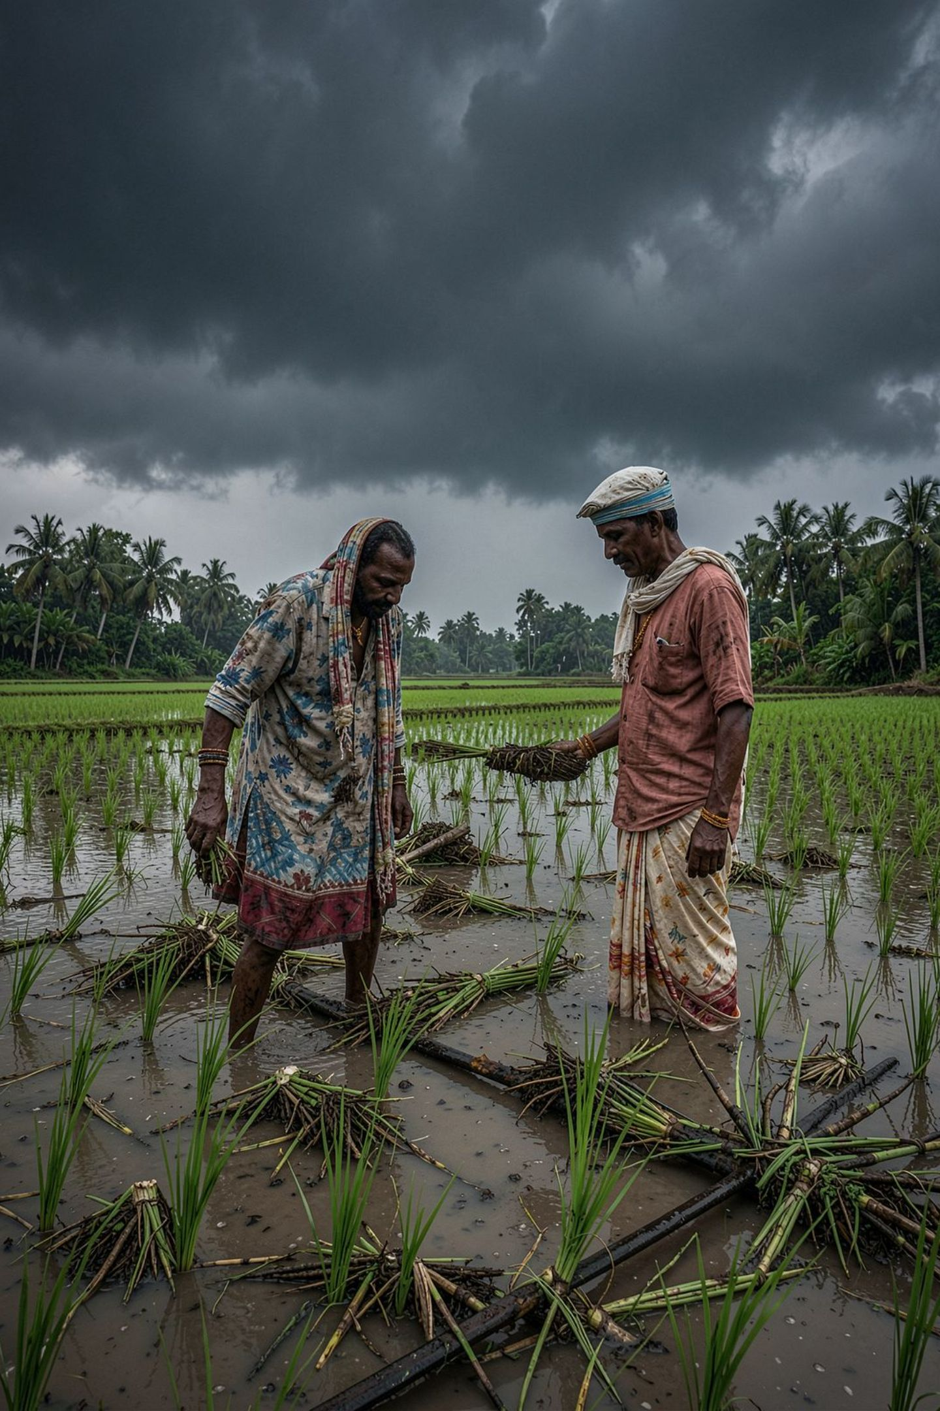
Goa's Farmers Need Warnings Before Crop Damage Happens
Why traditional visual scouting fails smallholder Goan farmers during monsoons
🌧️ Extreme Rainfall & Weather Volatility
Monsoon Shifts: Sudden heavy rain spells saturate coastal and khazan soils, triggering rapid root asphyxiation and waterlogging.
🌱 Soil Moisture & Acidic Laterite Stress
Laterite Chemistry: Goa's naturally acidic soils (pH 4.8–5.8) lock essential micronutrients when moisture fluctuates between extremes.
🦠 Silent Disease & Pest Proliferation
The 'Too-Late' Dilemma: Pathologies like Rice Blast and Cashew Dieback multiply invisibly days before physical foliar symptoms appear.
💡 Key Takeaway: Current agricultural support is largely reactive (compensating post-loss). Farmers need predictive, localized early warnings delivered in time to save crops.

Slide 3

From Reactive Agriculture to Predictive Intelligence
Fusing meteorological telemetry, soil parameters, and AI inference into farmer advisories
📍 12 Goa Talukas
Coverage: Hyper-localized GIS mapping from Tiswadi to Canacona.
🌾 Multi-Stress AI
Predictions: Evaluates Drought, Waterlog, Pest, Disease & Heat.
Farmer Advisory
Actionable recommendations
Weather Data
Real-time forecasts & trends
🔬 Visual Leaf AI
Diagnostics: Extracts colorimetry & necrotic lesion biomarkers.
🔍 Explainable AI
Transparency: Decomposes Gini feature drivers for every alert.
Early Warning
Timely alerts on threats
Predictive
Advisory Flow
Soil & Agro-Climatic
Soil moisture & microclimate
🌐 Trilingual Engine
Vernacular: Native Konkani (देवनागरी), Hindi, and English.
📱 2G SMS Inclusion
Delivery: Accessible on basic feature phones and WhatsApp.
Leaf Analysis
Visual foliar diagnostics
Machine Learning
Pattern detection & risk
🌾 Key Takeaway: Integrated Pipeline: Telemetry Ingestion ➔ Machine Learning Inference ➔ XAI Verification ➔ Actionable Farmer Advisory

Slide 4
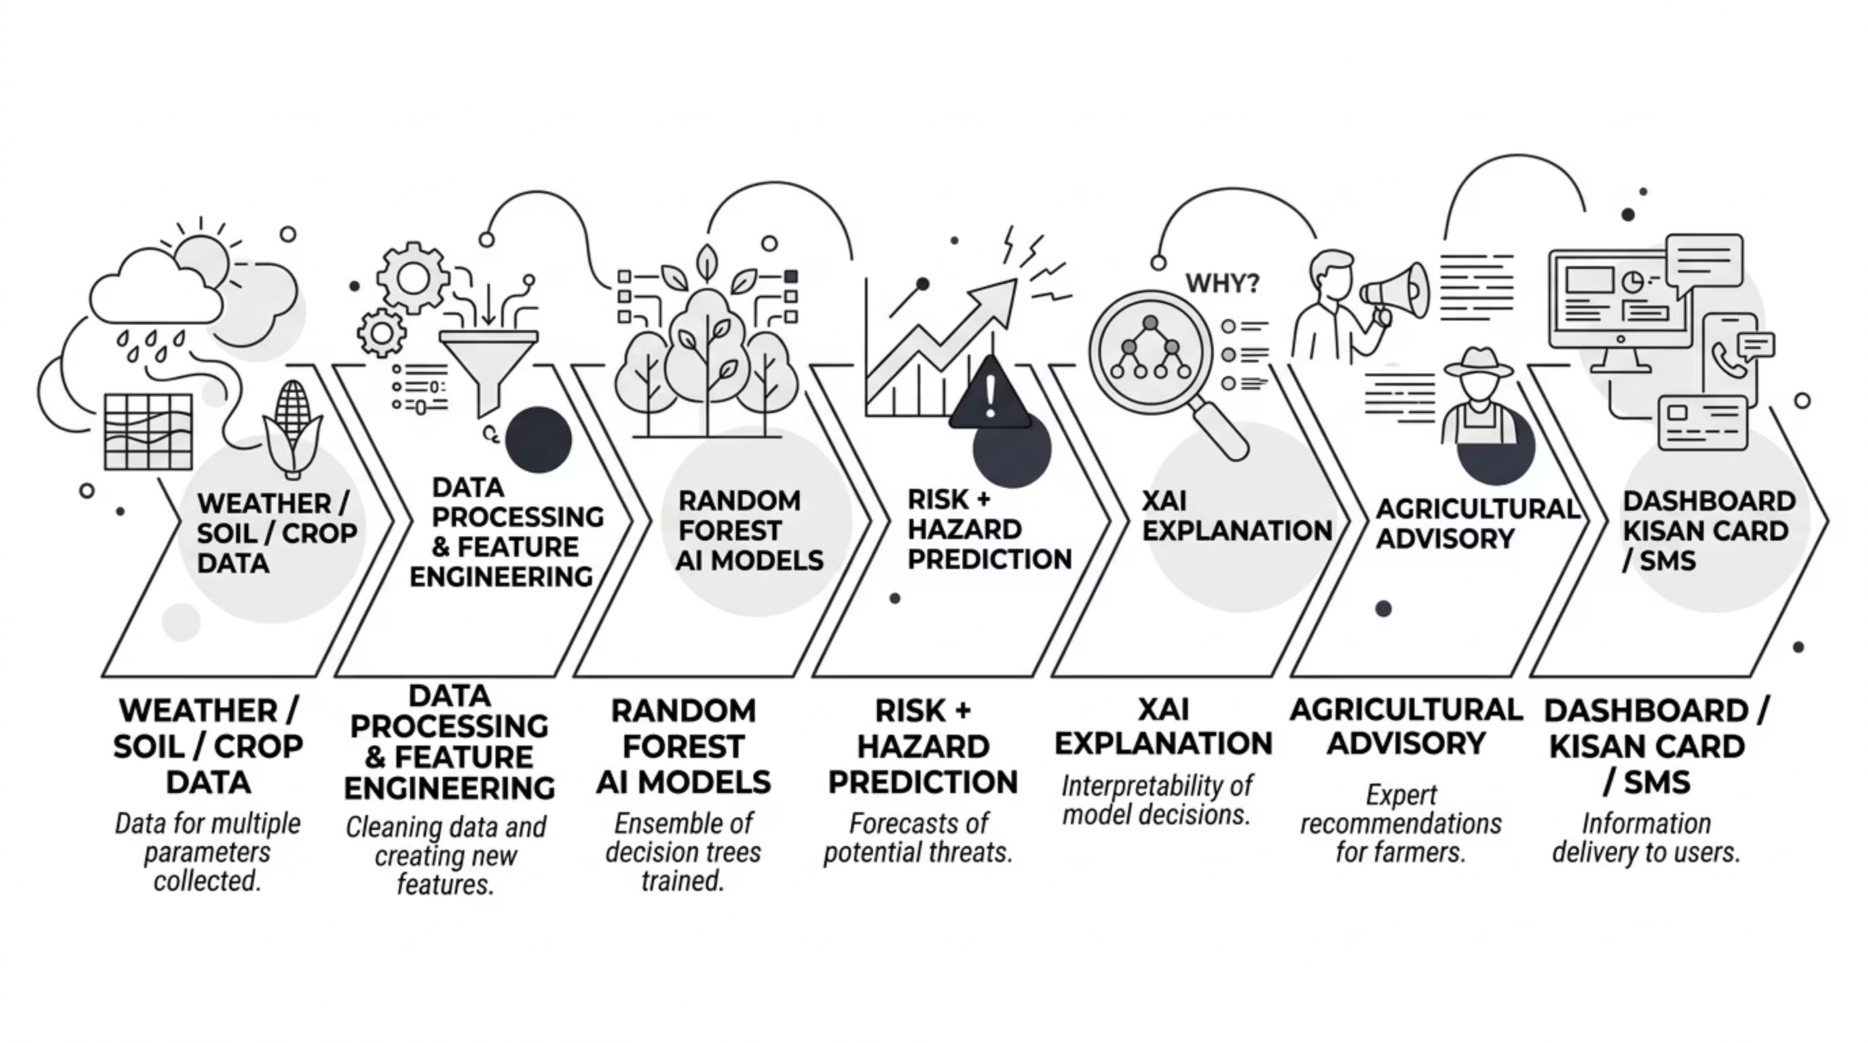
End-to-End System Architecture & Technology Stack
A modular, low-overhead pipeline from satellite telemetry ingestion to village-level delivery
🧠 Core AI & Analytics
Python 3.14 & Scikit-learn: Ensemble algorithms & data pipes.
Random Forest Models: Primary stress classifier + 6 sub-models.
StandardScaler & One-Hot: Normalized environmental telemetry.
🖥️ Interactive Dashboard
Streamlit Web Framework: Fast, reactive glassmorphic UI.
Folium GIS Mapping: Geospatial color-coded taluka markers.
Plotly Interactive Charts: Radar risk plots & XAI bar graphs.
📡 Ingestion & Multi-Channel
OpenWeatherMap Live API: Deterministic Goan simulation modes.
NumPy & PIL Colorimetry: Foliar lesion segmentation.
Twilio SMS & WhatsApp: Direct 2G farmer advisory delivery.

Slide 5
Real-Time Monitoring Across All 12 Goa Talukas
State-wide agro-climatic surveillance dashboard for Directorate of Agriculture & ZAO officers
🗺️ 12 Talukas Monitored Live
Complete Goa Coverage: Covers all North and South Goa talukas from Pernem to Canacona with pre-configured agro-climatic zones.
🌐 Interactive GIS Map & Satellites
Dual-Layer Mapping: Folium geospatial views with standard terrain maps and satellite crop canopy layers.
🟢 Risk-Based Dynamic Color Coding
Intuitive Status Tiers: Green (Normal), CadetBlue (Watch), Orange (Alert), and Red (Critical Intervention Required).
🌦️ Real-Time Environmental Telemetry
14 Parameters Evaluated: Temperature, relative humidity, 24h rainfall, dry/wet streaks, soil moisture, and soil pH.
📋 Taluka Vulnerability Watchlist
One-Click Drilldown: Instant summary cards displaying primary crops, ambient temp, soil pH, and immediate ICAR action plan.
🗣️ Trilingual Interface
Zero Language Barriers: Instant toggle between English, Konkani (गोंयची राजभास in Devanagari), and Hindi.
📊 Key Takeaway: Agriculture directors and ZAO officers can survey the entire state's agricultural risk at a glance and dispatch targeted alerts from a single centralized dashboard.

Slide 6
Digital Kisan Crop Health & Vulnerability Card (Prototype)
A prototype printable agro-meteorological advisory card bridging digital intelligence to the field
📄 What the Digital Kisan Card Delivers
👤 Farmer & Land Profile: Records farmer name, taluka, survey/parcel number, and Goan land types (Khazan, Morod, Keri).
🌦️ Meteorological Telemetry: Timestamped 24h rainfall, ambient temp, relative humidity, and consecutive wet/dry days.
🌱 Soil Health Telemetry: Goa laterite soil pH level (acidic loam) and root zone soil moisture percentage.
🤖 AI Agro-Stress Grading: Composite stress rating (Grade A to D) with active hazard classification.
🌿 ICAR-CCARI Prescriptions: Scientifically verified remediation protocol rendered in English and native Konkani.
🔲 Verification ID & QR Concept: Unique tracking serial (e.g. GOA-KISAN-2026-PON-4819) with tamper-resistant verification hash.
🏛️ Prototype Certificate Layout
Govt Header: Government of Goa • Directorate of Agriculture
Advisory Authority: In Technical Guidance with ICAR-CCARI, Old Goa
Sample Record: Ramesh Naik | Ponda (South Goa) | Parcel: S-412/3
Current Assessment: Rice (Paddy) — Tillering Stage | Laterite Soil pH: 5.2
AI Classification: 🟡 GRADE B (WATCH) • Stress Index: 38.4%
Prescribed Advisory: Adopt Alternate Wetting & Drying (AWD) water-saving.
Verification QR: [ 🔲 QR VERIFICATION ] • HASH: 48192026
🏛️ Key Takeaway: Prototype concept designed for future government integration: can be printed at 190+ Village Panchayat e-Gram kiosks to support PMFBY crop insurance claims and ZAO subsidy verification.

Slide 7

The AI Engine: Multi-Target Random Forest Architecture
Evaluating multi-dimensional environmental signals across Goan agriculture
🧠 Machine Learning Architecture
Multi-Target Design: 1 Primary Classifier (Overall Stress) + 6 specialized Binary Hazard Sub-Models (Drought, Waterlog, Pest, Disease, Heat, Soil pH).
Non-Linear Synthesis: Evaluates complex interactions (e.g. 50mm rain in low-lying Salcete causing blast vs. 80mm in sloped Sattari).
Engineered for Speed: Configured with n_jobs=1 for ultra-fast, in-process single-record inference under 0.05 seconds.
Hazard Predictions
7 risks + composite stress
Weather Features
Temperature, rain, humidity
Random Forest
Model
Crop Features
Growth stage, variety, health
Soil Features
Moisture, pH, texture
📊 Evaluation Benchmark Metrics
Primary Stress Classifier: 91.86% Accuracy | 96.38% Precision | 94.14% ROC-AUC
Hazard Sub-Models: Drought: 97.5% | Waterlog: 99.5% | Pest Bloom: 97.9% | Fungal Disease: 98.9%
Evaluation Dataset Note: Trained on synthetic Goa agro-climatic data (3,500 samples); real-world field validation with ICAR/ZAO is our proposed next step.
🧠 Key Takeaway: 1 Primary Classifier + 6 Binary Hazard Sub-Models evaluate non-linear multi-stress interactions across Goa in under 0.05 seconds.

Slide 8
Don't Just Predict Risk — Explain It (What-If & XAI)
Opening the black box: Decomposing exact meteorological drivers of crop stress
🧪 What-If Diagnostic Simulation Sandbox
Interactive Stress Injection: Allows agricultural officers to simulate weather disruptions and observe AI model responses in real time.
Dedicated Confirm Controls: Features explicit confirmation triggers so users tweak sliders smoothly without mid-input reload lag.
Simulated Weather Factors: 24h Rainfall (0–350mm) • Air Temperature (18–44°C) • Relative Humidity (25–100%)
Simulated Soil & Biological: Consecutive Dry/Wet Days • Soil Moisture (10–100%) • Soil pH (4.0–8.0) • Pest/Disease Pressure
🔍 Explainable AI (XAI) & Actionable Guidance
Feature Importance Attribution: Decomposes Gini decision weights so the model explicitly justifies why an alert was triggered.
No Black Box Guarantee: Officers can see which telemetry signals were most influential (e.g. Consecutive Dry Days: 0.216, Soil Moisture: 0.184).
6-Axis Spider / Radar Decomposition: Plots multi-hazard stress probabilities across Drought, Waterlog, Pest, Disease, Heat, and Soil Acidity simultaneously.
ICAR-CCARI Prescriptions: Automatically maps predicted hazards to scientific remediation protocols in English and Konkani.
🔍 Key Takeaway: Explainable AI builds trust with agricultural officers and farmers by proving which environmental telemetry signals drove the model's prediction before any advisory is dispatched.

Slide 9
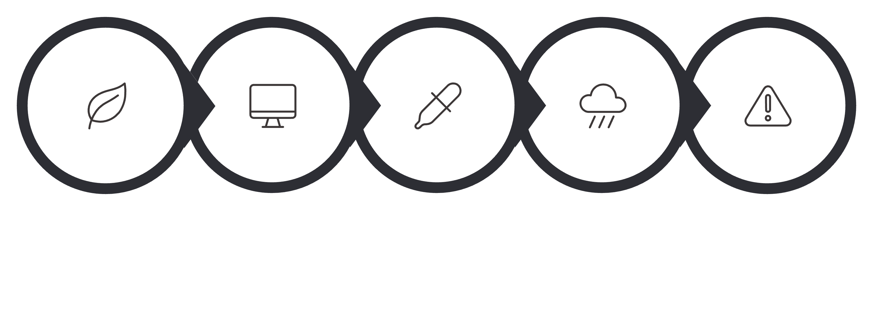
Multi-Modal Leaf Disease Scanner & Telemetry Fusion
Combining computer-vision lesion detection with live Goan microclimatic telemetry
1. Leaf Image
Field sample upload
2. Computer Vision
HSV color analysis
3. Color & Lesions
Necrosis area masking
4. Environmental Data
Microclimate fusion
5. Risk Assessment
Composite AI diagnosis
📸 Computer-Vision Leaf Analysis
Specimen Ingestion: Direct mobile upload with colorimetric RGB-to-HSV conversion.
Lesion Segmentation: Calculates foliar necrotic ratio & brown-spot clustering using NumPy & PIL.
Goan Pathologies: Calibrated for Rice Blast (भाताचेर करपा), Cashew Shoot Blight & Coconut Bud Rot.
🔬 Environmental Context Fusion
Beyond Pure Vision: Visual symptoms alone cannot distinguish harmless mud from fungal infection.
Microclimatic Heuristic: Cross-checks active spore proliferation (Humidity >85% + Temp 24–32°C).
Composite Action Plan: Combines visual indicators with taluka climate to produce trusted ICAR-CCARI treatment advice.

Slide 10
Bringing the Warning Directly to the Farmer (Digital Inclusivity)
Reaching smallholder farmers across Goa regardless of smartphone ownership or connectivity
📱 2G SMS Dispatch
Feature-Phone Ready: Concise alerts under 160 characters in native Konkani delivered to basic handsets.
💬 WhatsApp Broadcast
Village Groups: One-click pre-formatted text links for Village Panchayat farmer WhatsApp communities.
🖥️ Command Center
Officer Dashboard: Interactive Streamlit web platform with GIS maps, What-If simulation, and analytics.
🧾 Printable Kisan Card
Physical Bridge: Printable advisory certificates for walk-in farmers at Panchayat e-Gram kiosks.
🌐 Trilingual Empowerment
Native Konkani (गोंयची राजभास): Devanagari script removes all literacy and language barriers.
Hindi & English: Full state and national administrative accessibility.
🛡️ Anti-Spam Governance
15-Minute Cooldown: Intelligent rate limiter prevents bombarding farmers if sensors fluctuate.
High-Priority Queue: Guarantees critical weather hazard delivery.
📑 Timestamped Audit Trail
Administrative Records: Every dispatched alert is permanently logged to CSV with timestamps and taluka data.
Government Export: Downloadable for departmental review and subsidy verification.
🌾 Key Takeaway: A warning is useful only if it reaches the farmer. By pairing 2G SMS with native Konkani advisories, AgriWatch Goa ensures that no smallholder farmer is left behind.

