Slide 1

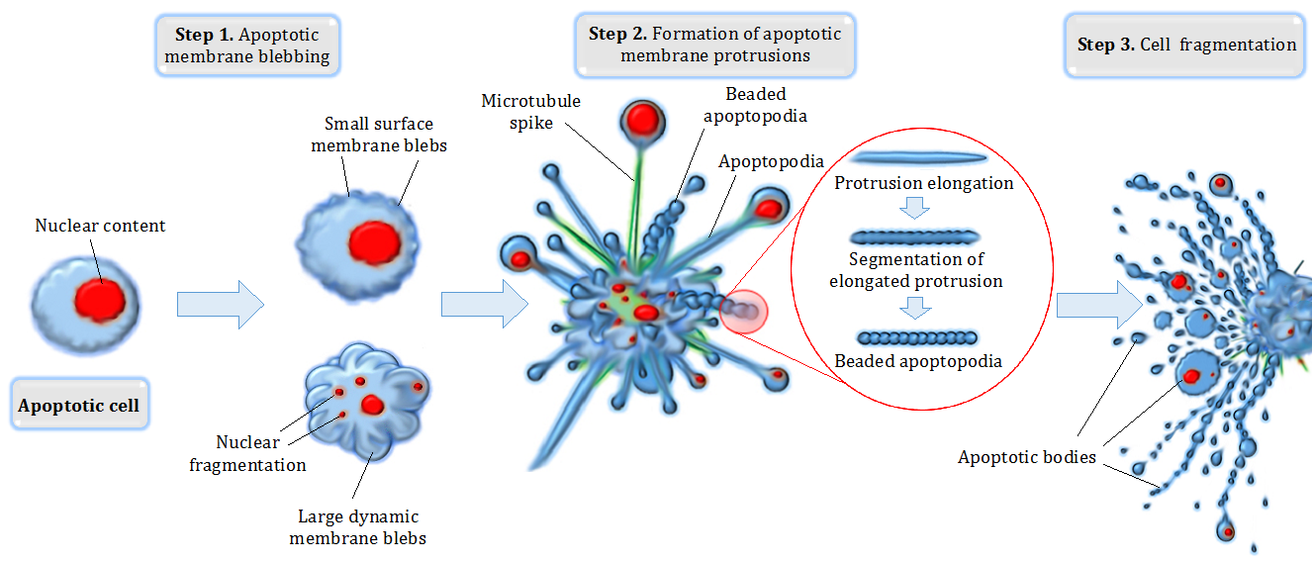
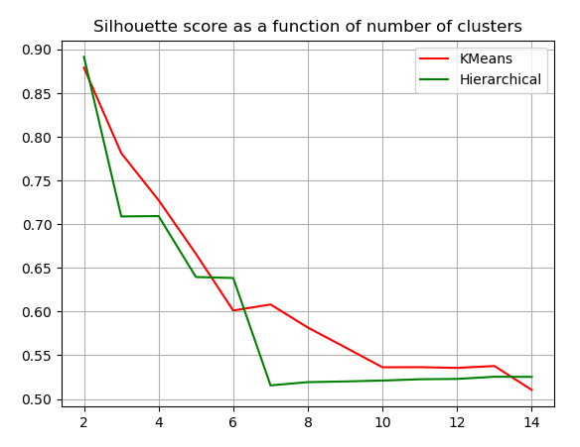
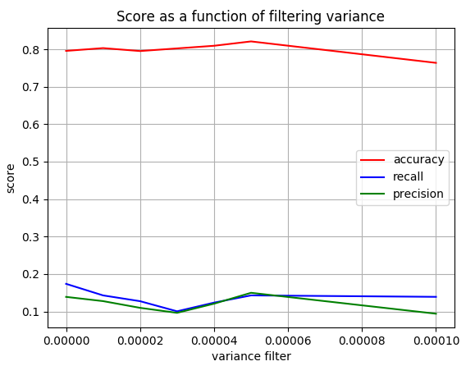
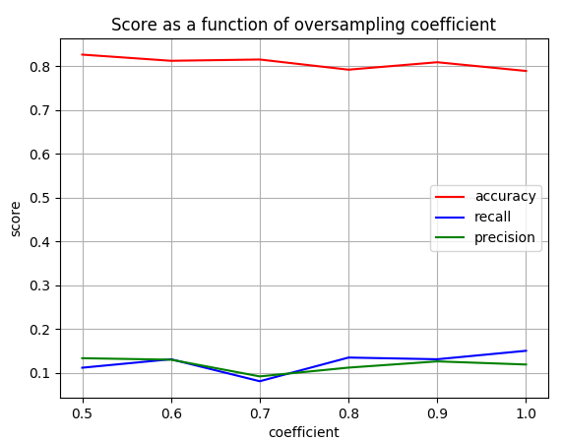

Comparing between supervised and unsupervised approaches to classify gene expression profiles of cancer patients
Anna Romanov¹, Maxim Kolchinsky¹
1 Computer Science Department, Technion – Israel Institute of Technology, Haifa, Israel
Background
Classifying
Apoptosis is a form of programmed cell death that occurs in multicellular organisms
Negative regulation of apoptosis inhibits cell death signaling pathways, helping tumors to evade cell death
Identification of targets for apoptosis induction is important to provide novel therapeutic approaches in breast cancer.
According to researchers [2], Protein Kinase Cδ supports survival of breast cancer cells by suppressing the ERK1/2 pathway, which mediates apoptosis.
The dataset we’ll use [1] contains gene expression levels in 2 breast cancer cell lines, before and after down regulation of Protein Kinase Cδ.
The breast cancer cell lines that appear in the dataset are:
- BT-549 (Invasive ductal carcinoma)
- MDA-mB-468 (adenocarcinoma)
TODO: briefly introduce each classifier
Decision tree
We tuned max_depth parameter of decision tree, using 5 folds on the training
set. We chose maximal depth of 70.
SVM
Similarly, we tuned max_iter parameter of SVM classifier. We chose to allow a maximal iterations number of 20.
TODO: graph of performance of decision tree vs. svm
Goals
Compare between different methods of supervised and unsupervised approaches of classifying gene expression.
Be able to classify whether a gene is related to apoptosis based on its expression levels in different cells, with and without treatment.
In order to train the classifier we’ll use a dataset with genes as the rows (“samples”) and cell-line samples as the features. The output will be TRUE or FALSE.
Clustering
Kmeans
We used Kmeans clustering with 3 clusters on the data.
Hierarchical Clustering
We used Agglomerative clustering algorithm for hierarchical clustering to compare
Its results to Kmeans with the same amount of clusters.
Material and methods
GEO – public genomics data repository
AmiGo – Web-based set of tools for searching and browsing the gene ontology. database. We used it to obtain a list of GO terms associated with apoptosis.
Scikit-learn – Python library for machine learning.
Building the dataset
Uniting all probes that belong to the same gene by calculating expression means.
Labeling the data using process GO term: label ‘TRUE’ for genes associated with apoptosis GO terms and label ‘FALSE’ otherwise.
10.74% of genes are labeled ‘TRUE’ in the initial dataset.
Scoring methods - classifying
Accuracy: percent of genes correctly classified.
Precision: the fraction of true positives out of all genes classified as ‘true’.
Recall: the fraction of true positives out of all genes with actual ‘true’’ label.
Scoring methods - clustering
Silhouette score: mean intra cluster distance (a) and mean nearest cluster distance (b) for each sample calculated as $\frac{b−a}{\max\left(a, b\right)}$
Data preparation and preprocessing
Dividing the data into training and test sets.
Normalizing and removing genes with
low-variance from the train set.
We performed a tuning of the variance
threshold that was used for filtering.
For score evaluation we used a
decision-tree classifier with default
parameters.
We chose a threshold of 0.00005.
Oversampling the train set, so that genes
with label ‘TRUE’ take a bigger part of the
dataset. We performed a tuning of the
desired ratio between ‘FALSE’ and ‘TRUE’
labels. Number of ‘FALSE’ genes is
multiplied by coefficient to obtain new
number of ‘TRUE’ genes.
We chose coefficient 1, so that ratio between
‘FALSE’ and ‘TRUE’ is 1:1.
Percentage of true labels per cluster:
Cluster 0: true labels: 0.2470960929250264
Cluster 1: true labels: 0.449438202247191
Conclusions
References
Achari C, Winslow S, Larsson C. Down Regulation of CLDND1 Induces Apoptosis in Breast Cancer Cells. PLoS One 2015;10(6):e0130300.
Lonne GK, Masoumi KC, Lennartsson J, Larsson C. Protein kinase Cdelta supports survival of MDA-MB-231 breast cancer cells by suppressing the ERK1/2 pathway. The Journal of biological chemistry. 2009;284(48):33456–65

