Slide 1

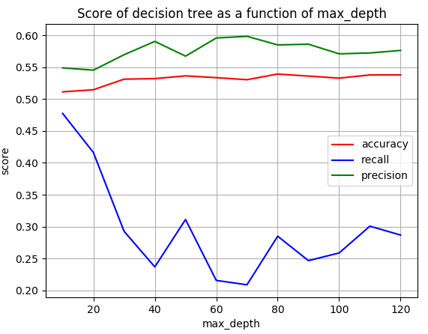
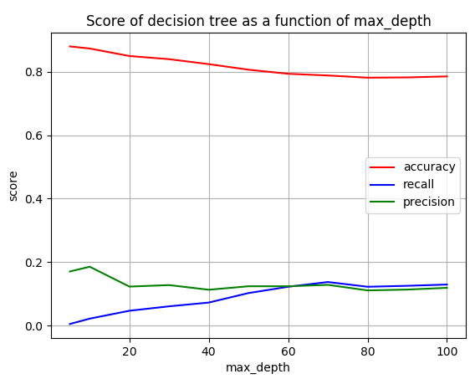
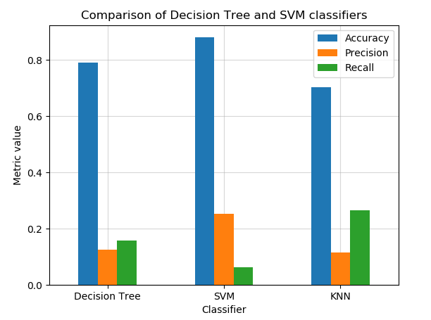
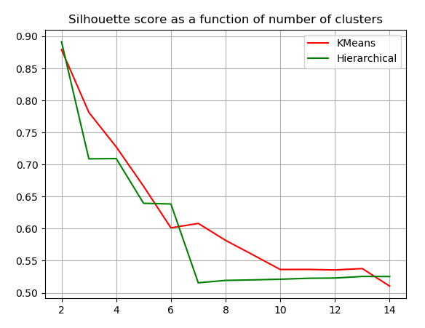
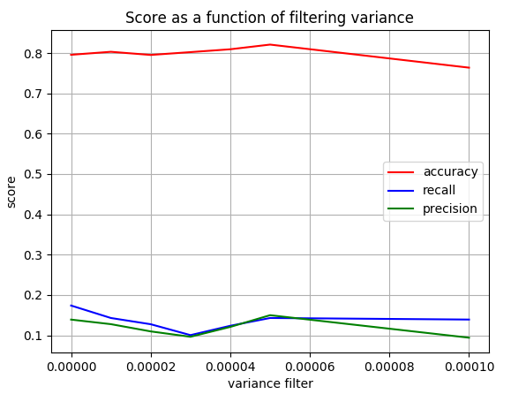
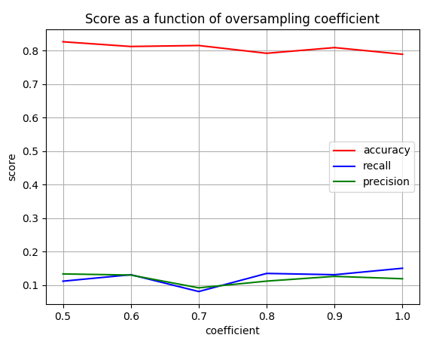

Comparing between supervised and unsupervised approaches to classify gene expression profiles of cancer patients
Anna Romanov¹, Maxim Kolchinsky¹
1 Computer Science Department, Technion – Israel Institute of Technology, Haifa, Israel
Background
Classifying
Apoptosis is a form of programmed cell death that occurs in multicellular organisms
Negative regulation of apoptosis inhibits apoptosis signaling pathways, helping tumors to evade cell death.
Identification of targets for apoptosis induction is important to provide novel therapeutic approaches in breast cancer.
It is therefore assumed that down-regulation of Protein Kinase Cδ can be used as treatment.
Decision tree
A decision tree uses tree-like model of decisions that only contains conditional control statements. We tuned max_depth parameter of decision tree, using 5 folds on the training set. We chose maximal depth of 70.
SVM (Support-vector machine)
A supervised learning model with associated learning algorithms that analyze data used for classification. Similarly, we tuned max_iter parameter of SVM classifier. We chose to allow a maximal iterations number of 20.
KNN (K nearest neighbors)
Non-parametric method used for classification and regression. We used 5 neighbors for KNN classifier.
SVM showed better performance in comparison
to decision tree and KNN in terms of accuracy but showed the poorest performance in terms of recall score.
SVM metrics:
accuracy score: 0.79
recall score: 0.26
precision score: 0.18
PKCδ
ERK1/2 pathway
Apoptosis
Goals
Compare between different methods of supervised and unsupervised approaches of classifying gene expression.
Be able to classify whether a gene is related to apoptosis based on its expression levels in different cells, with and without treatment. We expect genes associated with apoptosis show difference in expression levels between treatment and control samples.
Gene Expression
Data
Classifier
Based on
Go-Terms
Labels
(True, False)
Clustering
Material and methods
KMeans
Kmeans is a clustering algorithm in which each sample is iteratively assigned to
the cluster with the ‘nearest’ mean.
Hierarchical Clustering
Agglomerative clustering algorithm for hierarchical clustering is a bottom-up approach, each sample starts in its own cluster, and clusters are successively merged together.
We applied the two algorithms with different
number of clusters and compared the result.
We chose Kmeans with 2 clusters.
Percentage of true labels per cluster:
Cluster 0: true labels: 0.24
Cluster 1: true labels: 0.45
GEO – public genomics data repository
AmiGo – Web-based set of tools for searching and browsing the gene ontology. database. We used it to obtain a list of GO terms associated with apoptosis.
Scikit-learn – Python library for machine learning.
Building the dataset
Dataset: gene expression levels, before and after down regulation of PKCδ:
- BT-549 (Invasive ductal carcinoma)
- MDA-mB-468 (adenocarcinoma)
Uniting all probes that belong to the same gene by calculating expression means.
Labeling the data using process GO term: label ‘TRUE’ for genes associated with apoptosis GO terms and label ‘FALSE’ otherwise.
TODO: diagram of labeling
10.74% of genes are labeled ‘TRUE’ in the initial dataset.
Scoring methods - classifying
Accuracy: percent of genes correctly classified.
Precision: the fraction of true positives out of all genes classified as ‘true’.
Recall: the fraction of true positives out of all genes with actual ‘true’’ label.
Scoring methods - clustering
Silhouette score: for each sample, the score is calculated as $\frac{b−a}{\max\left(a, b\right)}$, where (a) is the mean intra cluster distance and (b) is the mean nearest cluster distance from the given sample.
Semi-supervised scoring: we’ll use the known labels to evaluate performance.
Semi-clustering: Using clustering as a classifying method by clustering labeled data and checking prediction of new data to specific clusters.
Data preparation and preprocessing
Dividing the data into training and test sets.
Normalizing and removing genes with
low-variance from the train set.
We performed a tuning of the variance
threshold that was used for filtering.
For score evaluation we used a
decision-tree classifier with default
parameters.
We chose a threshold of 0.00005.
Oversampling the train set, so that genes
with label ‘TRUE’ take a bigger part of the
dataset. We performed a tuning of the
desired ratio between ‘FALSE’ and ‘TRUE’
labels. Number of ‘FALSE’ genes is
multiplied by coefficient to obtain new
number of ‘TRUE’ genes.
We chose coefficient 1, so that ratio between
‘FALSE’ and ‘TRUE’ is 1:1.
Conclusions
Both supervised and unsupervised methods did not show good performance.
For supervised methods, there was a relatively high accuracy due to the small fraction of ‘TRUE’ labels in the dataset. We managed to improve precision and recall metrics, but still most ‘TRUE’ genes are wrongly classified.
For unsupervised methods, we chose the number of clusters that maximize silhouette score. However, with labels taken into account, the clusters are heterogenous.
A possible explanation could be that down-regulation of PKCδ has an affect on other biological functions and therefore non-apoptosis genes also show changes in expression levels.
Another point to note is that maybe some of the apoptosis genes are not affected by down-regulation of PKCδ and therefore their expression levels did not change, despite being labeled as ‘TRUE’.
We assume that for better results, perhaps a different labeling approach should be applied (for example, multiclass rather than binary).
References
Achari C, Winslow S, Larsson C. Down Regulation of CLDND1 Induces Apoptosis in Breast Cancer Cells. PLoS One 2015;10(6):e0130300.
Lonne GK, Masoumi KC, Lennartsson J, Larsson C. Protein kinase Cdelta supports survival of MDA-MB-231 breast cancer cells by suppressing the ERK1/2 pathway. The Journal of biological chemistry. 2009;284(48):33456–65

