Slide 1

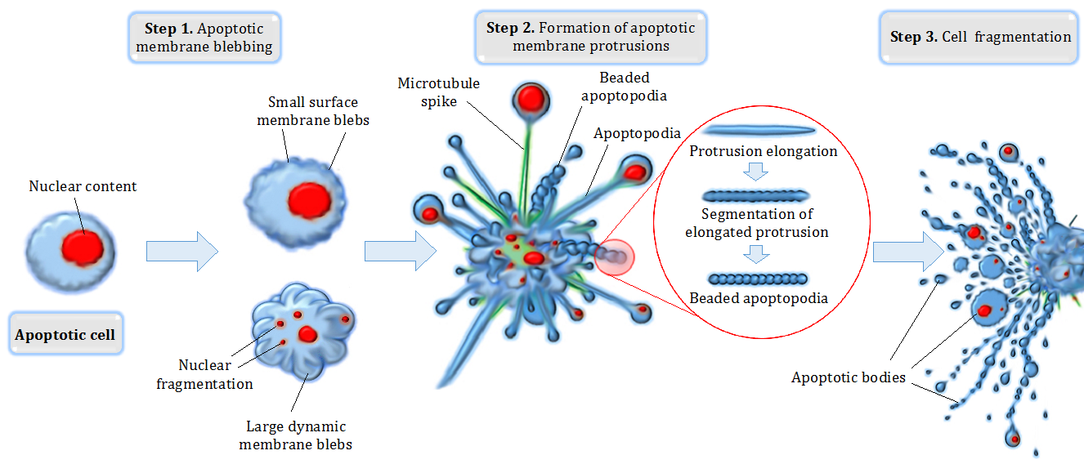
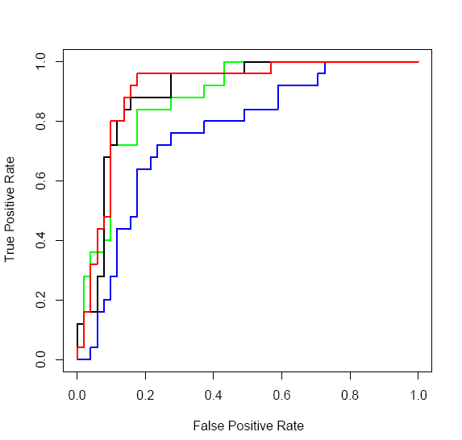
Comparing between supervised and unsupervised approaches to classify gene expression profiles of cancer patients
Anna Romanov¹, Maxim Kolchinsky¹
1 Computer Science Department, Technion – Israel Institute of Technology, Haifa, Israel
Background
Results
Apoptosis is a form of programmed cell death that occurs in multicellular organisms
Two activation mechanisms – intrinsic pathway and extrinsic pathway
Negative regulation of apoptosis inhibits cell death signaling pathways, helping tumors to evade cell death
Apoptotic cell disassembly – before the cell is disposed of, there is a process of disassembly
Identification of targets for apoptosis induction is important to provide novel therapeutic approaches in breast cancer
Text for Table 1
Goals
Compare between different methods of supervised and unsupervised approaches of classifying gene expression
Be able to classify whether a gene is related to apoptosis based on 4-12 samples.
97
A
B
Material and methods
GEO – public genomics data repository
AmiGo – Web-based set of tools for searching and browsing the gene ontology database
Building the database
Labeling the data using process go term
Filtering the data from probes of the same gene and oversampling
Dividing our data into training and test sets
Testing different classifiers
Kmeans – unsupervised clustering method
Decision Tree Classifier – supervised method using labeling
Text for figure 1A and 1B
Text for figure 2
Conclusions
References

