Slide 1

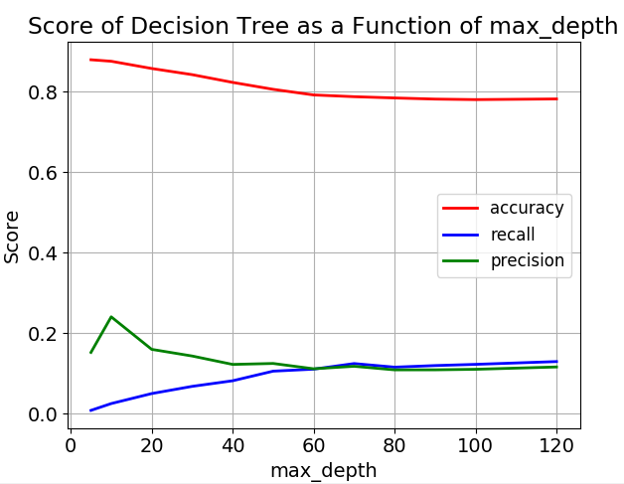
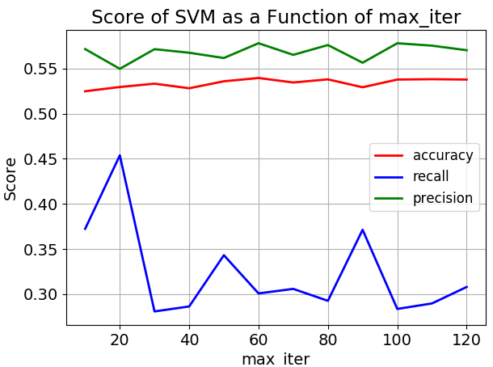
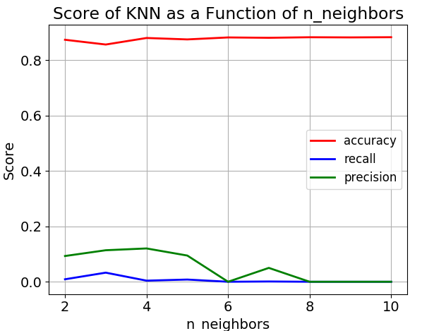
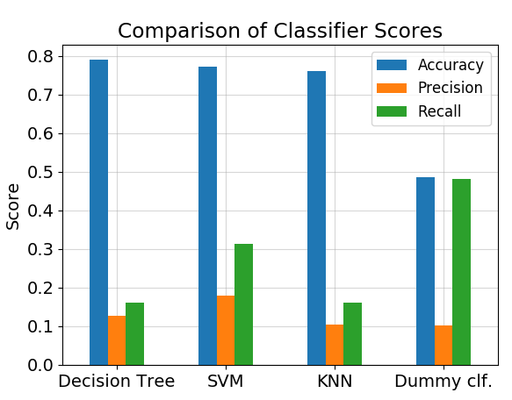
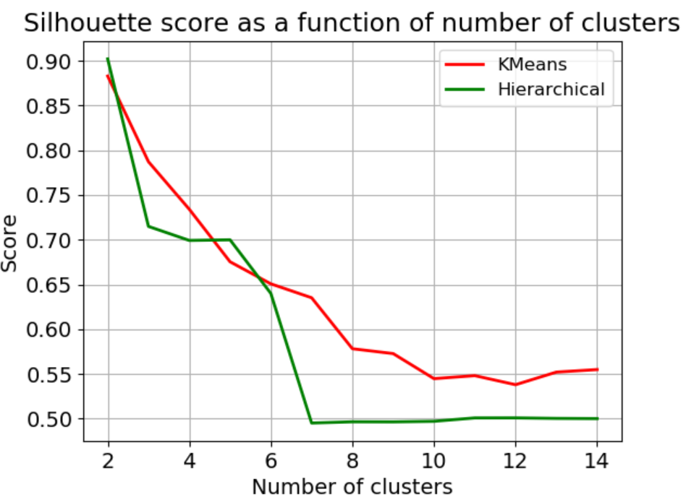
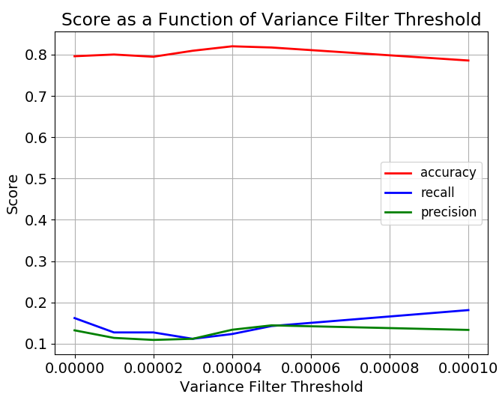
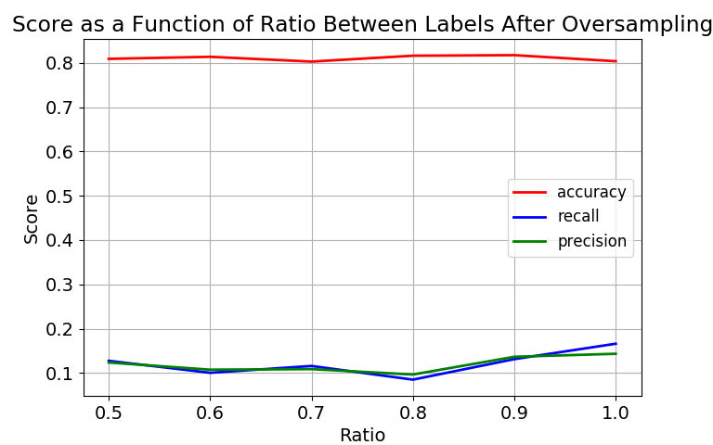
Comparing between supervised and unsupervised approaches to classify gene expression profiles of cancer patients
Anna Romanov¹, Maxim Kolchinsky¹
1 Computer Science Department, Technion – Israel Institute of Technology, Haifa, Israel
Background
Classifying
Apoptosis is a form of programmed cell death that occurs in multicellular organisms
Negative regulation of apoptosis inhibits apoptosis signaling pathways, helping tumors to evade cell death.
Identification of targets for apoptosis induction is important to provide novel therapeutic approaches in breast cancer.
It is therefore assumed that down-regulation of Protein Kinase Cδ can be used as treatment.
Decision tree
We tuned max_depth parameter of decision
tree, using 5 folds on the training set.
We chose maximal depth of 70.
SVM (Support-vector machine)
Similarly, we tuned max_iter parameter of
SVM classifier. We chose to allow a maximal
iterations number of 20.
KNN (K nearest neighbors)
We used 3 neighbors for KNN classifier.
PKCδ
ERK1/2 pathway
Apoptosis
Figure 3: Checking the affect of parameter tuning on 3 types of score for the Decision Tree classifier
Goals
Compare between different methods of supervised and unsupervised approaches of classifying gene expression.
Be able to classify whether a gene is related to apoptosis based on its expression levels in different cells, with and without treatment. We expect genes associated with apoptosis show difference in expression levels between treatment and control samples.
Gene Expression
Data
Classifier
Labels
(True, False)
Figure 4: Checking the affect of parameter tuning on 3 types of score for the SVM classifier
Figure 5: Checking the affect of parameter tuning on 3 types of score for the KNN classifier
All classifiers show similar result in terms of accuracy which are significantly better than our baseline classifier. In terms of precision and recall score we see no improvement compared to the baseline classifier.
Material and methods
GEO – public genomics data repository
AmiGo – Web-based set of tools for searching and browsing the gene ontology. database. We used it to obtain a list of GO terms associated with apoptosis.
Scikit-learn – Python library for machine learning.
Building the dataset
Dataset: 12 samples, gene expression levels, before and after down regulation of PKCδ: - BT-549 (Invasive ductal carcinoma)
- MDA-mB-468 (adenocarcinoma)
Data preparation and preprocessing
Dividing the data into training and test sets.
Run the following process:
Figure 6: Comparison between 3 supervised methods by 3 types of score compared to a baseline dummy classifier
Clustering
True if related to apoptosis term
Kmeans and Hierarchical Clustering
We applied the two algorithms with
Different number of clusters and
compared the result.
We chose Kmeans with 2 clusters.
1st cluster true labels: 10 %
2nd cluster true labels: 17 %
- No cluster with majority true
Unite
probes
by genes
Apoptosis terms list from amiGO
False otherwise
Figure 7: Comparison between KMeans and Hierarchical clustering by using silhouette score as a function of the number of clusters used. The score is calculated using semi clustering.
Normalize
Variance Filter
Conclusions
Both supervised and unsupervised methods did not show good performance.
For supervised methods, there was a relatively high accuracy due to the small fraction of ‘TRUE’ labels in the dataset. We managed to improve precision and recall metrics, but still most ‘TRUE’ genes are wrongly classified.
For unsupervised methods, we chose the number of clusters that maximize silhouette score. However, with labels taken into account, the clusters are heterogenous.
A possible explanation could be that down-regulation of PKCδ has an affect on other biological functions and therefore non-apoptosis genes also show changes in expression levels.
Another point to note is that maybe some of the apoptosis genes are not affected by down-regulation of PKCδ and therefore their expression levels did not change, despite being labeled as ‘TRUE’.
We assume that for better results, perhaps a different labeling approach should be applied (for example, multiclass rather than binary).
Clustering
Oversampling
Classifying
References
Figures 1 and 2: Checking the change of the score for 2 methods we used to fix data imbalances.
Achari C, Winslow S, Larsson C. Down Regulation of CLDND1 Induces Apoptosis in Breast Cancer Cells. PLoS One 2015;10(6):e0130300.
Lonne GK, Masoumi KC, Lennartsson J, Larsson C. Protein kinase Cdelta supports survival of MDA-MB-231 breast cancer cells by suppressing the ERK1/2 pathway. The Journal of biological chemistry. 2009;284(48):33456–65

