Slide 1
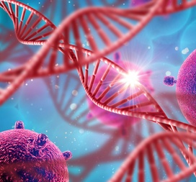
Bioinformatics Project Winter - 2019
Max Kolchinsky
Anna Romanov

Slide 2
The Problem
The problem of classification is hard
There are many classification methods
We would like to know how good are those methods on a specific dataset

Slide 3
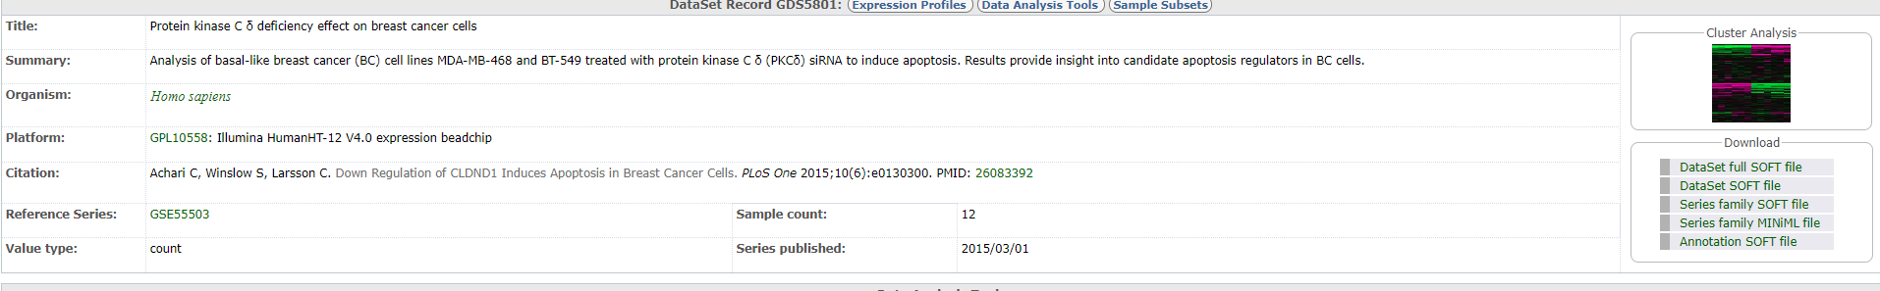
Our Dataset
https://www.ncbi.nlm.nih.gov/sites/GDSbrowser?acc=GDS5801&fbclid=IwAR2YoCBZlS1p9Ef7H0dMCqSAj0rsk8ysOuIEyde_3mqnsnb51GnjKHaHNeU

Slide 4

Biological Background
Breast Cancer
Protein Kinase C $δ$
Apoptosis

Slide 5
Working Plan
Choose the classification methods we would like to use for the project

Slide 6
Relevant Tools

Slide 7
Questions
Is this database the best choice for our project?

