Slide 1




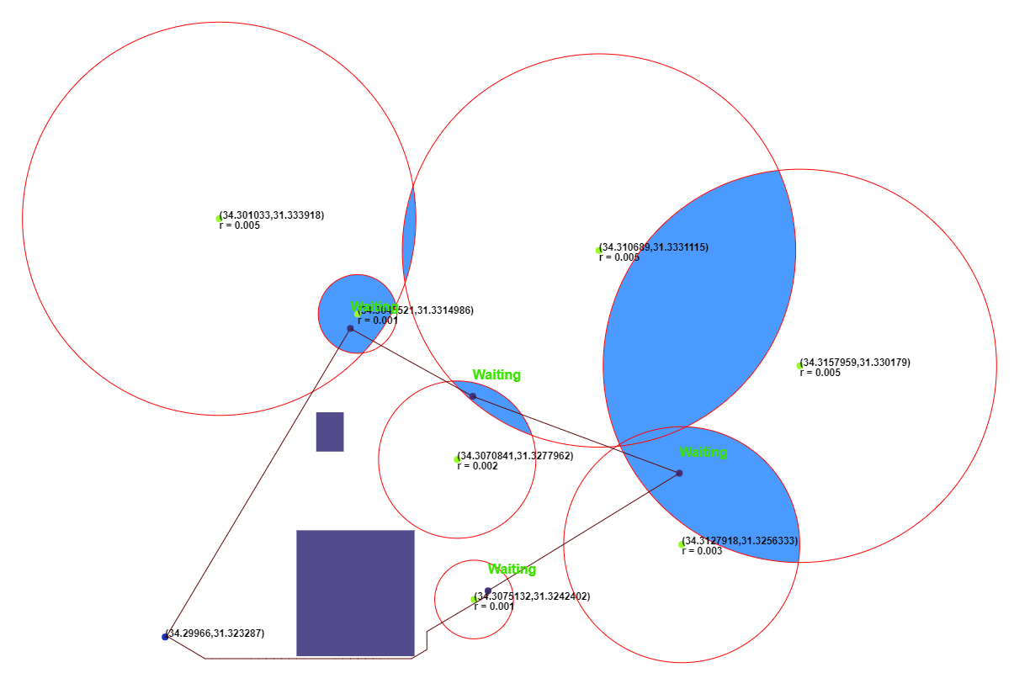
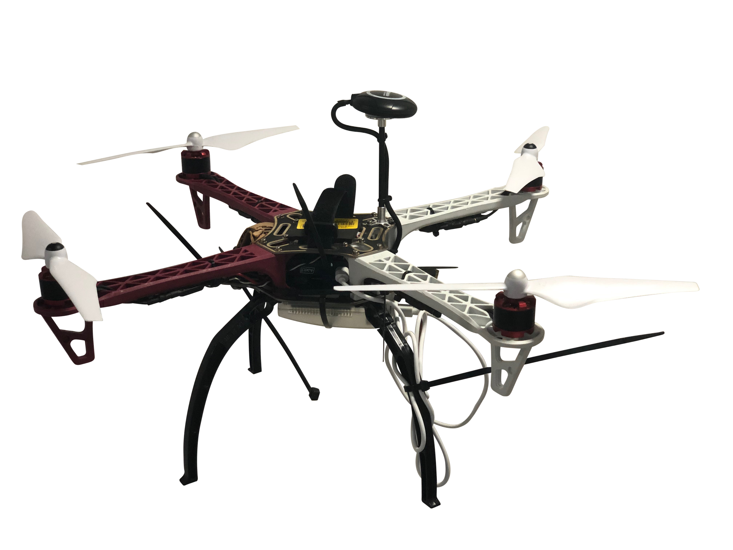
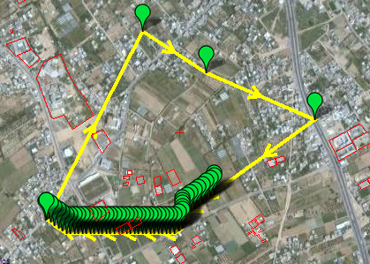
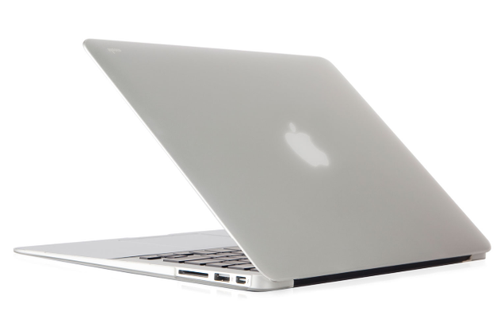
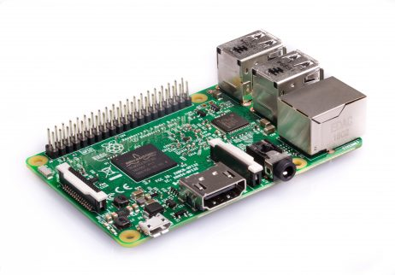
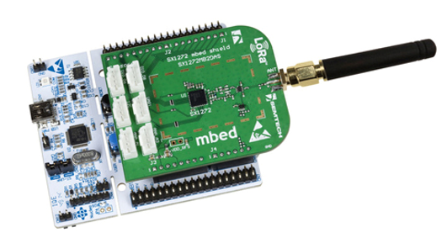
Collecting information from sensors using drone and LoRaWAN Protocol
Path Planning
Mission Planner
Drone
LoRa Server
R.PI LoRa Gateway
Calculate optimal path based on start point, sensor coordinates, radii and obstacles.
Open result via mission planner and write path to drone
Connect LoRa Gateway to drone
Send the drone to fly according to mission planner path
After returning with the data, unload it to LoRa server
LoRa Sensors
Maxim Kolchinsky, Ilya Freidkin
Instructors: Itzik Ashkenazi, Aviel Glam

