Slide 1
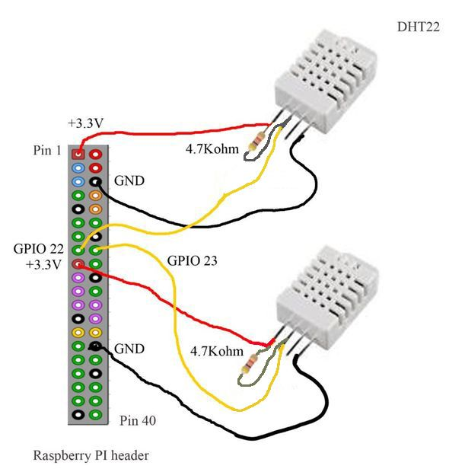
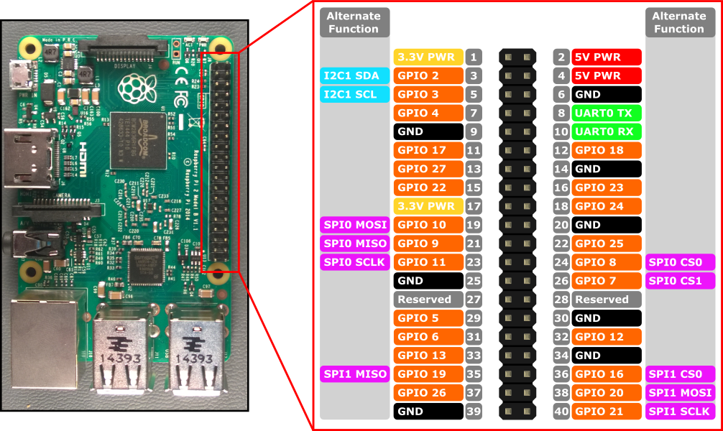
I used 8.6Kohm resistors-
White: Vin
Red: Signal
Black: Gnd
GPIO S1:4 & 10

