Slide 1
Did the web turn into a big market place is for the greater benefit?
‹#›

Slide 2
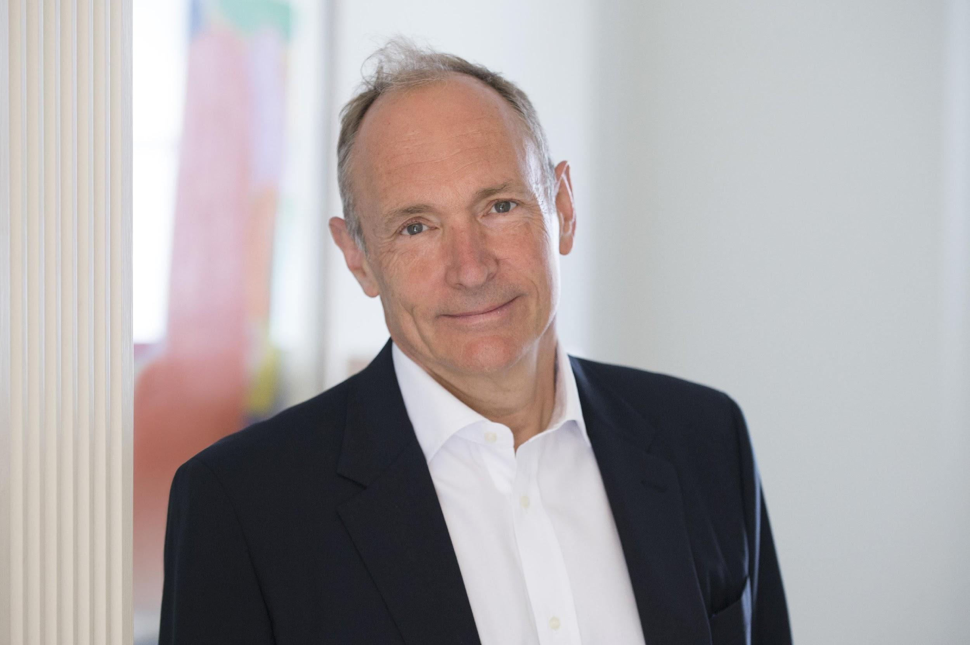
Tim Berners-Lee
‹#›

Slide 3








Seller
‹#›

Slide 4
To a networks with more and more seller
‹#›

