Slide 1
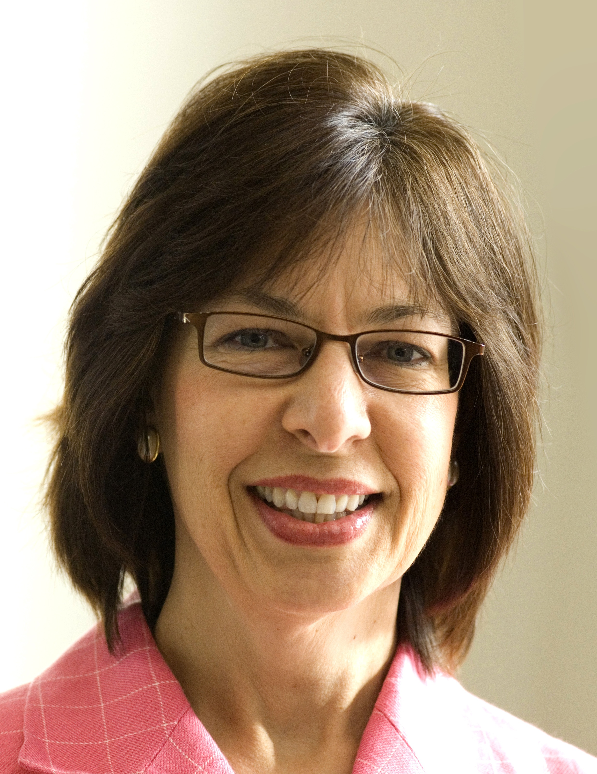
BlueSteps Executive Seminar
EFFECTIVE INTERVIEWING
Presented by
Louise Kursmark, MRW, CPRW, JCTC, CEIP, CCM
President, Best Impression Career Services, Inc.
http://www.yourbestimpression.com

Slide 2
Purpose
Employer’s purpose – either:
  Eliminate you from consideration or
  Move you to the next step in the selection process
Your purpose:
  Market yourself as a strong candidate for the position
  Communicate your key points (your agenda)
  Learn enough about the position, company, culture, and management team so you can determine if the opportunity is a good fit for you
  Advance to the next step in the selection process

Slide 3
Preparation
The basics: first impressions are lasting impressions
  Know where you’re going (don’t get lost)
  Arrive 15 minutes early – no excuses
  Present a polished, professional, absolutely impeccable appearance from hair to shoes and everything in between
  Be well rested and well nourished
Research
  The company
  The management team and individual members, especially those you’re meeting with
  The industry (challenges/emerging issues)

Slide 4
Preparation:
Establish Your Agenda
Match yourself/your value to what you know about the position, company, culture, challenges, and opportunities
  Your signature skills
  Unique accomplishments / evidence of contribution
  What sets you apart from others
Define key points that you want to communicate during the interview
Always maintain WIIFM mindset
Develop solutions tied to you/your brand

Slide 5
Agenda Example
Key points for position
VP Business Development—Asia
  Revenue driver
  Relationship builder/Asian culture
  Passion for customer service
  Strategic thinker/market analyst
  Sales team leader and motivator

Slide 6
Changing the Mindset
Old mindset:
  Interview is an interrogation/inquisition
  They’re trying to trap me
  They’re looking for any chance to eliminate me
New mindset:
  Interview is a business discussion of areas of mutual interest
  They’re trying to resolve any areas of potential concern
  They’re looking for every chance to hire me

Slide 7
Interview Structure
Warm-up
  “Tell me about yourself”
  Information about the position and company
Work-out
  Interview questions
Cool-down
  Your questions
  Wrap-up

Slide 8
Tell Me About Yourself
Do’s and don’ts:
  Don’t tell your life story
  Don’t ramble
  Don’t exceed 3 minutes in your response (even better, 60 to 90 seconds)
  Don’t expect the interviewer to be listening too intently

Slide 9
Tell Me About Yourself
Do’s and Don’ts
  Do use this as an opportunity to immediately communicate your brand/value statements
  Do paint the picture of someone who is an ideal candidate for the position
  Do start strongly
  Do include compelling information (achievement highlights)
  Do keep it interesting—just the highlights, save the details for later
  Do wrap it up and make a graceful segue back to the interviewer

Slide 10
Tell Me About Yourself: Interview
I’m a high-energy sales and business development executive with 15 years’ experience marketing technology products and services into new markets in Asia. In the past three years I built the Asian IT services division for Zytec from zero to $60 million. Before that, during a 12-year career with Intelligent Solutions, I led new sales initiatives in 6 distinct Asian markets, and in every case we exceeded our first-year objectives.
One of my greatest strengths is quickly and accurately assessing the market opportunity. This helps us make the right initiatives at the right time in the most promising markets. For example, with Zytec, I developed the strategy and timeline for highly successful market launches in China, Japan, South Korea, and Malaysia.
They say that sales is all about relationships, and nowhere is that more true than in Asia. Because I’ve lived in six Asian countries and devoted myself to learning as much as I could about the local culture, I understand the nuances in building business relationships in each distinct country and market. What that means is that the business I develop is highly sustainable. At Intelligent Solutions, our Asian business had the best 3-year retention rate in the company.
What I’m most proud of during my career is that I have repeatedly developed superb sales teams. I get a lot of satisfaction from mentoring my people and making sure they are adequately trained and have what they need to be successful.
As you may know, Zytec was recently acquired by Labtech, and they have decided to close all of their Asian offices and manage those customers from the US. They’ve offered me an excellent position, but I prefer to remain in Asia at this point. The opportunities there are so tremendous, I’d like to lead another great run for a company that shares my view! And that’s why I’m here today. I’m looking forward to learning more about your strategy for the Asian market and sharing how my experience can be of value to you.

Slide 11
Tell Me About Yourself: Networking Meeting
As a Product Development Manager, my greatest skill is envisioning “what might be” within the realm of available technology. I understand what’s mainstream, what’s cutting edge, and what is yet to be perfected, with the result that the vast majority of products I’ve contributed to have been easy to manufacture and quick to bring to market.
My ideal role would be as a Product Development Manager for a company with a strong technology component. I can lead product teams from concept through design, testing, and product launch, and I am particularly good at motivating my team through sticky challenges, whether technical, financial, business, or interpersonal. I enjoy the dynamic environment of a start-up or early-stage company; or I’d be happy in a division of a larger corporation, perhaps a skunk works or other new product initiative where I can play a lead role in developing new products that are not only visionary but practical. I am most concerned with the challenge, the opportunity, and the team rather than career advancement or job title. I’m looking to join a great company that will benefit from my passion as well as my skills.
I’d really appreciate your help! Specifically…

Slide 12
Overall Strategy: Responding to Interview Questions
Listen carefully, focus on the question, and give an answer that is responsive
Be concise – understand what you are trying to convey, and get your message across without unnecessary detail or delving into side issues
Keep your answers brief – no more than 2 to 3 minutes without some kind of break
Don’t be afraid of silence
Always focus on the positive

Slide 13
Interview Response Strategy, cont.
Look for openings to address your agenda
Learn to deal with your “issues”
  Reason for leaving your last employer
  Gaps in employment
  Lack of success on a particular job
  Short-term employment
  Lack of a college degree
  Employment with a company that has been in the headlines (and not in a good way)
  Whatever looms large in your mind

Slide 14
Types of Interview Questions
Standard/Traditional
Response strategy: Prepare for questions like these and hit them out of the park
  Why are you looking for a new job?
  Why did you leave your last position?
  What is your experience with [job-related function, technology, etc.]
  Why weren’t you more successful in your last position?
  What have you been doing since you left your last position?
  Why is it taking you so long to find a job?
  What will your supervisor/peers/subordinates say about you?
  What are your strengths? What are your weaknesses?
  If you could change something about your life, what would it be and why?
  Why should we hire you?

Slide 15
Types of Interview Questions
Situational: “What-if” questions
  If we were to hire you, what is the first thing you would do?
  How do you deal with stress on the job?
Response strategy: “Walk” the interviewer through your thought process, then bolster your response with a specific example

Slide 16
Types of Interview Questions
Behavior-based: Questions that require you to respond with specific examples from your past experience
  Tell me about a crisis you could have prevented. Did you do anything differently after the crisis had passed?
  Describe a situation in which you were blocked from reaching a goal. What did you do?
Response strategy: Choose an example that supports your agenda

Slide 17
Types of Interview Questions
Culture-fit: Critical questions to determine if you are a good fit for the company, culture, and job environment
  What gave you the greatest feeling of achievement in your last job? Why was this so satisfying?
  What motivates you to work hard? Give me some examples.
Response strategy: Be honest, but don’t be afraid to shift your response just a bit to fit in with the culture you’ve identified.

Slide 18
Types of Interview Questions
“Show-me” / Whiteboard / Simulation: An opportunity for you to actually demonstrate what you will do on the job
Response strategy: Seize the golden opportunity and show ‘em your stuff
  If possible, prepare in advance
  Consider asking for this oportunity

Slide 19
Secret Weapon of Interviewing
CAR stories
Logical story-telling flow:
  Challenge or Situation (what was going on)
  Action (what you did about it)
  Result (the outcome)
When to use the CAR format:
  Always in response to a behavior-based question
  Whenever possible to support other interview responses that are general or theoretical – “Let me give you an example”

Slide 20
How to Prepare Your CAR Stories
  Review your agenda – what competencies do you want to communicate?
  Example competencies:
    Leadership
    Crisis Management
    Persuasiveness
    Strategic Planning
    Creativity/Innovation
    Team Building
  Find 3 to 5 specific examples of those competencies in action
  Practice

Slide 21
Tips for Successful CAR Storytelling
  Challenge: describe briefly
    Give just enough information to put the listener in the picture
  Actions: provide insights into how you tackle challenges, your thought process, etc.
    Don’t get bogged down
  Results: must be specific and strong
    Add fourth component—Strategic Impact

Slide 22
Asking Questions
Prepare at least 5 good questions in advance
Add to your notes during the interview
Ask the right questions for the particular interviewer and stage in the process

Slide 23
What to Ask About
Roles and responsibilities / Reporting structures
Key performance goals for the position
  Obstacles to achieving goals
  Resources that will be available to you
Company immediate and long-term objectives / Competitive threats / Reason for lack of success in a new venture or market
  How company plans to achieve its objectives
How long senior executives have been with the company
Once a job offer has been extended: Ask to speak to others in your department and other departments
What not to ask: WIFM

Slide 24
Discussing Compensation
When to discuss
How to deflect
Strategy with recruiters

Slide 25
Following Up
When: after every interview
To whom: every person you met with
What to say
  Reiterate key selling points
  Overcome objections
  Provide added value
  Ask for the next step
Never leave an interview without knowing next steps/timeline

Slide 26
Wrap-up
Key takeaways:
  Interviewing is a two-way street / business meeting, NOT an inquisition
  Prepare YOUR agenda
  Prepare an effective introduction
  Master the art of storytelling (CARs)
  Reinforce your messages with appropriate follow-up
Questions?

