Slide 1
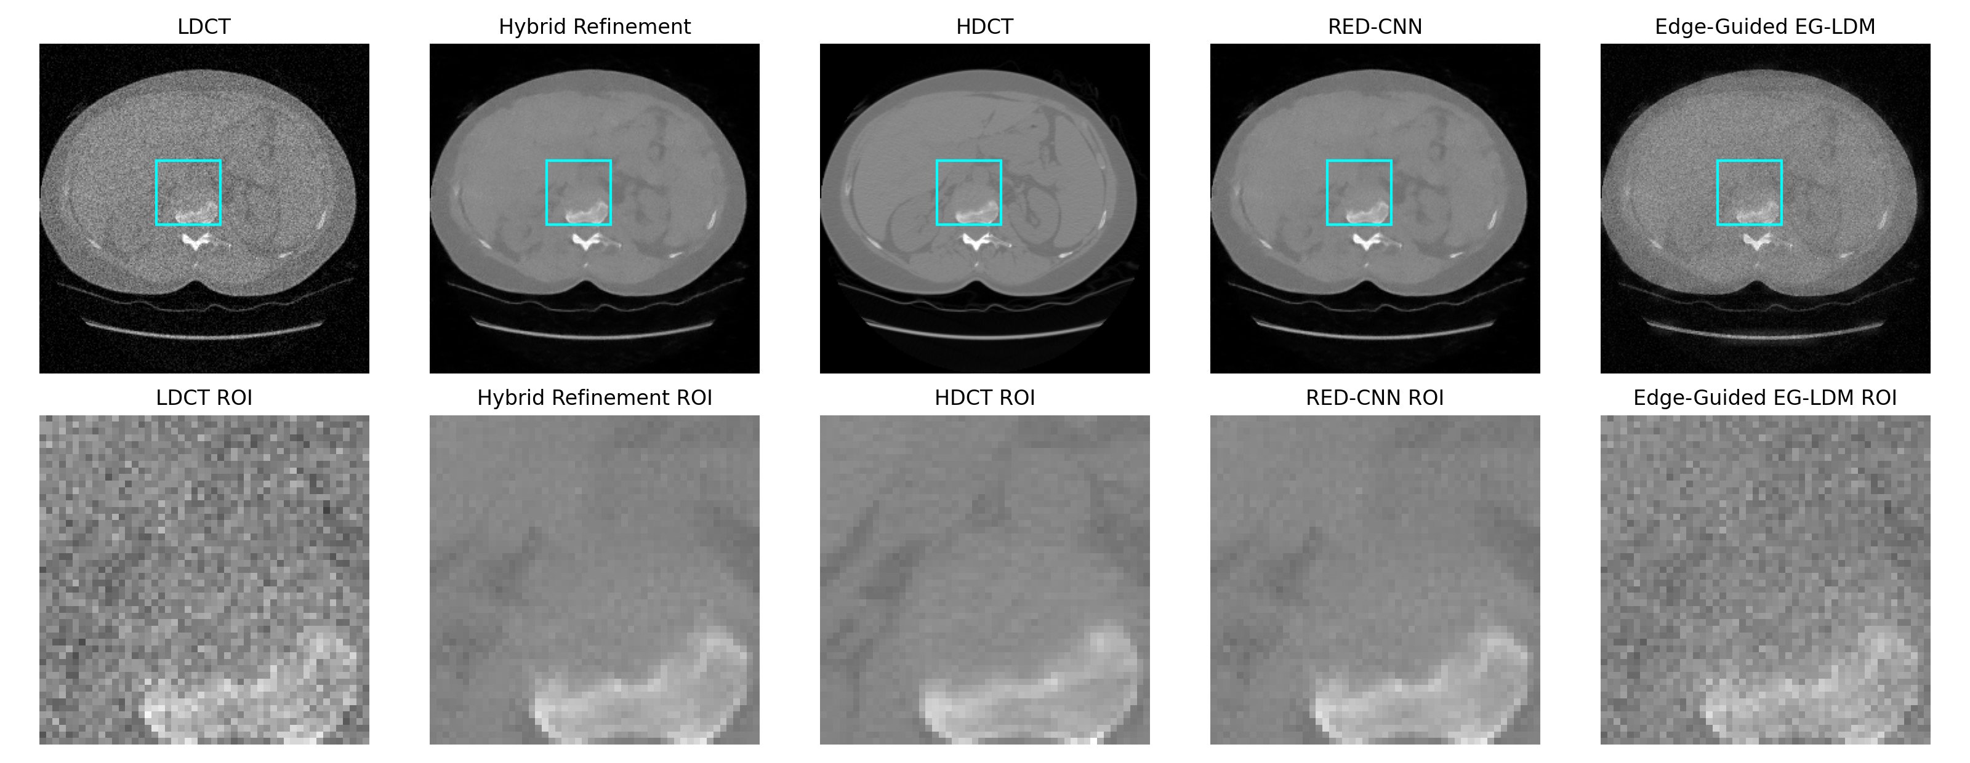
Hybrid Edge-Guided Diffusion Refinement for Leakage-Free LDCT Denoising
Zhexi Feng, Bingrui Zhang | UC San Diego | ECE Department
Main message: diffusion is most effective here as a conservative anatomical refiner around a strong deterministic RED-CNN anchor.
Patients
Valid CT slices
Hybrid test result
1,010
243,957
35.12 / 0.904 / 0.0356
Leakage-free patient-level LIDC-IDRI protocol on raw DICOM.
Hybrid EG-LDM slightly exceeds the RED-CNN anchor on the held-out test split.
Standalone diffusion is weaker; hybrid refinement is the key result.
1

Slide 2
Why This Benchmark Matters
Problem
Low-dose CT denoising must reduce noise without inventing anatomy.
Slice-level random splits in volumetric CT can leak near-duplicate anatomy.
LIDC-IDRI has real anatomy but not paired standard-dose / low-dose scans.
Train / Val / Test patients
Series
Valid slices
808 / 101 / 101
1,018
243,957
Preprocessing pipeline
Raw DICOM
HU clip + normalize
Synthetic LDCT
Protocol
Scan 382,009 candidate DICOM files and retain 243,957 valid CT slices from 1,010 patients.
Persist patient-level train / val / test splits: 808 / 101 / 101 patients.
Construct paired supervision by adding signal-dependent Gaussian corruption to clean preprocessed CT slices.
Goal: credible, leakage-free evidence before claiming denoising gains.
2

Slide 3
Method: Diffusion as a Conservative Refiner
Center LDCT
RED-CNN anchor
Neighbor slices
Edge-guided latent diffusion LDCT latent + neighbor context + Canny edge prior
Anchor-aware blend + edge-adaptive fusion
Output x-hat
Edge map
Key idea: the diffusion branch predicts a small structured residual, not the entire reconstruction.
Edge guidance and 2.5D neighboring slices improve structural awareness.
Auxiliary intensity and gradient losses translate structural gains into pixel fidelity.
3

Slide 4
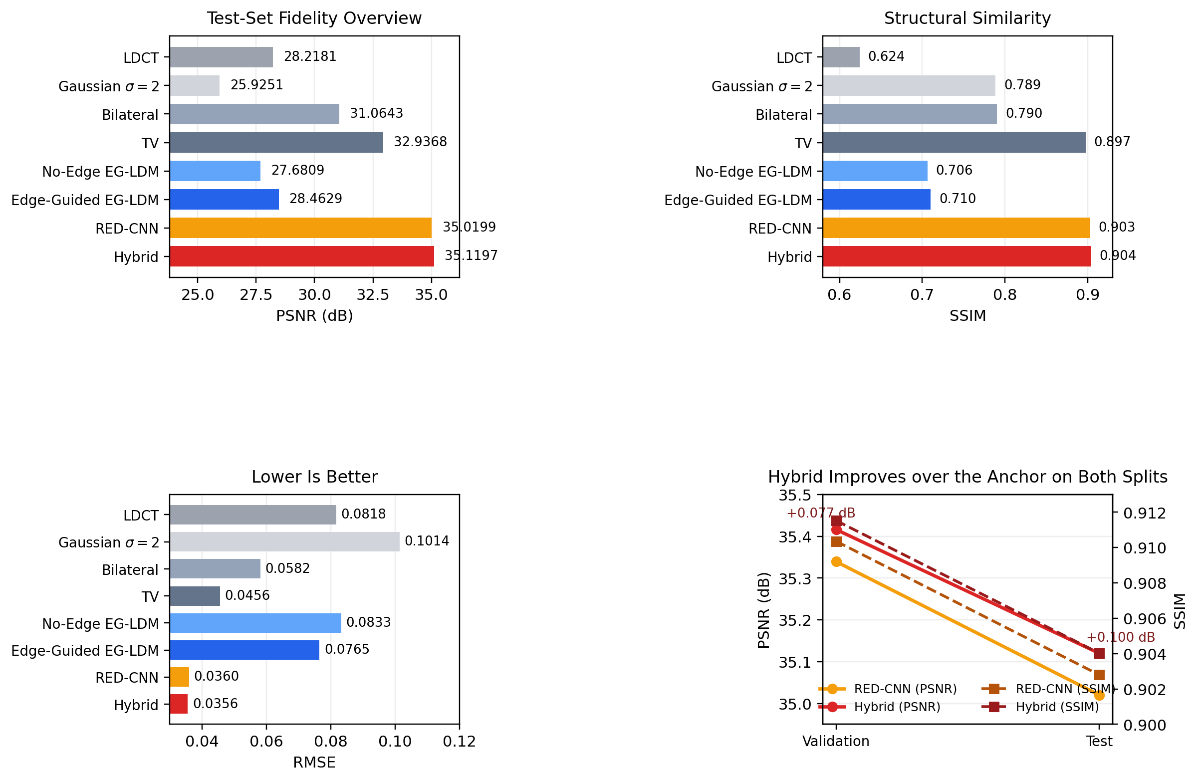
Quantitative Results on the Held-Out Test Split
Method
PSNR
SSIM
RMSE
LDCT
28.218
0.6244
0.08176
RED-CNN
35.020
0.9028
0.03598
No-Edge EG-LDM
27.681
0.7063
0.08328
Edge-Guided EG-LDM
28.463
0.7102
0.07652
Hybrid EG-LDM
35.120
0.9040
0.03558
Hybrid vs RED-CNN +0.0998 dB PSNR | +0.00123 SSIM | -0.00040 RMSE
4

Slide 5
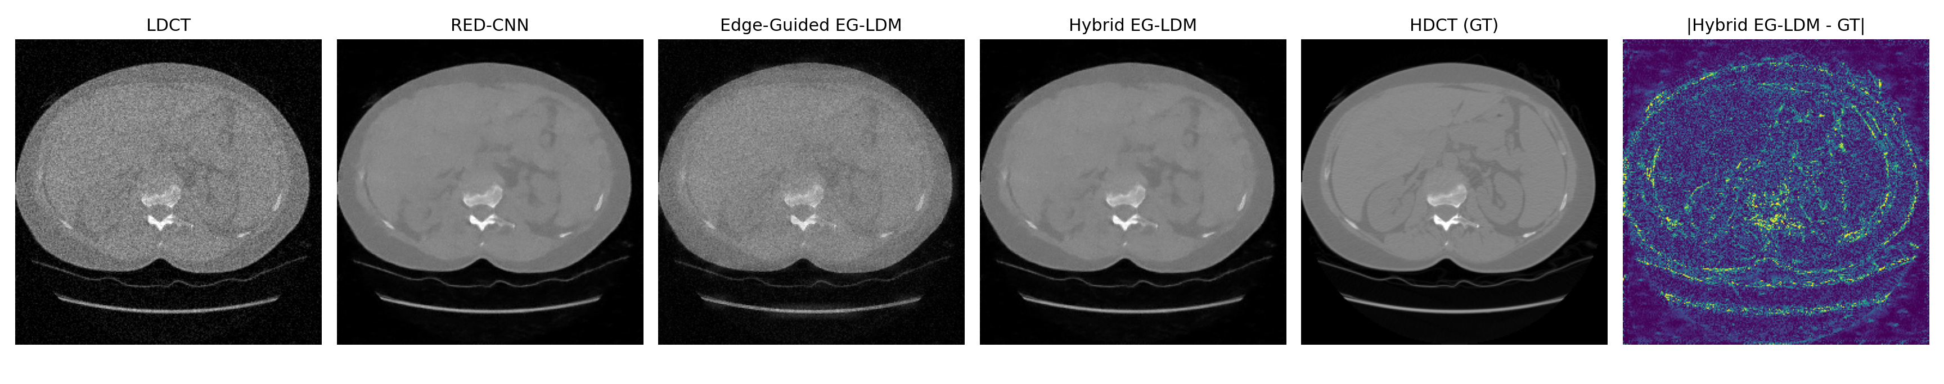
Qualitative Result and Final Takeaway
Takeaways
Edge guidance improves the diffusion family over the no-edge ablation.
Standalone diffusion remains soft; the best role of diffusion is hybrid refinement.
Conservative anchor-aware and edge-adaptive fusion keeps the output tethered to measured LDCT.
Limitation
Low-dose measurements are synthetic, not paired clinical acquisitions.
Result gain over RED-CNN is modest but consistent under the reported protocol.
Thank you.
5

