Slide 1
RSKCNN – Introducing Randomly–Sparse–Kernel CNN
Team name: Maltese
1

Slide 2
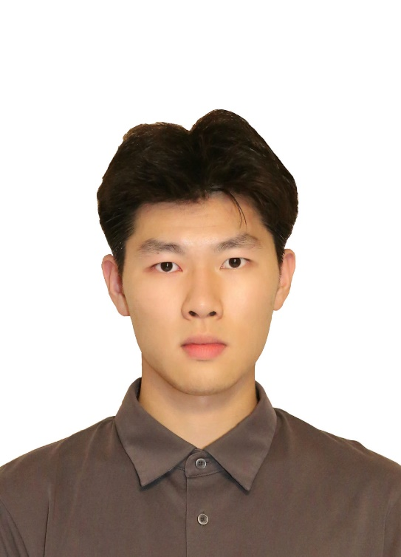

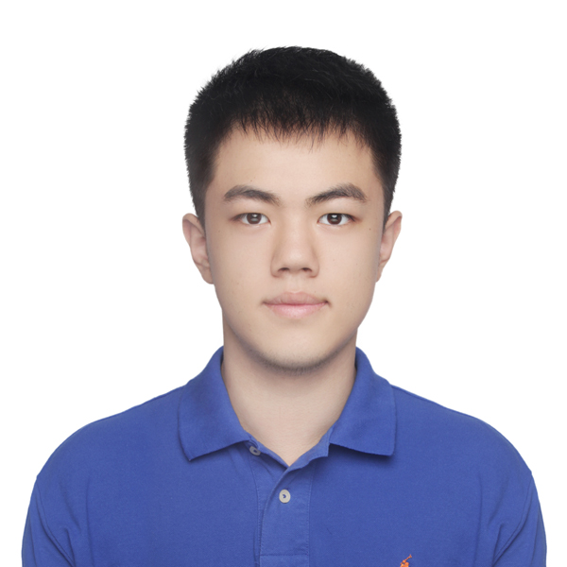
Maltese members
Alex – Zhexi Feng
Jilin Universitiy
Harietta – Yutao He
Nanjing Universitiy
Simon – Yucheng Li
Beijing Normal University -- Hong Kong Baptist University United International College
2

Slide 3
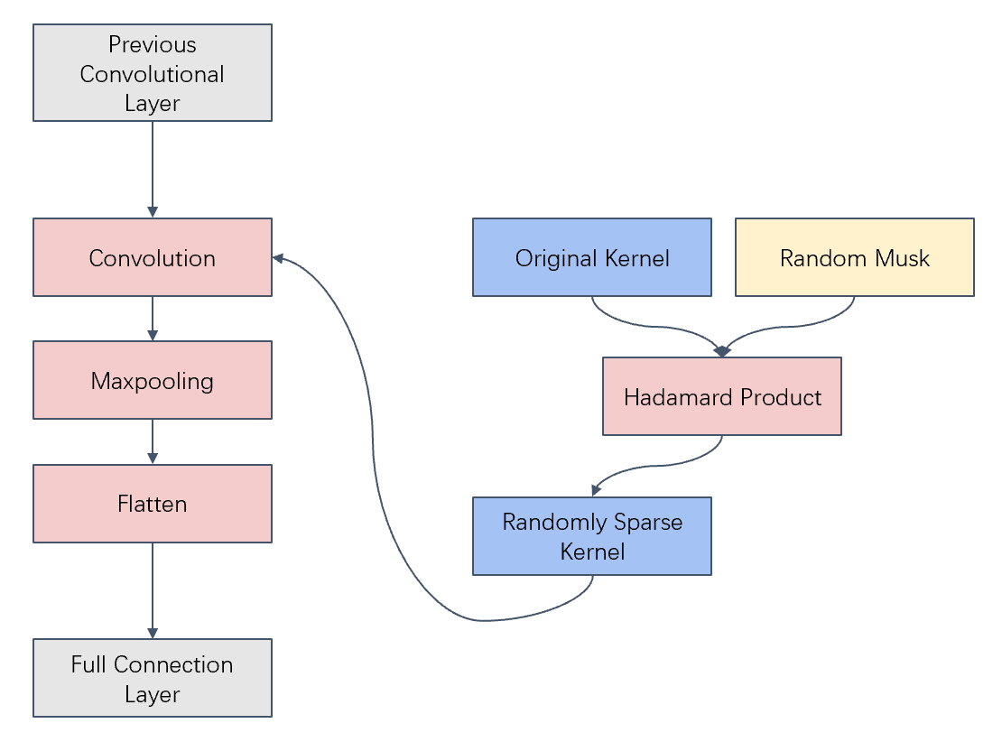
Contents
①
Background
②
Related Work
③
Method
④
Experiment
⑤
Conclusion and Prospect
Simon - Yucheng Li 3

Slide 4
Background
①
4

Slide 5
Background
exhibit excellent performance in many image processing and computer vision tasks and beyond.
complex structure
the vast number of parameters
LeNet-5: 61 thousand
VGG-16: 1.3 million
limited transferability
easy to overfit
Simon - Yucheng Li 5

Slide 6
Related Work
②
6

Slide 7
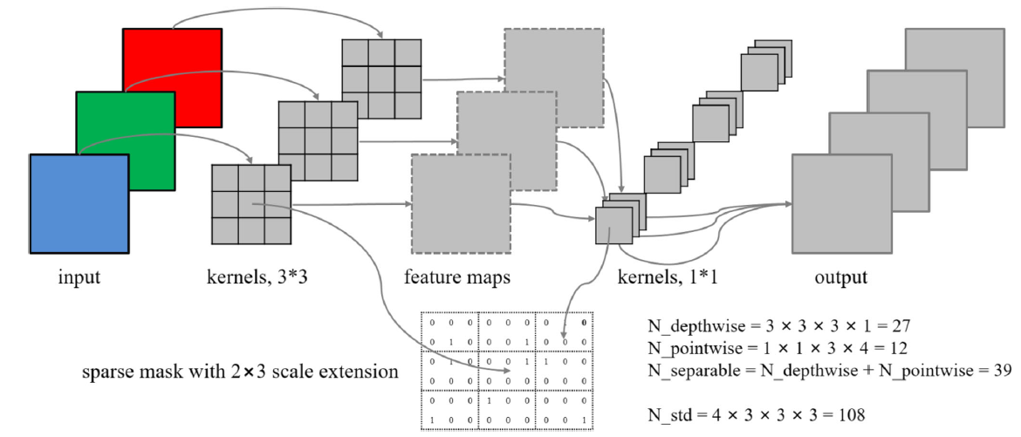
Related Work
《Block-sparse CNN: towards a fast and memory-efficient framework for convolutional neural networks》[1]
BSCNN
Introduces sparse matrices to randomise convolutional kernels
Reduces storage space requirements and time complexity.
But usually does not improve model accuracy.
Simon - Yucheng Li 7

Slide 8
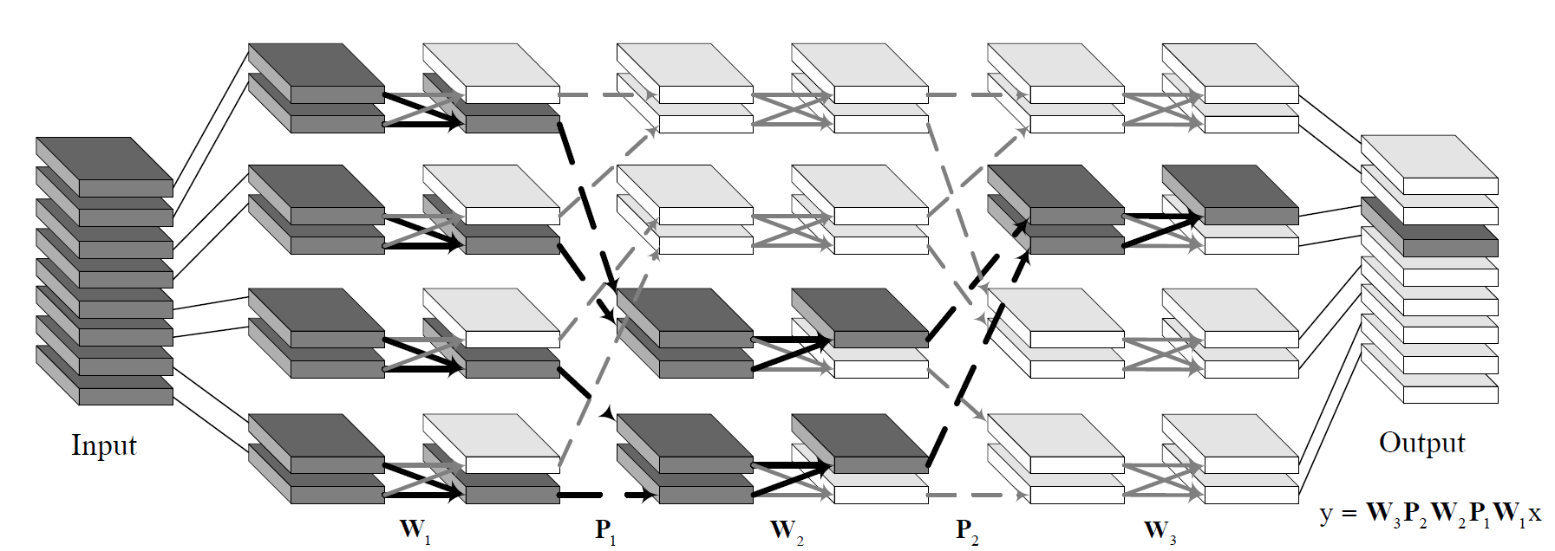
Related Work
《Interleaved Structured Sparse Convolutional Neural Networks》[2]
IGCV2
Extends two structured sparse kernels to the product of more structured sparse kernels
Introduces complementary and balancing conditions
Model size, computational complexity, classification performance
Simon - Yucheng Li 8

Slide 9
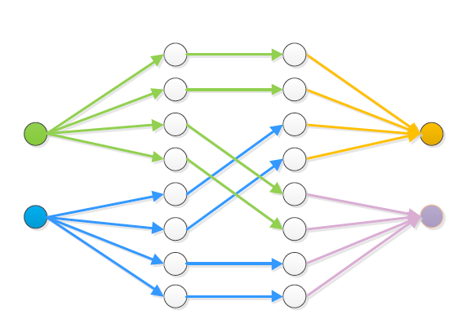
Related Work
《IGCV3: Interleaved Low-Rank Group Convolutions for Efficient Deep Neural Networks》[3]
IGCV3
Combines the composition of structured sparse kernels and low-rank kernels
Introduces a low-rank design pattern into group pointwise convolutions
Outperforms IGCV2
Simon - Yucheng Li 9

Slide 10
Method
③
10

Slide 11
Method Overview
Dropout in convolutional kernel
Prevent overfitting
Accuracy
Speed
Alex - Zhexi Feng 11

Slide 12
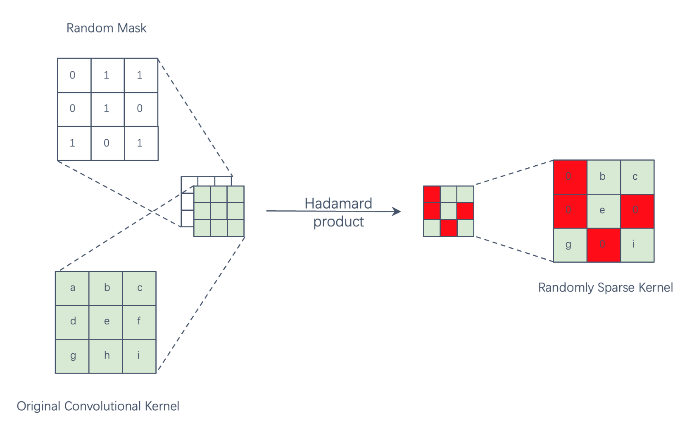
Implement Details
Set P
Random mask
Hadamard product
Multiply P while testing
Alex - Zhexi Feng 12

Slide 13
Output feature map
Iteration1
Iteration2
Iteration3
Alex - Zhexi Feng 13
Notes:
Created by @srvmshr
Sourav @ yahoo.com

Slide 14
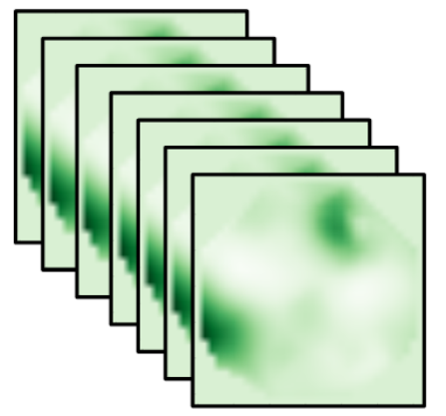
Convolutional Layer
Hidden Layers
Flatten
Softmax
Conv Last
Output Layer
Input Layer
Conv1
Conv2
Y
X
Alex - Zhexi Feng 14
Notes:
Created By @srvmshr
sourav@yahoo.com

Slide 15
Method Improvement
Defect: Slow convergence rate
Higher p converge faster
Solution: Initial P to 1 and decrease
Alex - Zhexi Feng 15

Slide 16
Using
P different
Final convolutional layer size
Test best p before use
Alex - Zhexi Feng 16

Slide 17
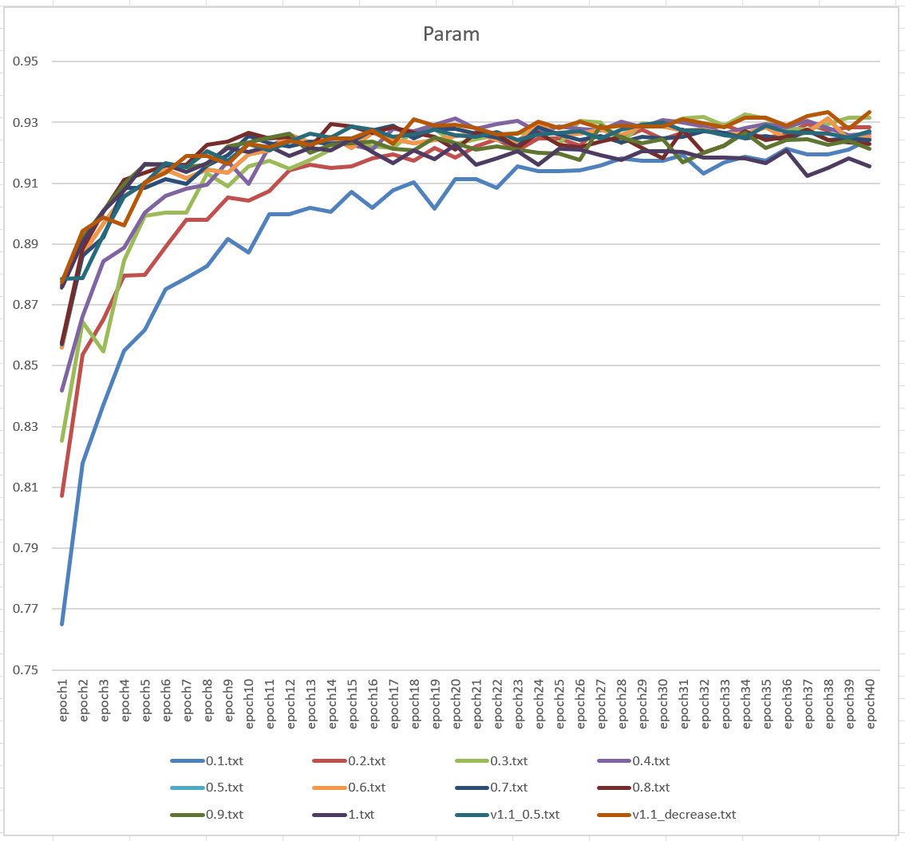
Implement
First round P=1
Test different P
Initial P to 1 and decrease
Alex - Zhexi Feng 17

Slide 18
Experiment
④
18

Slide 19
Different Hardware and Platform
A800（Nvidia） ubantu（x86）
4090laptop（Nvidia） windows11 （x86）
i913980hx（Intel） windows11 （x86）
m3pro （Apple）MacOS （ARM）
Alex - Zhexi Feng 19

Slide 20
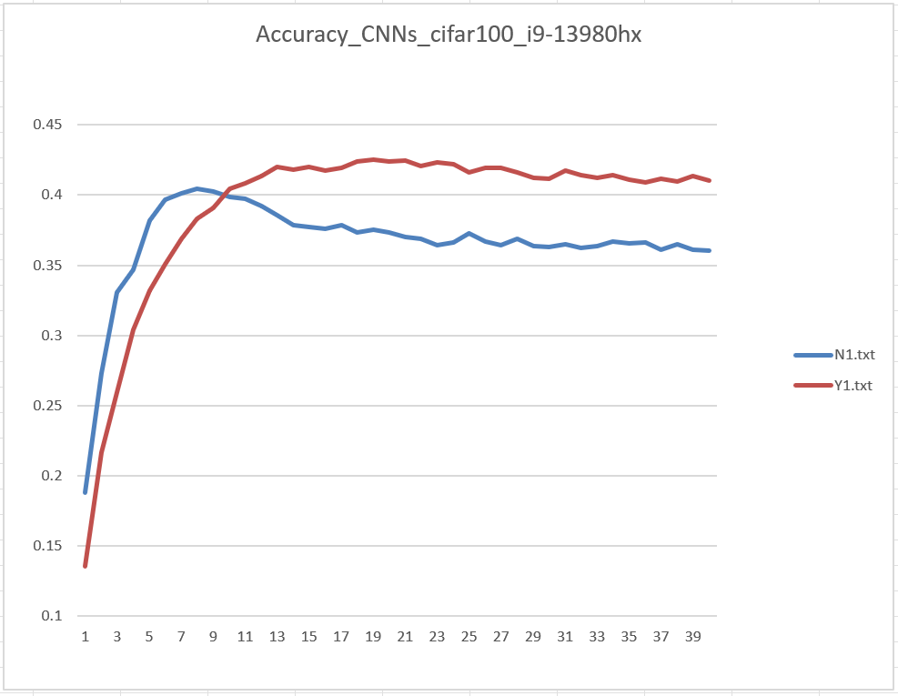
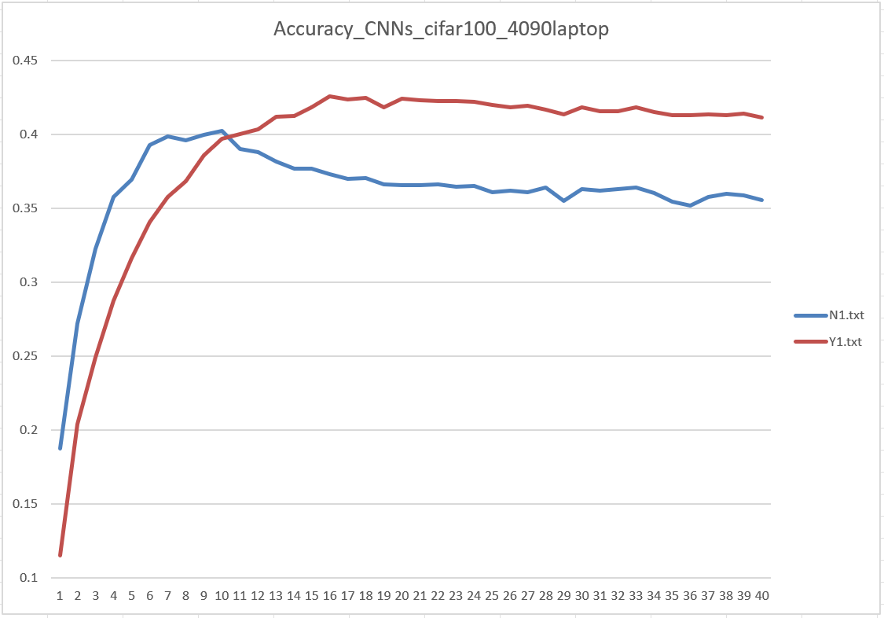
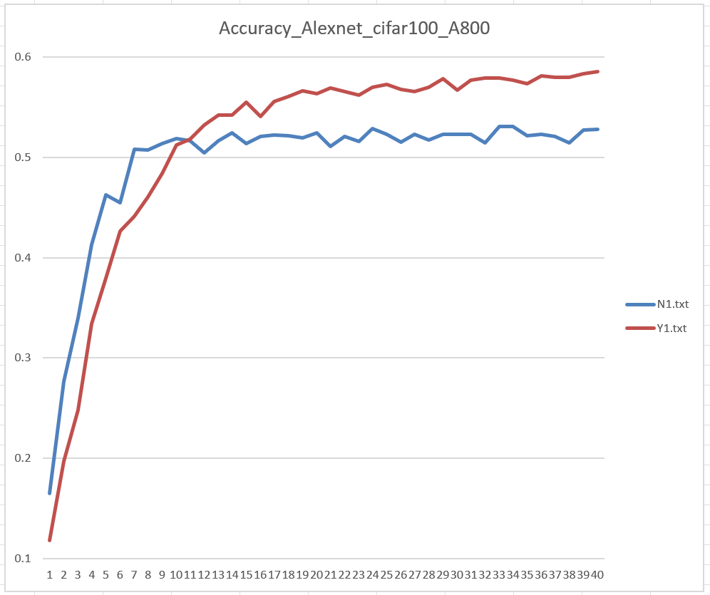
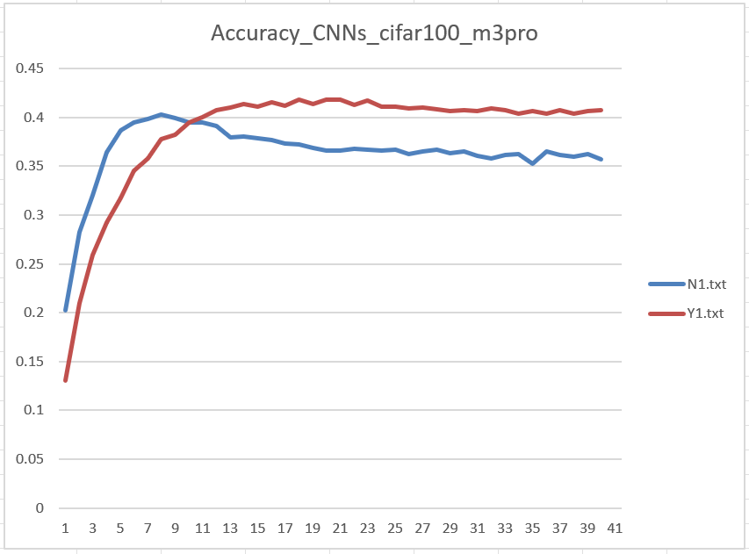
Accuracy
Red: our method
Blue: traditional method
Alex - Zhexi Feng 20

Slide 21
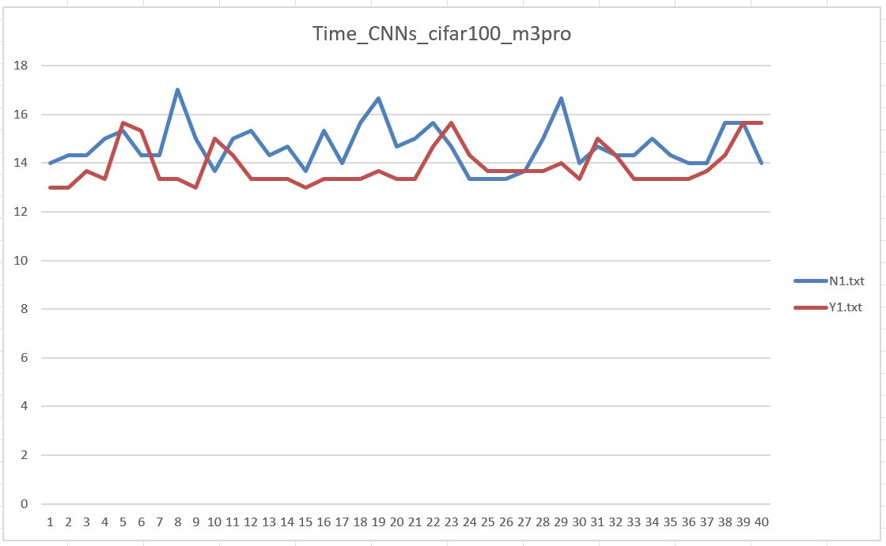
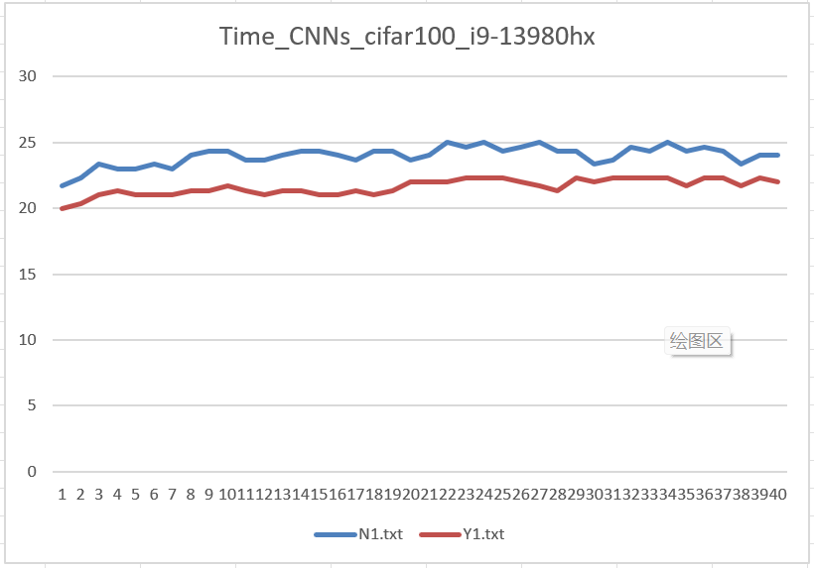
Time
Alex - Zhexi Feng 21

Slide 22
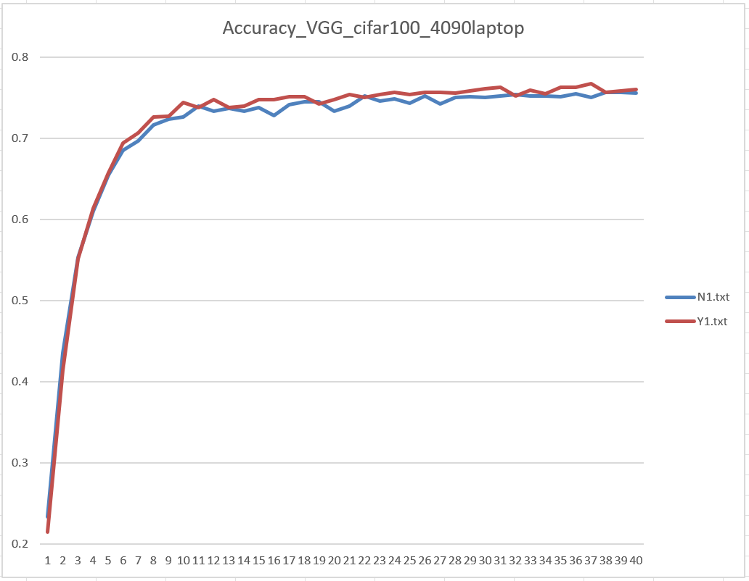
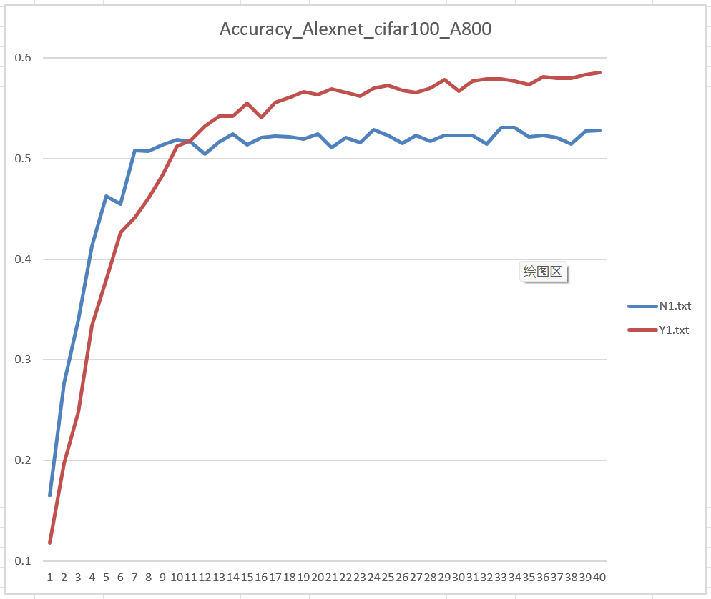
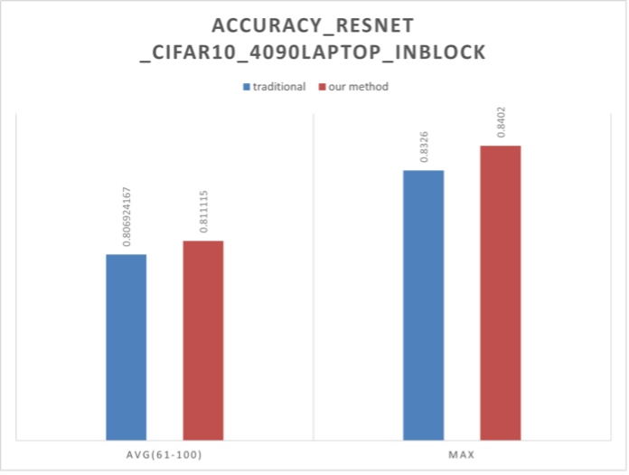
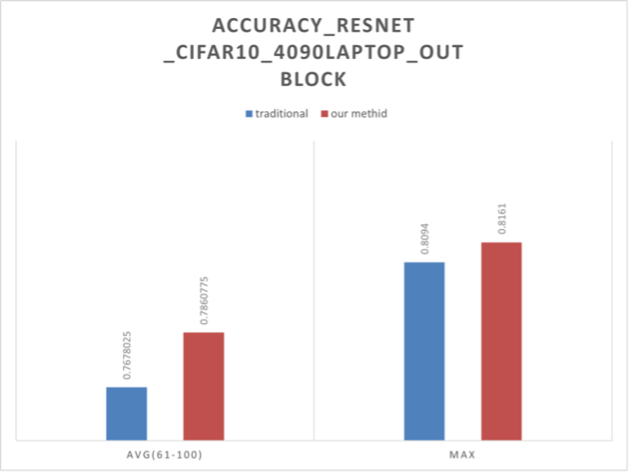
Different Network
Alex - Zhexi Feng 22

Slide 23
Different Dataset
MNIST
MNIST-fashion
cifar10
cifar100
Caltech101
Caltech256
Alex - Zhexi Feng 23

Slide 24
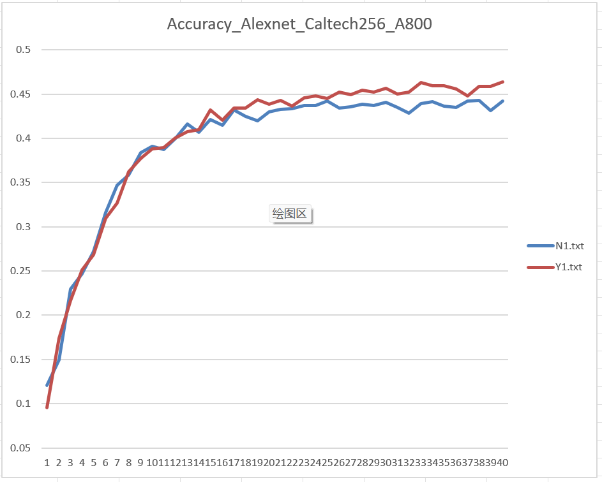
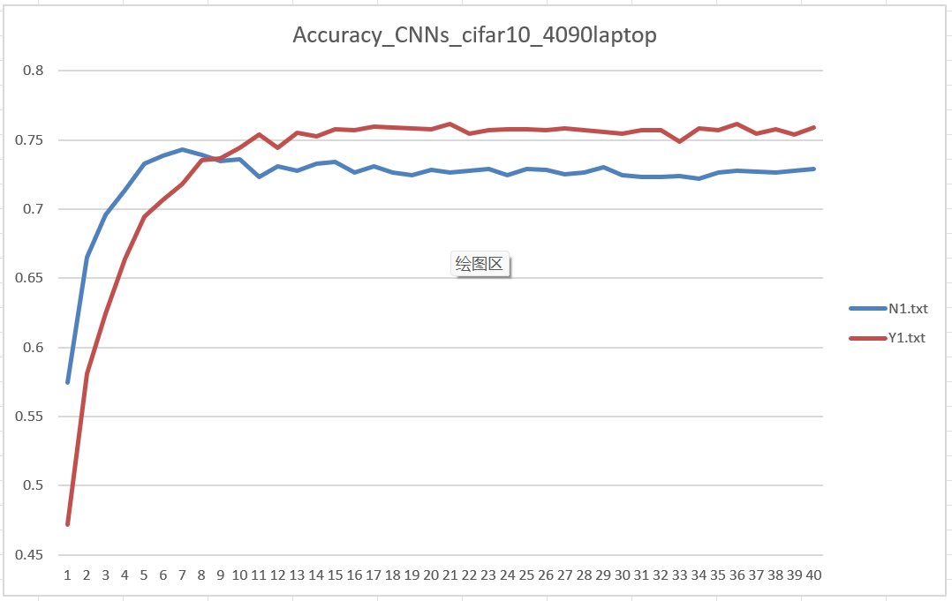
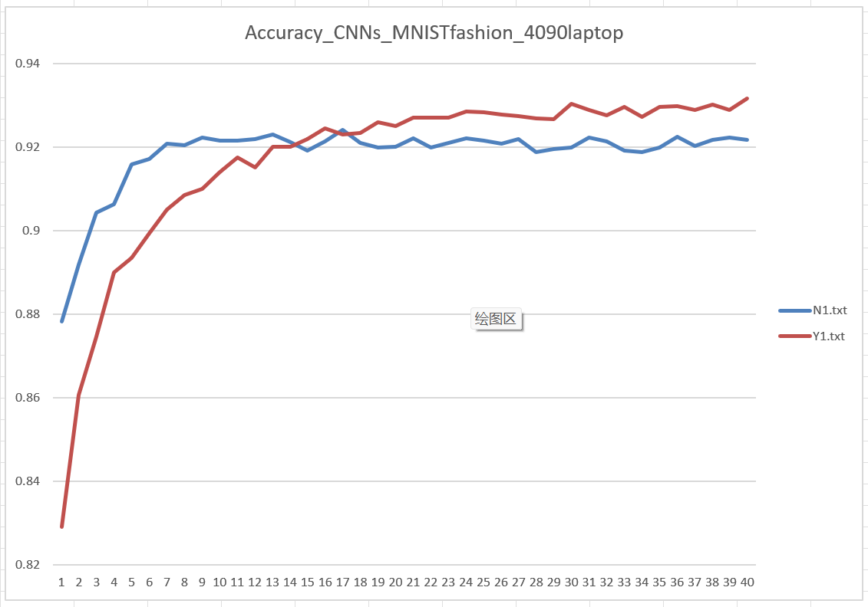
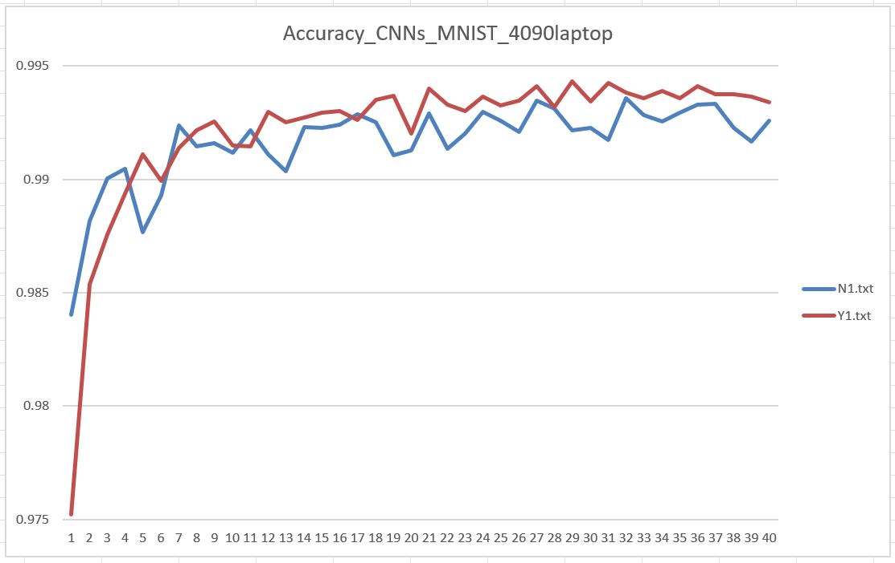
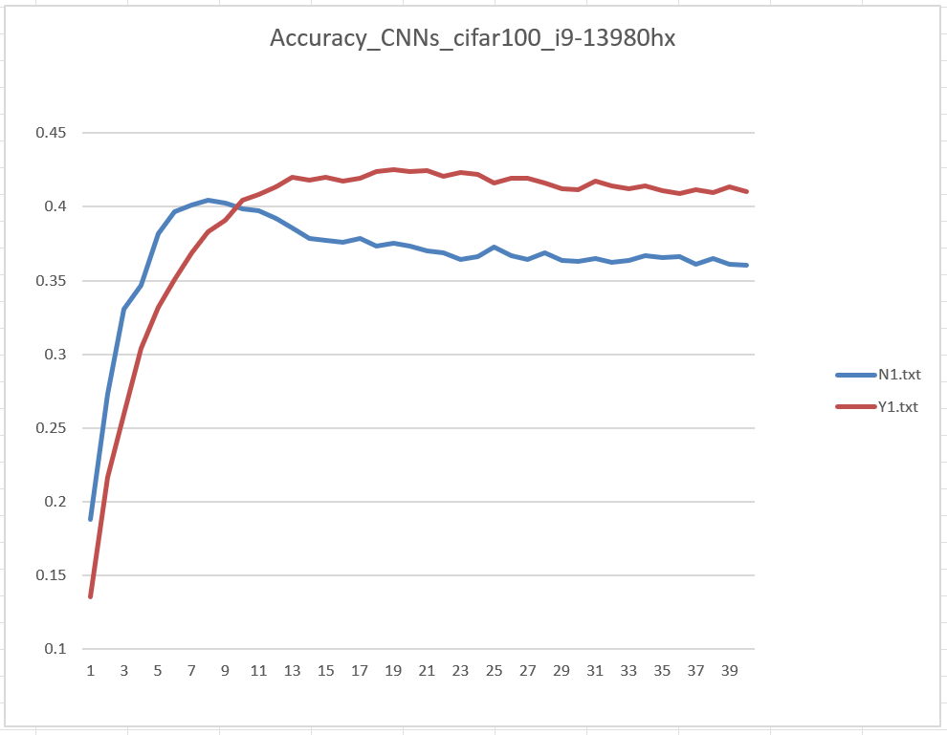
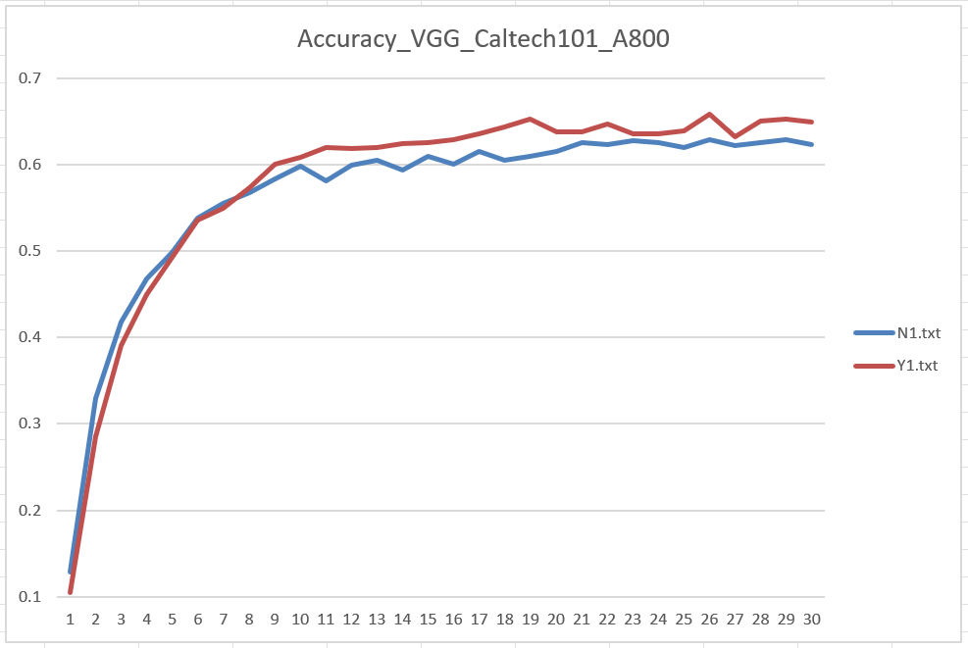
Alex - Zhexi Feng 24

Slide 25
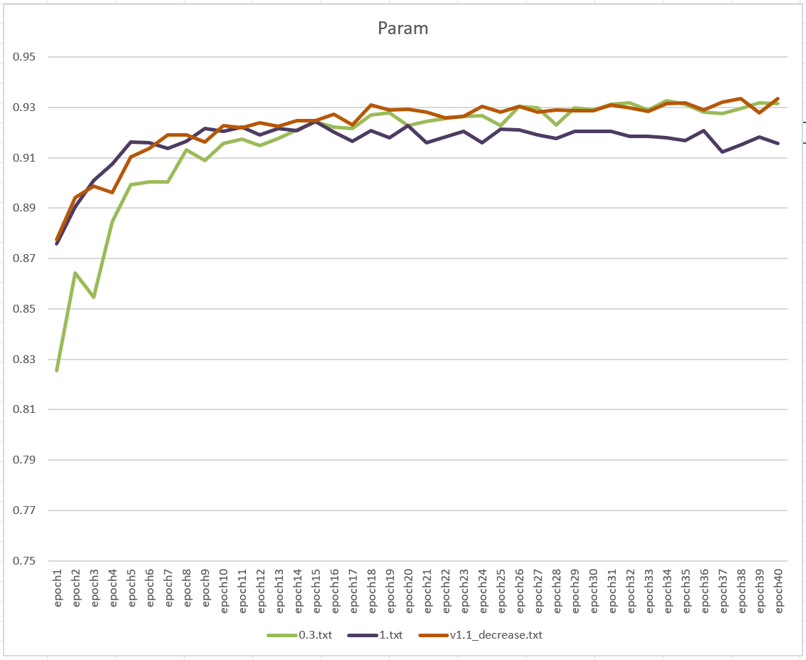
With improvement
Alex - Zhexi Feng 25

Slide 26
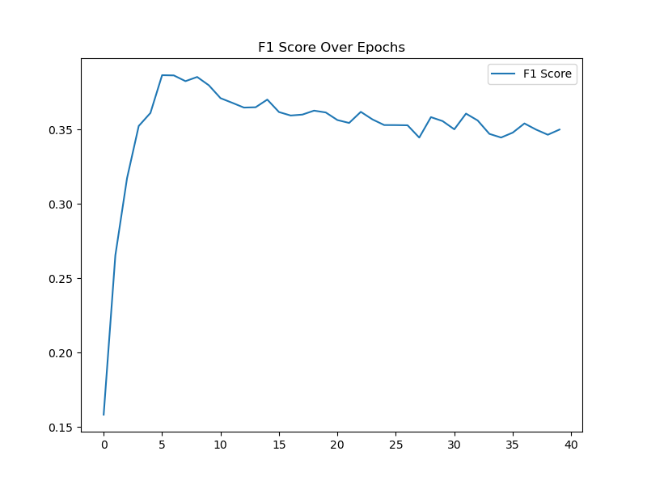
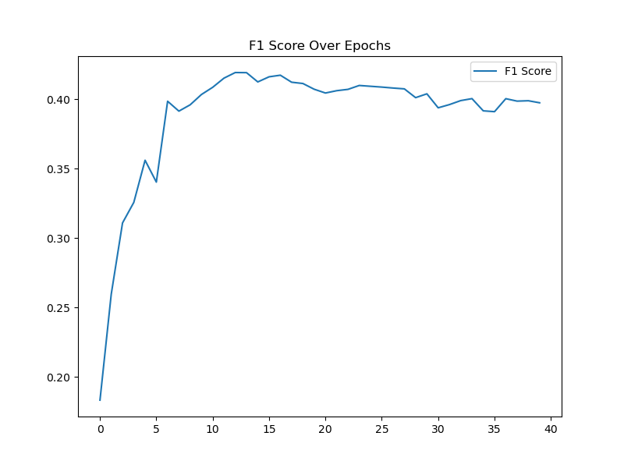
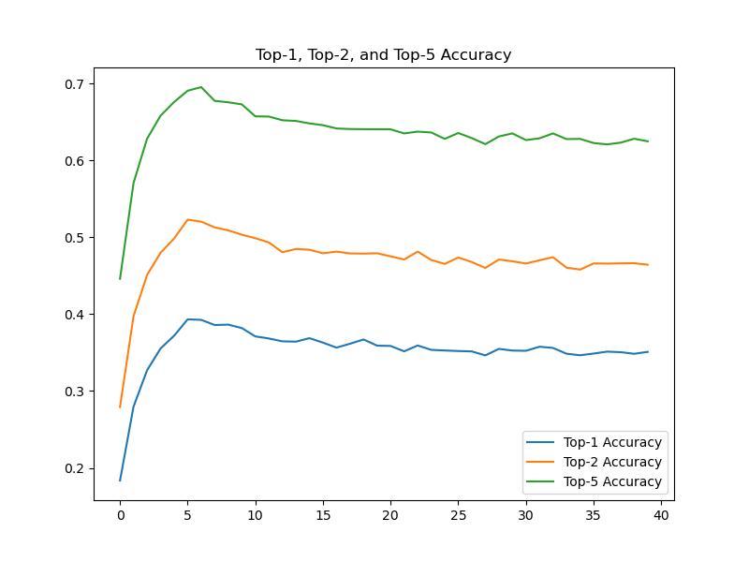
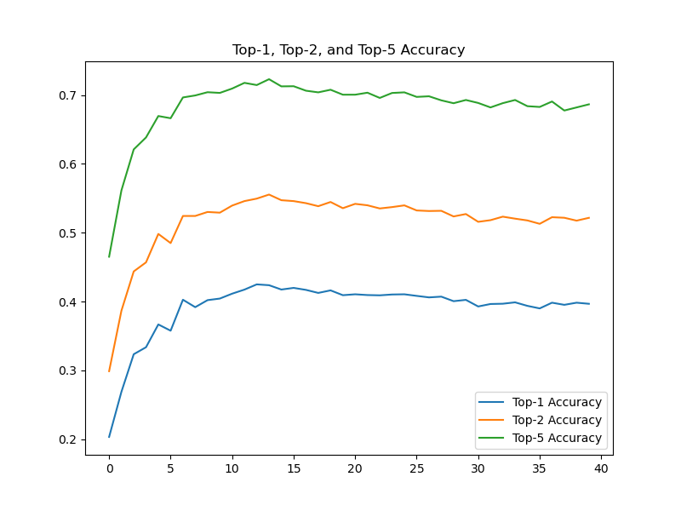
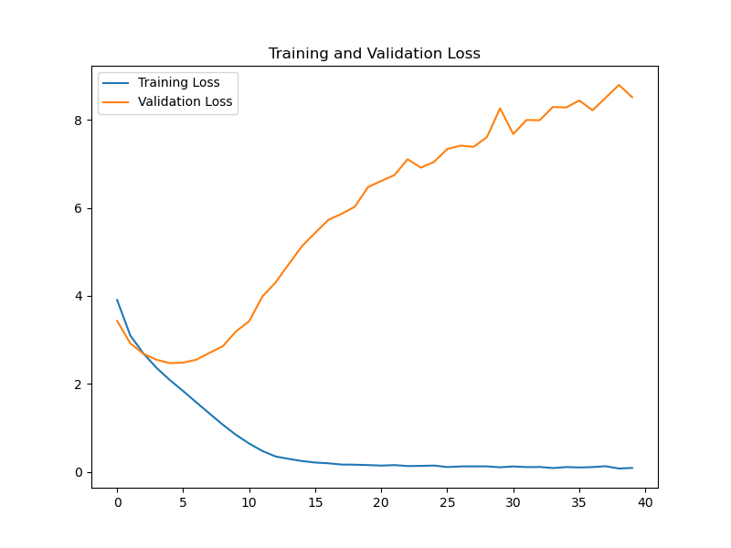
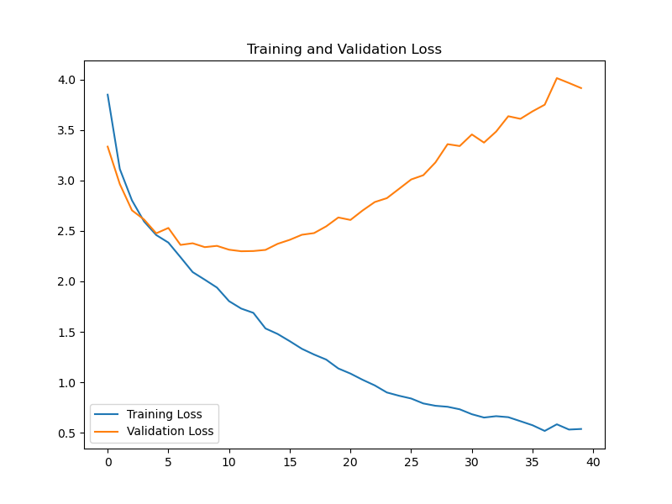
Other Metrics
Right: our method
Left: traditional method
Alex - Zhexi Feng 26

Slide 27
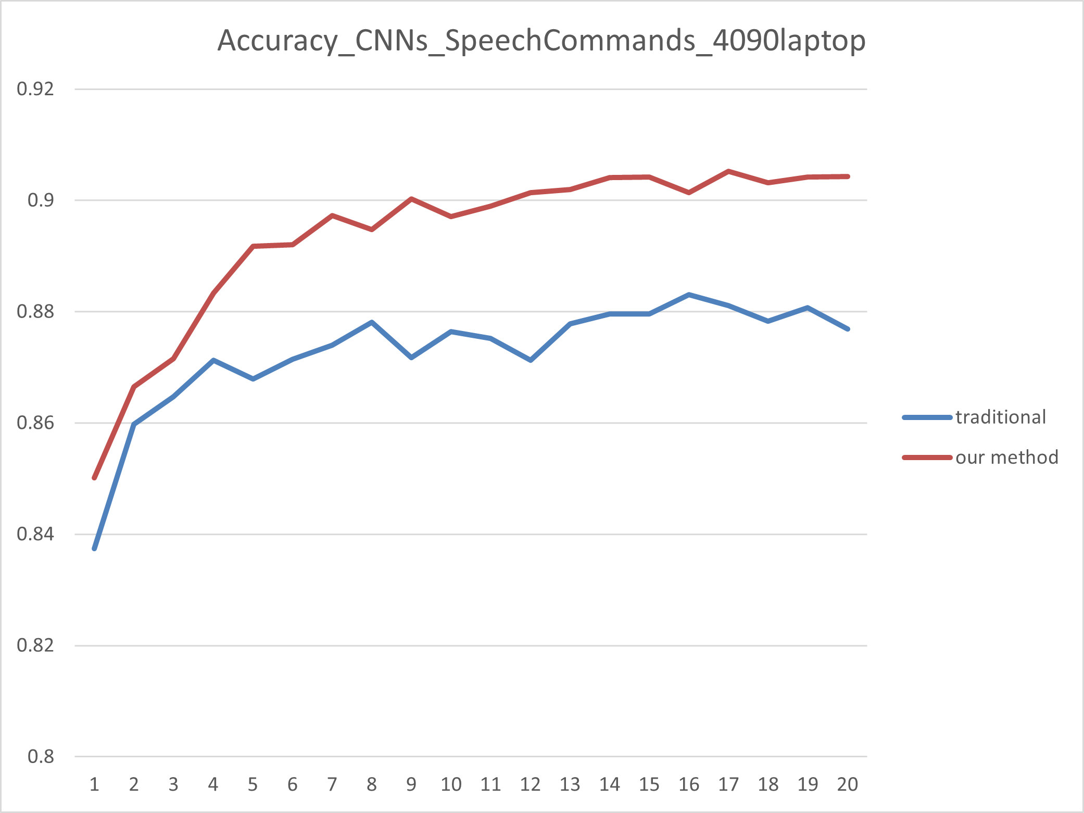
Other Tasks Using SRKCNN
Alex - Zhexi Feng 27

Slide 28
Conclusion and Prospect
⑤
28

Slide 29
Result
Efficiency
Less time overhead
High accuracy
Cifar10/100
MNIST
MNIST-FASHION
Caltech101/256
Simon - Yucheng Li 29

Slide 30
Solved problem
Overfitting phenomenon
Large Data size
Simon - Yucheng Li 30

Slide 31

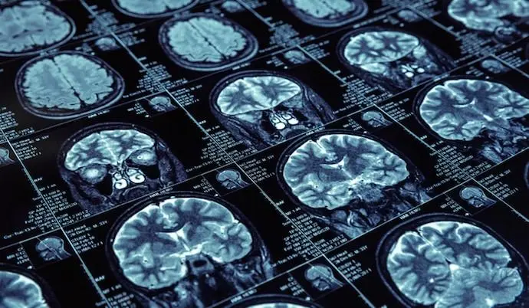
Application
Vehicle automatic driving
Identify traffic information
Medical imaging
Identify disease type
https://www.sohu.com/a/764938005_120134505
https://baike.baidu.com/tashuo/browse/content?id=db3f0c11480b65d5057ca7aa
Simon - Yucheng Li 31

Slide 32
Future work
Algorithm optimization
Better methods to obtain P-values, improved accuracy.
How does the algorithm reduce the number of parameters and improve the speed.
Simon - Yucheng Li 32

Slide 33
Reference
[1] N. Wen, R. Guo, B. He, Y. Fan, and D. Ma, “Block-sparse cnn: towards a fast and memory-efficient framework for convolutional neural networks,” Applied Intelligence, vol. 51, pp. 441–452, 2021.
[2] G. Xie, J. Wang, T. Zhang, J. Lai, R. Hong, and G.- J. Qi, “Interleaved structured sparse convolutional neural networks,” in Proceedings of the IEEE Conference on Computer Vision and Pattern Recognition, 2018, pp.8847–8856.
[3] K. Sun, M. Li, D. Liu, and J. Wang, “Igcv3: Interleaved low-rank group convolutions for efficient deep neural networks,” arXiv preprint arXiv:1806.00178, 2018.
33

