Slide 1


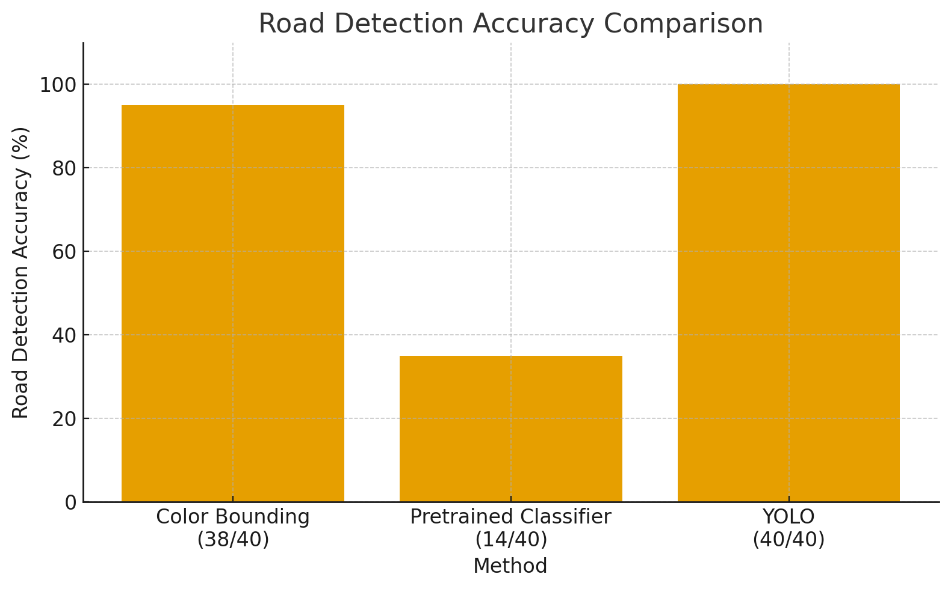
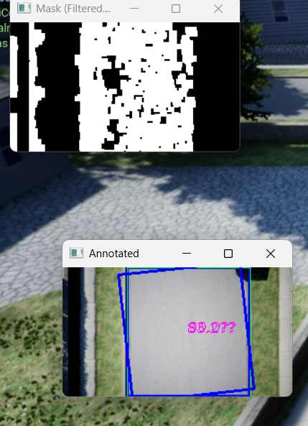
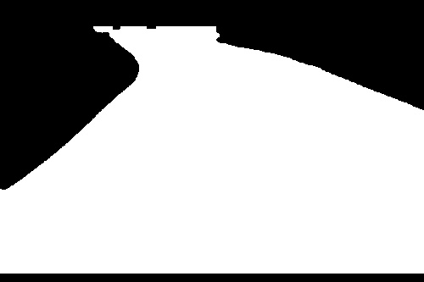
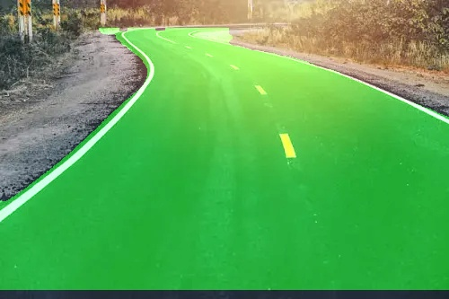
HERMES: A High-precision Enhanced Road-Mapper
with Embedded CV Systems
Arnav Prabhudesai
Advisor: Dr. Crowthers
Introduction
Online mapping using methods that are not always frequently updated results in low quality maps for many people. This is a large problem, especially for the millions of people that live in areas that are not so frequently mapped by large scale providers like Apple or Google Maps. It affects areas both remote rural regions and rapidly changing urban regions often do not have high-quality and frequently updated maps.
The aim of this project is to build a drone that can autonomously map a road system. This will be done using a drone that has a camera mounted onboard. After collecting the data, the drone will transfer it to another device, where it will be rendered as an actual map that can be used to navigate.
Problem
Online mapping often uses expensive, inaccurate and slow methods, resulting in maps that are not frequently updated with current data.
Objective
The aim of this project is to build a drone that can autonomously map a road system using a CV model that works in many different conditions.
Analysis
The bounding-box method achieved a 95% detection rate for the location of the road with a very low latency of 7 ms. However, it could only find the general direction of the road 17.5% of the frames that it was tested on. Worse, its reliance on color similarity, reduces the model’s capability to adapt. Therefore, this method is too sensitive to be practical.
The pretrained Image Classifier, detected the road in 35% of frames with a latency of 142 ms. The lower accuracy means the training data was too generic. Due to its highest latency, this method is both inaccurate and inefficient.
The custom YOLO model successfully identified the area of the road 100% of the time. It also produced high detail pixel segmentation that found each pixel that contained the road. With a 97% accuracy, this model found the road’s exact shape and boundaries. However, this high accuracy comes at a computational cost of 100 ms per frame. Despite the higher computational load, the accuracy and reliability of this method make it the most effective strategy evaluated.
Therefore, with this information and the Pugh Chart below, it was determined that the custom-trained YOLO computer vision model performed the strongest among all tested approaches.
Background
Current methods for mapping road infrastructure primarily rely on satellite imagery, or manned vehicles such as Google’s Street view cars.
These methods can provide accurate maps but are largely inefficient due to their high cost and low speed
Images made by satellites often have low spatial resolution which can reduce the precision of the data.
Worse, these satellites depend on the area having good weather and no cloud cover.
On the other hand, vehicle-based mapping systems that use LiDAR, cameras, and GPS system are extremely difficult to logistically, since they require a large number of resources
In addition, these vehicles are not at all autonomous, meaning that they require skilled personnel to operate.
Therefore, vehicle-based mapping systems are only viable in more urbanized areas which can support the equipment required.
More remote regions, on the other hand, lack the infrastructure, making these vehicles hard to support and leaving no financial incentives to businesses to maintain coverage.
Successful implementation of a color-based bounding box on a segment of road. Notably, the model is able to identify the location on direction of the road. However, the model is also confused by the presence of a sidewalk, which is the same color as the road.
Pugh Decision Chart for Model Type
Method | Accuracy (10) | Direction (7) | Latency (3) | Total (Weighted)
Custom YOLO | 10 | 3 | 5 | 136
Color Bounding Box | 8 | 1 | 10 | 117
Pretrained YOLO | 1 | 6 | 3 | 61
Camera Vision Methods
There are two main strategies to accomplish this.
The first strategy, using a bounding box, involves finding the color of the road manually. After that, the camera will filter for this color and draw a box around the area with the most of this color.
It is also possible to use image classification, which involves using an AI model to classify the different things it sees in the image, such as a tree, a mailbox, or in this case, a road.
In addition, the strategy of image classification can be divided into using a custom neural network, made with a framework like YOLO, or a premade generic neural network.
Premade neural networks are much easier to implement, as they do not require training, which is a long process.
Custom-made models require much less computational power and device storage space.
Successful implementation of a YOLO CV model where all pixels identified to be within the road are highlighted in green. Notably, this method does not produce an accurate “overall direction” of the road but is does show the exact path. Therefore, this method is more computationally expensive, as is requires both preprocessing and postprocessing on the incoming data.
Further Applications
This system has the potential to serve much more than just navigation.
In a disaster response scenario, drones equipped with this technology could rapidly scan and map road networks, detect blockages or damage, and relay information on how to navigate through damaged infrastructure in real time. Early detection of damaged roads could prevent accidents, guide emergency responders, and support faster recovery efforts. In a natural disaster drones equipped with this system could be deployed within minutes. They could scan road networks, identify blocked or collapsed roads, and provide real-time updates to emergency response teams. This rapid information flow could save lives by directing responders along safe routes or helping residents evacuate more quickly.

