Slide 1



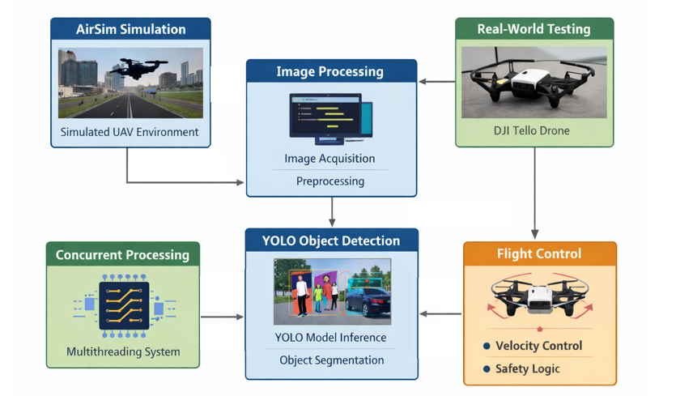
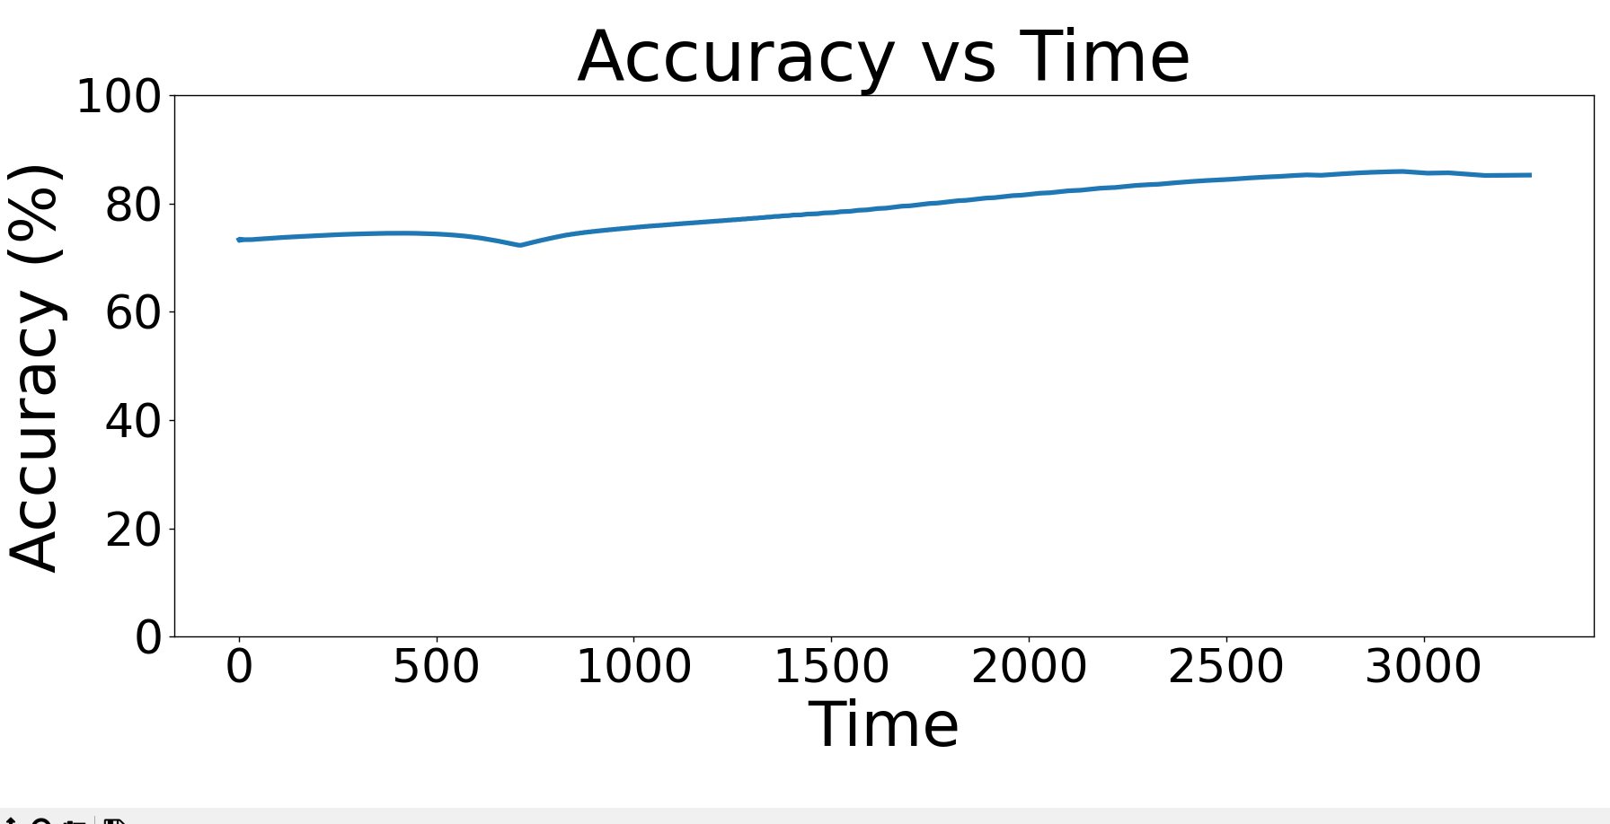
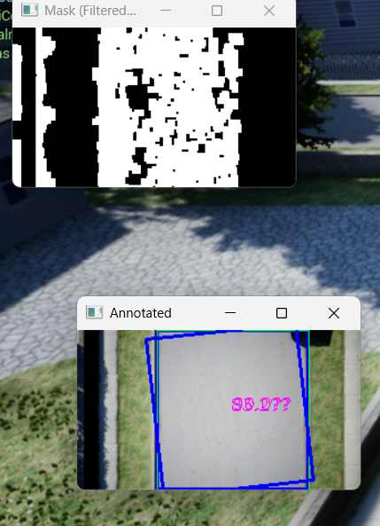
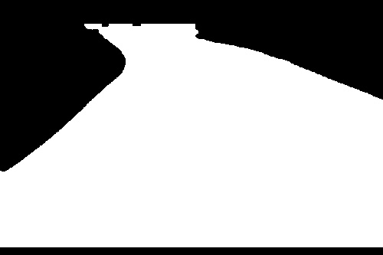
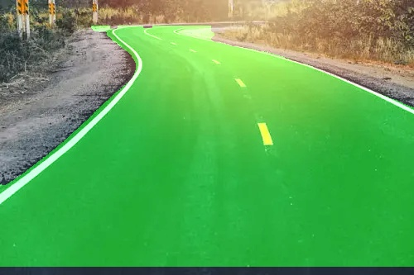
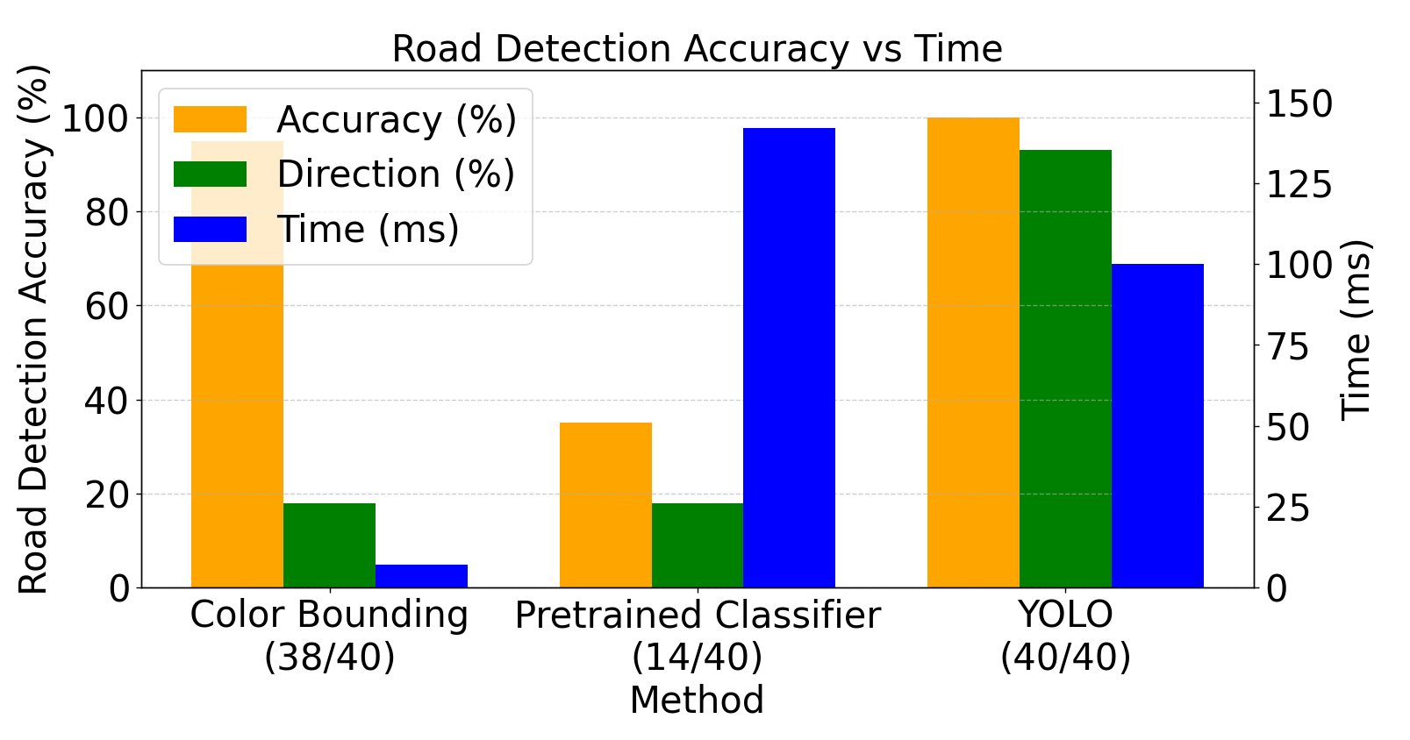
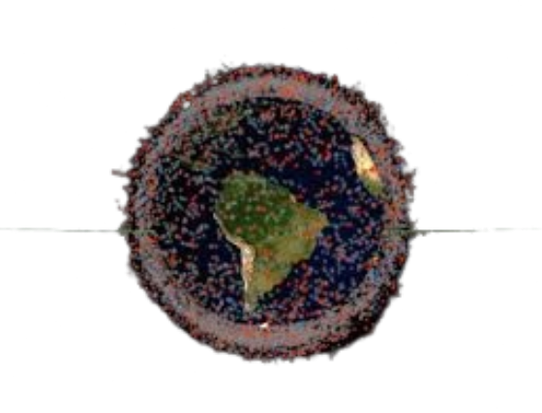
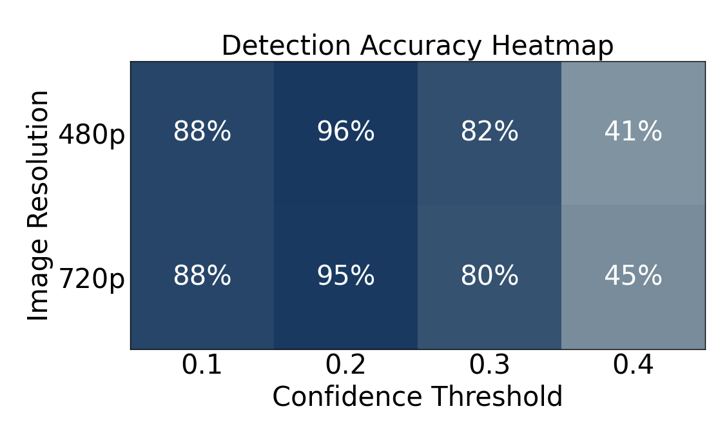

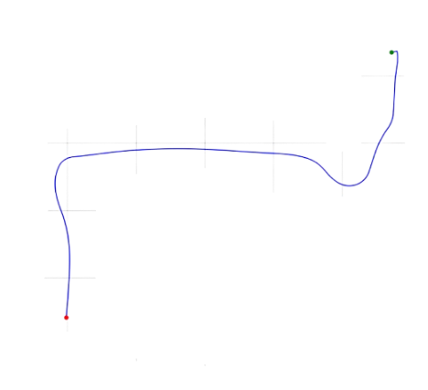
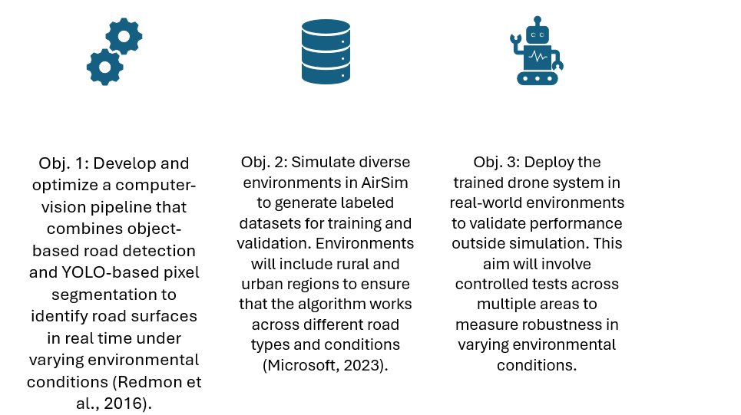
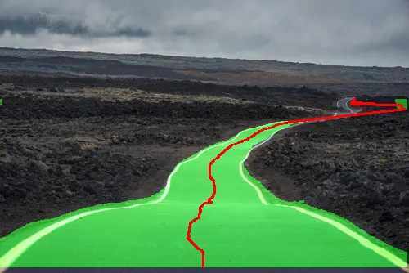
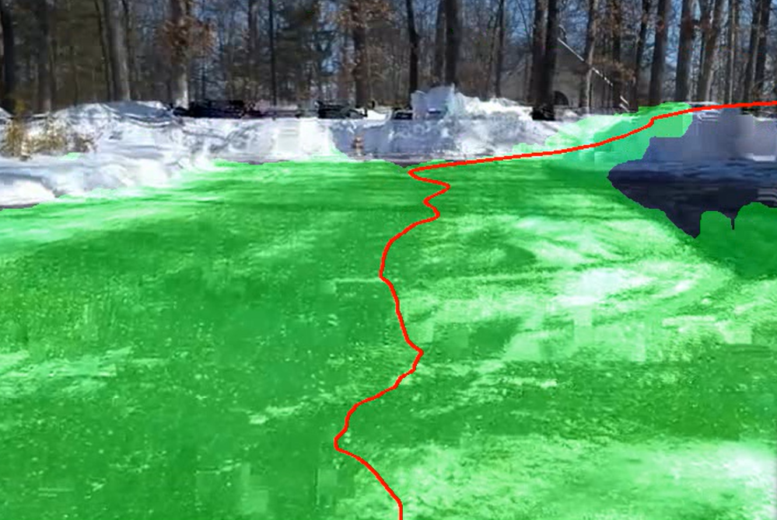
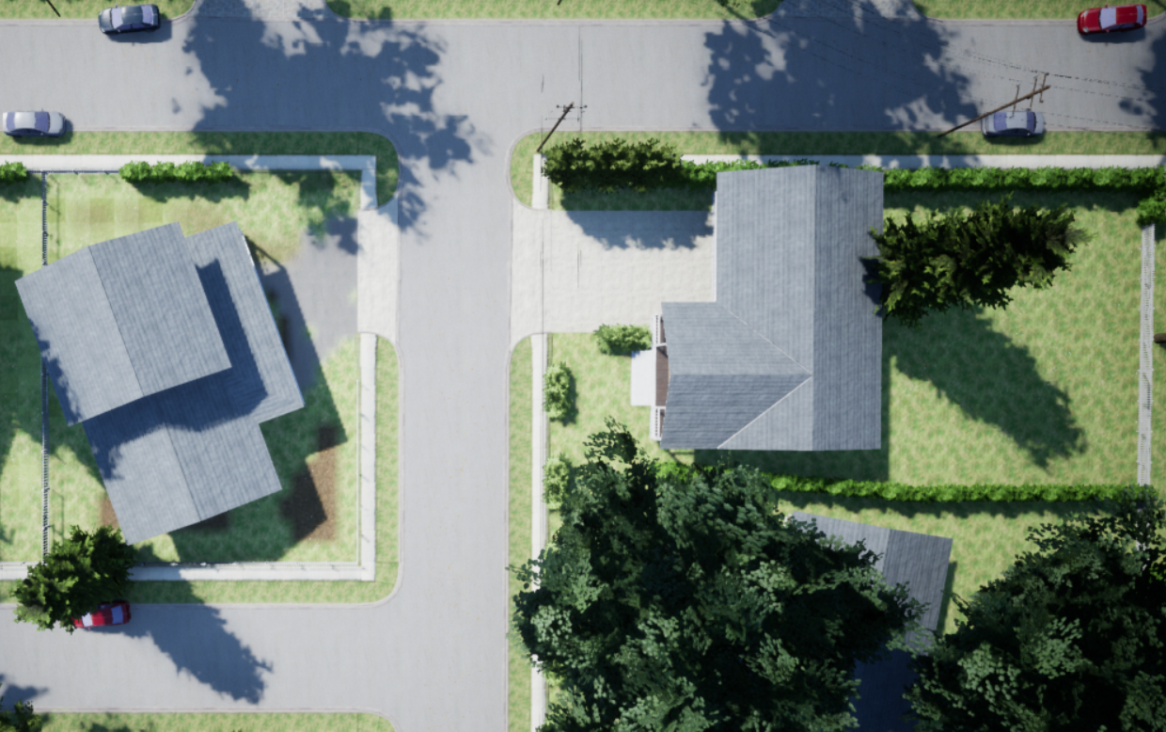
HERMES: A High-precision Enhanced Road-Mapper with Embedded CV Systems
Arnav Prabhudesai
Advisor: Dr. Crowthers
DISCUSSION
ENGINEERING OBJECTIVE
Discussion
Figure 10 (Right) shows
the accuracy of the drone
was measured by finding
the predicted value for the
center of the road and
subtracting it from the
actual value for the center
of the road. The drone
maintained an overall accuracy of >70% at all times.
Each frame took on average 500ms to process with the maximum being 2523ms. In multiple tests in simulation, the drone never left the boundaries of the road.
ENGINEERING NEED
Objective
The aim of this project is to build a drone that can autonomously map a road system using a CV model that works in many different conditions.
Graphical Abstract
Problem
Online mapping often uses expensive, inaccurate and slow methods, resulting in maps that are not frequently updated with current data.
GRAPHICAL ABSTRACT
METHODOLOGY & RESULTS
Bounding Box Detection
YOLOv8 Detection
Fig 1
Fig 2
Fig 3
Fig 4
CONCLUSION
Online mapping using methods that are not always frequently updated results in low quality maps for many people. This is a large problem, especially for disaster areas where rapid mapping is needed. It also affects areas both remote rural regions and rapidly changing urban regions often do not have high-quality and frequently updated maps (UAV Coach, 2024).
The aim of this project is to build a drone that can autonomously map a road system. This will be done using a drone that has a camera mounted onboard.
Maps made by satellites often have low spatial resolution
And depend on the area having good weather and no
cloud cover. On the other hand, vehicle-based mapping
systems that use LiDAR, cameras, and GPS system are
extremely difficult to logistically, since they require many
resources. In addition, these vehicles are not at all autonomous, meaning that they require skilled personnel to operate (Geoweek, News 2023).
Conclusion
The application of a YOLO road detection and segmentation methodology overcomes the limitations associated with approaches. By integrating instance segmentation with a Kalman filter, the model generated a stable centerline that remained resilient to transient detection flickers. This resulted in a smooth, continuous path for the drone to follow, significantly reducing the lateral "jitter" often associated with raw visual processing in autonomous flight.
The drone maintained high fidelity to the intended trajectory by utilizing a proportional control loop driven by the calculated horizontal error.
This approach shows the capabilities and feasibility of using a lightweight and mobile UAV system in autonomously tracking the infrastructure along a road and creating a road geometry map based on positional tracking.
INTRODUCTION
Figures 1 & 2 (Top Left): Successful implementation of a color-based bounding box on a segment of road. Unfortunately, the model is also confused by the presence of a sidewalk, which is the same color as the road.
Figures 3 & 4 (Top Right): Successful implementation of a YOLO CV model where all pixels identified to be within the road are highlighted in green. This method is more computationally expensive, as is requires both preprocessing and postprocessing on the incoming data.
Figure 5 (Right): Latency and accuracy numbers for each of the 3 models. Accuracy comes from a dataset made of online images, real-world image, and simulation images. Latency is the average over all 40 images. A Custom YOLO model was shown to be the best.
Metrics for each CV Model
Fig 5
TOPSIS Analysis for Model Type
Metrics for each Preprocessing Config
Figure 6: Different preprocessing configurations and their accuracy. After testing, it was determined that a 480p image with a confidence threshold of 0.2 is optimal. 720p was not used because it was slower and did not provide a statistically significant increase in accuracy by any significance level (p > 0.86).
FUTURE STEPS
Method | Accuracy (1/2) | Direction (1/3) | Latency (1/6) | Ideality
Custom YOLO | 40/40 | 37/40 | 100 | 0.807
Color Bounding Box | 38/40 | 7/40 | 7 | 0.485
Pretrained YOLO | 14/40 | 4/40 | 142 | 0.000
Further Applications
Currently, I am working on transferring movement from the simulation into the real world. This would complete the functionality of the drone and prove its importance outside of solely a simulated environment. In addition, I would also like to implement better logic for navigating junctions and crossroads.
In a disaster response scenario, drones equipped with this technology could rapidly scan and map road networks, detect blockages or damage, and relay information on how to navigate through damaged infrastructure in real time. Early detection of damaged roads could prevent accidents, guide emergency responders, and support faster recovery efforts. In a natural disaster drones equipped with this system could be deployed within minutes. They could scan road networks, identify blocked or collapsed roads, and provide real-time updates to emergency response teams. This rapid information flow could save lives by directing responders along safe routes or helping residents evacuate more quickly.
RESEARCH OBJECTIVES
Research Objectives
The goal of this project is to engineer a system that is capable of autonomously mapping a road system and send that data, including traffic information, to the user’s device. The expected outcome of this work is a robust, low-cost, and scalable drone capable of producing high-resolution road maps in areas with limited prior coverage.
Road Centerline Detection
In order to find the center of the road, a program divides the green segmented area into rows. It then finds the midpoint of each row and applies a Kalman filter in order the smooth the centerline.
Figure 7 (right): Isolated centerline
in red for a segmented road image
Real World Implementation
After testing the system in simulation, the code was run in the real world. To do this, the DJI Tello drone was used for this. The drone was run in a 20 second flight where it took off, moved up and rotated, and then landed, while analyzing camera frames in real time.
Figure 9 (right): Real world
road detection using a
drone with 720p resolution
at 30fps. Still frame taken
from video footage of flight
REFERENCES
References
Geoweek News. (2023). The state of vehicle-based mobile mapping systems. https://www.geoweeknews.com/news/mobile-mapping-lidar-software-hardware-trimble-leica-riegl
Microsoft. (2023). AirSim (Version 1.8.1) [Computer software]. GitHub. https://github.com/microsoft/AirSimRedmon, J., Divvala, S., Girshick, R., & Farhadi, A. (2016). You only look once: Unified, real-time object detection. In Proceedings of the IEEE Conference on Computer Vision and Pattern Recognition (pp. 779–788). https://doi.org/10.1109/CVPR.2016.91
Singh, R., & Verma, A. (2024). Autonomous UAV navigation using deep learning-based computer vision. Journal of Intelligent & Robotic Systems. https://www.sciencedirect.com/science/article/pii/S2590005624000274
UAV Coach. (2024). Drone mapping: An in-depth guide. https://uavcoach.com/drone-mapping
CAMERA VISION
Map Creation
The program was then used and tested on an AirSim drone with these results.
Figure 8 (right): Map made by
Drone visualized as the path
of the drone versus ground
truth (actual location of road)
in AirSim environment
Camera Vision
The drone can use two main strategies to find the road. The first strategy, using a bounding box, involves finding the color of the road manually. After that, the camera will filter for this color. On the other hand, it is also possible to use image classification, which decides whether each pixel is part of the road. Image classification is much more consistent and precise. However, it is also more computationally heavy (Singh & Verma, 2024). Image classification can either use a framework like YOLO, or a premade neural network.

