Slide 1
Capstone Project
Alex Lohse

Slide 2
Table of Contents
Explored Data
Formulated Question
Visualized Dataset
K Nearest Neighbor Approach
K Nearest Neighbor Results
Conclusion

Slide 3
Formulated Question
Question: Based on the data given, can relationship status be predicted based on personal health?

Slide 4
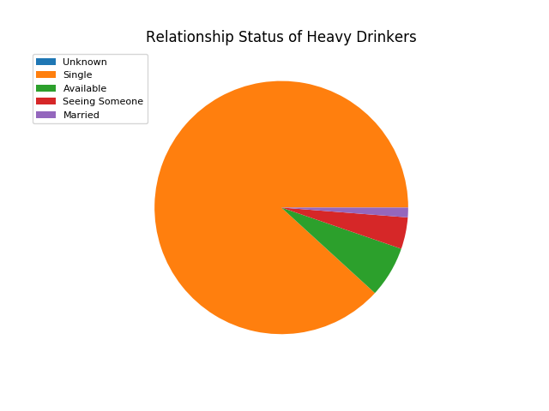
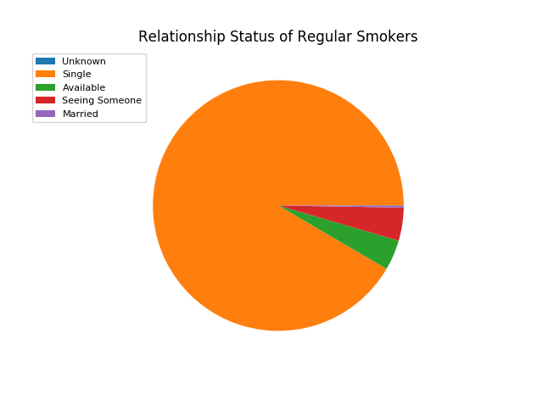
Visualized Dataset
These graphs show sample data of relationship status’ based on health habits

Slide 5
K Nearest Neighbor Approach
Use K Nearest Neighbors to predict a persons status
Select random data points each time the program’s ran to make the best model
Fit the model 150 times to get good results

Slide 6
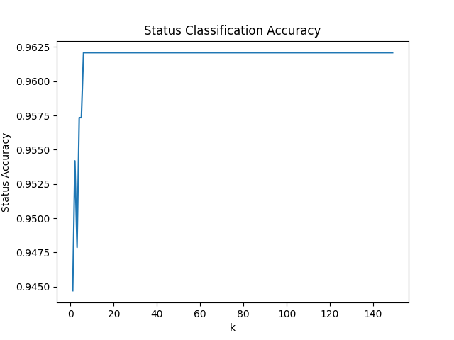
K Nearest Neighbor Results
As a result of running the K Nearest Neighbor algorithm, the status accuracy plateaued after k was equal to six. After fitting the data at least five times, the program was able to strongly predict a persons status with about 96% accuracy.

Slide 7
Conclusion
Most people are single despite health habits and helped with highly accurate prediction

