Slide 1
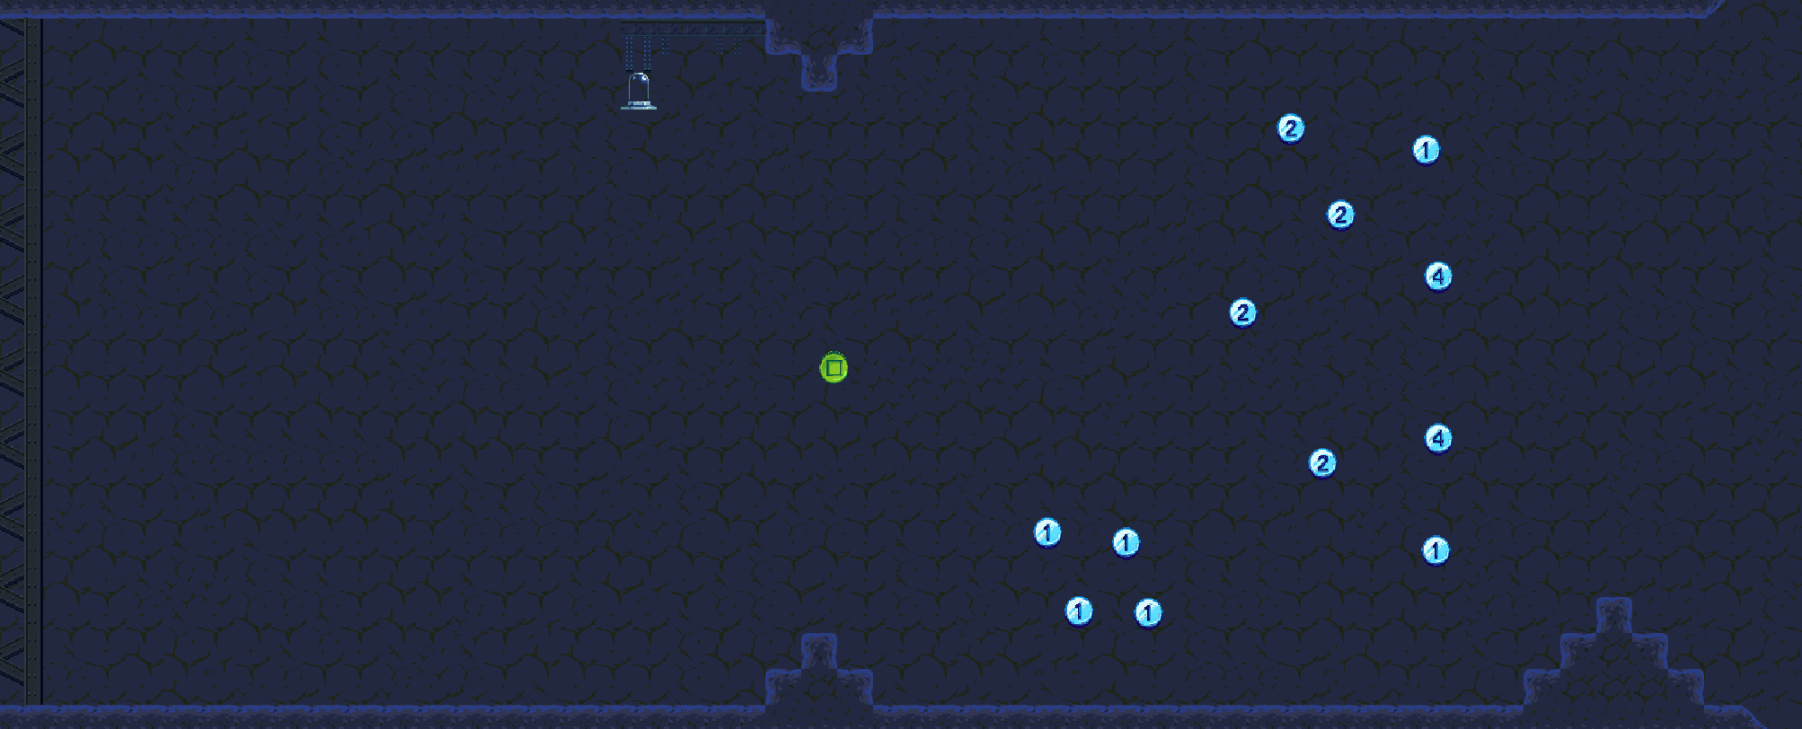
Prefab spawn points for enemies that instantiate after the player spawns in. Solving the problem of the enemy attempting to target the player when they don’t yet exist.
All spawn points are linked to a reset position that dictates how far each enemy can go before being forced to turn back. Hence solving the problem of enemies getting stuck where they’re not supposed to be.

