Slide 1
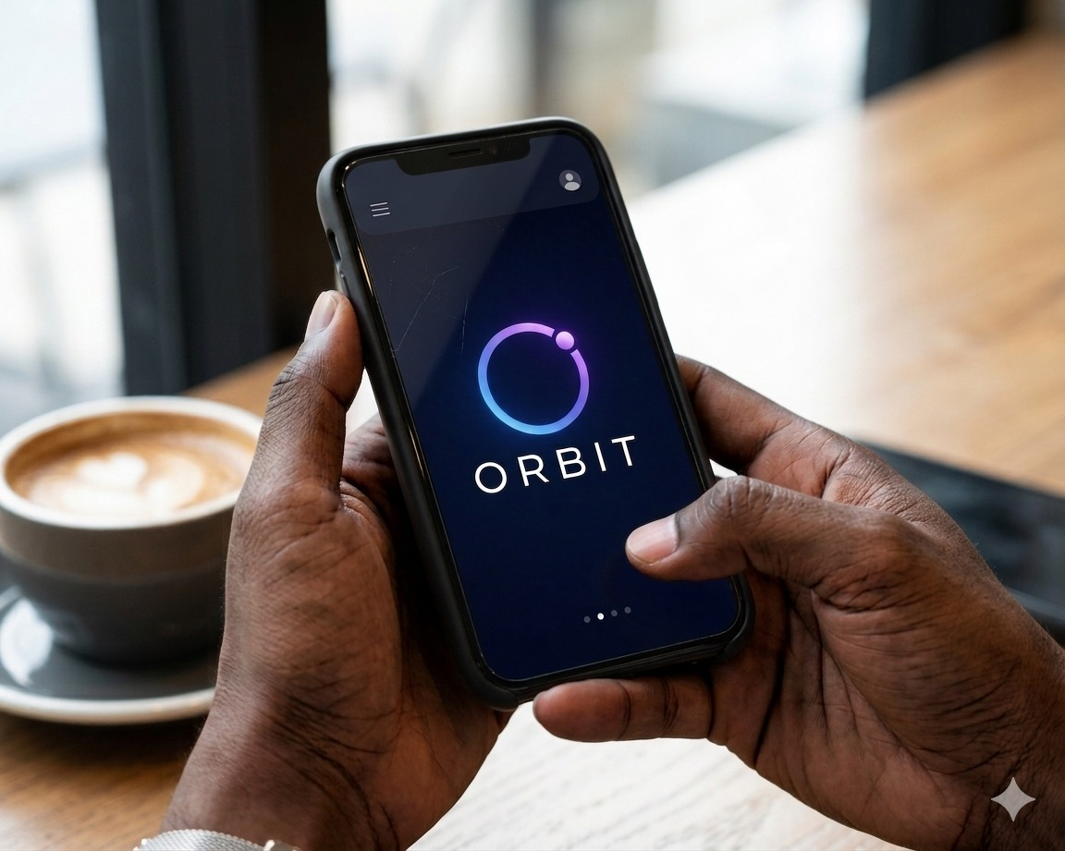
MOBILE CONTENT.COM
O.R.B.I.T. SYSTEM
Online Real-Time Based Identification and Tracking System

Slide 2
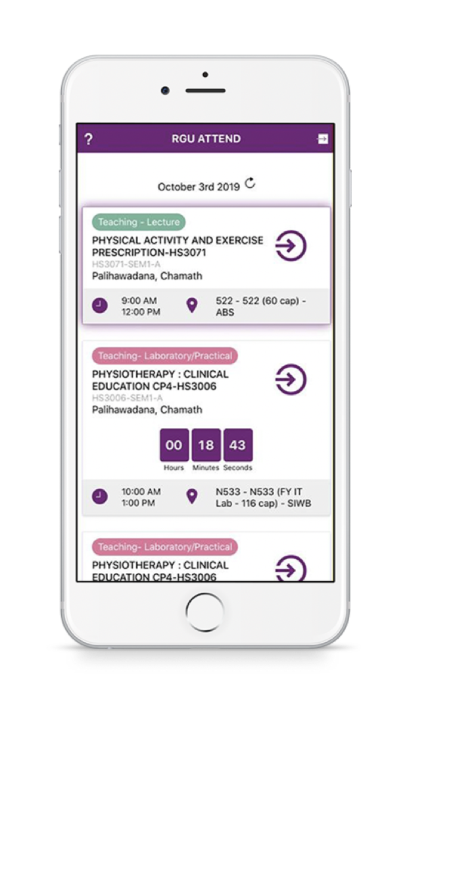
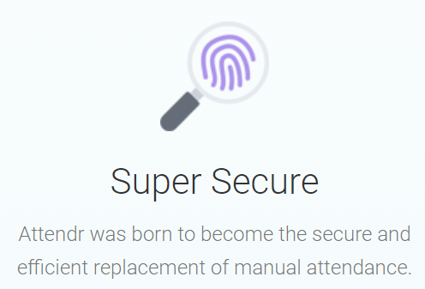
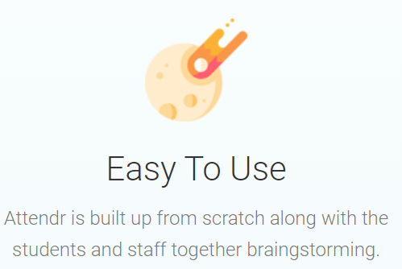
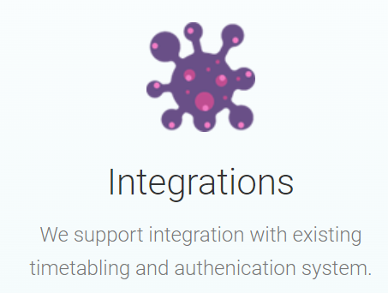
What is O.R.B.I.T. SYSTEM
The O.R.B.I.T. system is a customized, innovative, low-cost attendance monitoring and workforce scheduling solution, that enables institutions to efficiently manage attendance and shift operations through an integrated analytics and automation portal.
Notes:
1

Slide 3
MODERN INDUSTRY CHALLENGES
Educational Institutions
Proxy attendance
Lecture hall overcrowding
Manual roll calls wasting class time
Difficulty monitoring remote learning attendance
Poor attendance analytics
Student movement analytics
Corporate Institutions
Ghost workers
Time theft
Manual registers
Poor workforce accountability
Weak field worker monitoring
Shift conflicts
Poor communication regarding schedules

Slide 4
WHAT O.R.B.I.T. SYSTEM OFFERS
Workforce automation
Smart attendance validation
Employee identity management
Push notifications
Innovative Process
Low hardware cost
Extensible to existing platforms
Increase Productivity
Dedicated (customized) App
User friendly

Slide 5
BENEFITS OF O.R.B.I.T.
Create annual savings, eliminating the cost and installation of hardware devices e.g. biometric reader and manual data entry
Create an immediate digital footprint of staff/ students’ attendance
Prevents absent friends and colleagues’ sign-in
Prevents long hours of data entries which can be invalidated by simple mistakes
Prevents unnecessary delays and distractions from swiping cards or biometric readers
Facilitates consistent and streamline cross departmental attendance managements

Slide 6
ATTENDANCE METHODS COMPARISON
Method | How It Works | Pros | Cons | Recommended Use
QR Code | Users scan dynamic QR code | Cheap, easy, fast | Screenshot fraud possible | Schools, events
BLE (Bluetooth Low Energy) | Device detects secure beacon signal | Passive, seamless, low power | Requires Bluetooth enabled | Offices, universities
GPS Geolocation | User checks in from approved location | Remote work support | GPS spoofing possible | Field workers, remote staff
NFC | Tap phone/card against reader | Very fast and secure | Requires NFC-capable devices | Government and enterprise
WiFi Verification | Verify organization WiFi network | Easy deployment | Weak security alone | Secondary validation
Facial Recognition | AI face verification | Strong identity validation | Privacy concerns | High-security environments
Biometric Fingerprint | Fingerprint scanners | Accurate | Expensive hardware | Restricted environments
Device Binding | Trusted device registration | Fraud prevention | Device replacement issues | Enterprise systems
OTP Verification | One-time authentication code | Additional security | Slower user experience | Sensitive attendance
Geofencing | Virtual attendance boundary | Automated verification | Requires GPS | Remote/hybrid staff

Slide 7
BEST RECOMMENDED: HYBRID METHOD
The strongest modern architecture is:
Primary Methods
BLE Verification
Dynamic QR Code
GPS + Geofencing
Secondary Security Layers
Device Binding
Face Verification (Optional)
WiFi Verification
Time-based Tokens
Recommended Core Combination
This hybrid model provides:
High accuracy
Low cost
Fast deployment
Strong anti-fraud protection
Flexibility across industries

Slide 8
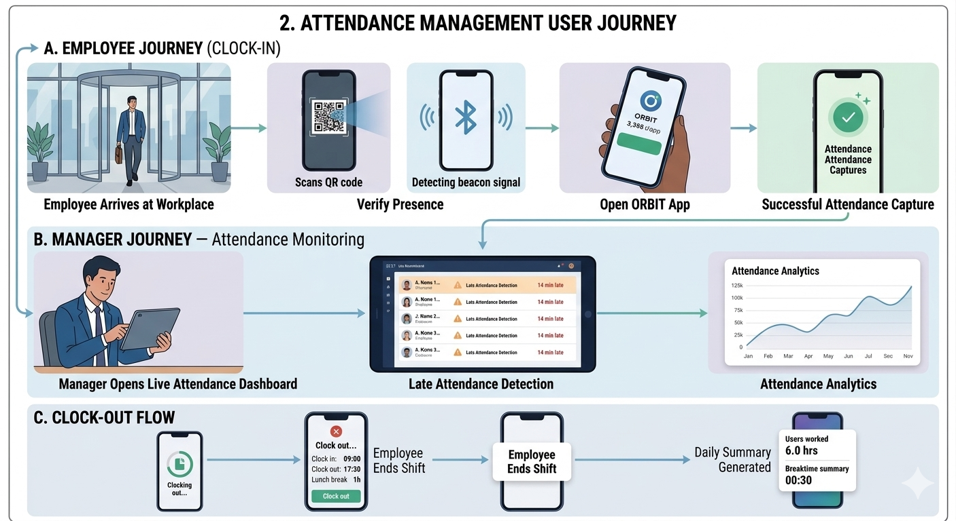
ATTENDANCE USER JOURNEY

Slide 9
SHIFT SCHEDULING COMPONENT
Scheduling Benefits
The system helps to:
Reduce staffing conflicts
Improve workforce planning
Increase operational efficiency

Slide 10
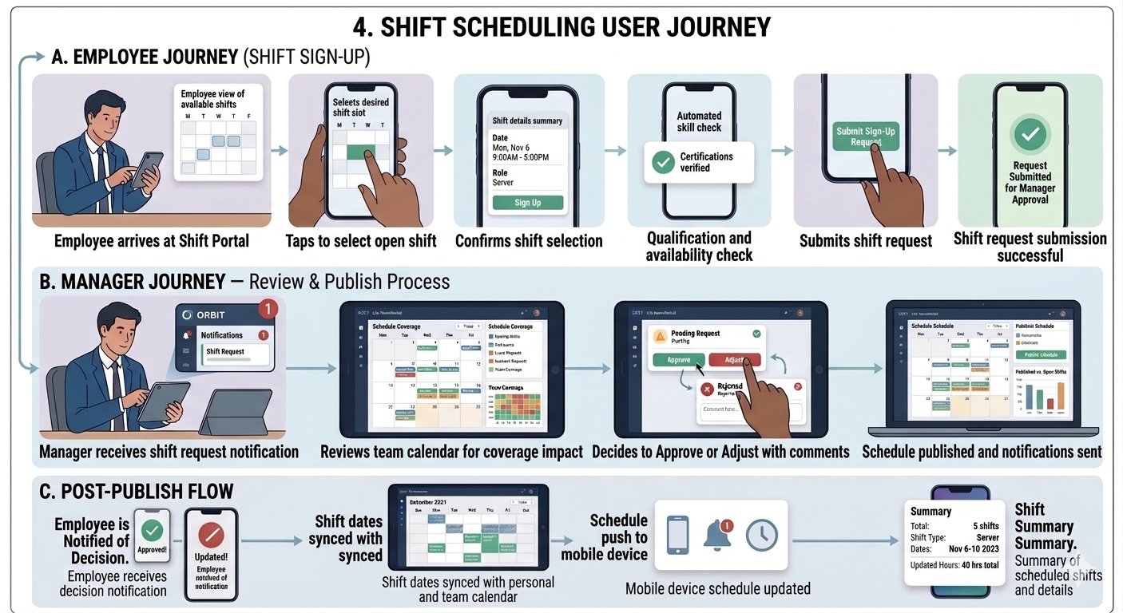
SHIFT SCHEDULING COMPONENT

Slide 11
LEAVE MANAGEMENT COMPONENT
Employee Features
Employees can submit requests for:
Vacation leave
Sick leave
Emergency leave
Maternity leave
Admin Features
Administrators can:
Approve leave requests
Reject leave requests
Monitor leave calendars
Track leave balances

Slide 12
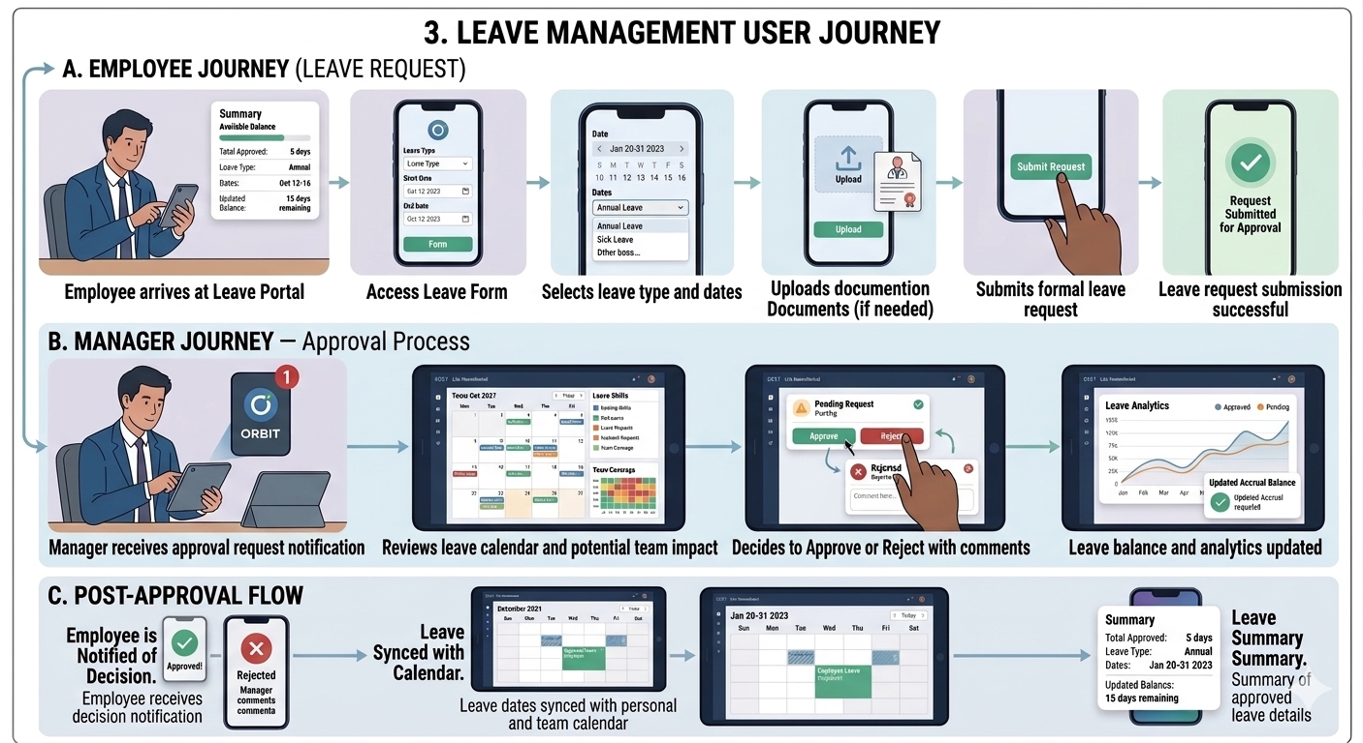
LEAVE MANAGEMENT COMPONENT

Slide 13
EXTRA FEATURES
Guest login
Remote login
Sign-off and Geolocation referencing
Analytics Dashboard
Manager Sign-off
Custom login integration
Custom data out API
Advance app customisations

Slide 14
CORE REVENUE STREAMS
Subscription model
Per-employee/student pricing
One time setup fee/onboarding fees
Custom Push notifications
Analytics & Intelligence Upsells allows organizations pay extra for advanced analytics.

Slide 15
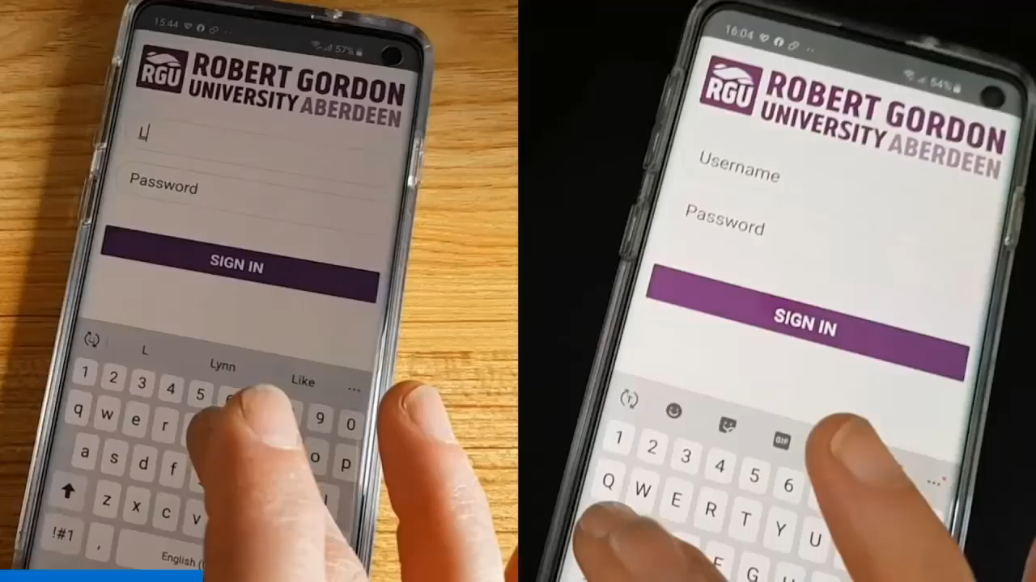
DEMO

Slide 16
MOBILE CONTENT.COM
Thank You!

