Slide 1
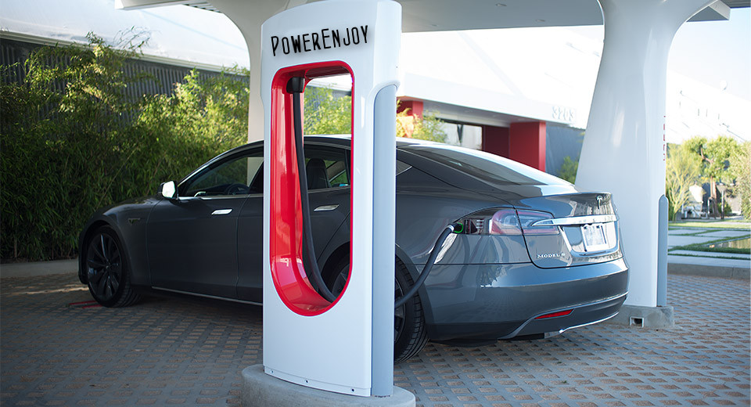

Software Engineering 2
2016/2017
BOGLIO SIMONE 772263
CROCE LORENZO 807833
Link to the original image: http://www.blogcdn.com/green.autoblog.com/media/2013/05/tesla-model-s-supercharger.jpg

Slide 2
RASD

Slide 3
STAKEHOLDERS AND ACTORS
Stakeholders
Car-sharing company
Actors
PowerEnjoy car users

Slide 4
MAIN GOALS
Web and Mobile application
User registration
Car search
Car reservation
User can pick up and drive car
Provide information to user during ride
Incentivize behaviour of user
Public API

Slide 5
PRE-EXISTENT SITUATION
User → Call center → Search/Reservation
User → PowerEnjoy area → Office operator → Pick up/return car
There are some operators that manage the car balance in the areas
There is an internal information system where the information are stored
There is an external company that is responsible of car maintenance

Slide 6
MAIN ASSUMPTIONS
User has a valid license car
User has enough money to pay the ride
User drive back car into a safe area
User can reserve only one car at time
Safe areas are predeterminated
Car has enough charge for the ride
All the car are of the same model (5 seats)

Slide 7
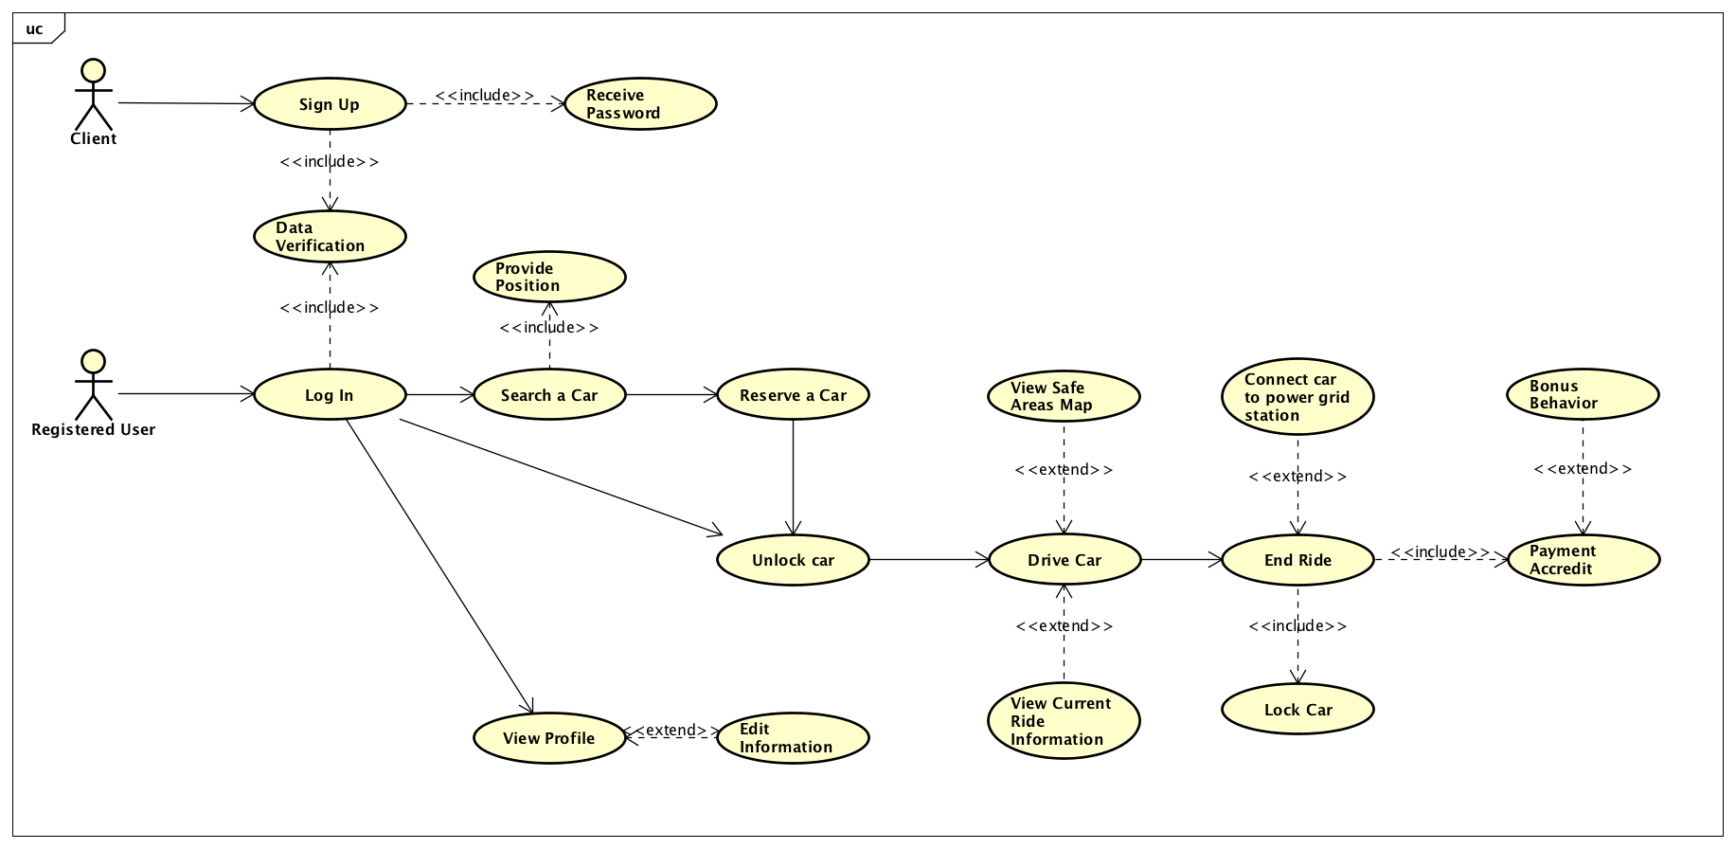
USE CASE

Slide 8
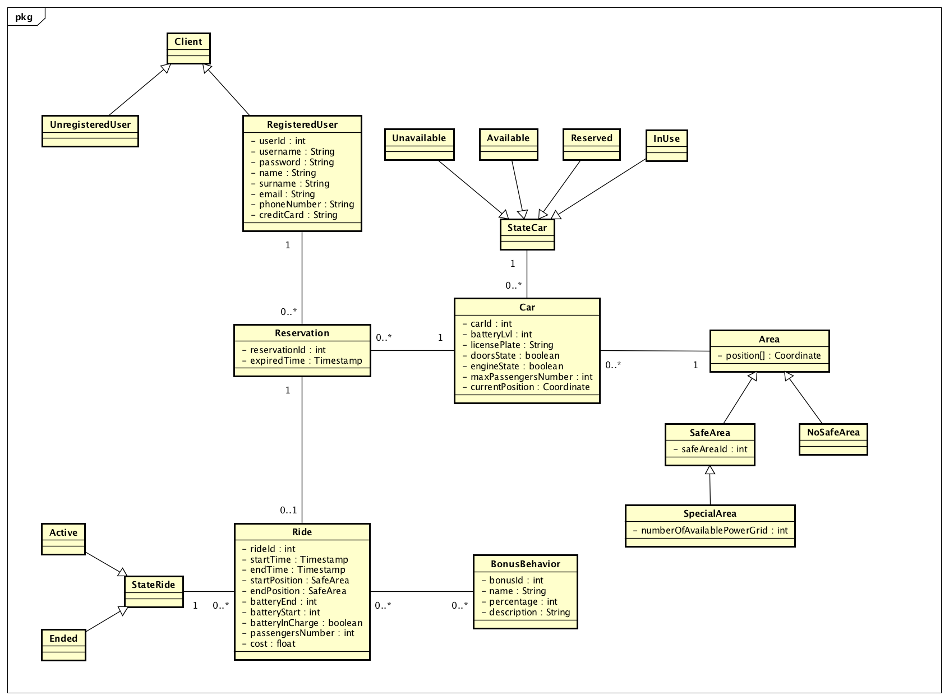
CLASS DIAGRAM

Slide 9
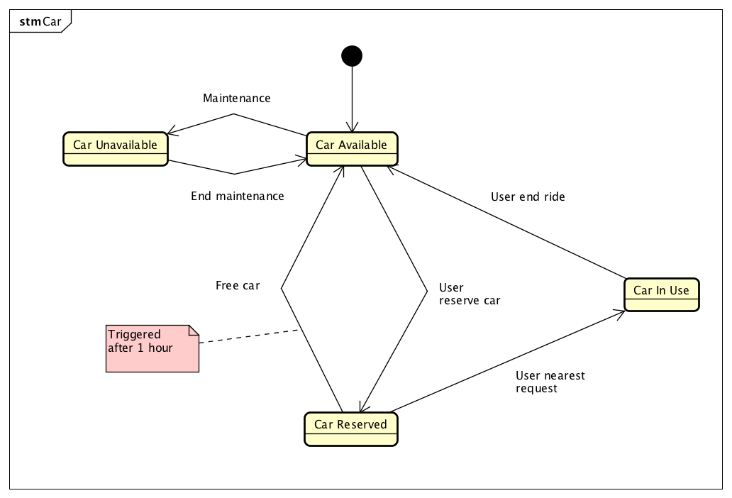
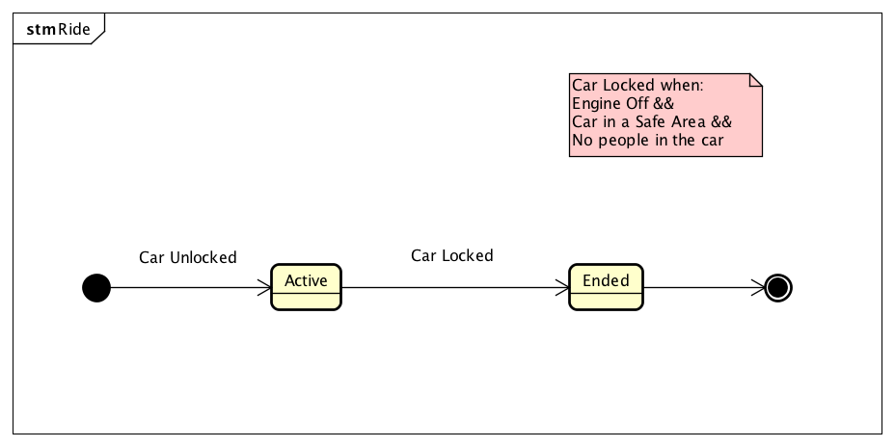
STATE DIAGRAMS

Slide 10
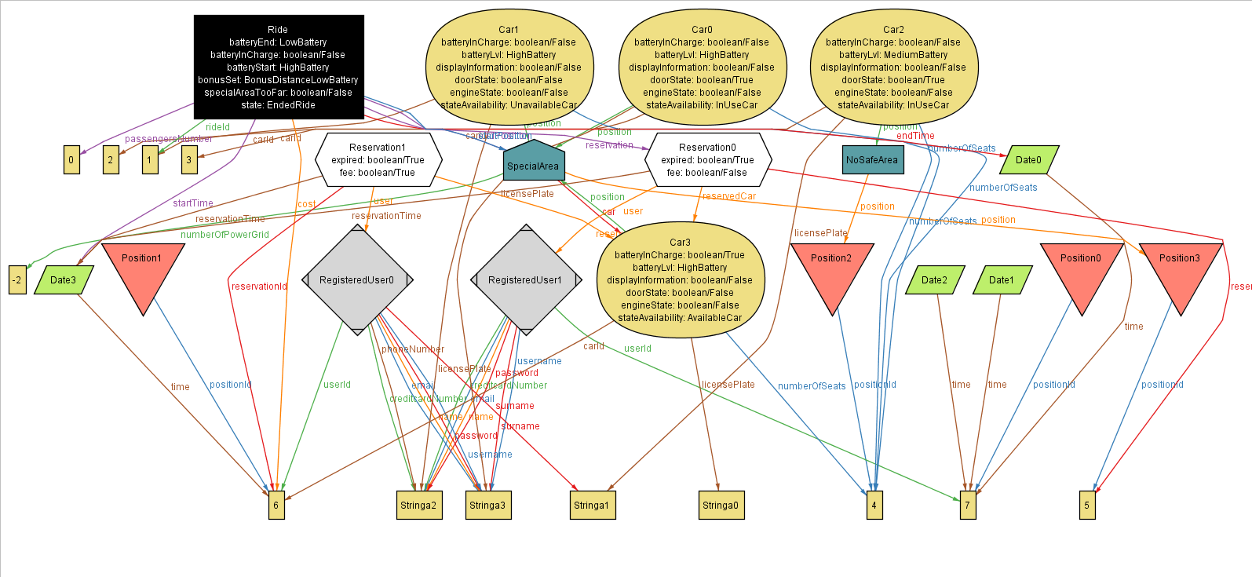
ALLOY

Slide 11
DD

Slide 12
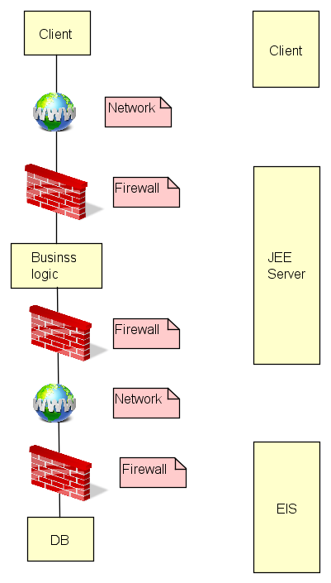
SYSTEM TIERS

Slide 13
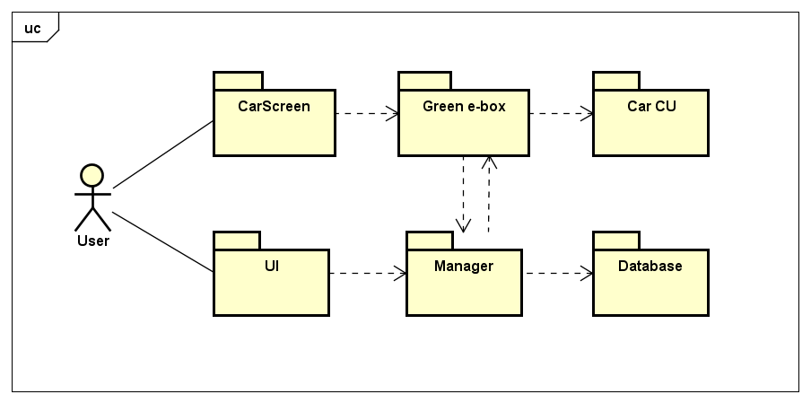
HIGH-LEVEL PACKAGES INTERACTION

Slide 14
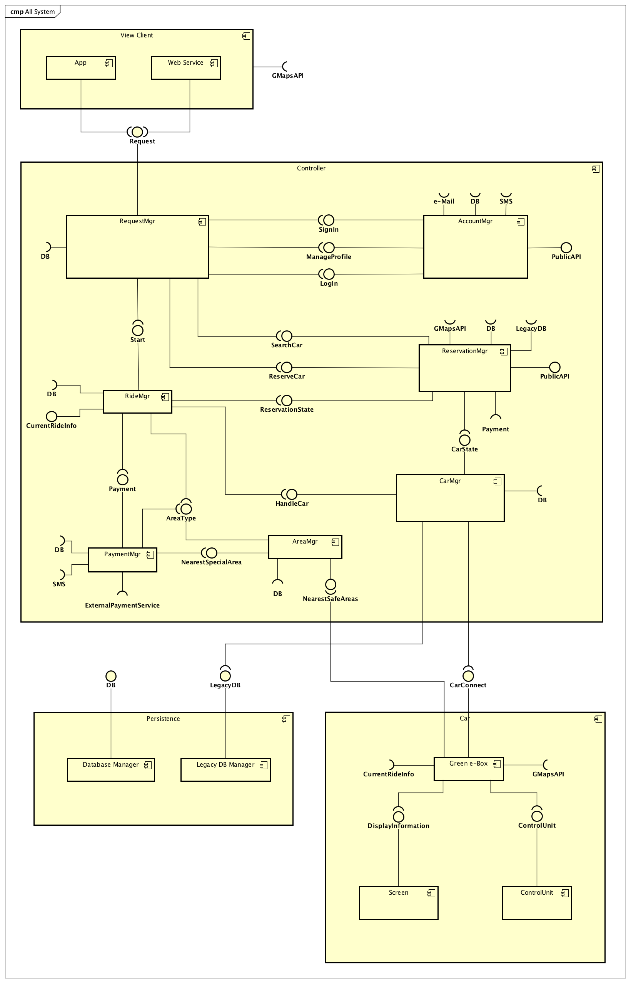
COMPONENT VIEW AND INTERFACES (HIGH-LEVEL)

Slide 15
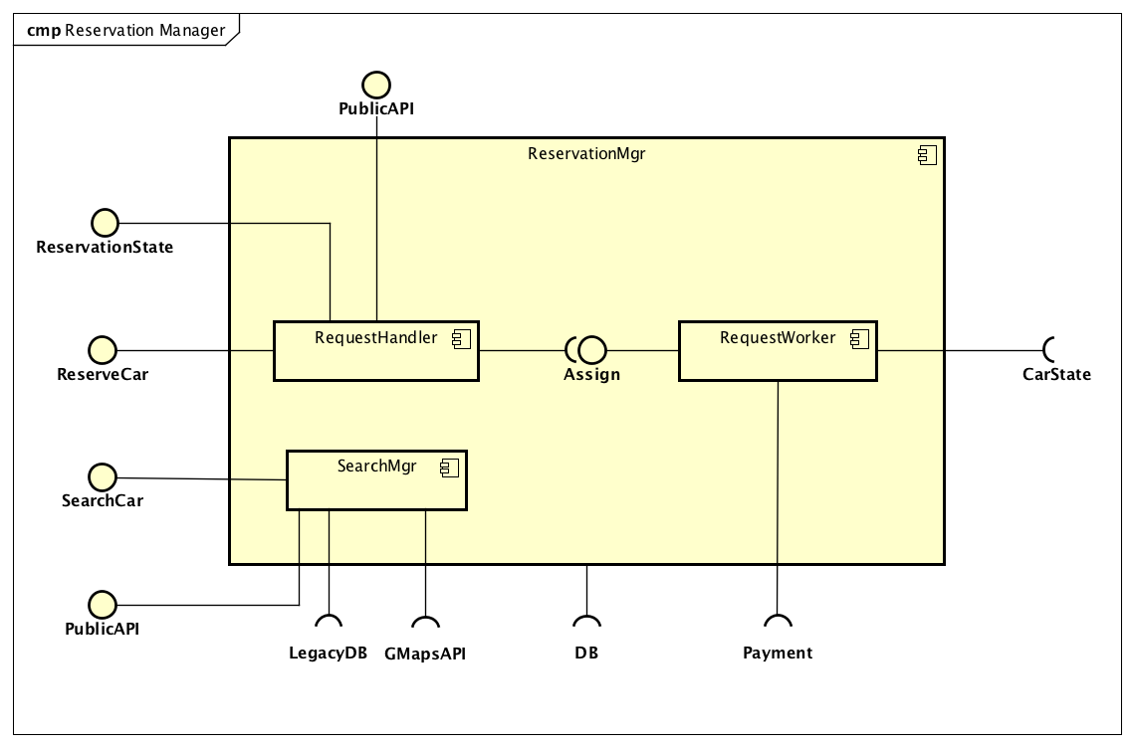
RESERVATION MANAGER SUB-COMPONENT

Slide 16
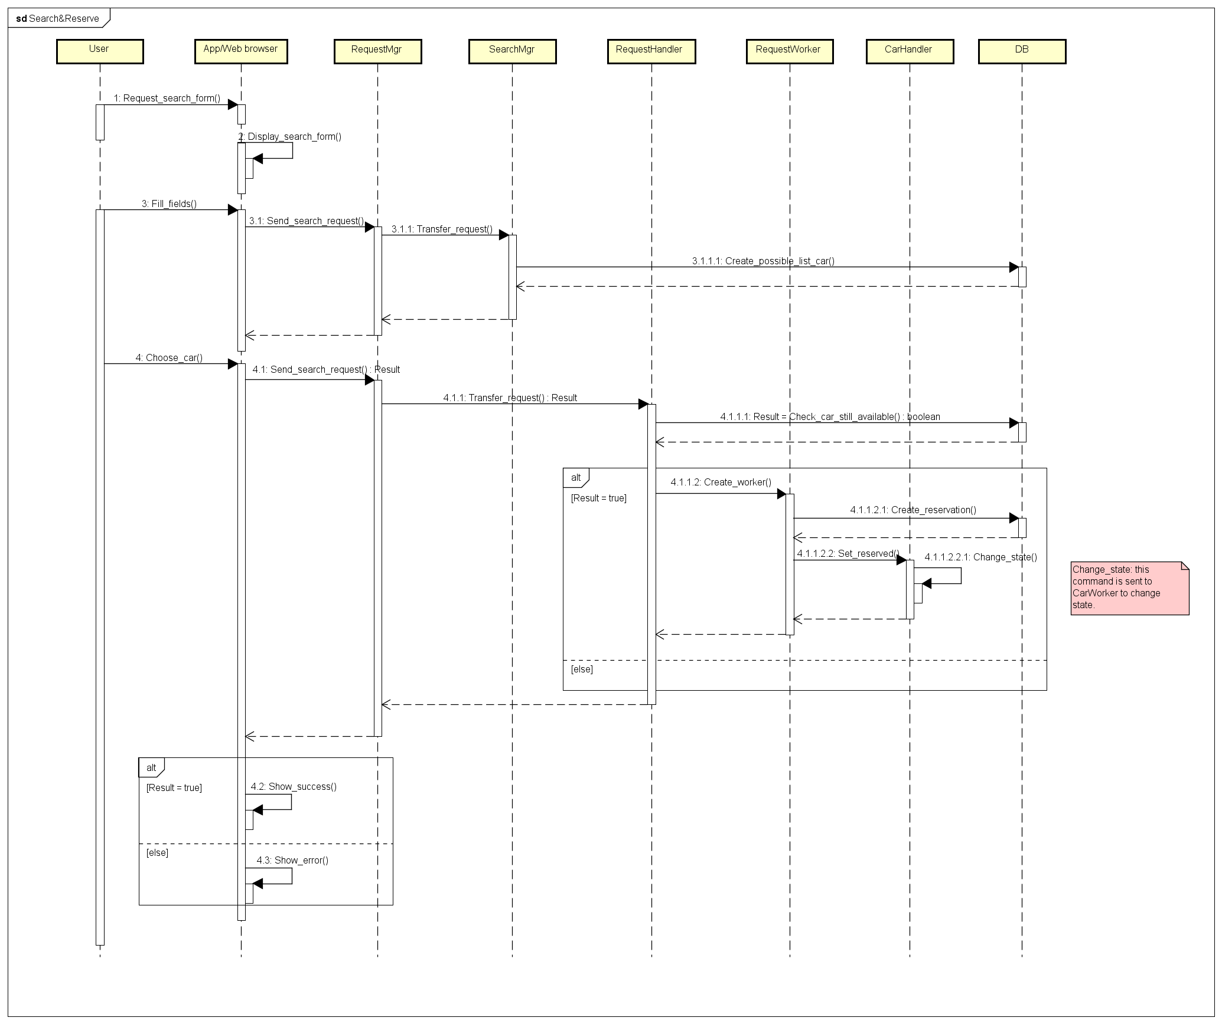
CAR RESERVATION: SEQUENCE DIAGRAM

Slide 17
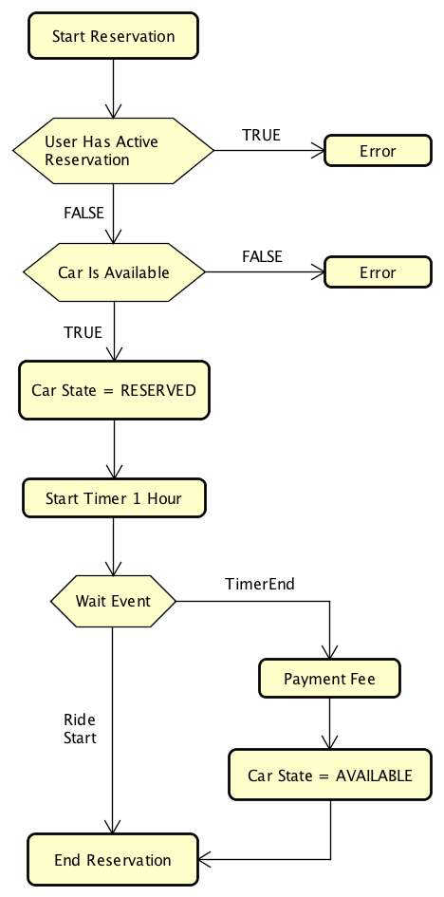
CAR RESERVATION: FLOW CHART

Slide 18
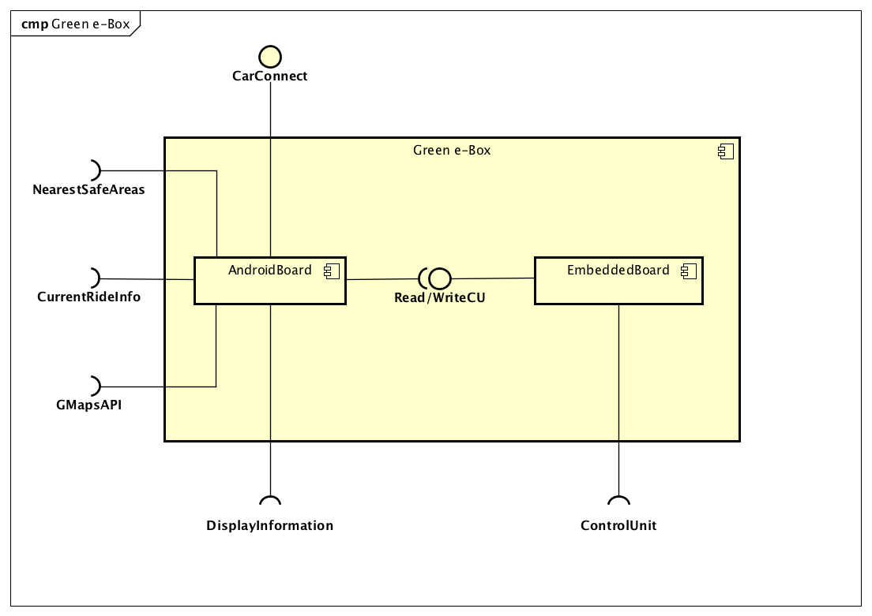
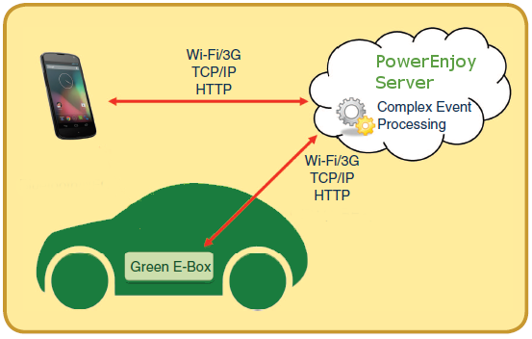
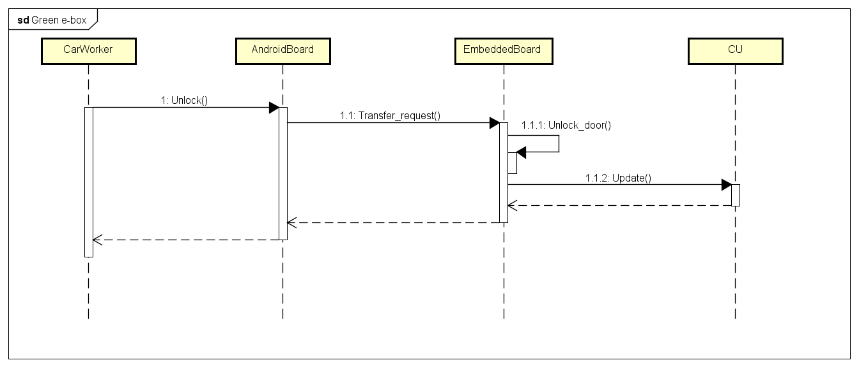
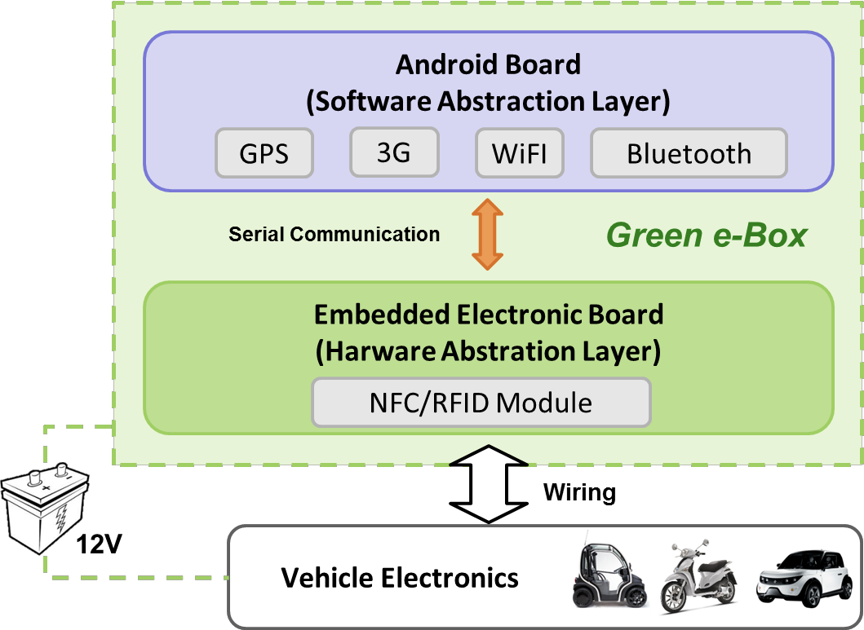
GREEN E-BOX

Slide 19
ITPD

Slide 20
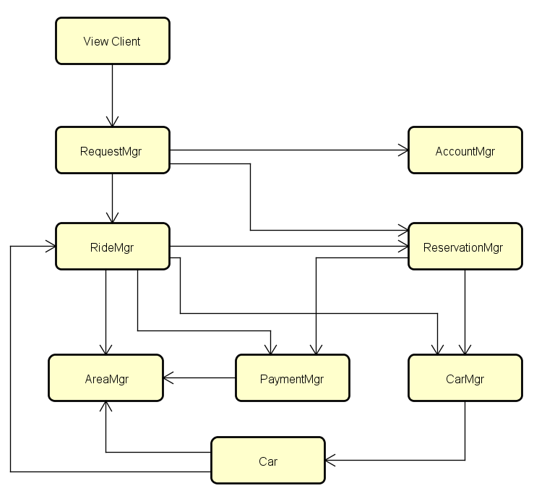
HIGH LEVEL COMPONENT INTEGRATION

Slide 21
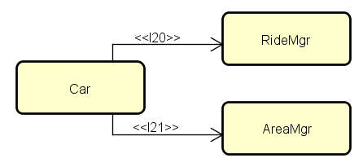
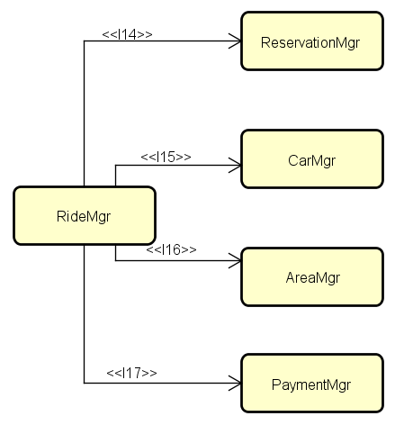
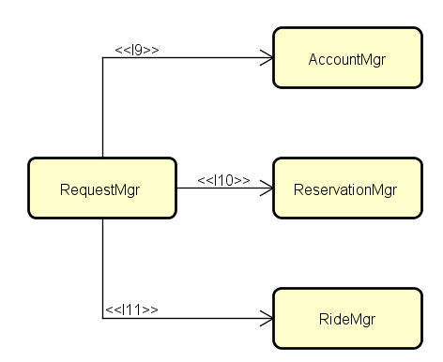
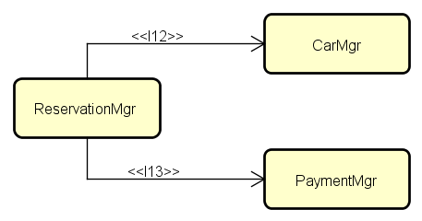
MAIN INTEGRATION SEQUENCES

Slide 22
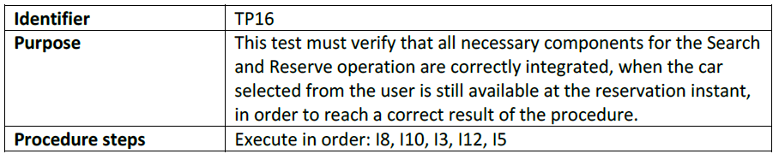
CAR RESERVATION: INTEGRATION PLAN

Slide 23
DRIVERS, STUBS AND DATA
Stubs
Account Manager
Reservation Manager
Ride Manager
Car Manager
Area Manager
Payment Manager
Car (Green e-box)
Drivers
Client
Car
Request Manager
Ride Manager
Reservation Manager
Data
Some registered user data
A set of reservations for the cars
A set of cars
A set of area zones
A set of rides

Slide 24
PP

Slide 25
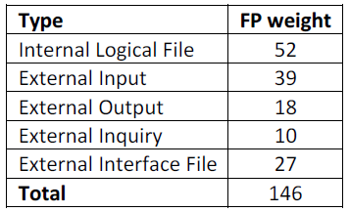

FUNCTION POINT ANALYSIS

Slide 26
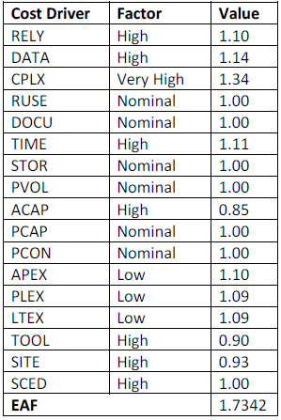
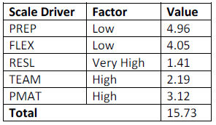
COCOMO II ANALISYS
Effort estimation:
Effort_{L} = 38,92 PM
Effort_{U} = 58,15 PM

Slide 27
SCHEDULE ESTIMATION
1: Estimate size and duration of the team
2: Estimate duration with 2 people team
3: COCOMO II automated tool
Duration
Duration_{L} = 14.91 months
Duration_{U} = 16.91 months
Team size
N_{people-L} = 2.61 ≈ 3
N_{people-U} = 3.44 ≈ 4
Duration
Duration_{L} = 19.46 months
Duration_{U} = 26.07 months
Team size
N_{people} = 2
Duration
Duration = 16.91 months
Team size
N_{people-L} = 2.43 ≈ 3

Slide 28
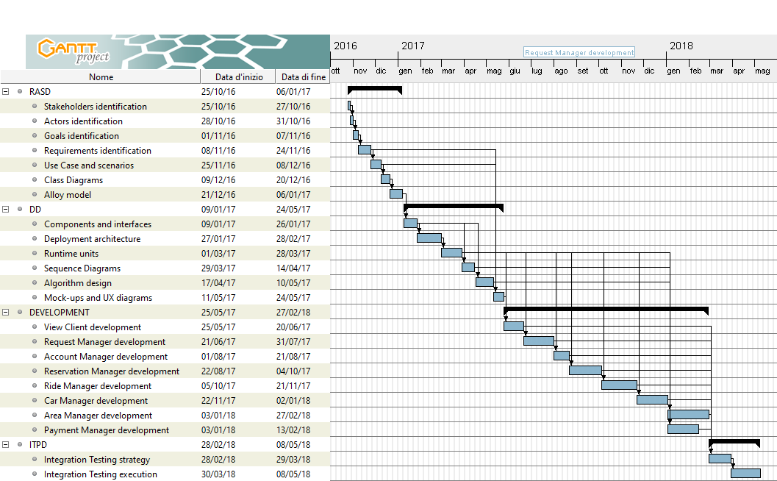
TASK SCHEDULE

Slide 29
RISKS PLANNING AND MANAGEMENT
Project delays
Stakeholders bankrupt
Wrong functionalities / user interfaces
Project team problems
External components failure
Loss of work

Slide 30
END

