Slide 1

SOFTWARE
ARCHITECTURES FOR
ROBOTICS - Assignment
• B e n e d e t t i L o r e n z o
• M a n e r a A n d r e a
• S a b z e v a r i D a n i a l
P r e s e n t e d b y
A c a d e m i c y e a r 2 0 2 1 - 2 0 2 2

Slide 2

Introduction
In this assignment we have developed the navigation and mapping with ROS 2 using the Nav2 package for
robot navigation and SLAM Toolbox for 2D mapping. We have tested and explored the capabilities of new
localization and mapping framework with different map layouts.
Discussed Topics:
• TIAGO robot
• Different Environments based on webots
• ROS 2 Navigation
• ROS Navigation vs Navigation2
• Code Brief Explanation
• An eye on Navigation2
• An eye on SLAM mode
• An eye on Localization mode
• An eye on LifeLong mode
2

Slide 3
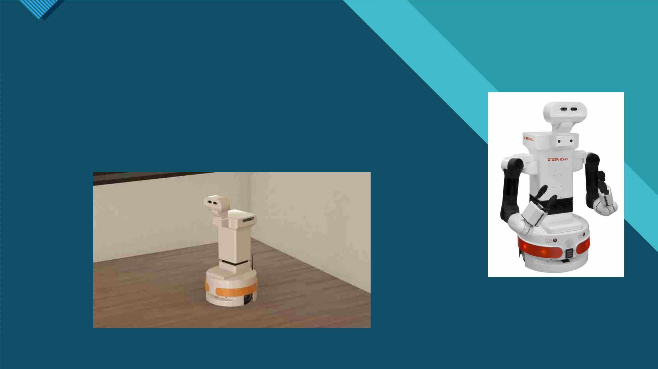
TIAGO Robot
TIAGO is a service robot designed to work in indoor environments.
TIAGO’s features make it the ideal platform for research, especially on
ambient assisted living or light industry. It combines mobility, perception,
manipulation and human-robot interaction capabilities for one specific
goal: to be able to assist in research.
3

Slide 4
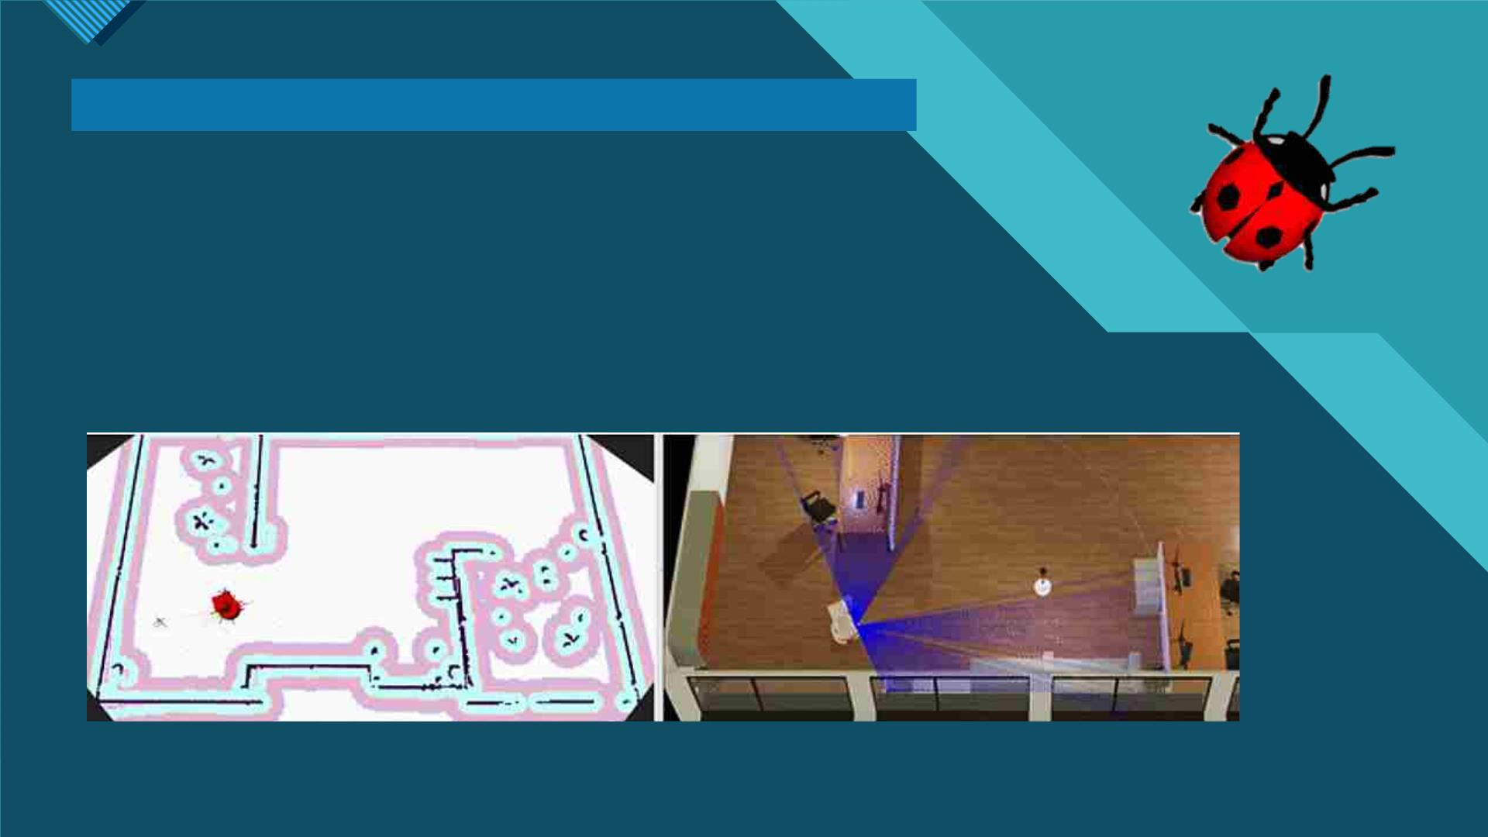
Different Environments based on webots
Webots is an open source and multi-platform desktop application used
to simulate robots. It provides a complete development environment to
model, program and simulate robots.
webots_ros2 is a package that provides the necessary interfaces to simulate
a robot in the Webots open-source 3D rigid body simulator for robots. It
integrates with ROS using ROS messages and services.
4

Slide 5
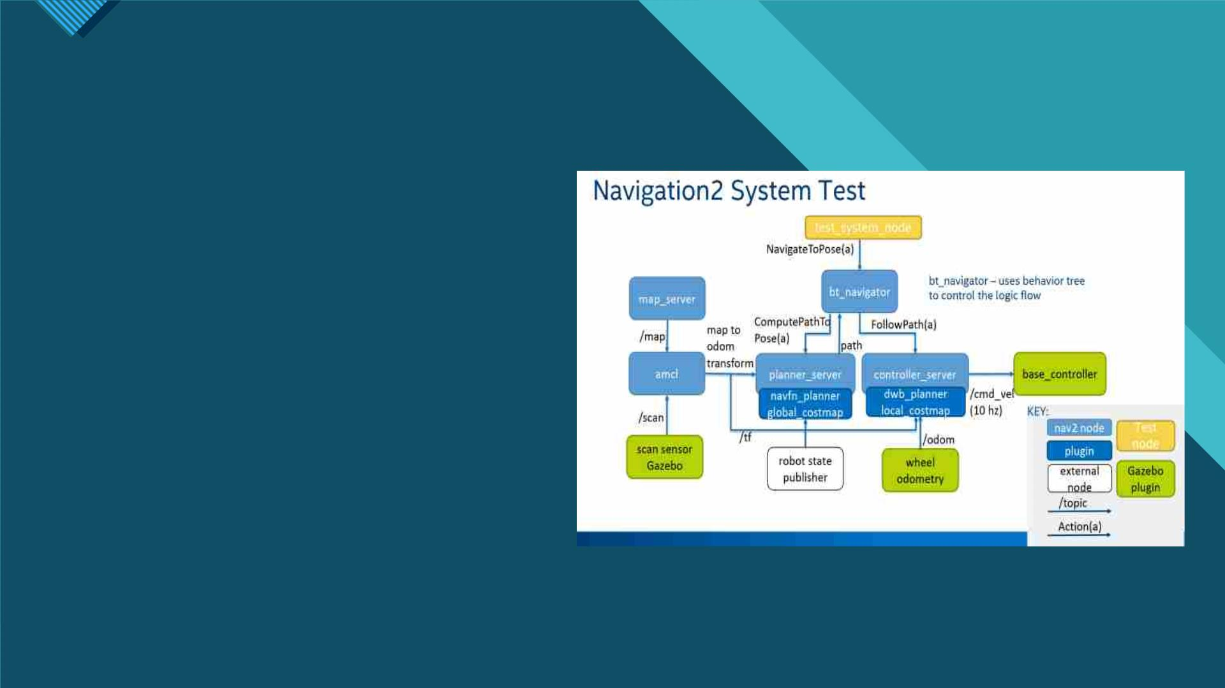
Navigation2
Navigation2 is a key component of ROS2
functionality. Navigation2 uses behavior trees,
lifecycle nodes to provide customization and
reliability, bring up launch files for ease of use,
system tests for fast testing.
A behavior tree is used to orchestrate these
tasks. This allows Navigation2 to have highly
configurable
navigation
behavior
without
programming by rearranging tasks in a behavior
tree xml file.
5

Slide 6
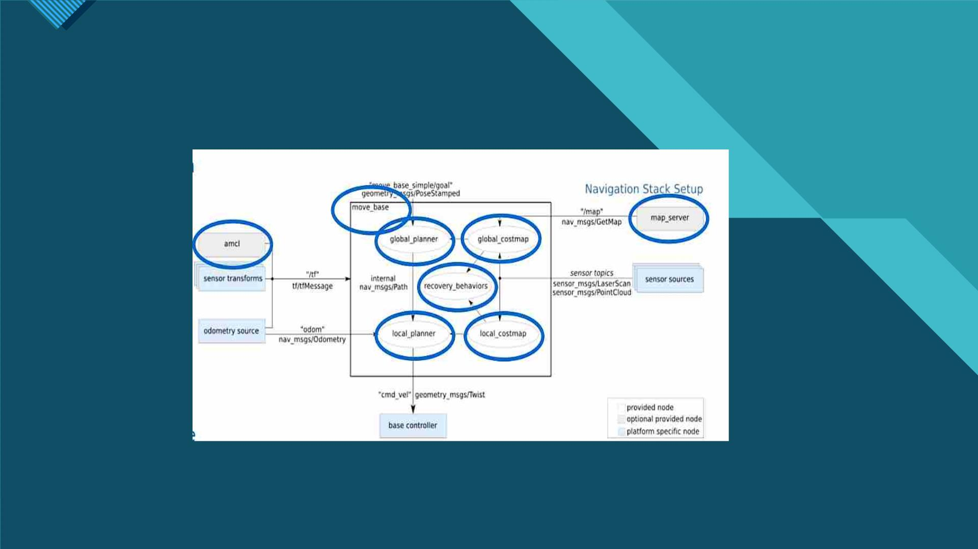
ROS Navigation vs Navigation2
The default plugins provided are ported from ROS 1, namely: DWB, NavFn, and similar behaviors such as
spinning and clearing costmaps.
A new behavior for waiting a fixed duration was also added. These servers are called from the BT navigator
through their action servers to compute a result or complete a task.
6

Slide 7
ROS Navigation vs Navigation2
Main changes
• amcl and map_server – ported from ROS Navigation with refactoring.
• move_base – replaced by behavior tree-based navigation node called ‘bt_navigator’.
• recovery_behaviors – now actions within the behavior tree(s).
• global_planner – navfn ported as a global planner called navfn_planner.
• local_planner – ‘dwb’ local planner ported from the robot_navigation project as dwb_planner.
• global_costmap and local_costmap - contained within the global and local planners respectively.
• planner_server and controller_server (NEW) - ROS2 action servers (ComputePathToPose) and
(FollowPath).
7

Slide 8
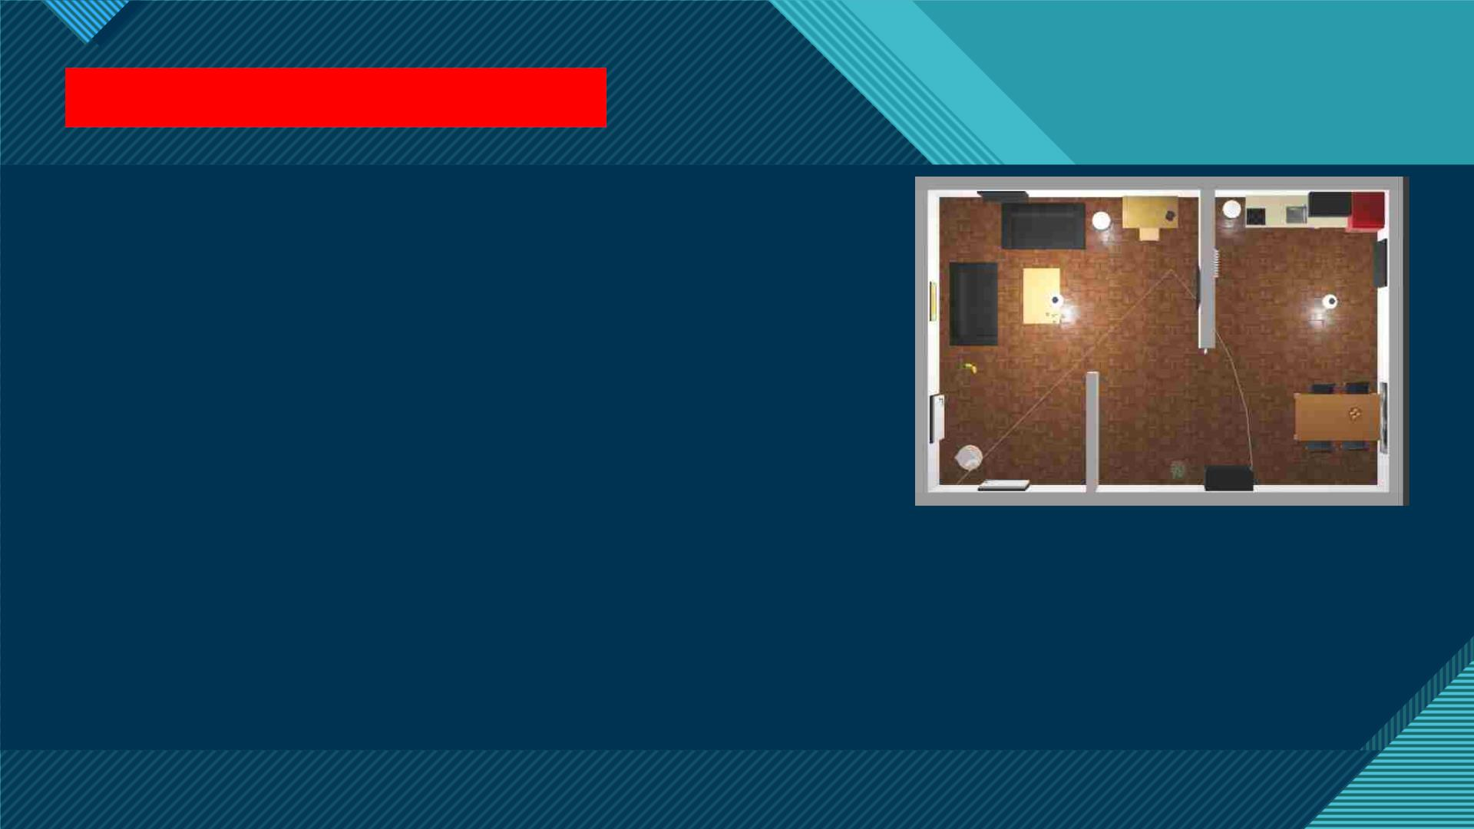
Code Brief Explanation
We have developed our code taking advantage of the official
online repositories, in particular the one of Steve Macenski.
• Parameters in ROS2 are implemented/attached to/served
by each node individually, as opposed to the parameter
server associated with roscore in ROS1, therefore, when
the node dies, so do its parameters. This is easier to
understand if you already know that in ROS2 we do not
have roscore.
• YAML means “YAML Ain’t Markup Language”. It’s a great fit
for loading a configuration file at run time, which is exactly
what ROS2 params are about.
These 2 points are really important since we had to deal with
4 YAML parameters file around which we have created our
code and developed the 4 modalities, communicating with
TIAGO robot that «works» only in ROS1.
8

Slide 9
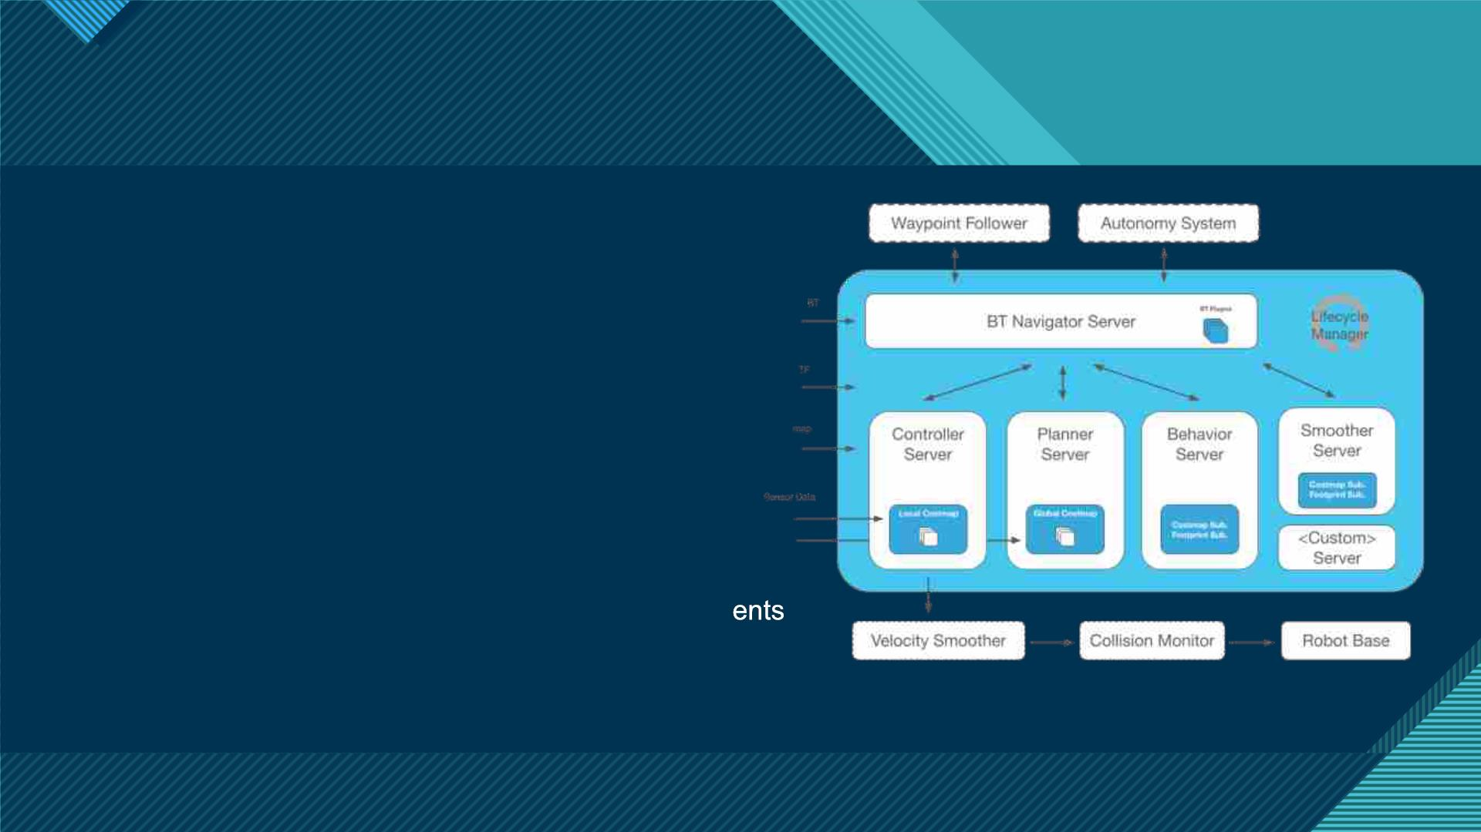
An eye on Navigation2 mode
• One of the key and most used packages of ROS.
• Autonomous movement for a robot in a 2D map.
• Given a ‘current pose’ and a ‘goal ‘pose’.
• Path is planned, robot drives itself to the goal.
• Key to accelerating ROS2 development and adoption
across the community and industry.
• Ported, refactored, and made architectural improvem
from ROS.
9

Slide 10

An eye on Navigation2 mode
• Action Server
A common way to control long running tasks like navigation used in this stack to
communicate with the highest-level BT navigator through a NavigateToPose action
message.
• Lifecycle Nodes
Contain state machine transitions for bringup and teardown of ROS 2 servers. It
also helps users structure their programs in reasonable ways for commercial uses
and debugging.
and Bond
• Behavior Trees
Program flow control decision trees, like state machines, but hierarchical in nature.
10

Slide 11

An eye on Navigation2 mode
• Compute shortest path
Planners
• Compute complete coverage path
• Compute paths along sparse or predefined routes
• Follow a path
• Dock with a charging station using detectors in the
odometric frame
Controllers
Servers
• Board an elevator
• Interface with a tool
Behaviors
Smoothers
• Deal with unknown or failure conditions of the
system and autonomously handle them.
• Responsible for reducing path raggedness and smoothing abrupt
rotations
• increasing distance from obstacles and high-cost areas
11

Slide 12

An eye on Navigation2 mode
Example video :
12

Slide 13
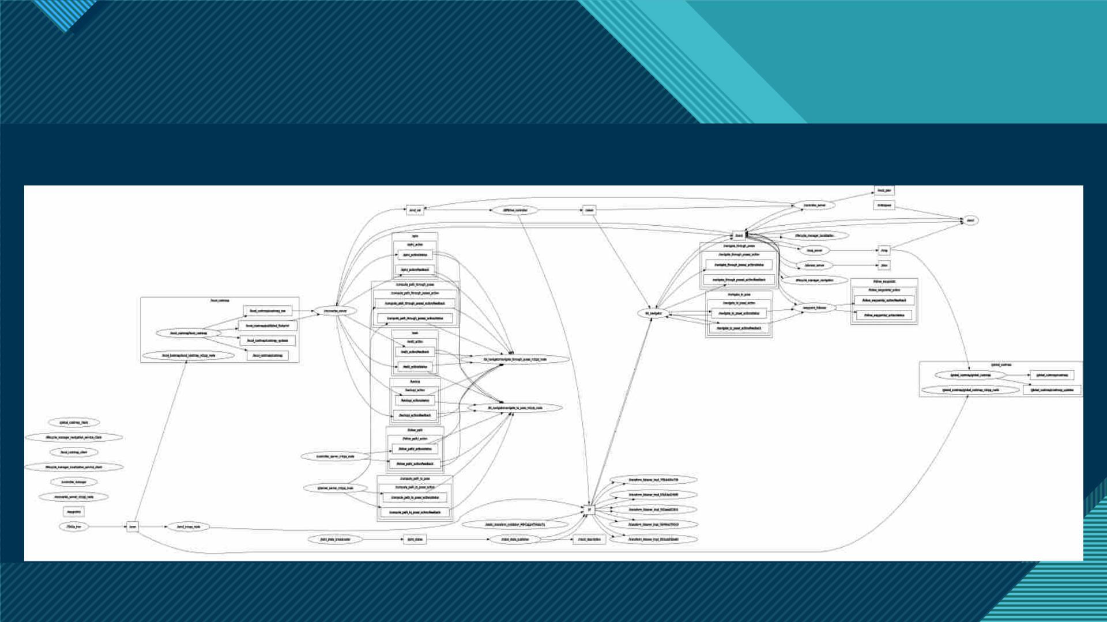
An eye on Navigation2 mode
Nodes interaction (better look on github) :
13

Slide 14

An eye on SLAM mode
Slam Toolbox is a set of tools and capabilities for 2D SLAM built by Steve Macenski. This project contains
the ability to do most everything any other available SLAM library, both free and paid, and more.
• Synchronous and asynchronous
• Utilities such as kinematic map merging
• Localization mode
SLAM Toolbox modes of mapping
• Multi-session mapping
• Improved graph optimization
• Substantially reduced compute time and prototype lifelong and
distributed mapping applications
14

Slide 15

An eye on SLAM mode
• Range Finders
• Odometry Sources (encoders, IMU, etc)
• Camera
• Radar
Receive sensing from the environment
• Bayes-based filter
approaches
SLAM algorithms
• Graph-based approaches
• GMapping (Grisetti et al., 2007)
• HectorSLAM (Kohlbrecher et al.,
2011)
ROS-based available
packages
• Cartographer (Hess et al., 2016)
• KartoSLAM (Konolige et al., 2010)
15

Slide 16

An eye on SLAM mode
Example video :
16

Slide 17
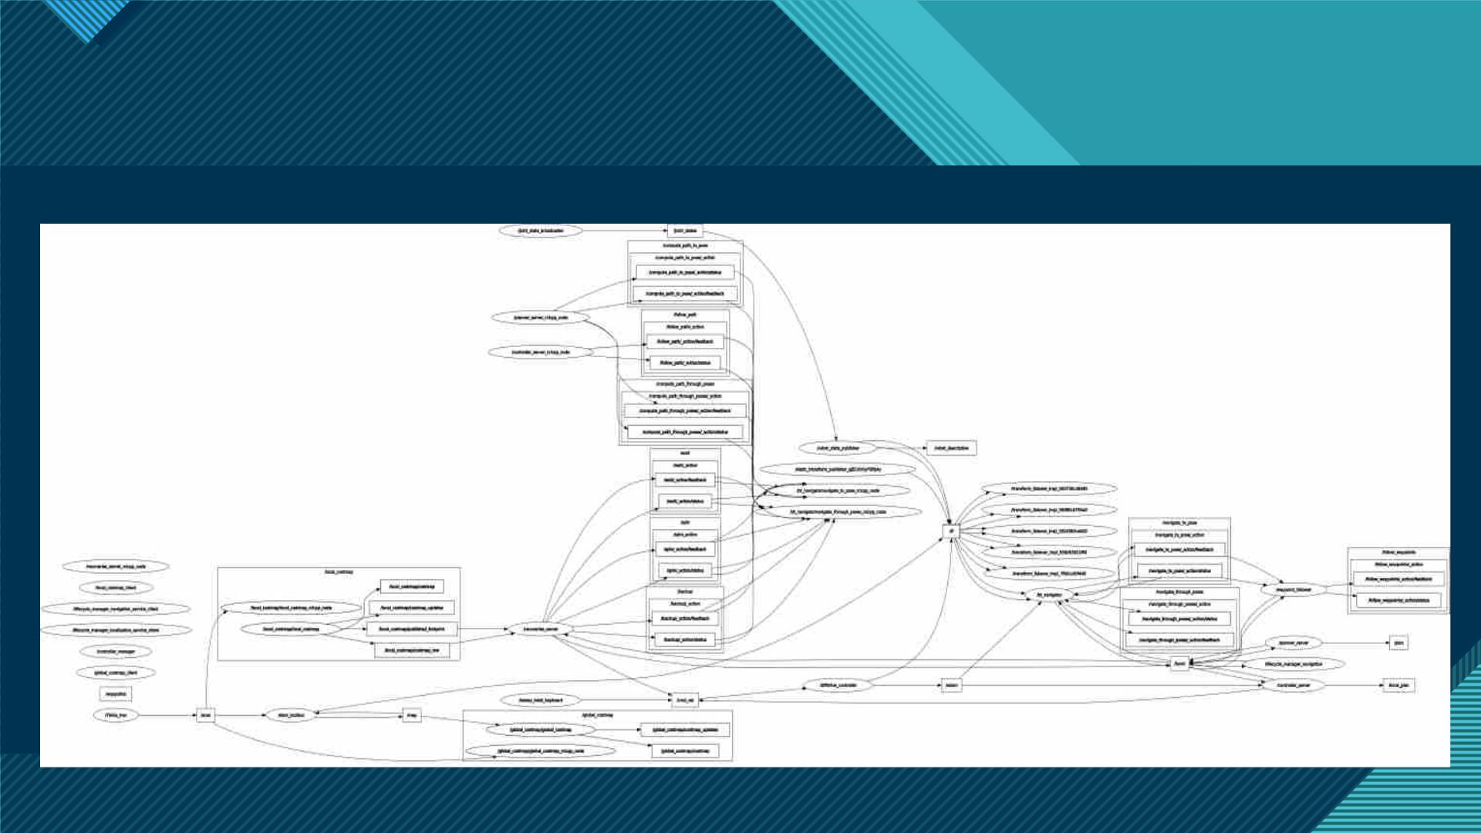
An eye on SLAM mode
Nodes interaction (better look on github) (SLAM with the keyboard) :
17

Slide 18
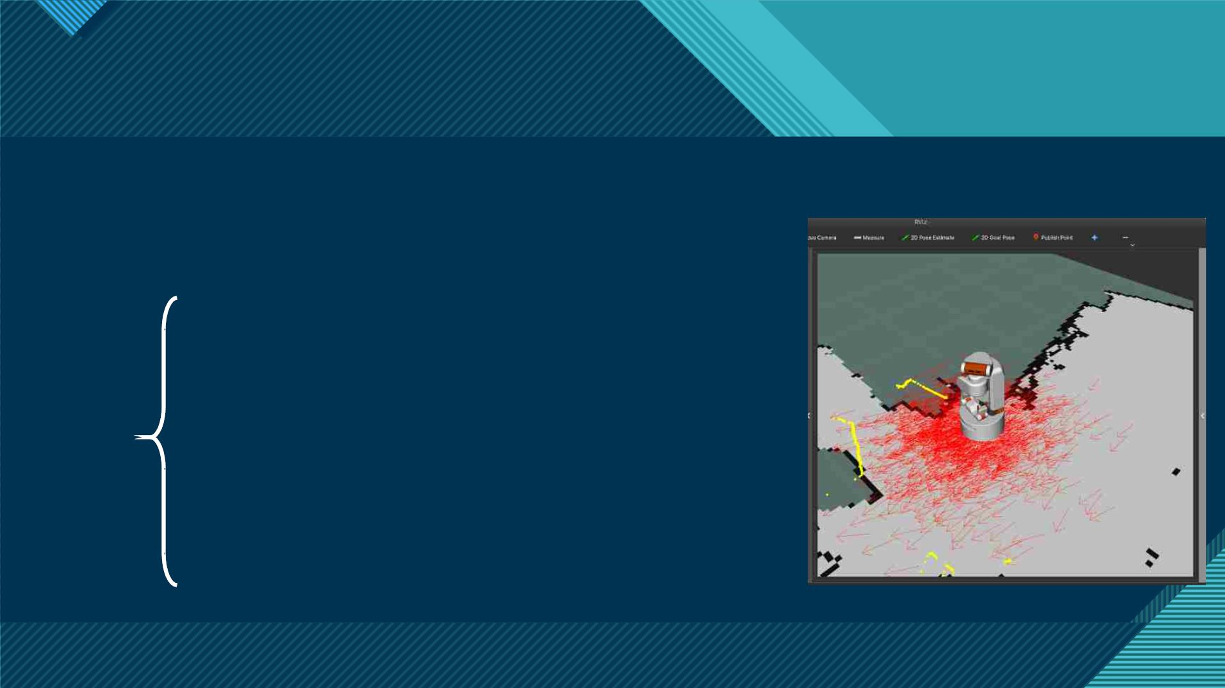
An eye on the Localization mode
Using the robot_localization package to use an Extended Kalman
Filter (ekf_node) to fuse the data from sensor inputs.
•/wheel/odometry : Position and velocity estimate based
on the information from the differential drive Gazebo plugin
•/imu/data : Data from the Inertial Measurement Unit (IMU)
Packages
sensor Gazebo plugin
•/odometry/filtered : The smoothed odometry information
•/tf : Coordinate transform from the odom frame (parent) to
the base_footprint frame (child)
18

Slide 19

An eye on the Localization mode
Example video :
19

Slide 20
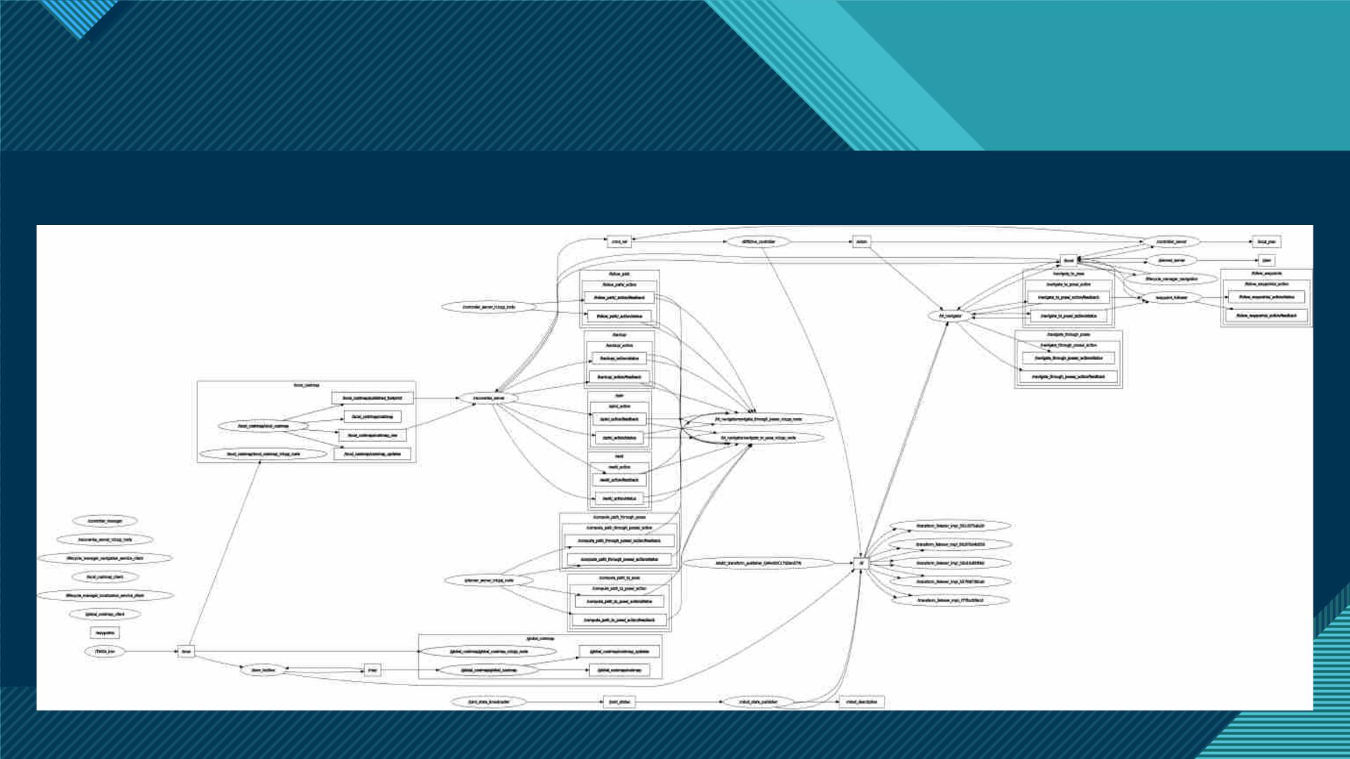
An eye on the Localization mode
Nodes interaction (better look on github) :
20

Slide 21
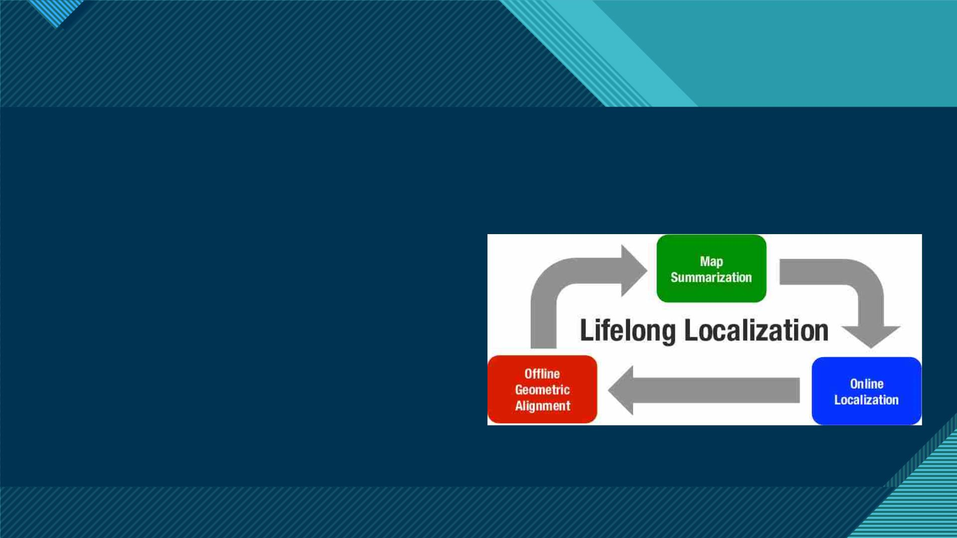
An eye on the LifeLong mode
The concept of being able to map a space, completely or partially, and over time, refine and update that map
as you continue to interact with the space.
Key steps :
• Serialization and Deserialization to store and reload
map information.
• KD-Tree search matching to locate the robot in its
position on reinitalization.
• Pose-graph optimizition based SLAM with 2D scan
matching abstraction.
21

Slide 22

An eye on the LifeLong mode
Example video :
22

Slide 23
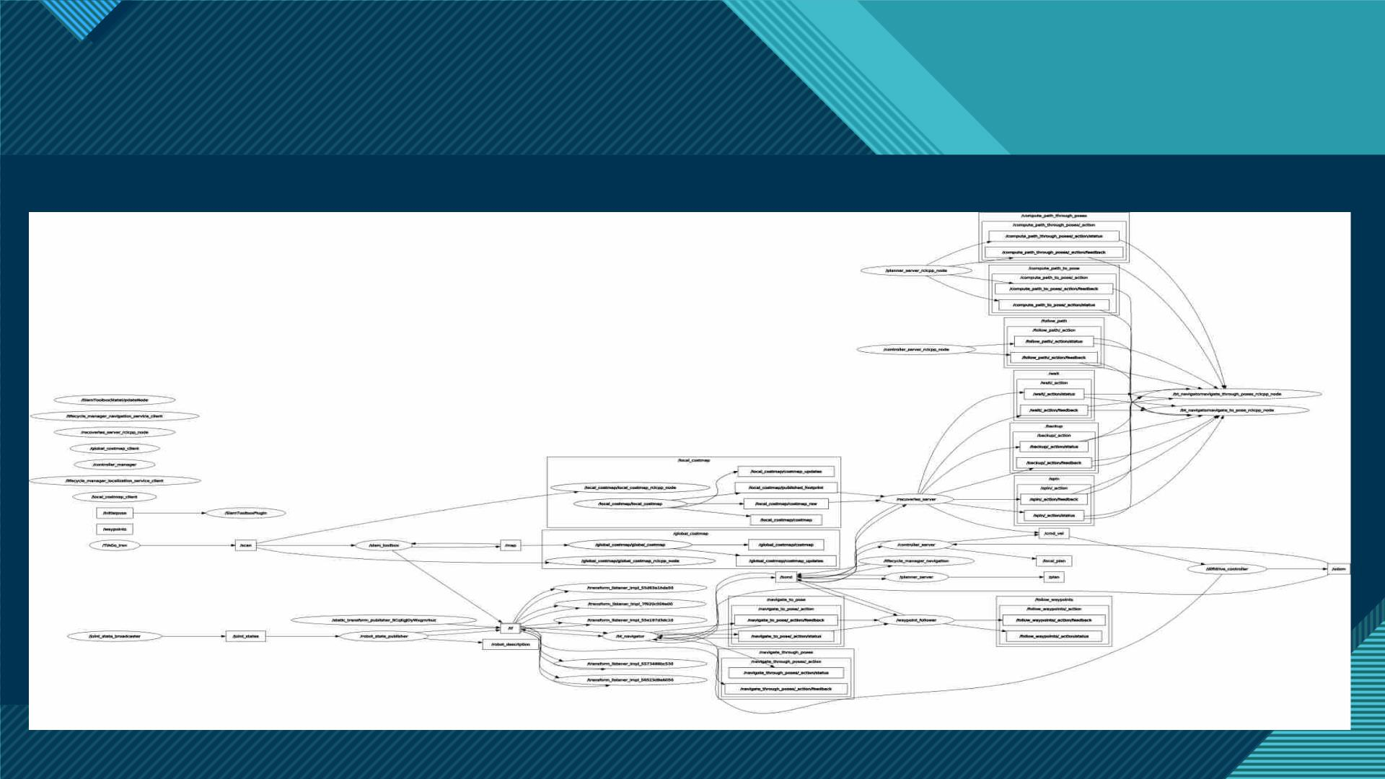
An eye on the LifeLong mode
Nodes interaction (better look on github) :
23

Slide 24

Conclusion
• Exciting and interesting to develop the project code.
• Inspiration from official Github repositories (Steve Macenski, Ros Planning, Cyberbotics,…).
• Better improvenments can be done, using also different parameters.
24

Slide 25
References
• http://wiki.ros.org/navigation
• https://navigation.ros.org/index.html
• https://github.com/SteveMacenski/slam_toolbox
• https://joss.theoj.org/papers/10.21105/joss.02783
25

Slide 26

Thank you!

