Slide 1


X-SUM(MARIZATION)
TEXT ANALYSIS OF NEWS ARTICLES
Giannelli Alessio
Imbonati Lorenzo
Valoti Davide
Data Science Master’s Degree
Text Mining Exam

Slide 2
INDEX
Text-homogeneity
Stop words removal
Tokenization and Lemmatization
Preprocessing
Bag of Words
LDA
Hyper-parameters tuning
Topic modeling
T5
BART
PEGASUS
Fine tuning
Text summarization

Slide 3
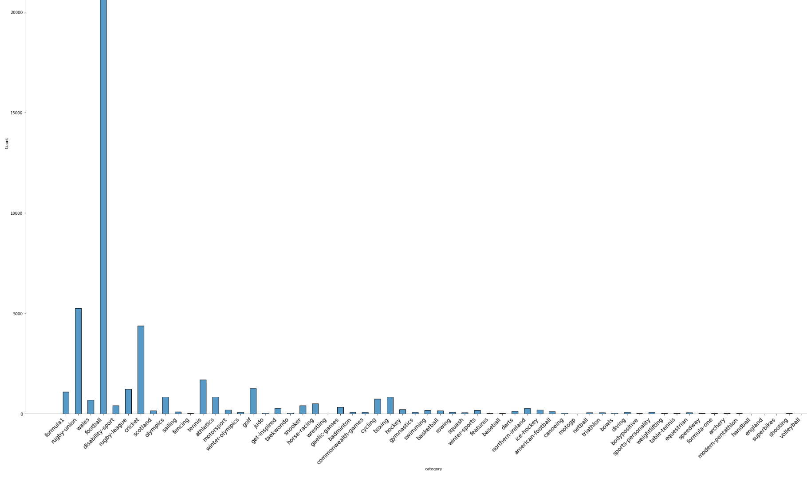
EXPLORATORY DATA ANALYSIS
CATEGORY | DOCUMENT
Football | 25718
Rugby Union | 5253
Cricket | 4370
Tennis | 1693
Golf | 1255
Rugby League | 1227
Formula 1 | 1081
Boxing | 844
Olympics | 834
Athletics | 831
Cycling | 741
Wales | 681
Horse racing | 513
EDA key stage for selection of relevant observations and task definition.
Only articles related to sports were chosen.
Original dataset:
226,711 documents
Filtered dataset:
55,416 documents

Slide 4
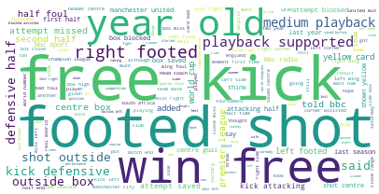
EXPLORATORY DATA ANALYSIS
Wordcloud
WORD | FREQUENCY
Free kick | 1.00
Footed shot | 0.81
Win free | 0.80
Year old | 0.57
Right footed | 0.56

Slide 5
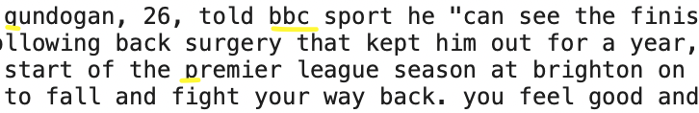
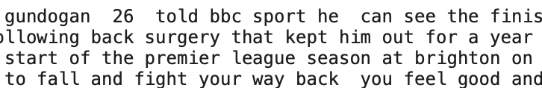
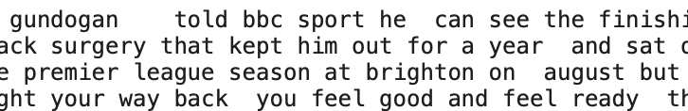
PRE-PROCESSING
Text Homogeneity
White space removal
Spelling correction
Emoji, links and HTML tags removal
Lower case conversion
Symbol and punctuations removal
Numbers removal

Slide 6
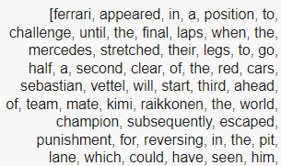
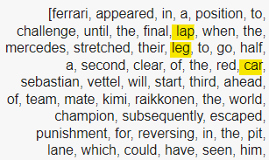
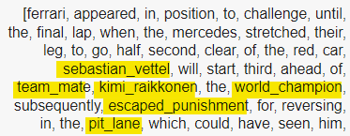
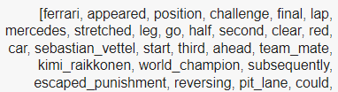
PRE-PROCESSING
Tokenization
Lemmatization
Bigrams and trigrams
Stop words removal

Slide 7
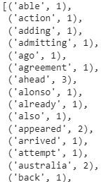
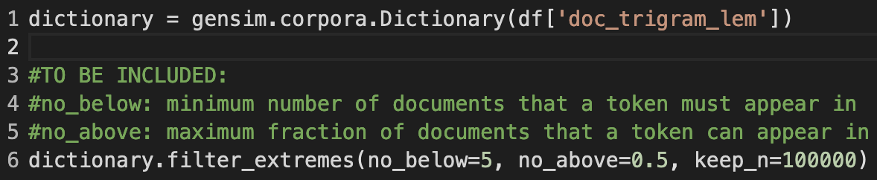
TOPIC MODELING
LDA - Input
Doc Representation
Bag of Words
Dictionary & Filter

Slide 8
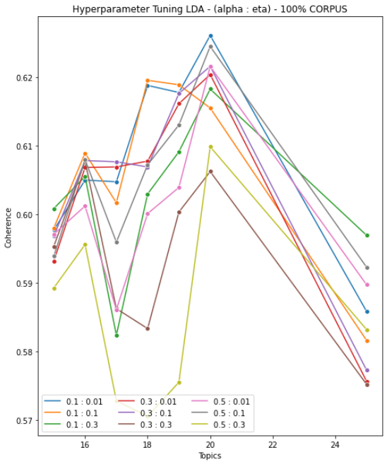
TOPIC MODELING
LDA - Hyper-parameters tuning
The tuning phase was driven by CV_coherence (y-axis) and the number of the latent topics (x-axis).
In this phase we have optimized alpha and beta, the hyperparameters used for the Dirichlet prior distribution that define the document-topic and word-topic relationships.

Slide 9
TOPIC MODELING
LDA - Final model results
lda_model = gensim.models.LdaModel(bow_corpus, id2word=dictionary, num_topics=20, offset=2, random_state=100, update_every=1, passes=10, alpha='0.1', eta='0.01', per_word_topics=True)
Coherence CV
0.626
The Coherence CV value of 0.62 indicates that the model has good internal coherence.
Coherence Umass
-1.723
The Coherence Umass value of -1.72 suggests that the model may have issues with external coherence.
Perplexity
-7.626
The Perplexity of -7.62 indicates that the model has good generalization ability.

Slide 10
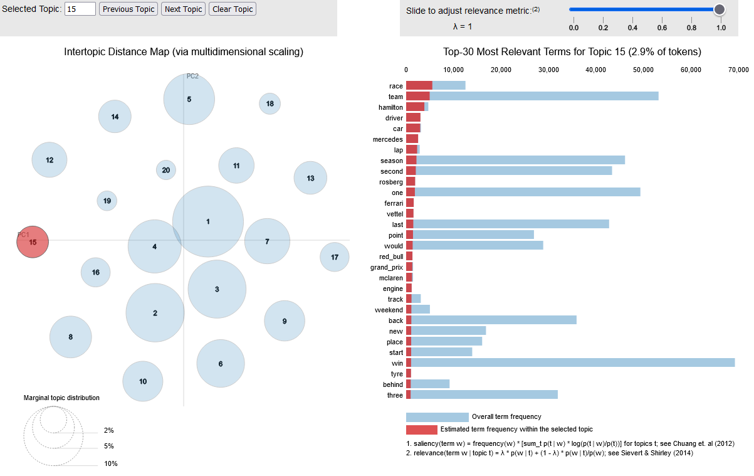
TOPIC MODELING
LDA - Evaluation Results
LET’S LEAVE ROOM FOR LDA_viz.html

Slide 11
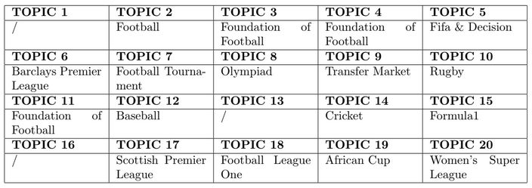

TOPIC MODELING - LDA Evaluation Result
Human Evaluation
This string represent the 20 top words in Topic 15, sorted by their semantic relevance to the topic.
Each word is accompanied by its weight, represented as a float, which indicates how strongly the word is associated with the topic.
Words Distribution

Slide 12
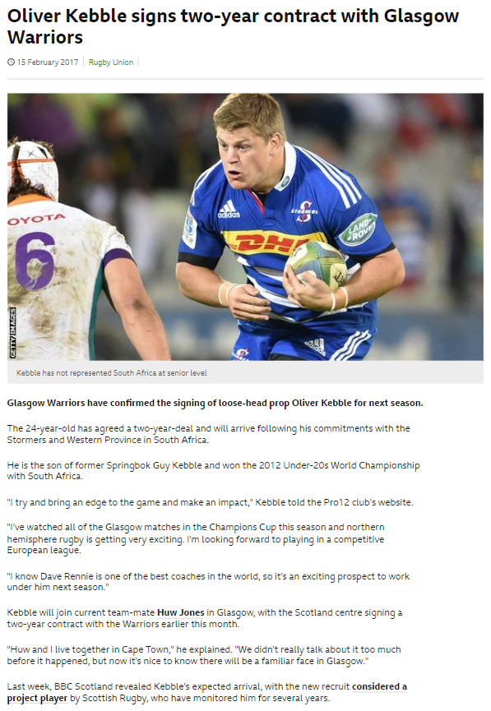
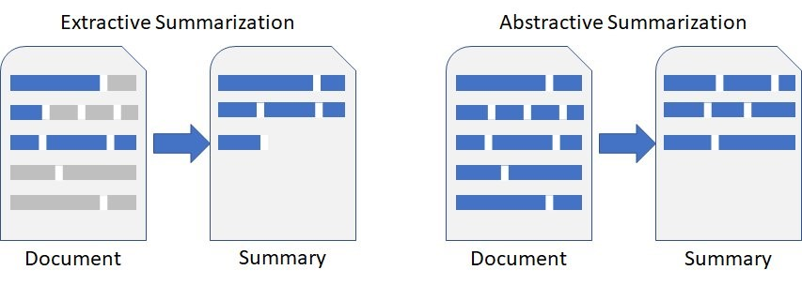
TEXT SUMMARIZATION
Implementation of different multi-document summarization algorithms, in order to find the best one for the considered dataset.

Slide 13
TEXT SUMMARIZATION
Extractive approach
Selection of important phrases or sentences from the input document.
Naive approach as benchmark: selection of the first three sentences of each document.
 | ROUGE-1 | ROUGE-2 | ROUGE-L | ROUGE-L SUM
BASELINE | 0.168 | 0.020 | 0.107 | 0.107
“The 24-year-old has agreed a two-year-deal and will arrive following his commitments with the Stormers and Western Province in South Africa. He is the son of former Springbok Guy Kebble and won the 2012 Under-20s World Championship with South Africa. "I try and bring an edge to the game and make an impact," Kebble told the Pro12 club's website.”
 | ROUGE-1 | ROUGE-2 | ROUGE-L | ROUGE-L SUM
BASELINE | 0.075 | 0.000 | 0.075 | 0.075

Slide 14
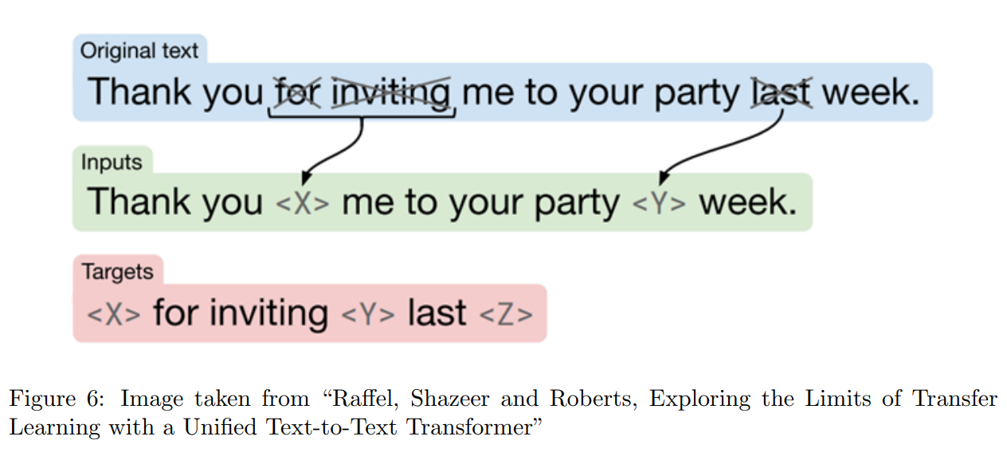
TEXT SUMMARIZATION
Abstractive approach
Architectures used:
T5 (Exploring the limits of Transfer Learning with a Unified Text-To-Text Transfer Transformer)
BART (Bidirectional Auto-Regressive Transformers)
PEGASUS (Pre-training with Extracted Gap-sentences for Abstractive SUmmarization Sequence-to-sequence)

Slide 15
ABSTRACTIVE SUMMARIZATION
Preprocessing
"Gregor Townsend gave a debut to powerhouse fijian-born wallaby wing Taqele Naiyaravoro . the dragons gave first starts of the season to wing aled Brew and hooker Elliot Dee . it took 24 minutes for a disjointed game to produce a try ."
Use of AutoTokenizer for the preprocessing phase.
Main steps:
Text normalization
Tokenization
Byte-pair encoding (BPE)
Special tokens
Padding and truncation
Encoding
[32939, 1422, 114, 4042, 112, 19077, 19716, 46827, 121, 7623, 1075, 304, 1846, 6959, 781, 19854, 12078, 6856, 9162, 32708, 26977, 110, 107, 109, 24674, 1422, 211, 2171, 113, 109, 578, 112, 6959, 114, 4105, 20663, 111, 5922, 420, 29592, 15960, 110, 107, 126, 635, 1202, 542, 118, 114, 62478, 389, 112, 1449, 114, 508, 110, 107, 1]

Slide 16
ABSTRACTIVE SUMMARIZATION
Results
 | ROUGE-1 | ROUGE-2 | ROUGE-L | ROUGE-L SUM
BASELINE | 0.168 | 0.020 | 0.107 | 0.107
T5 | 0.171 | 0.023 | 0.117 | 0.117
BART | 0.203 | 0.041 | 0.135 | 0.166
PEGASUS | 0.472 | 0.269 | 0.412 | 0.414
PEGASUS obtains best performance for the considered dataset.

Slide 17
ABSTRACTIVE SUMMARIZATION
Single document results
“the 24-year-old has agreed a two-year deal with the Stormers and Western Province . he is the son of former Springbok Guy Kebble and won the 2012 under-20s world championship with south africa . Kebble will join current team-mate Huw Jones in Glasgow .”
 | ROUGE-1 | ROUGE-2 | ROUGE-L | ROUGE-L SUM
T5 | 0.131 | 0.000 | 0.098 | 0.098
“Kebble is the son of former Springbok Guy Kebble and won the 2012 Under-20s World Championship with South Africa. The 24-year-old has agreed a two-year deal with the Pro12 club. He will arrive following his commitments with the Stormers and Western Province in South Africa and will join current team-mate Huw Jones.”
 | ROUGE-1 | ROUGE-2 | ROUGE-L | ROUGE-L SUM
BART | 0.083 | 0.000 | 0.083 | 0.083
 | ROUGE-1 | ROUGE-2 | ROUGE-L | ROUGE-L SUM
PEGASUS | 0.320 | 0.174 | 0.320 | 0.320
“Glasgow Warriors have signed South African scrum-half Ruan Kebble.”

Slide 18
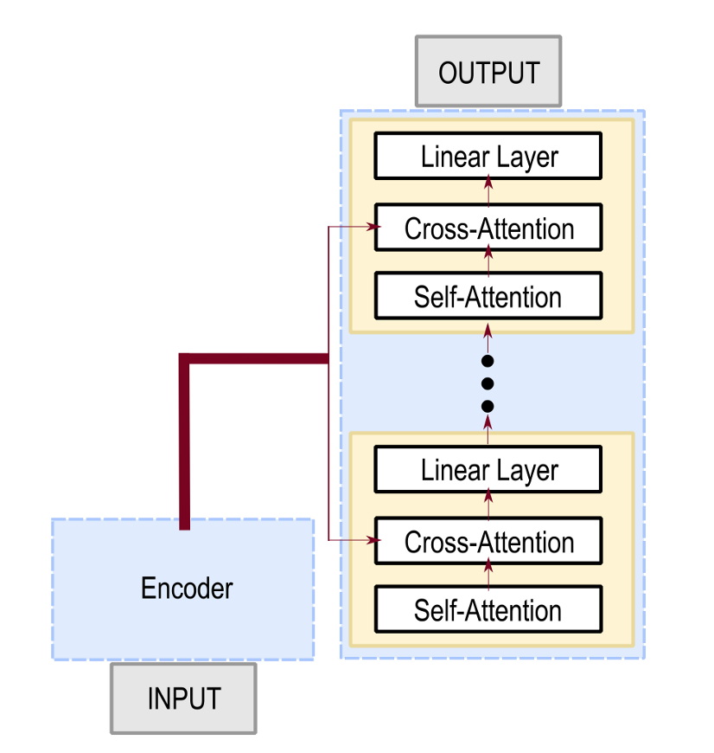
ABSTRACTIVE SUMMARIZATION
PEGASUS Fine-tuning
Encoder-Decoder
Training set:
10000 documents
Validation set:
1000 documents
Application of a Seq2Seq trainer to estimate parameters adaptive to the new training set (supervised fine-tuning).
Main parameters:
8 epochs of training
Training batch size of 8 documents
Validation batch size of 4 documents

Slide 19
ABSTRACTIVE SUMMARIZATION
PEGASUS Fine-tuning results
 | ROUGE-1 | ROUGE-2 | ROUGE-L | ROUGE-L SUM
PEGASUS | 0.472 | 0.269 | 0.412 | 0.414
PEGASUS FINE-TUNING | 0.497 | 0.275 | 0.418 | 0.418
Proposal summary
True Summary
“Glasgow Warriors have signed South African loose-head prop Oli Kebble for next season.”
“Glasgow Warriors have confirmed the signing of loose-head prop Oliver Kebble for next season”
 | ROUGE-1 | ROUGE-2 | ROUGE-L | ROUGE-L SUM
PEGASUS | 0.320 | 0.174 | 0.320 | 0.320
PEGASUS FINE-TUNING | 0.690 | 0.519 | 0.690 | 0.690

Slide 20
CONCLUSIONS & FUTURE DEVELOPMENTS
Through the LDA model it was possible to identify the main Topics and the related terms that characterize the various documents.
Topic Modeling
PEGASUS model the best to implement Extractive and Abstractive summarization, and Fine-Tuning has further improved performance.
Summarization
Results of topic modeling as input for Extractive Text Summarization to make a better comparison between Extractive and Abstractive summarization.
Future developments

