Slide 1
ACCIDENTS CLASSIFIER

Slide 2
ABSTRACT
WHAT THE PROBLEM IS ABOUT?
Road accidents happen all the time due to several different conditions. An accident can be labeled as lethal or not through an index called "Severity Index"
SEVERITY INDEX
It is a numerical integer index whose range can vary depending on the country.
OBJECTIVE
Building a model that will be able to predict the severity index of an accident when given in input the road conditions and information

Slide 3
DATASET DESCRIPTION
6 YEARS
The information in the dataset were collected in the arc of 6 years in 49 countries in the US. The Severity Index goes from 1 to 4.
2021
2020
2019
Number of records = about 2.9 million Number of features = 47
2018
2017
The features include:
Timestamp of the accident (so also if it was day or night)
Road information (presence of signals, railway, junction, bump ecc...) Weather Condition (rain precipitation,wind speed, humidity ecc...) Brief description of the accident
2016

Slide 4
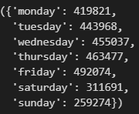
FEATURE EXTRACTION
As said in the previous slide, one of the features represent the timestamp of the accident. The format of the timestamp makes it unusable for classification purposes, so some transformations were carried out on it.
STEP 4
Transform the integer values in the correspondent labels
STEP 1
Some of the timestamps contain also the milliseconds. The split() method was used to retrieve the part without milliseconds
STEP 2
transform all the timestamps according to the format %Y-%m-%d
%H:%M:%S
STEP 3
Use the weekday() method on the timestamps to retrieve the day of the week the accident happened

Slide 5
PREPROCESSING
USELESS FEATURES
ID = the id given to the accident ZIPCODE = the
zipcode of the city DESCRIPTION =
the description of the accident
REDUNDANT FEATURES
CIVIL TWILIGHT,NAUTICAL TWILIGHT,ASTRONOMICAL
TWILIGHT = different ways of considering the start of the sunset period
END_TIME = timestamp of the end of the accident
Given the number of features, an inspection was carried out to understand if some of the columns were useless regarding our objective.
FEATURE DROP
Here on the right side there are examples of feature that were dropped
FEATURES WITH ALL THE SAME VALUE
Some of the features have basically the same value for every record, so they are useless when it comes to classification. These features are:
TRAFFIC CALMING TURNING LOOP ROUNDABOUT BUMP
NO EXIT

Slide 6
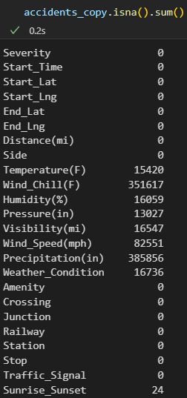
PREPROCESSING
DROP OF THE ROWS
TEMPERATURE HUMIDITY SUNRISE_SUNSET
MEAN OF THE FEATURE
WIND_CHILL PRESSURE VISIBILITY WIND_SPEED PRECIPITATION
MODE OF THE FEATURE
WEATHER_CONDI TION
After all the useless features have been dropped, the following step consists in handling the missing values.
A total of 9 features were detected to have NaN values.

Slide 7
PREPROCESSING
RESULT
After the preprocessing steps of the previous slides that were carried out, the dataset contained about 2.5 million rows and 24 features.
SEVERITY INDEX
Upon futher inspection of the Severity feature, it could be observed that the classes associated with the values 1 and 4 were very few, infact the latter was only present in 26000 records, while the classes for 2 and 3 were more present in the dataset. In this sense undersampling and oversampling didn't produce good results if 1 and 4 were taken into account, but if all the rows related to them were dropped, much better output were produced, so the related rows were dropped to keep the problem interesting.
FURTHER ROWS DROPPED
Even after these modifications, the number of rows was still over 2 million, which was too much in terms of computational time for the classification. The goal was to keep them under 1 million and for this purpose the date of the accident was exploited: as said in the beginning, the data were collected in the arc of 6 years, so dropping rows related to some of the years was enough.

Slide 8
PREPROCESSING
The only thing that remained to handle were the categorical features. More specifically, there were 2 feature of this type: START_TIME and WEATHER_CONDITION
ENCODING
Among the possible strategies, the best one was observed to be the get_dummies() method
RESULT
The original 2 features were dropped and replaced by a column for each of the categorical value
GET DUMMIES

Slide 9
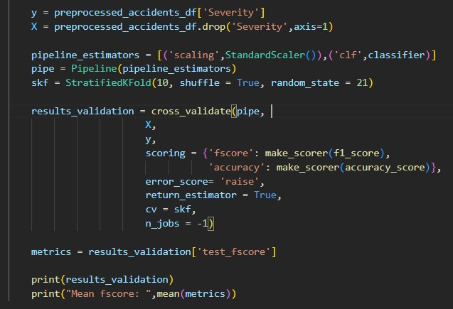
CROSS VALIDATION
To ensure the quality of the eventual model and compare the performance of different classifiers, a cross validation was carried out.
Pipeline and pipeline estimators were used to do so in order to prevent Data Leakage and therefore getting clean results. Oversampling (SMOTE) in combination with UnderSampling (RandomUnderSampling) was used to get a better result.
ADABOOST
Fscore: 82%
LOGISTIC REGRESSION
Fscore: 80%
RANDOM FOREST
Fscore: 86%
K-NN
Fscore: 82%

Slide 10
CROSS VALIDATION
Here the best accuracy results are reported with some of the possible combination
DecisionTree
Criterion:
GINI -> 79%
ENTROPY -> 80%
Adaboost
n_estimators: 50 -> 81,9%
60 -> 82%
70 -> 82,3%
80 -> 82,7%
K-NN
RandomForest
Criterion:
GINI -> 85,8%
ENTROPY -> 86%
Logistic Regression
Class_Weight: NONE-> 80%
BALANCED-> 80%
k:
10 -> 81,9%
9 -> 82%
8 -> 82%
7 -> 82%
6 -> 82%
5 -> 82%

Slide 11
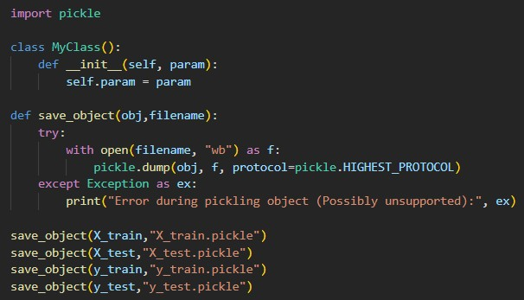
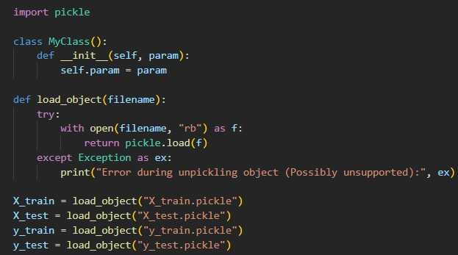
TRAINING THE MODEL
Since the goal was building a model able to predict the severity of an accident, the dataset was split beforehand in train data and test data. The preprocessing steps were carried out and the best result from cross-validation was used to create the model
SAVING THE MODEL
Once the training was completed the model was saved in order to be imported for creating the Application.

Slide 12
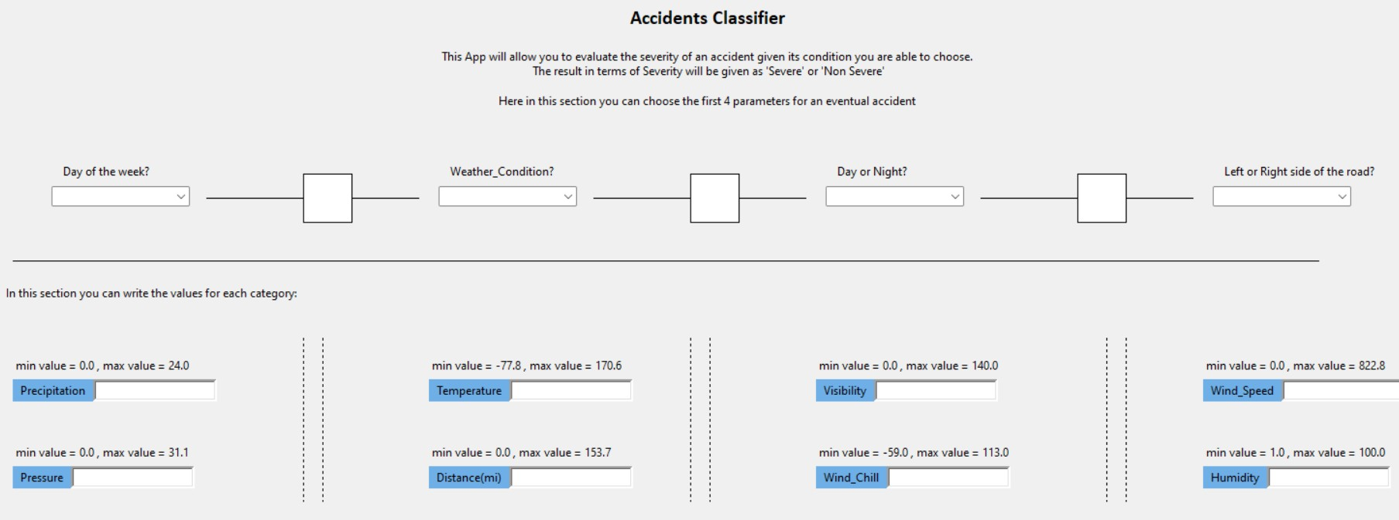
APPLICATION
First Section: Comboboxes to choose the option
Second Section: the user can type the values into the Entries

Slide 13
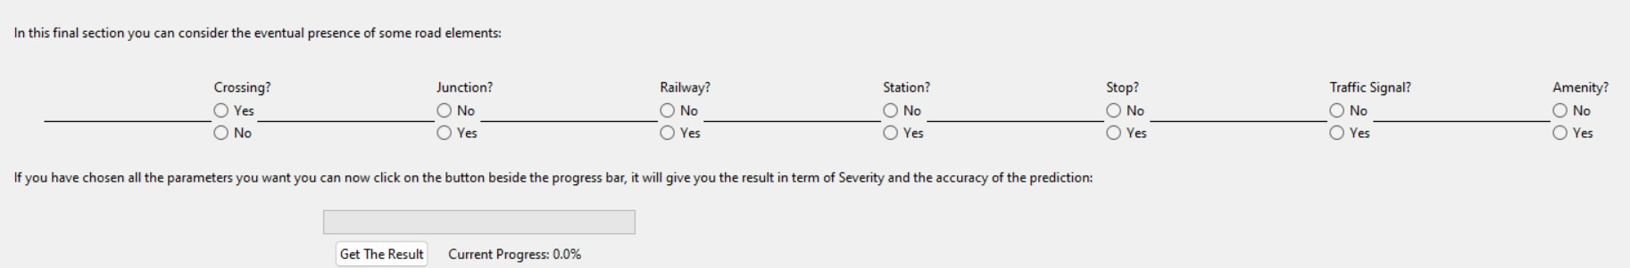
APPLICATION
Third Section: Radio buttons to choose the option
Last Section: Progress bar and related button to compute the prediction
Once the prediction has been computed, the result will be shown to the user.

Slide 14
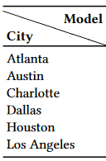


PAPERS
There are 2 papers regarding this dataset and its classification problem. The model that were decided to use were mostly Logistic Regression (LR) and also Deep Neural Networks (DNN). As said, classification was carried also in this case and the precision of the models was measured with the Weighted Average F1 Score. The models were tested on the records regarding 6 cities, here is the result:
LR DNN
https://arxiv.org/pdf/1906.05409.pdf https://arxiv.org/pdf/1909.09638.pdf

Slide 15
THANKS FOR THE ATTENTION

