Slide 1
Dynamo: Amazon’s Highly Available Key-value Store
康鸿博
2020310795

Slide 2
Introduction
Applications use (key, value) pattern to access storage
Programs can deal with inconsistency
Shopping carts
Applications show different requirements between “Consistency, Availability, Latency”

Slide 3
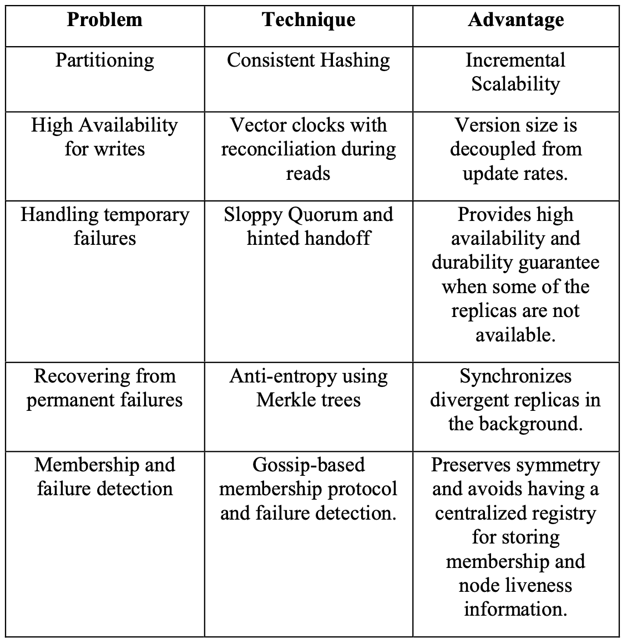
Introduction
Dynamo’s approach
Key-Value store + SLA
Consistent Hashing for partitioning & placement
Eventual Consistency + Multiple Version
Multiple Copy + Quorum Based Get/Update
Gossip-based failure detection & membership record

Slide 4
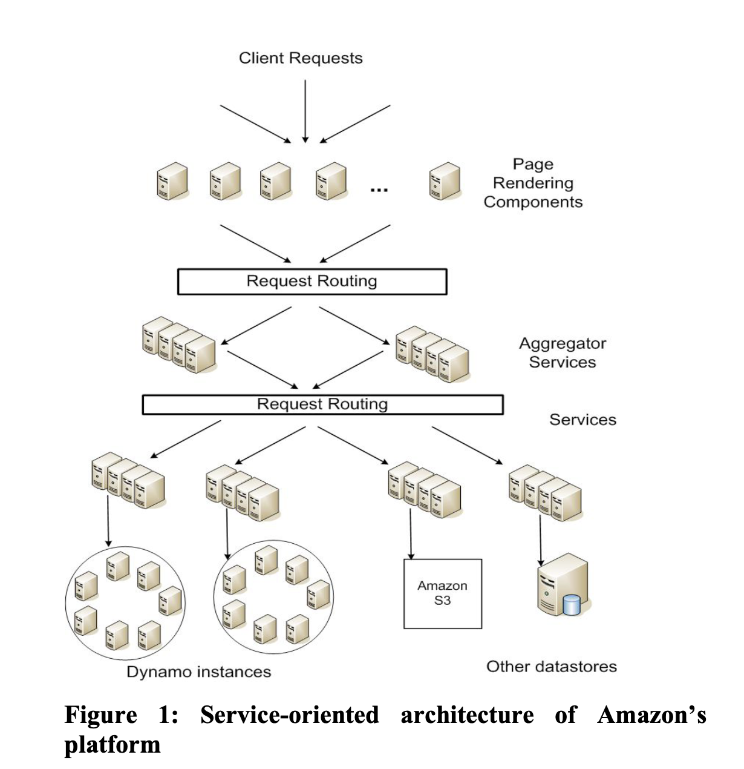
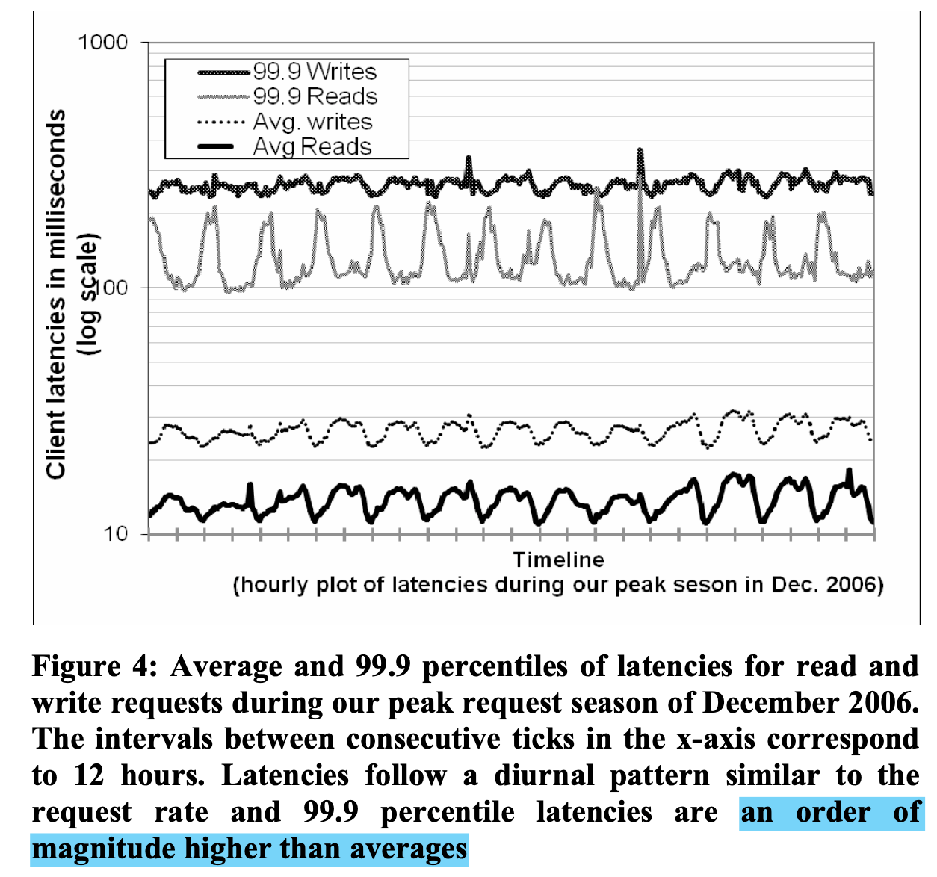
Key-Value Store + SLA

Slide 5
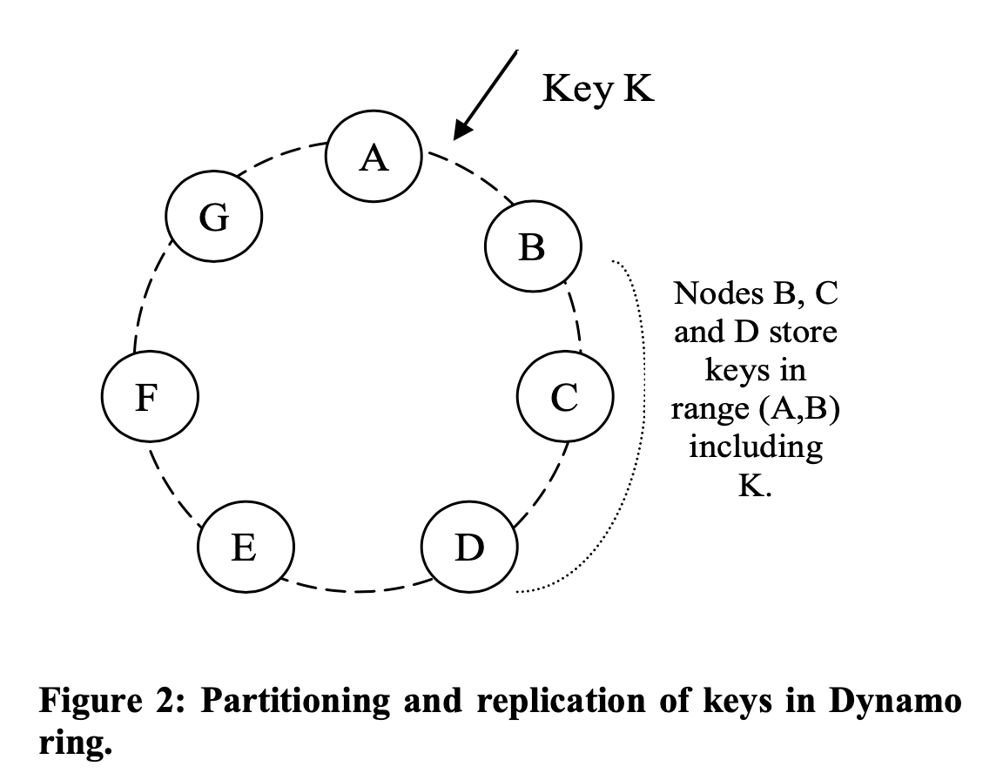
Consistent Hashing

Slide 6
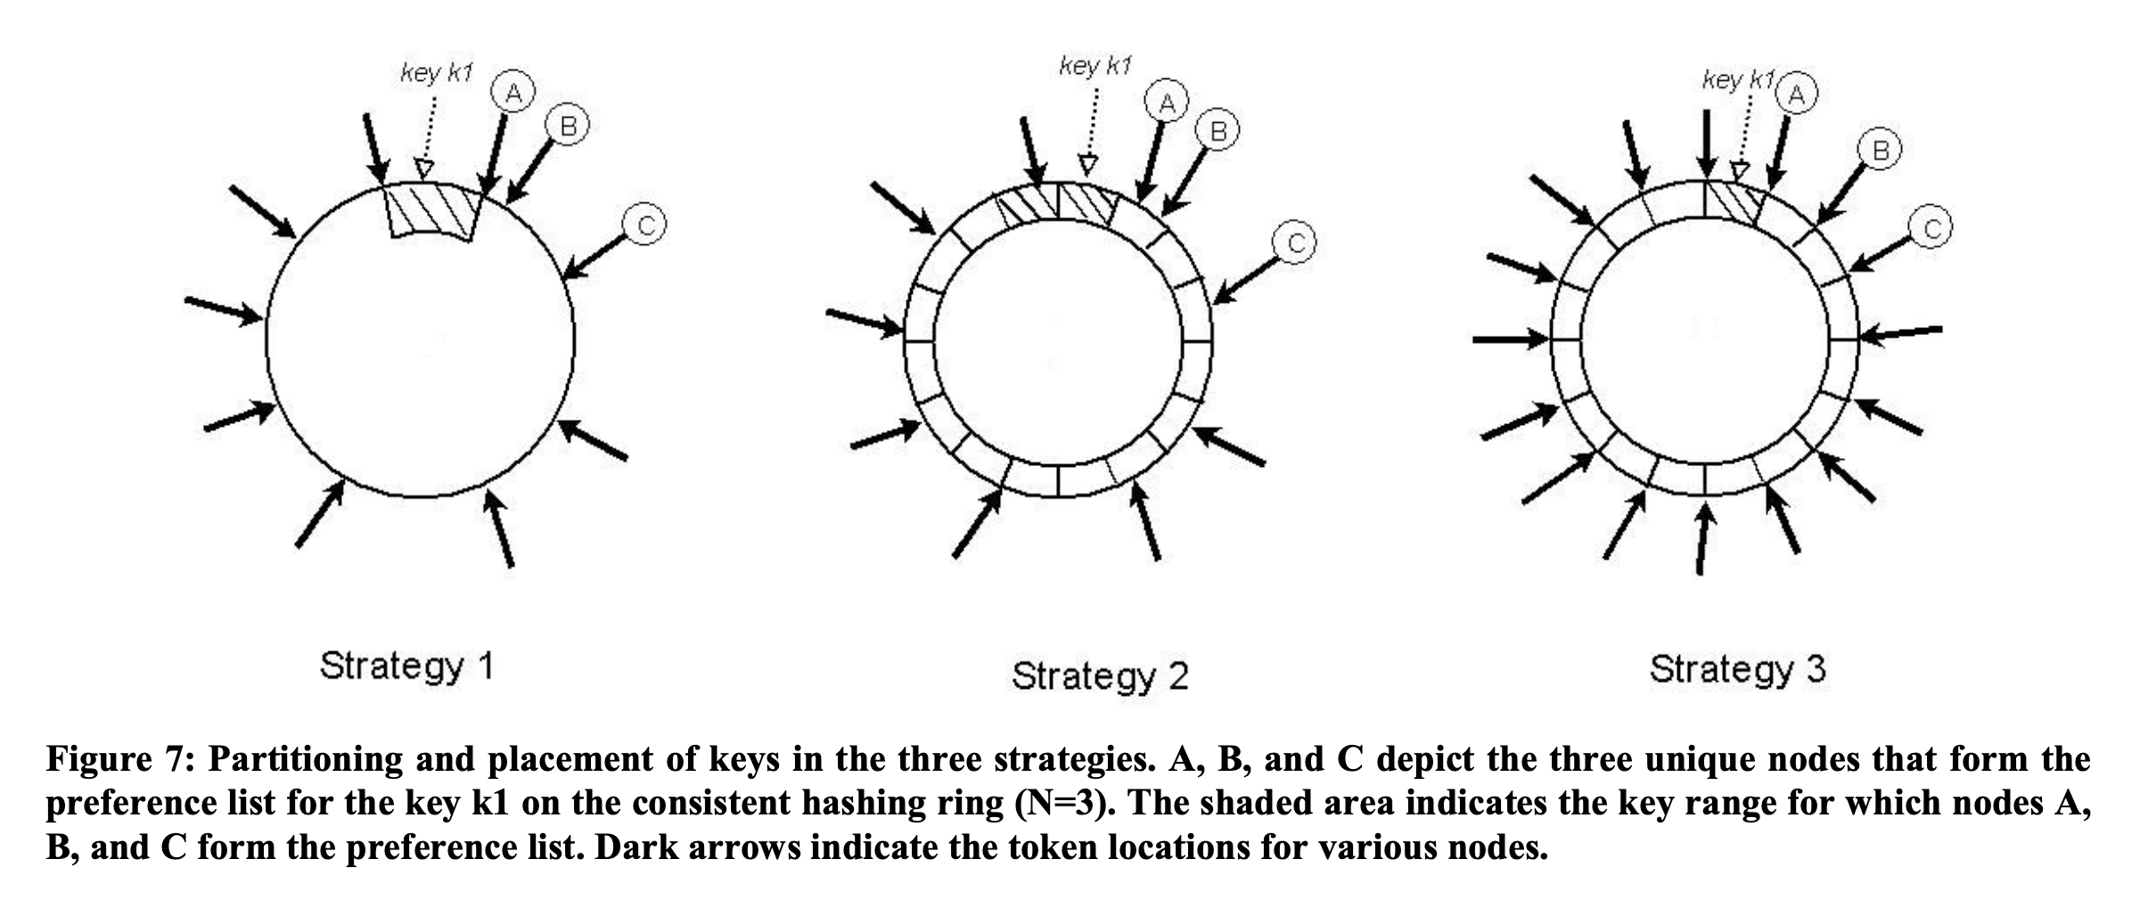
Consistent Hashing: Partitioning & Placement

Slide 7
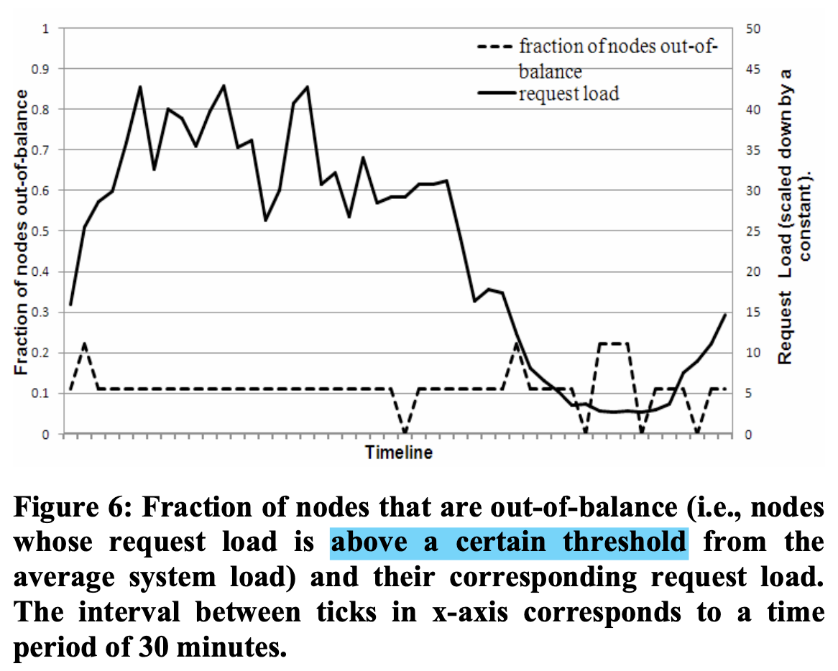
Consistent Hashing

Slide 8
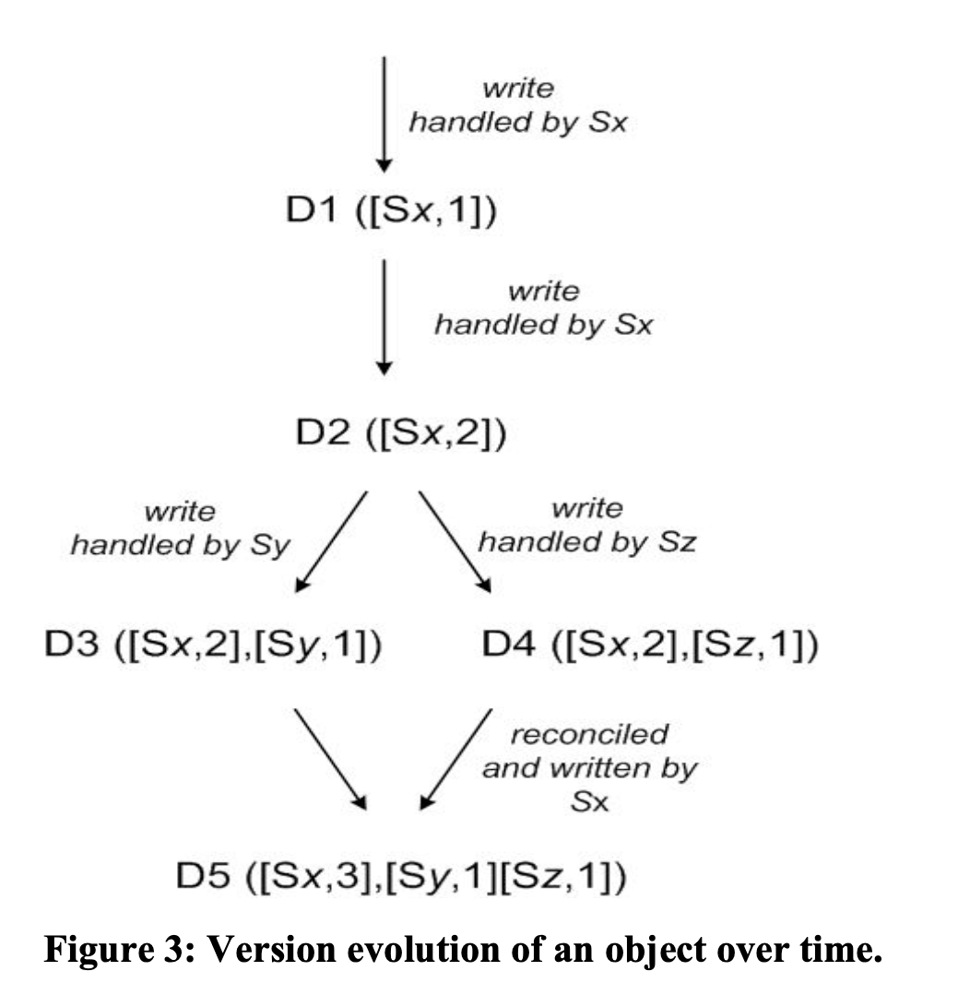
Multiple Version
”Write First” design
Find the first active node
Conflicts solved by clients

Slide 9
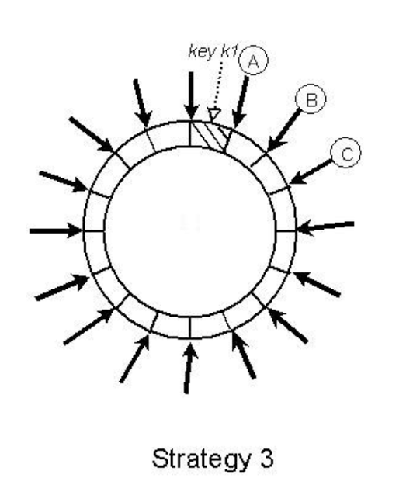
Quorum based R/W
Read from R nodes
Write to W nodes
Have N copy
Delayed update: send updates when the server is back alive
Merkle tree for lost update

Slide 10
Gossip-based member management
Similar to that in P2P network / routing protocols
Use some “seed” server to reduce synchronization latency of the network

Slide 11
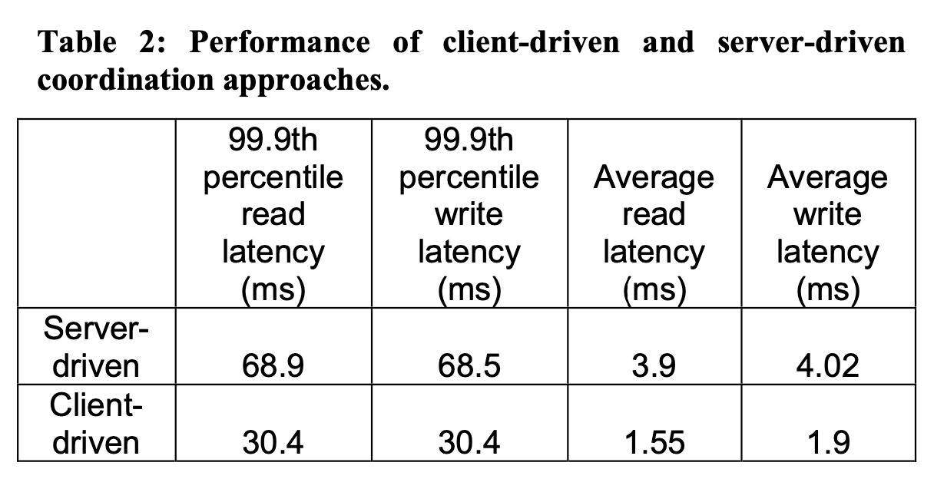
Performance

