Slide 1
Hyperkernel: Push-Button Verification of an OS Kernel
康鸿博
2020310795

Slide 2
Introduction
Push-button verification of OS kernel
Verify
Initial state
Trap handlers as state transformation
Declarative specifications
C implementation + Z3 solver + Python specifications

Slide 3
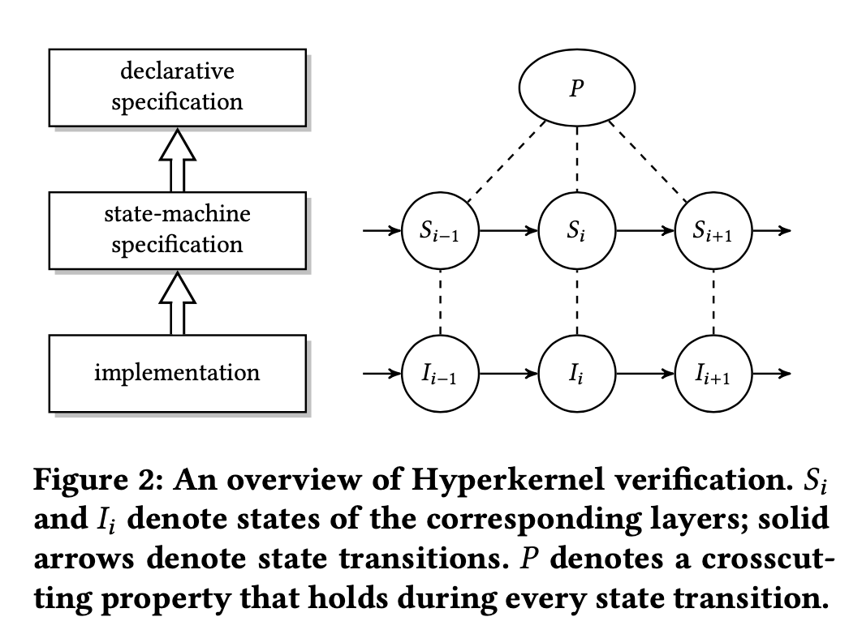
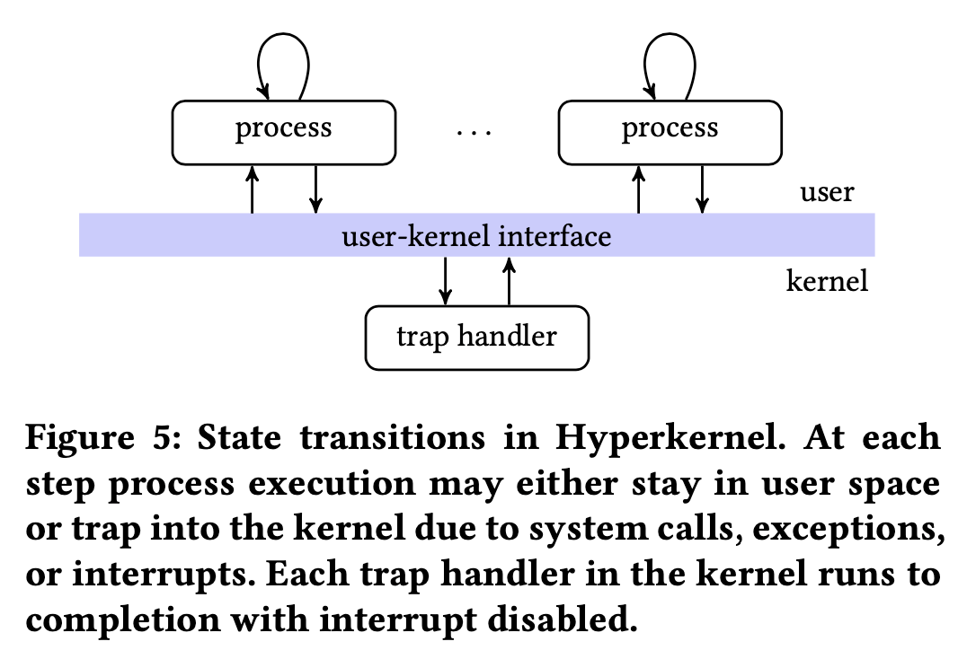

Slide 4
Introduction
Main Difficulties
Virtual-to-Physical memory mapping
Unbounded loop & recursion
C programming language
Other Difficulties
Concurrency caused by DMA
Declarative specification

Slide 5
Virtual-to-Physical Mapping
Hardware Virtualization
separate “kernel” and “user” page table
Use identity mapping in kernel space

Slide 6
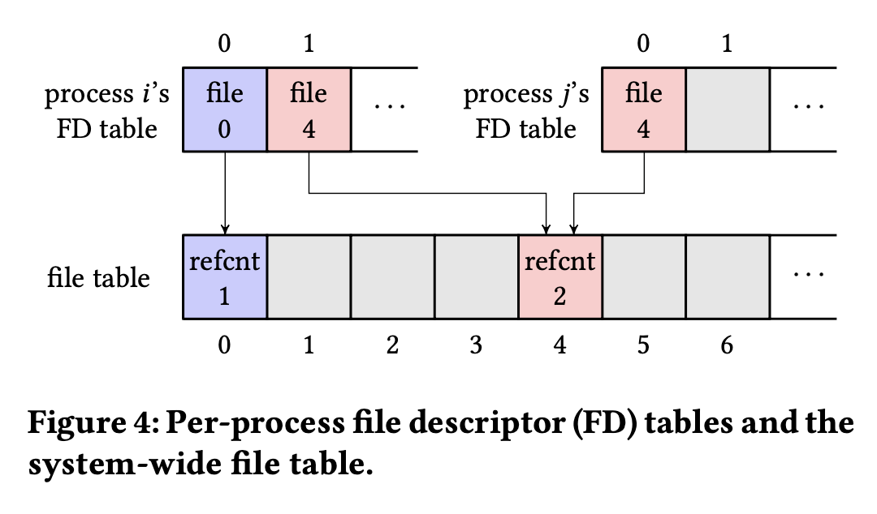
Unbounded loop / recursion
Design trap handlers with bounded loop / recursion
Dup(oldID) -> Dup(oldID, newID)

Slide 7
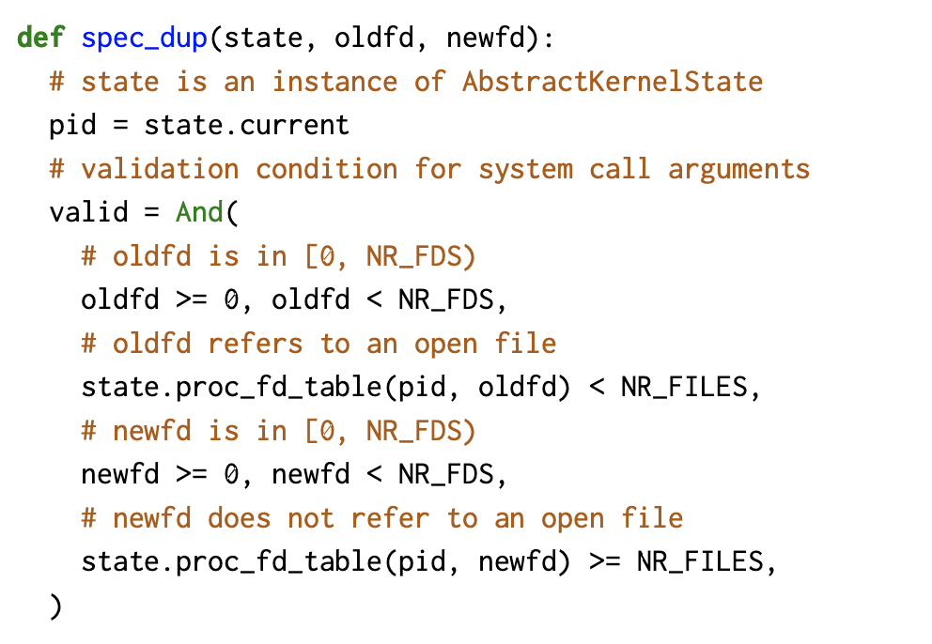
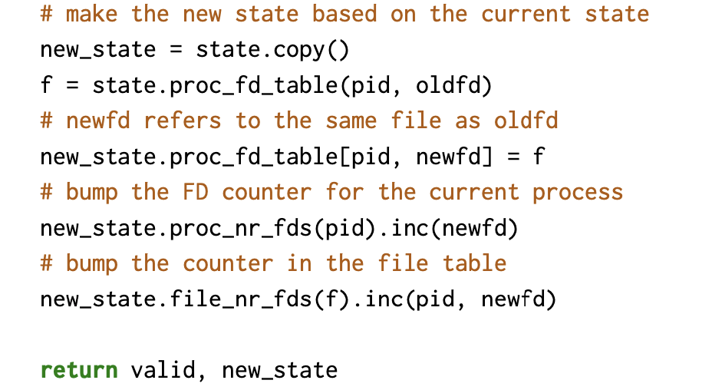
Dup

Slide 8
C programming language
Verify based on LLVM IR
Loop unroll and traverse all possible path
Undefined behaviors:
Immediate undefined behaviors
Solved by adding additional restraints
Undefined values
New variables with any possible value
Poison values
Avoided, may be removed in the future

Slide 9
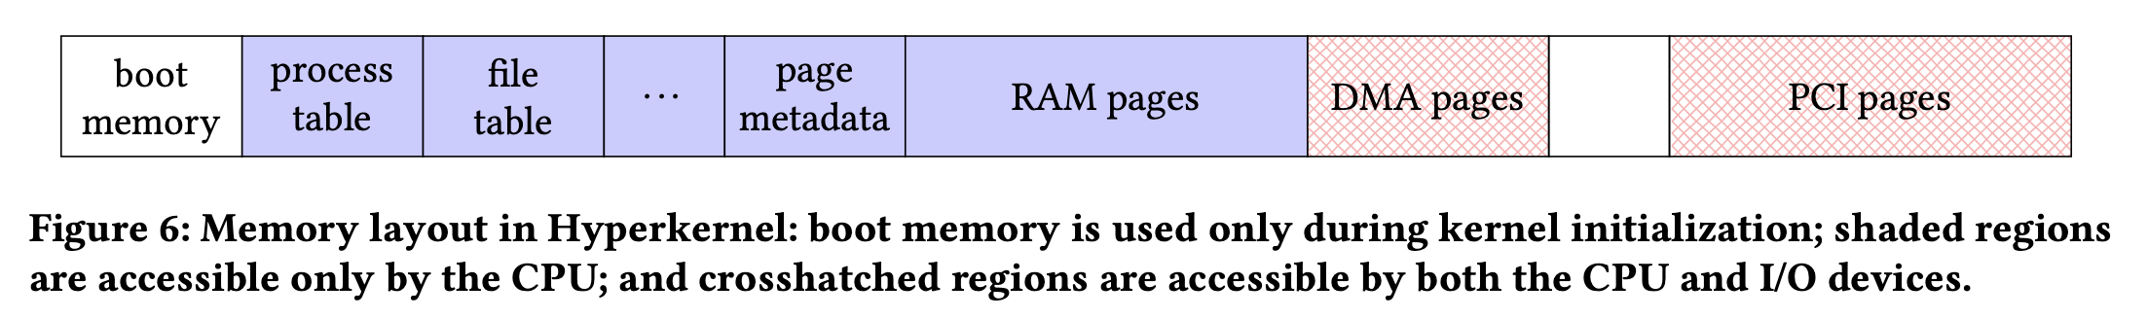
Concurrency by DMA
Limit DMA access to special memory region
Treat them as volatile

Slide 10


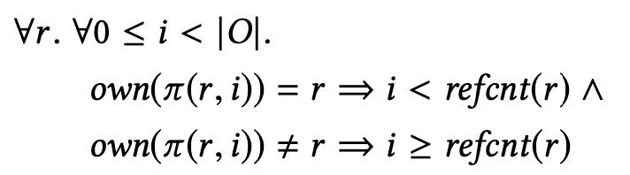

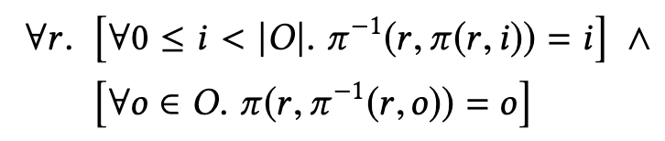
Declarative specification
Notes:
Own(o): 进程o拥有的资源

Slide 11
Performance – Find Bugs
Declarative specifications help find bugs
Reference count specifications
Isolation specifications for memory pages
Z3 solver give counterexamples

Slide 12
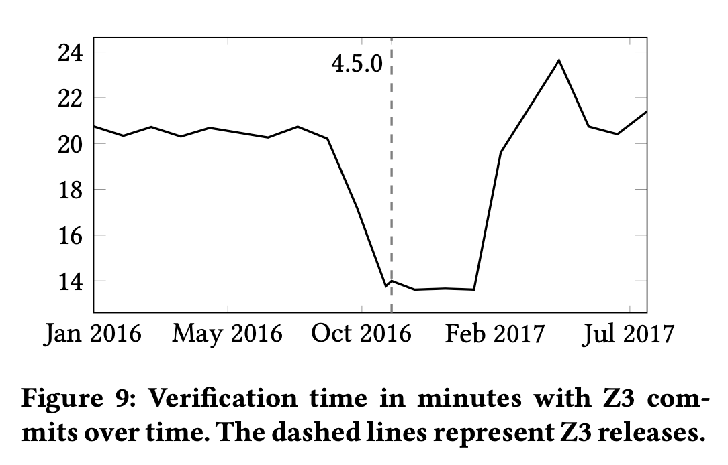
Proof Performance

Slide 13
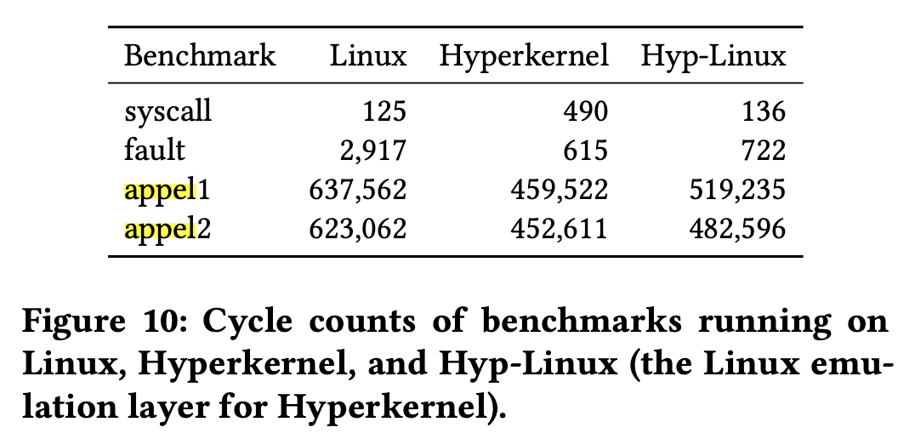
Run-time Performance

