Slide 1
Scalable Address Spaces Using RCU Balanced Trees
康鸿博
2020310795

Slide 2
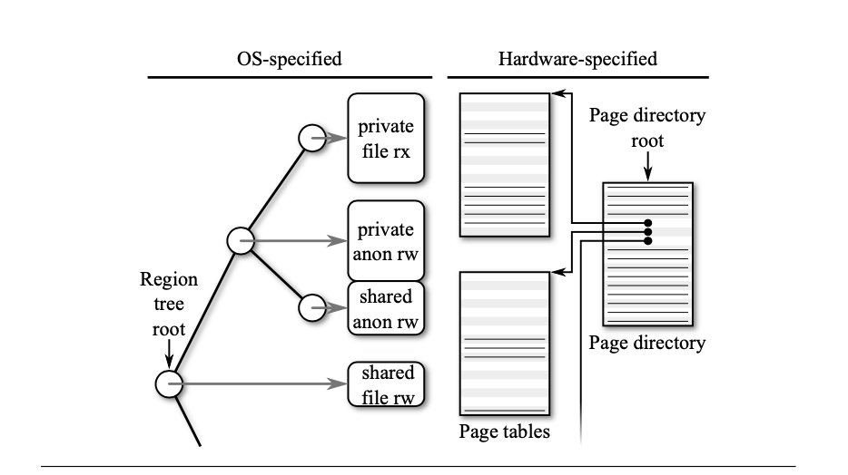
Introduction

Slide 3
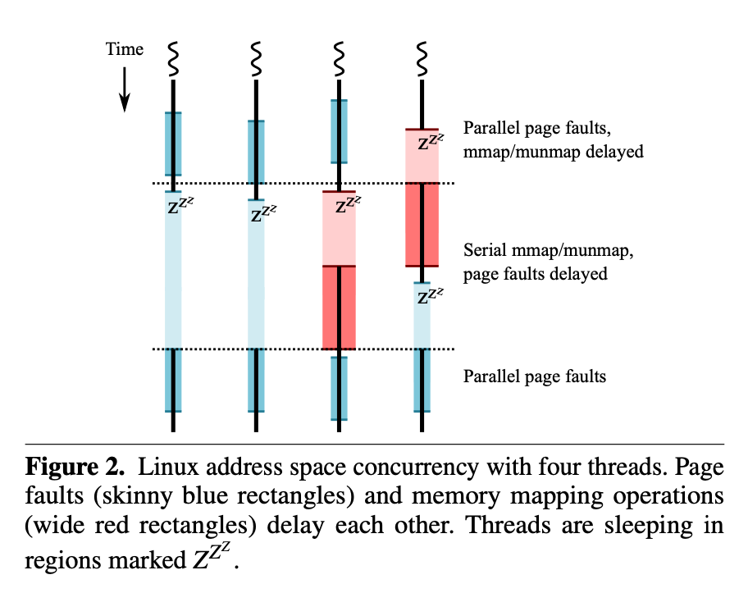
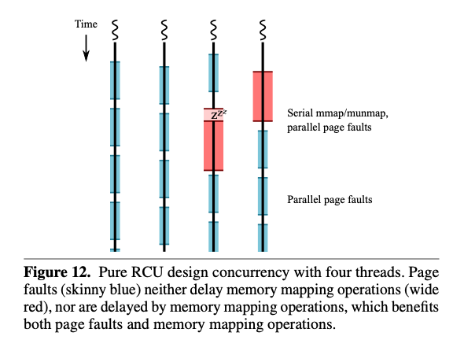
Introduction

Slide 4
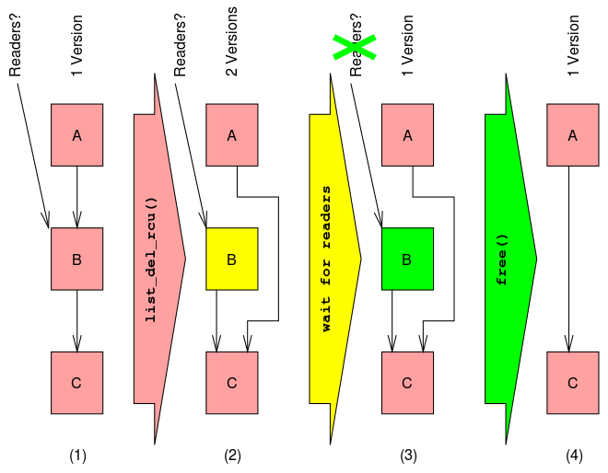
RCU

Slide 5
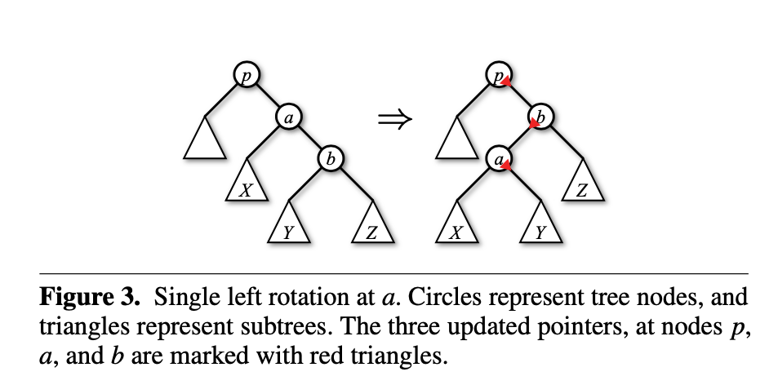
Hard to use RCU

Slide 6
How to use RCU
RCU balanced tree
Linearizable for single operation
Solve Race Condition between tree&page_table / different ops

Slide 7
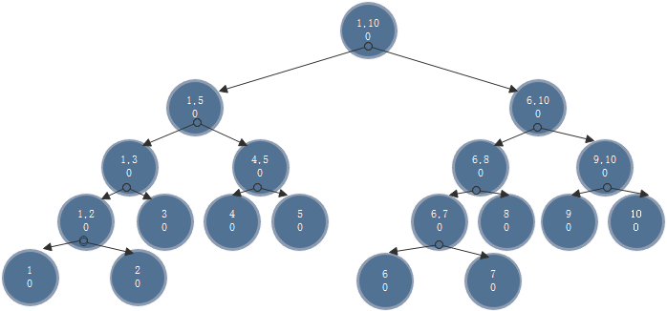
RCU balanced Tree

Slide 8
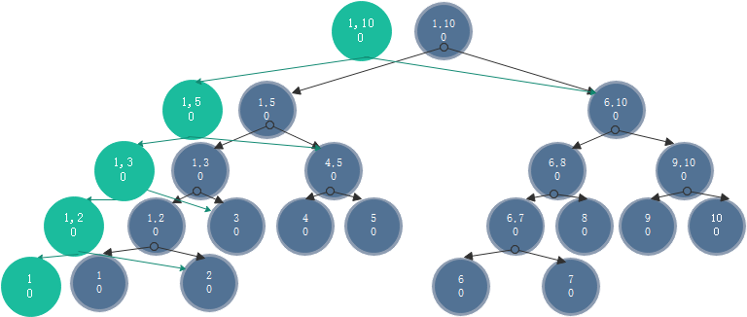
RCU balanced Tree : a[1] += 0

Slide 9
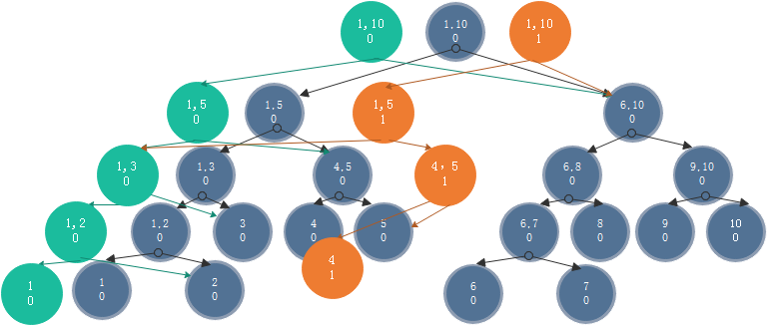
RCU balanced Tree: a[4] += 1

Slide 10
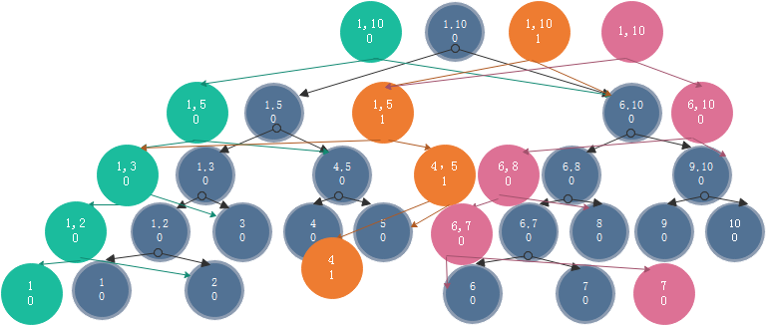
RCU balanced Tree: a[7] += 0

Slide 11
RCU balanced Tree
Atomically update the root
Need O(logn) space

Slide 12
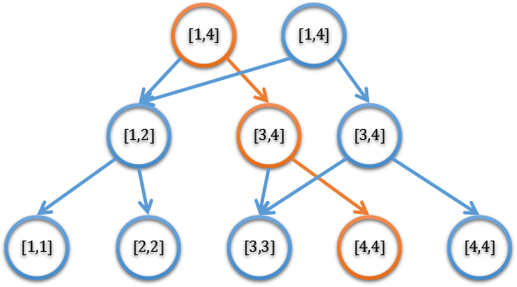
Key observation
Do not need to be “persistent”
Change pointers bottom up
New nodes only for
the “changed” keys

Slide 13
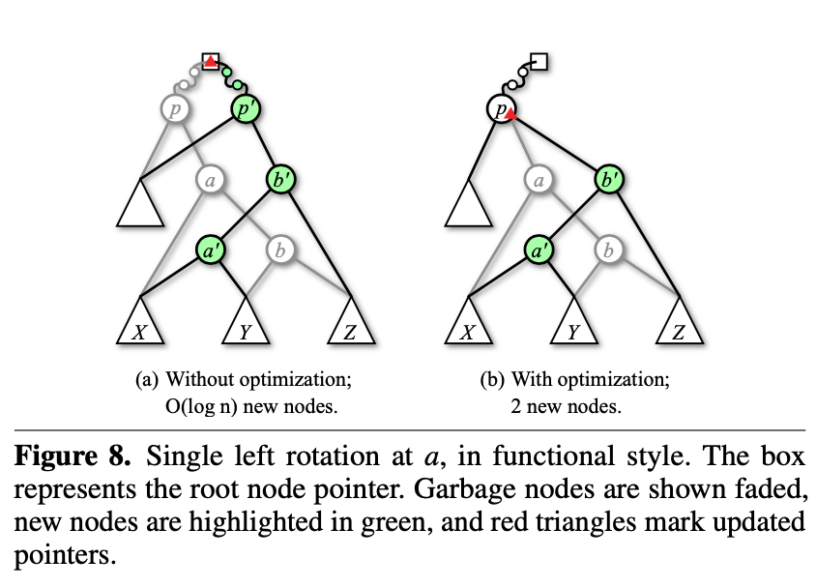
3 step towards scalable address space
Fault locking
Hybrid locking / RCU
Pure RCU

Slide 14
Fault Locking
Read Only Phase
Map
Fault

Slide 15
Hybrid locking / RCU
Map
Fault

Slide 16
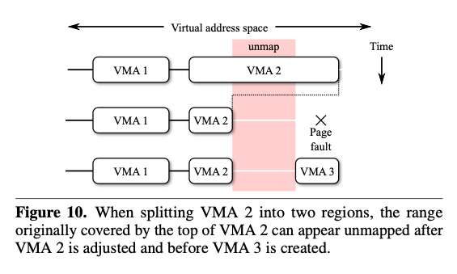
VMA Split Race

Slide 17
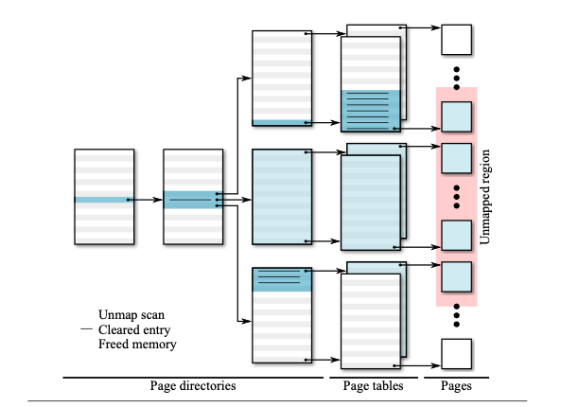
Page Table Deallocation Race
Page fault
Unmap

Slide 18
Page Table Fill Race
Page fault
Unmap

Slide 19
Pure RCU
Map
Fault

Slide 20
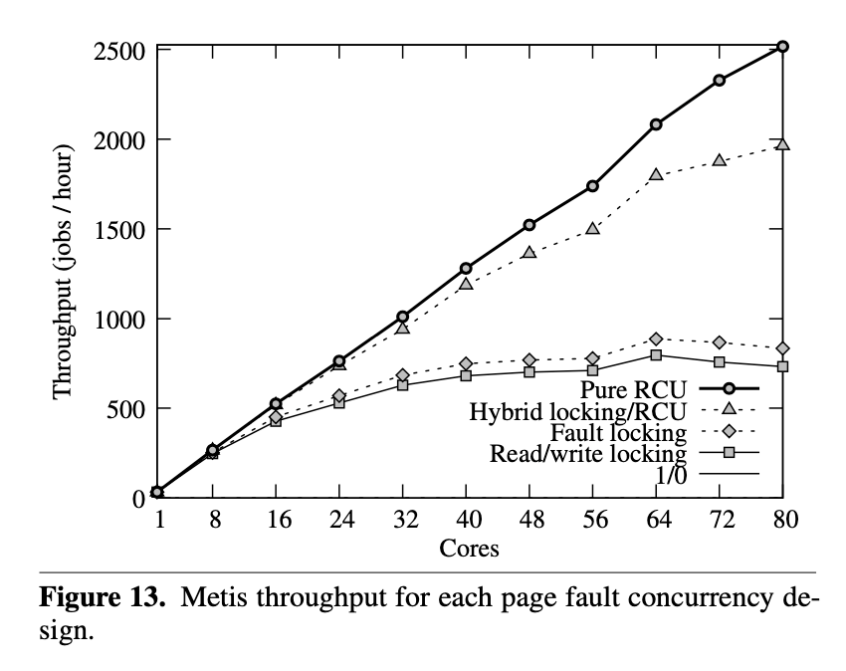
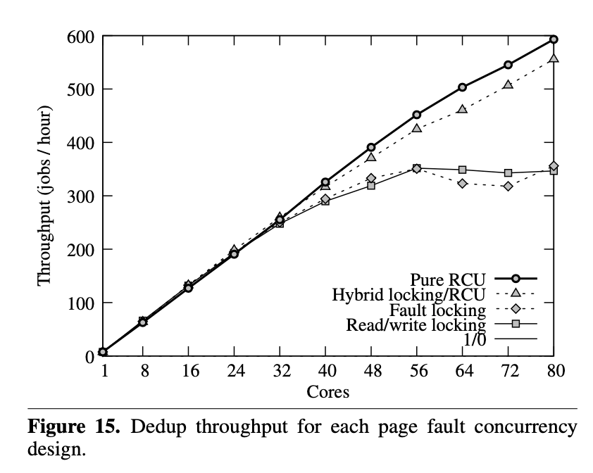
Performance

Slide 21
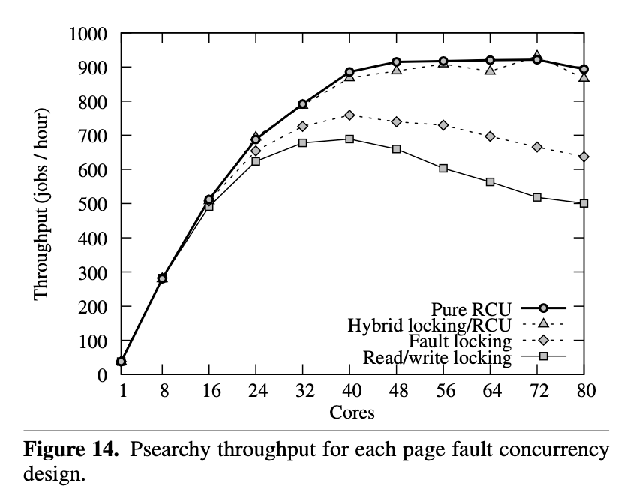
Performance

Slide 22
Performance

Slide 23
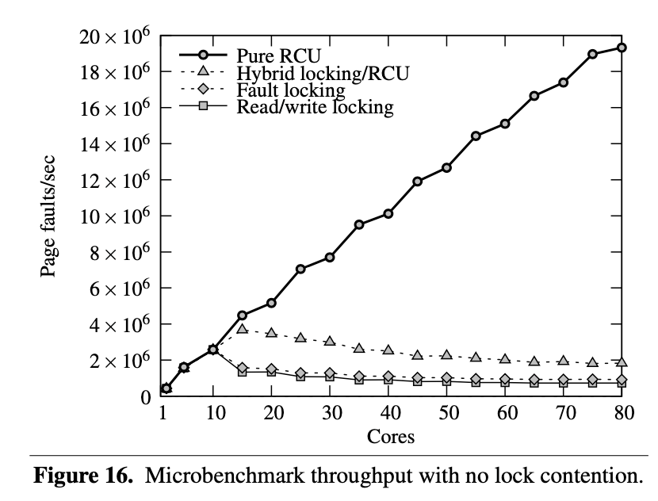
Performance

Slide 24
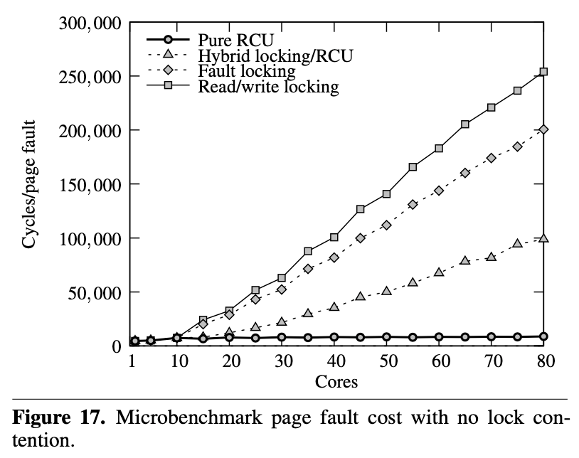
Performance

Slide 25
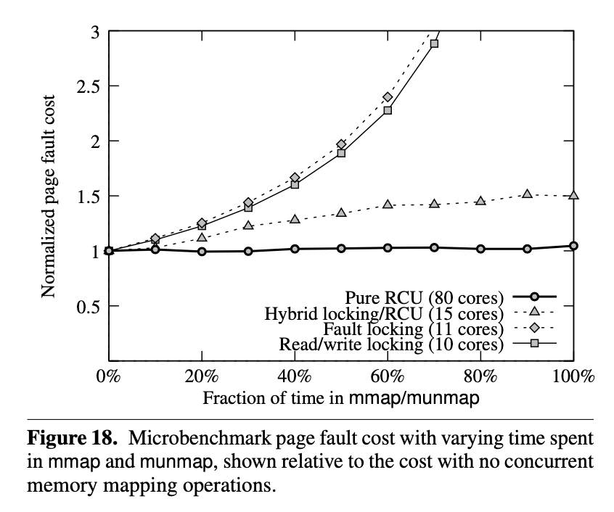
Performance

