Slide 1
Verifying Correctness of Concurrent Algorithms by TLA+
康鸿博 2020310795

Slide 2
Concurrent Algorithms
Hard to understand
Hard to implement
Hard to verify
Has to enumerate all possible execution sequence

Slide 3
TLA+
A specification language for concurrent algorithms
Support model checker TLC
Proposed by Leslie Lamport

Slide 4
TLA+ specification language
Describe state machines
Invariants
Initialization / Next
Model Checking
Give counter examples

Slide 5
Work
Learn TLA+
Using TLA+ to verify the correctness of RCU
Using TLA+ to verify the correctness of Raft Leader Election

Slide 6
Learn TLA+
Main difficulties
Do not compose
UNCHANGED <<**>>

Slide 7
Verify the Correctness of RCU
Main difficulty of RCU: How to recycle objects
RCU by disabling preemption
Updates are done in 3 steps
Update the value with a write lock
Release the lock, and schedule this task on any core once
Recycle the removed object
Turn off preemption when reading

Slide 8
Demo

Slide 9
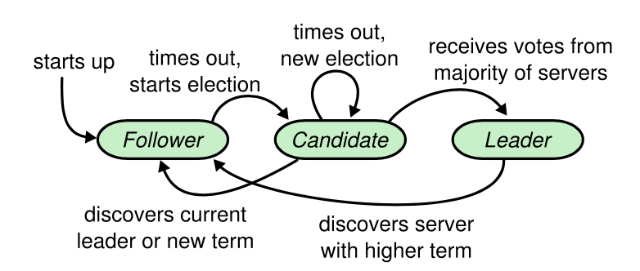
Verifying the Correctness of Raft Leader Election
Main difficulty of Raft
Details not clearly specified
Different implementations
Hard to debug
Timeout
Crash
Leader Election

Slide 10
Demo

