Slide 1
A Logic of Authentication
康鸿博
2020310795

Slide 2
Introduction
It’s hard to design a authentication protocol that’s
Succinct
Safe
Attack
Man-in-the-middle Attack
Replay Attack
We want “white list” instead of a “black list” correctness

Slide 3

How to Model Protocols
Principals, keys, formulas (statements)
P believes X
P sees X
P said X
P controls X
P ←K→ Q ⬄ P <
|-K-> P
{X}_{K} ⬄ <X>_{Y}

Slide 4
How to Model Protocols
Fresh(X)

Slide 5



Logical Postulates - Said

Slide 6
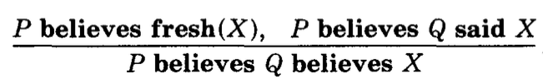

Logical Postulates - Believe

Slide 7
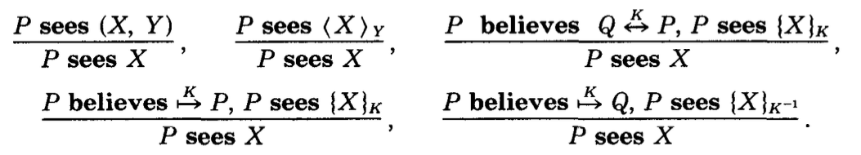
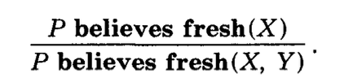
Logical Postulates - Compose

Slide 8


Formalization

Slide 9
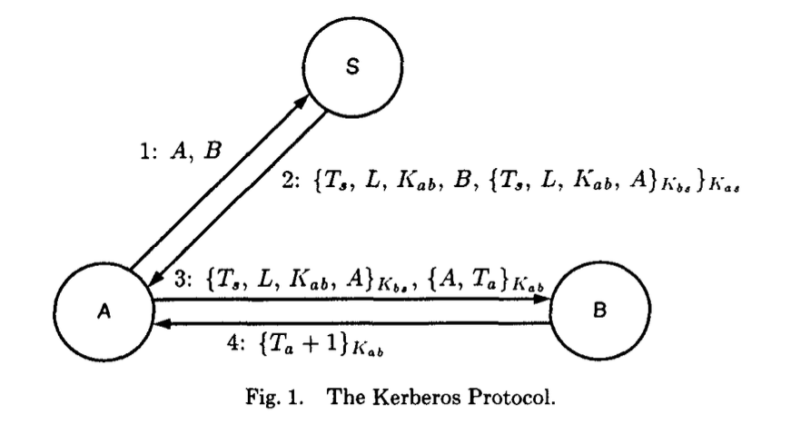
Kerberos Protocol

Slide 10
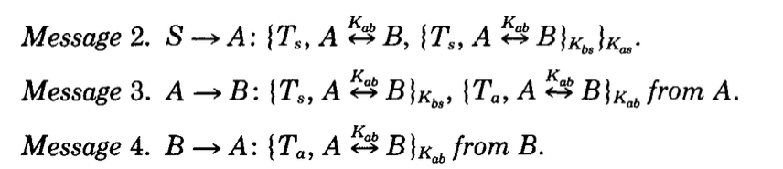

Slide 11
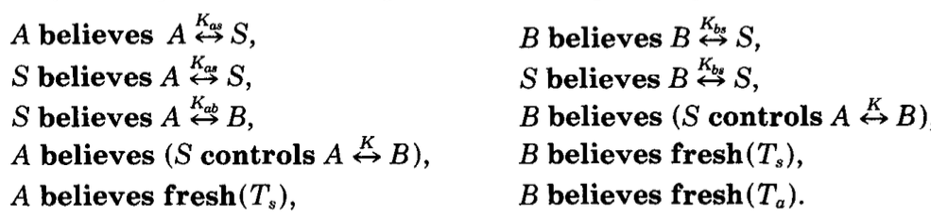

Slide 12
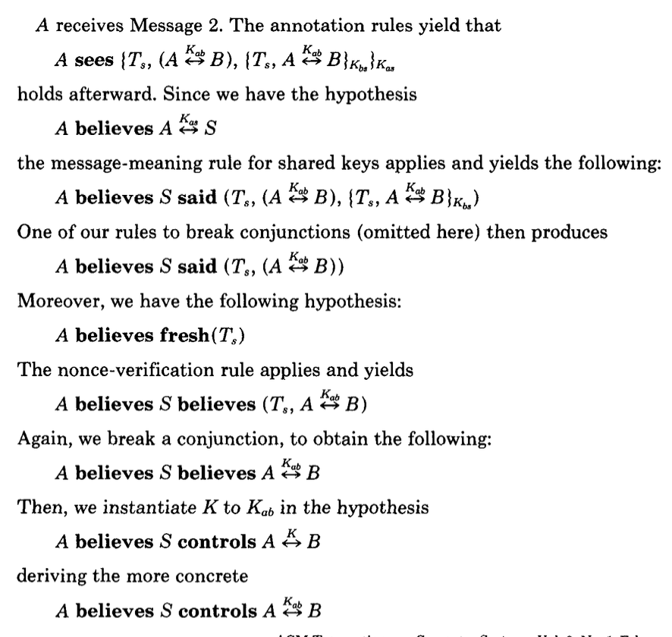

Slide 13


Slide 14
Removing the 4th message

Slide 15
Removing the 4th message
B doesn’t exist

Slide 16
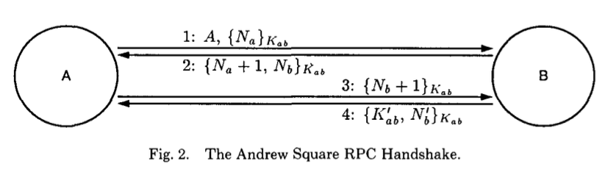
Andrew Secure RPC Handshake

Slide 17
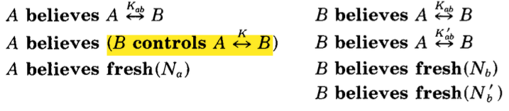

Slide 18
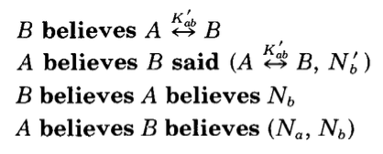

Slide 19
Replay Attack on the 4th message

