Slide 1
CONTACT MECHANICS · AFM NANOINDENTATION
Elastic-modulus models for
thin-film nanoindentation
Four ways to turn a force–indentation curve F(δ) into a Young's modulus E — and the assumptions that decide which one is valid.
paraboloid tip · χ = √(Rδ)/h · E★ = E/(1−ν²)

Slide 2
THE SHARED PICTURE
One curve, four inversions
REDUCED (CONTACT) MODULUS
E★ = E / (1 − ν²)
WHY THICKNESS MATTERS
◆ A rigid substrate under a thin film makes it feel stiffer than a half-space — the bottom effect.
◆ Ignoring it (bare Hertz) over-estimates E, more so as the film thins (χ grows).
◆ The substrate bond matters: a bonded incompressible film is far stiffer than one free to slide.
BOTTOM-EFFECT VARIABLE
χ = √(R δ) / h

Slide 3
HERTZ · 1882 · ELASTIC HALF-SPACE
Hertz — the half-space baseline
FORCE
F = (4/3) E★ √R δ3/2
PARTICULARITIES & CONSTRAINTS
◆ Semi-infinite half-space — no thickness, no substrate. The reference all others correct.
◆ Linear-elastic, isotropic, homogeneous; small strain.
◆ Small contact: δ ≪ R, frictionless, no adhesion.
◆ Over-estimates E for thin films — misses the bottom effect.
SOLVED FOR THE MODULUS
E = 3(1−ν²) F / (4 √R δ3/2)

Slide 4
DIMITRIADIS ET AL. · BIOPHYS. J. 82, 2798 · 2002 · NON-BONDED
Dimitriadis 2002 — thin film, free base
FORCE — HERTZ × BEC POLYNOMIAL
F = (4/3) E★ √R δ3/2 · Φfree(χ)
PARTICULARITIES & CONSTRAINTS
◆ Finite thickness h on a substrate the film does not adhere to — free to slide (frictionless base).
◆ BEC quartic in χ = √(Rδ)/h; reduces to Hertz as h → ∞.
◆ Valid only for small χ ≲ 1 (a ≲ h); degrades beyond.
◆ Softer than the bonded branch — relieves confinement by sliding.
FREE-BASE COEFFICIENTS (→ Ν = ½)
α₀ = −(0.347 − 0.056 ν) → −0.319, β₀ = 0.164

Slide 5
CHADWICK · SIAM J. APPL. MATH. 62, 1520 · 2002
Chadwick 2002 — thin incompressible bonded layer
FORCE — THIN-FILM LIMIT, Ν = ½
F = (2π/3) E R² δ³ / h³
PARTICULARITIES & CONSTRAINTS
◆ Opposite limit to Hertz: valid when contact radius a ≫ h (genuinely thin film).
◆ Strictly incompressible (ν = ½) and bonded to the substrate.
◆ Strong 1/h³ stiffening; force scales as δ³, not δ^{3/2}.
◆ Does not reduce to Hertz — thin-film regime only.
SOLVED FOR THE MODULUS
E = 3 F h³ / (2π R² δ³)

Slide 6
GARCIA & GARCIA · BIOPHYS. J. 114, 2923 · 2018 · BONDED BEC
Garcia & Garcia 2018 — paraboloid BEC
FORCE — HERTZ × BONDED BEC POLYNOMIAL
F = (4/3) E★ √R δ3/2 · Σ cₖ χk
PARTICULARITIES & CONSTRAINTS
◆ Practical BEC for cells / films bonded to a rigid support — the workhorse paraboloid correction.
◆ Keeps E★ = E/(1−ν²) → works for arbitrary ν, not just ½.
◆ Reduces to Hertz (h→∞) and captures thin-film stiffening — wider δ/h range than bare Hertz.
◆ Assumes bonded base, frictionless contact, small strain.
COEFFICIENTS
c = [1, 1.133, 1.497, 1.469, 0.755], χ = √(Rδ)/h

Slide 7
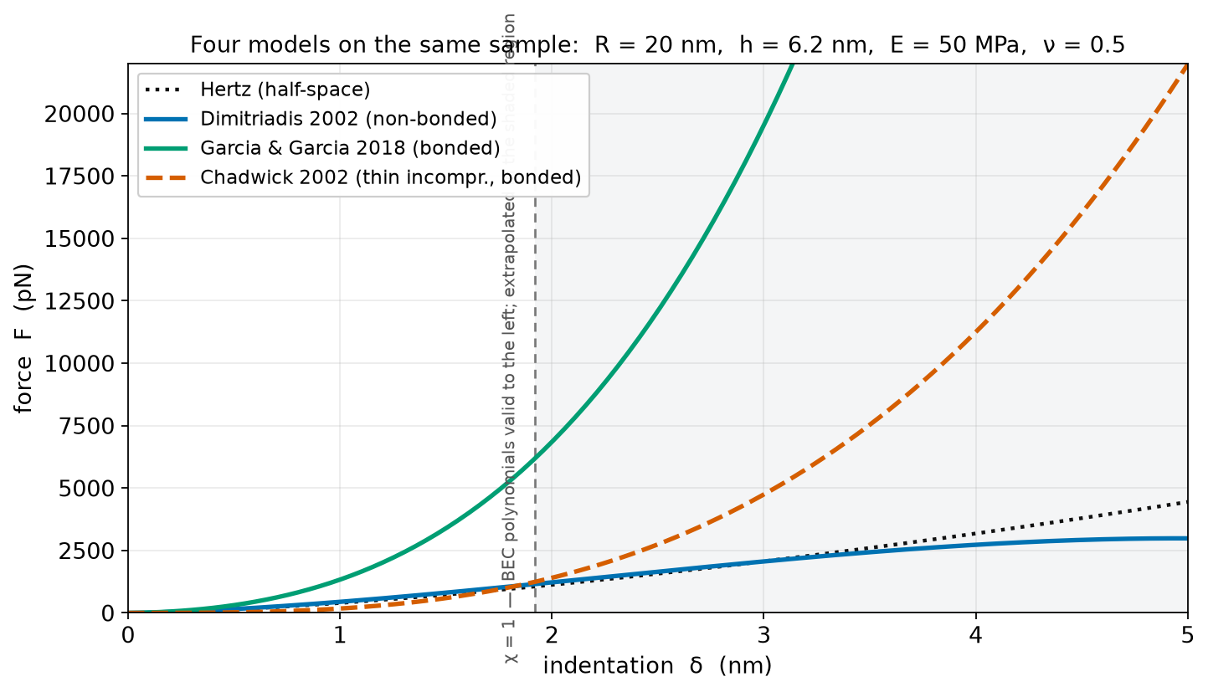
SAME SAMPLE, FOUR MODELS
F(δ) for R=20 nm, h=6.2 nm, E=50 MPa
READING IT
◆ Same E and geometry — the spread is purely the model assumption.
◆ Dimitriadis-free sits lowest (softest), bonded models highest.
◆ Chadwick (δ³) overtakes at large δ; no Hertz limit.
◆ The true response is bracketed by free and bonded.

Slide 8
AT A GLANCE
Which model, when
Model | Force law | Regime | Substrate | ν | Watch out
Hertz (1882) | F ∝ E★√R δ^1.5 | Half-space (h→∞) | none | any | Over-estimates E on thin films
Dimitriadis 2002 (non-bonded) | Hertz × Φ_free(χ) | Thin, χ ≲ 1 | free / slip | general | Degrades for χ > 1
Chadwick 2002 (SIAM) | F ∝ E R²δ³/h³ | Thin, a ≫ h | bonded | ½ only | No Hertz limit; thin-film only
Garcia & Garcia 2018 | Hertz × Σcₖχ^k | Thin → thick | bonded | general | Assumes bonded hard support

