Slide 1
PySoftK: Polymer modelling
with a Python library
Dr. Alejandro Santana-Bonilla
02 November 2022

Slide 2
Introduction
Brief introduction to Polymers
PySoftK: Automatic Polymer modelling
Software development
Future developments: Big data and
data mining.
Conclusions

Slide 3

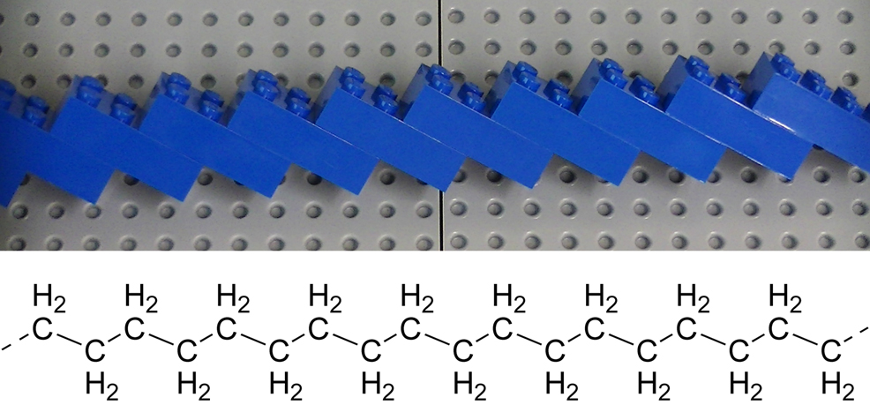

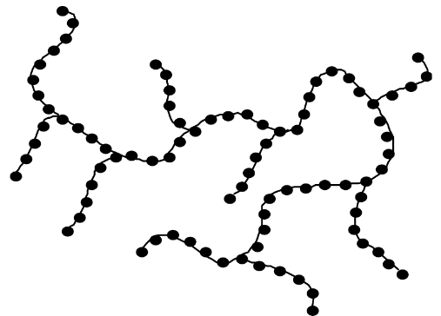
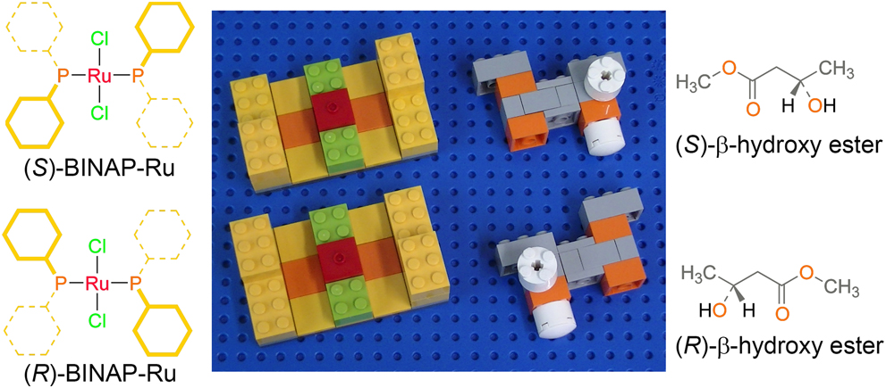
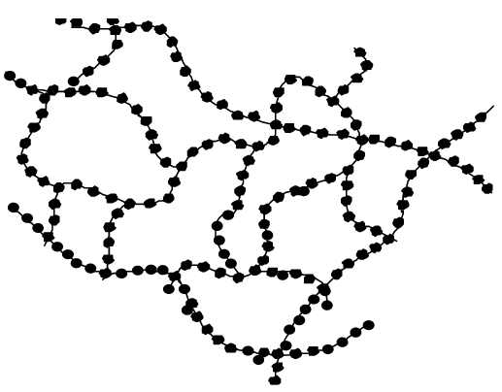
Polymers
Polymers are long, chain-like molecules linked via chemical (covalent) bonds
Lego-molecular approach:
Linear
Branched
Crosslinked

Slide 4
Polymers
Polymers are easy to change for tuning electronic/vibrational properties
Molecular engineering

Slide 5
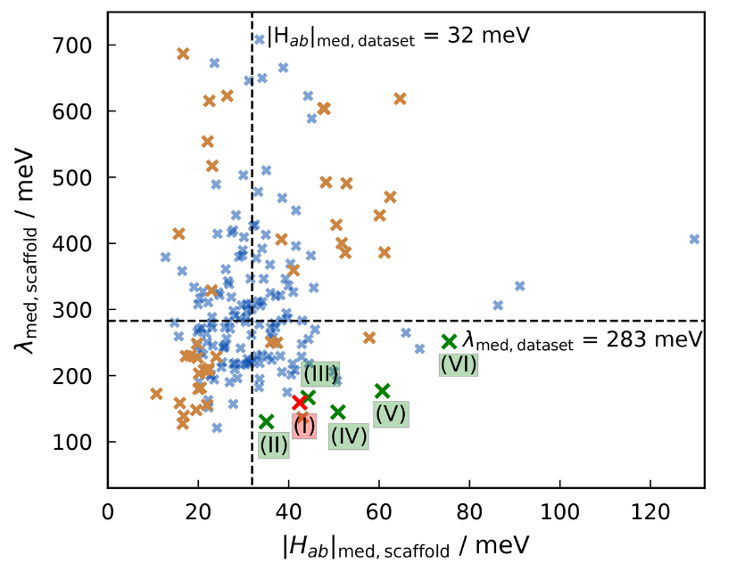
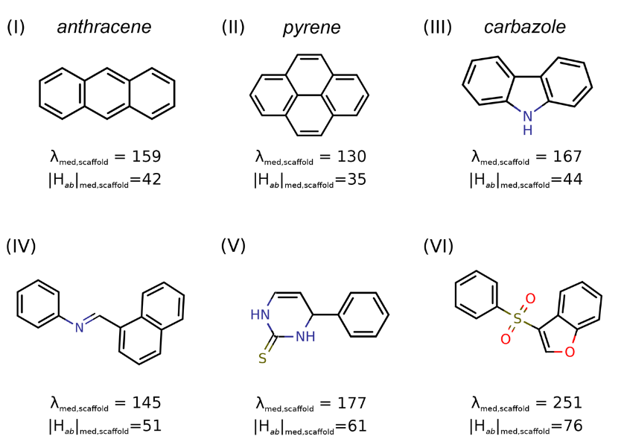
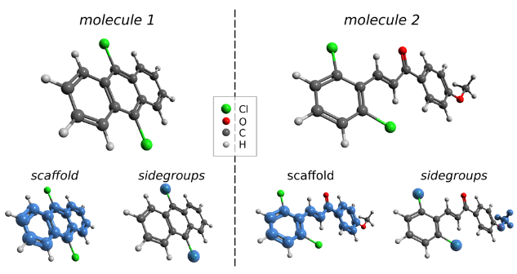
Polymers
Molecular engineering is faster and easier to perform via
computational techniques
(1) Large (experimental) database (10000+)
(2) High-Throughput calculations
Reliable theoretical approaches
(Marcus model)
New candidates found in existing
molecules
[1] Kunkel, Christian, et al. "Finding the right bricks for molecular legos: A data mining approach to organic semiconductor design." Chemistry of Materials 31.3 (2019): 969-978.

Slide 6
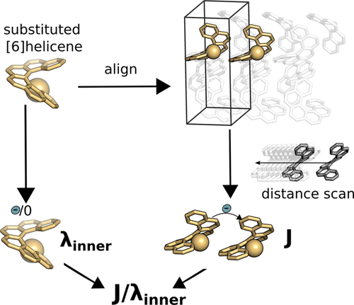
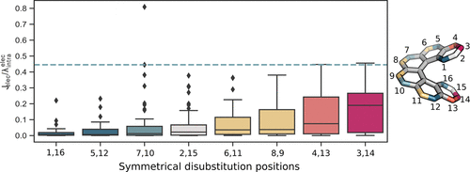
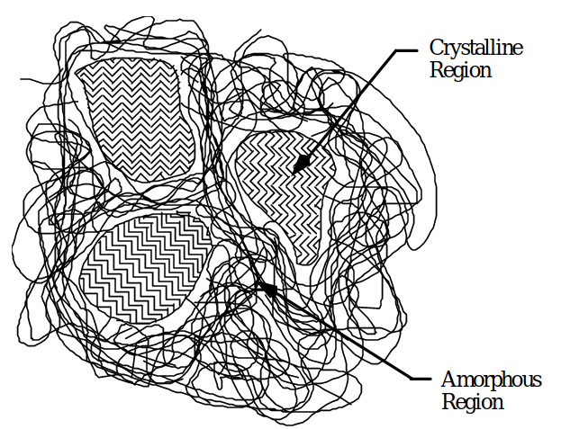
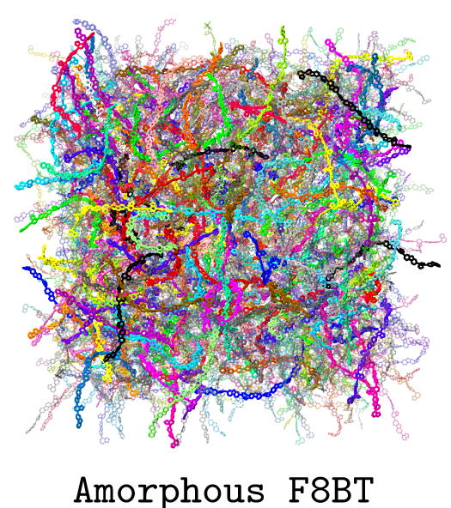
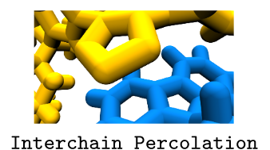
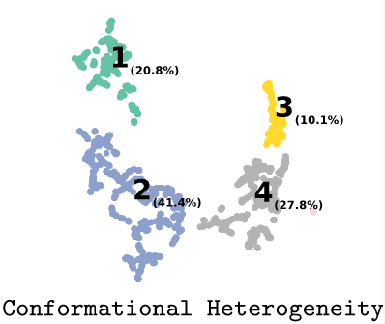
Polymers
Useful molecular properties are usually a consequence of
interactions between systems
Crystalline Structure Prediction (CSP)
[2] Ziolek, Robert M., et al. "Conformational Heterogeneity and Interchain Percolation Revealed in an Amorphous Conjugated Polymer." ACS nano (2022).

Slide 7
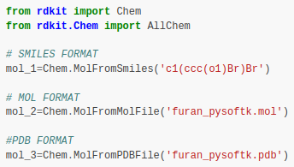
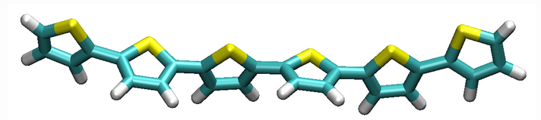
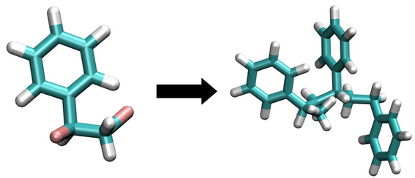

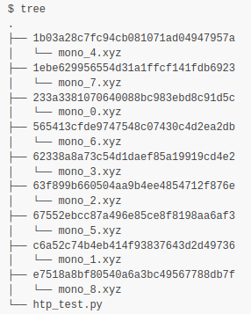
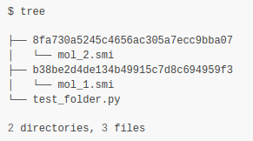
PySoftK: Python Soft-Matter King’s College London
01 Molecules
03 Polimerization
02 Structure formation
05 Database structure
05 Data creation
04 Calculators
[1] Santana Bonilla, A., Lorenz, C., “PySoftK: A modular and versatile software for modelling polymeric structures”. To be submitted.

Slide 8
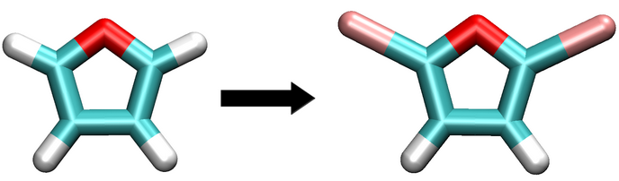
PySoftK: Python Soft-Matter King’s College London
PySoftK is a modular and stand-alone software for modelling polymers with different topologies
Prepare the first monomer
Linear
Circular
Branched
Random
[1] Santana Bonilla, A., Lorenz, C., “PySoftK: A modular and versatile software for modelling polymeric structures”. To be submitted.

Slide 9
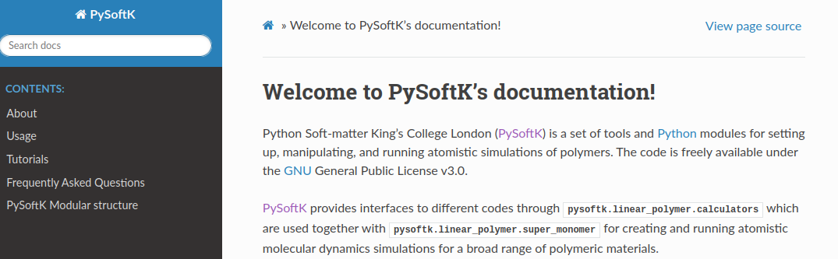

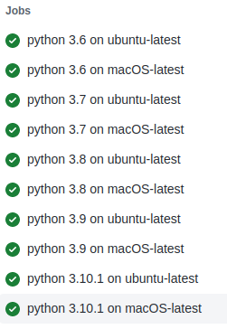
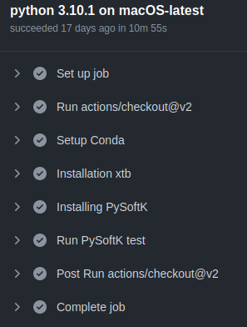
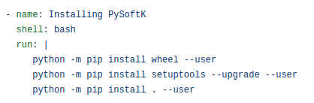
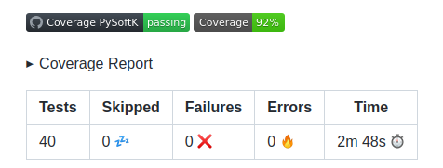
PySoftK: Python Soft-Matter King’s College London
Extensive documentation and tutorials:
Hosted in:
Easy to install in any environment (cluster or PC):
[1] Santana Bonilla, A., Lorenz, C., “PySoftK: A modular and versatile software for modelling polymeric structures”. To be submitted.

Slide 10
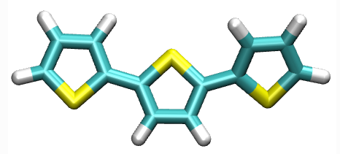

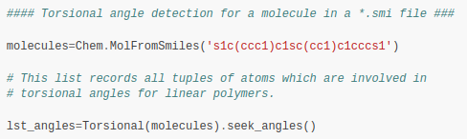
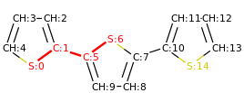
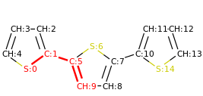
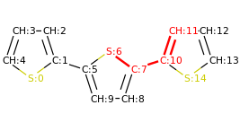
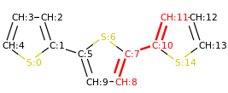
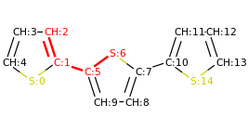
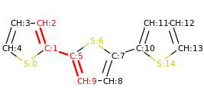
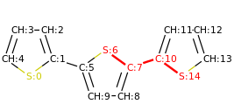
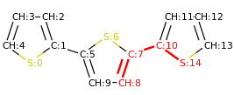
PySoftK: Python Soft-Matter King’s College London
Post-Processing tool analysis:
Finding the atoms involved in a torsional angle (automatically) for a force-field reparametrization is a complicated task in a long polymer
This list of atoms can be used to compare problematic angles in ambertools or create PES profiles
[1] Santana Bonilla, A., Lorenz, C., “PySoftK: A modular and versatile software for modelling polymeric structures”. To be submitted.

Slide 11
PySoftK: Python Soft-Matter King’s College London
Automated workflows
CI/CD
Testing
Automatic creation of polymers with different topologies including parallelized calculations and task management
PySoftK has been developed following modern software standard using a Continuous Integration (CI) and Continuous Deployment (CD) paradigm.
PySoftK testing database has been developed to display maximum coverage of the code to ensure code correctness and avoid legacy problems.
[1] Santana Bonilla, A., Lorenz, C., “PySoftK: A modular and versatile software for modelling polymeric structures”. To be submitted.

Slide 12
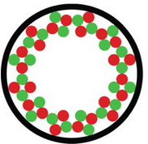
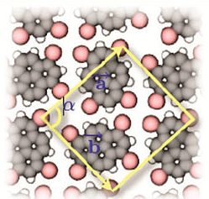
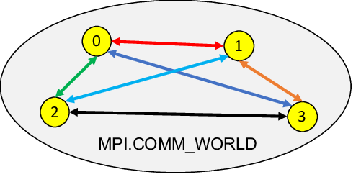

PySoftK: Python Soft-Matter King’s College London
Data mining
Big Data
Topology
Polymeric
Nanoparticles
Self-assembly
via VdW
Provenance
of data
Internode task
management
parallelization
PySoftK
Database
formatting
Scalability
(Exascale)
Wrappers to AI models
(Neural Networks)
Big data store
management

Slide 13

Conclusions
Crystallization of polymers is a complex process that needs to be accelerated via computational approaches for further and effective material discovery.
PySoftK is a new modular and versatile code that
has been developed to module polymeric materials automating HTp workflows with a minimal user intervention.
PySoftK has been developed following the main CI/CD strategies while making it accessible for
further development.

