Slide 1
Lab inventory
Thomas Van Havere
Lorenz Put

Slide 2
Voorbereiding
Laptop
Account op mongoLabs
MongoDB server
Account op Heroku
Hosting server

Slide 3
Prijskaartje
Wat | Hoeveelheid | Kost
Innolux 7” touchscreen | 1 | 31 €
Barcode Scanner | 1 | 16 €
RPI GPIO extension board | 1 | 3 €
RPI B+ | 1 | 40 €
WiPi | 1 | 20 €
Bluetooth stick | 1 | 10 €
SD kaart | 1 | 10 €
Sigaren kistje | 1 | 0 €
Licentie MongoDB | 1 | 0 €
Totaal | 7 | 130 €

Slide 4
De MEAN stack
M for MongoDB
E for Express
A for AngularJS
N for NodeJS

Slide 5
M for MongoDB
Connectie via NodeJS
Document structuur

Slide 6
De MEAN stack
M for MongoDB
E for Express
A for AngularJS
N for NodeJS

Slide 7
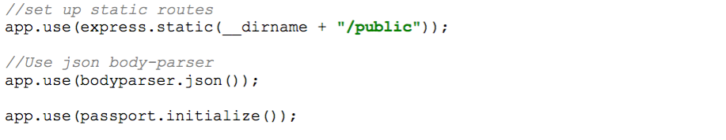
E for Express
Initialiseren Express app
Related express modules

Slide 8
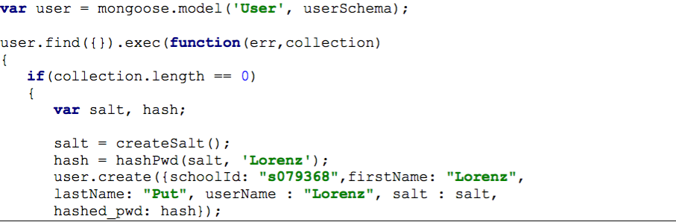
E for Express : Login
Initialisatie users

Slide 9
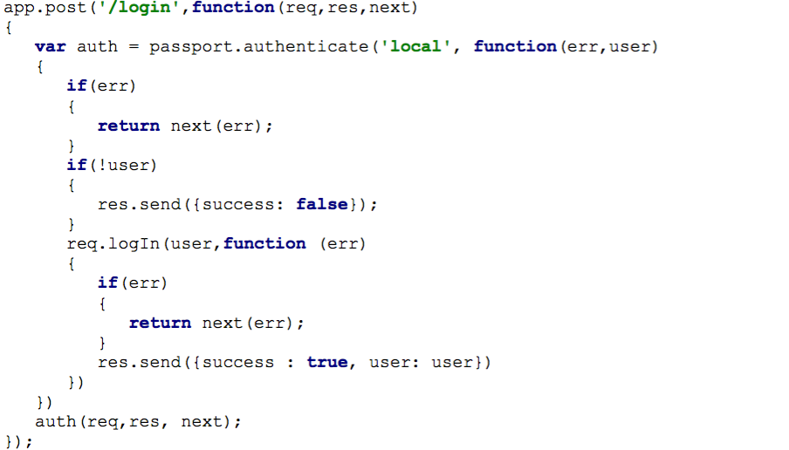
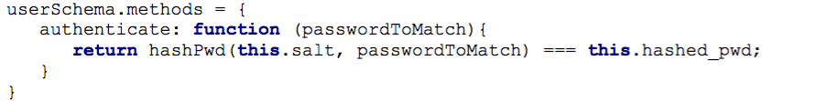
E for Express : Login
Authentication

Slide 10

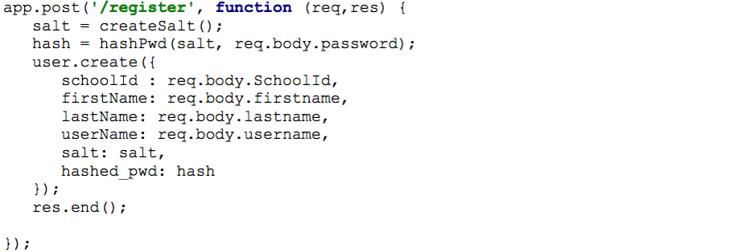
E for Express : Administratie
Uitloggen en registreren

Slide 11
De MEAN stack
M for MongoDB
E for Express
A for AngularJS
N for NodeJS

Slide 12
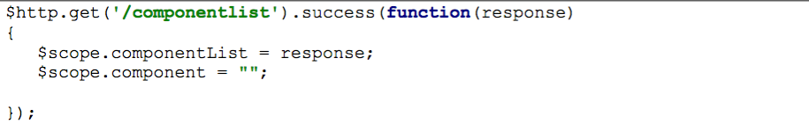
A for AngularJS
Laden pagina
Search bar

Slide 13
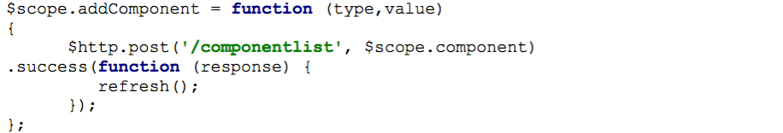
A for AngularJS
Add knop

Slide 14
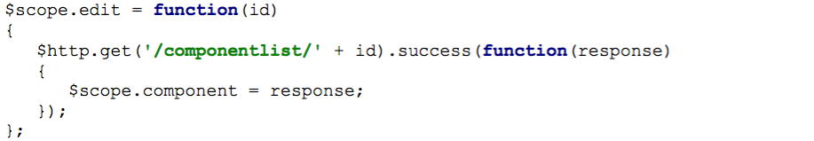
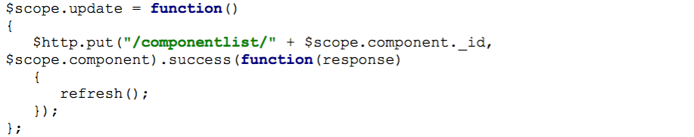
A for AngularJS
Update / edit knop

Slide 15
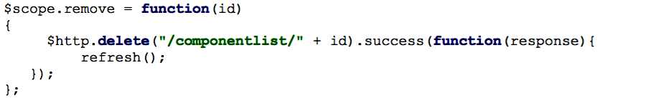
A for AngularJS
Remove knop

Slide 16
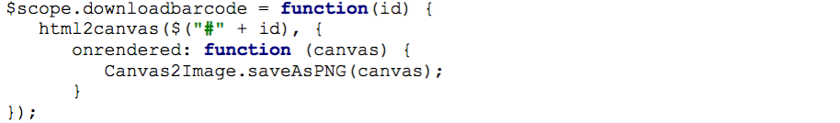
A for AngularJS
Barcode generator

Slide 17
De MEAN stack
M for MongoDB
E for Express
A for AngularJS
N for NodeJS

Slide 18
N for NodeJS
Javascript engine
Basis Express
I/O events

Slide 19


