Slide 1
Persephonē
The invisible canals of Milan
FINAL REPORT
Design Decisions • Heuristic Evaluation • User Testing

Slide 2
Persephonē
Contents
01
Project Recap
02
Key Design Decisions
03
Heuristic Evaluation
04
Improvements: Implemented & Planned
05
User Testing
02

Slide 3
Persephonē
Project Recap
Rationale
Milan's covered Navigli are a unique, still-embedded but largely invisible piece of urban heritage. Persephonē responds to a clear civic desire to rediscover them — bridging what exists beneath the city with what people can see, understand and experience today.
94%
in favour of reopening the
Navigli — 2011 public referendum
Persephone (the mythological figure who moves between the surface and the underworld) frames the project not as a reconstruction of the past, but as a process of revealing what is already there, just unseen.
03

Slide 4
Persephonē
Scenario & Core Tasks
Narciso, a student intrigued by Milan's buried Navigli, moves through a multimodal journey: remote discovery at home → AR re-emergence on-site → conversation with a virtual guide → gamified on-site exploration.
1
2
3
4
Remote Discovery
Photo Game
AR Re-emergence
Conversational Sciura
Interactive map, historical/current photo slider, and directions to a Navigli node.
GPS “hot-and-cold” acoustic hunt for a historical photo point, ending in a gallery unlock.
Camera anchors the pavement; a voice command (“Bring the water back!”) triggers the 3D canal.
Hands-free spoken dialogue with a virtual Milanese avatar about the canal's history.
Touch + Map
GPS + Audio
Voice + Vision (AR)
Voice + Vision
04

Slide 5
02
Key Design
Decisions
Architecture, technology choices, and the multimodal robustness strategies behind Persephonē.
Persephonē

Slide 6
Persephonē
What We Built
A lightweight, mobile-first WebAR + Conversational-AI experience — zero app install required.
Zero-App Access
Multimodal WebAR
Nuxt 3 + 8th Wall + A-Frame. The experience is launched directly in the browser — no install friction.
8th Wall SLAM and custom shaders anchor the 3D canal reconstruction realistically beneath street level.
Conversational AI
Gamified Localization
Hands-free dialogue with the Sciura di Milano avatar, powered by Deepgram STT, Groq Llama 3.1, and ElevenLabs TTS.
GPS-based “hot-and-cold” photo hunt using acoustic feedback to motivate physical exploration.
06

Slide 7
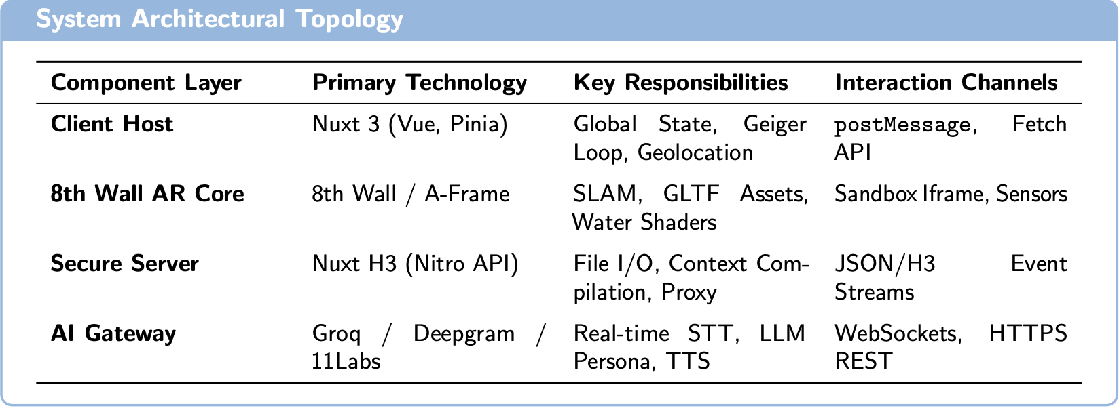
Persephonē
System Architecture
A decoupled stack keeps heavy WebGL rendering and low-latency speech isolated from the main UI thread.
Nuxt 3 Frontend Host — global state, UI, audio playback, geofencing loop.
8th Wall AR Subsystem (iframe) — SLAM + A-Frame, sandboxed, talks via postMessage.
Nuxt Server Middleware — compiles POI prompts, proxies credentials to external APIs.
External Services Gateway — Deepgram (STT), Groq (LLM persona), ElevenLabs (TTS).
07

Slide 8
Persephonē
Per-Task Design Decisions
Each task's interaction modalities were chosen to match its real-world environmental constraints.
1. Remote Discovery
2. Photo Game
Goal Discover access points, compare past/present, get directions. Constraints User remote, indoors, possibly moving, varying light. Modalities Touch (map, slider) + Vision (GPS context)
Goal Locate a historical photo point via acoustic GPS guidance. Constraints Outdoors, GPS accuracy, screen-off operation. Modalities GPS + Audio (Geiger-style feedback)
3. AR Re-emergence
4. Conversational Sciura
Goal Trigger a voice-activated AR reconstruction of the canal. Constraints Outdoors, daylight/glare, traffic noise, physical obstacles. Modalities Vision (camera framing) + Voice (trigger)
Goal Learn the canal's history through spoken Q&A. Constraints Outdoors, ambient noise, glare or low light at night. Modalities Vision (spatial context) + Voice (dialogue)
08

Slide 9
Persephonē
Robustness by Design
Every core task ships with an explicit fallback loop for when a modality fails — no dead ends.
Handoff Failure (Task 1)
Environmental Noise → Modality Fallback (Task 3)
If the OS blocks the native Maps app hand-off, the system shows the destination address in-app with a “Copy Address” button, so navigation never dead-ends.
When street noise drops speech-recognition confidence, the app doesn't guess: it surfaces “Too noisy to hear you — tap to type,” switching to a text chat interface.
09

Slide 10
03
Heuristic
Evaluation
An independent, expert-based evaluation of the prototype against Nielsen's ten heuristics, specialised for multimodal interaction.
Persephonē

Slide 11
Persephonē
Evaluation Method
Evaluator & Device
Heuristics Applied
Severity Scale
A team of evaluators, testing end-to-end on Android and iOS devices, plus a demo video.
Nielsen's ten usability heuristics (H1–H10), specialised for multimodal interaction: grounding of referents, temporal coordination, repair, modality discoverability & fallback.
Standard 0–4 Nielsen scale: 0 Not a problem • 1 Cosmetic • 2 Minor • 3 Major • 4 Catastrophe.
4 tasks were exercised end-to-end where physically possible. Task 2 (Photo Game) was evaluated partially — its GPS/on-site success path was confirmed via teammates who tested on location in Milan.
Grounding patterns referenced: P1 Deictic Frame + Speak · P2 Region Selection + Conversation · P3 Vision Proposes → Conversation Confirms · P5 Temporal Binding Window · P6 Persistent Referent Tokens · P7 Repair-first Prompts.
12

Slide 12
Persephonē
Summary of Findings
14 findings across onboarding and the four core tasks, ranked by severity.
ID
Finding
Heuristics
Severity
3.1
Sciura voice output fails on Android (spec–prototype mismatch)
H4, H2
Sev 3
2.2
No SLAM scanning feedback
H1, H9
Sev 3
2.3
No anchoring confirmation, no re-anchor option
H1, H3, H5
Sev 3
2.4
Speech recognition does not echo recognised transcript
H1, H5
Sev 3
3.3
User cannot interrupt the avatar mid-response
H3
Sev 3
3.4
Implicit-yes interpretation of follow-up questions
H5, H9
Sev 3
C.2
No vision fallback for low-light conditions
H9
Sev 3
1.1
Runtime permissions not framed in-app
H10, H5
Sev 2
1.2
“Take me there” silently exits to native maps
H1, H3
Sev 2
2.1
Mic permission requested before user understands AR flow
H4, H10
Sev 2
3.2
No transcript echo of user's spoken input
H1, H5
Sev 2
C.1
Italian system message in English interface, persistent
H2, H4, H8
Sev 2
1.3
Comparison slider angles diverge for older eras
H2
Sev 1
C.3
Minor transition feedback gap in AR mount
H1
Sev 1
13

Slide 13
Persephonē
What the Evaluation Confirmed as Strong
Coherent visual identity across all sections: blue accents, consistent buttons, stable Map → POI → AR/Game navigation.
Voice input has a clean, exemplary text fallback in Task 3 — modality fallback done right.
Voice recognition is tolerant to phrasing variants (“bring the water back” / “make the water comeback”).
In-character network-loss recovery in Task 4: the Sciura stays in persona while asking the user to repeat.
Progressive, well-timed permission requests follow web best practice.
Low end-to-end conversational latency (~3s), sustaining a natural rhythm even without audio output.
14

Slide 14
04
Improvements
Eight concrete changes the team committed to after reviewing the heuristic evaluation, each mapped back to its finding and owner.
Persephonē

Slide 15
Persephonē
Improvements — Round 1
Directly addressing Findings 1.2, 2.3, 2.4/3.2, and 3.1.
Finding 1.2 — Sev 2
Sev 2
Finding 2.3 — Sev 3
Sev 3
Warn before leaving the app
Re-anchor without leaving AR
“Take me there” now shows an explicit in-app notice before handing off to the native Maps app, so the context switch is never silent.
Users can now reposition the 3D canal model directly in AR, without exiting and re-entering the camera view.
Findings 2.4 / 3.2 — Sev 3 / 2
Sev 3
Finding 3.1 — Sev 3
Sev 3
Echo what the system heard
Fix Sciura voice on Android
Both the voice trigger and the Sciura dialogue now show a written/visual echo of the recognised speech before acting on it.
Root cause traced to an Android permissions/autoplay issue in the audio pipeline; being resolved with the course staff (Valoriani).
16

Slide 16
Persephonē
Improvements — Round 2
Directly addressing Findings 3.3, 3.4, C.1, and C.2.
Finding 3.3 — Sev 3
Sev 3
Finding 3.4 — Sev 3
Sev 3
Make the Sciura interruptible
Stop the implicit-yes pattern
Any new user input during a response now cuts the avatar's current message and is processed immediately, instead of waiting for it to finish.
System prompt rewritten so the Sciura no longer assumes “yes” by default — she now respects an explicit “no” / topic-change request.
Finding C.1 — Sev 2
Sev 2
Finding C.2 — Sev 3
Sev 3
Localise & dismiss the GPS banner
Detect & report low-light SLAM failure
The GPS-disabled warning is no longer hard-coded in Italian and no longer persists forever — it now follows the interface language and can be dismissed.
When SLAM cannot anchor the model in poor lighting, the system now detects the failure and notifies the user with concrete guidance.
17

Slide 17
05
User
Testing
Validation with real users, carried after the heuristic evaluation round.
Persephonē

Slide 18
METHODOLOGY
How the test was conducted
9
4
2
3
Participants
Tasks per session
Measurement tools
Metrics collected
1+ per team member
with defined success criteria
Observer Log + Questionnaire
Objective, SEQ, SUS
SESSION PROTOCOL
1
2
3
4
Briefing & consent
→
Task execution (Think-Aloud)
→
Post-task questionnaire (SEQ)
→
Final questionnaire (SUS)
User Testing Report
2

Slide 19
PARTICIPANTS
Demographic overview
Age range
Tech familiarity & experience
Device
AR familiarity
Education level
Map usage
Voice assistant usage
User Testing Report
3

Slide 20
OBJECTIVE RESULTS
Performance by task
Average completion time (s)
Task outcome
Clicks / average interactions
Errors / average failed attempts
User Testing Report
4

Slide 21
PERCEIVED RESULTS
SEQ — Perceived ease by task
Single Ease Question, scale 1 (very difficult) – 7 (very easy), collected after each task
MOST APPRECIATED TASK
Task 4
6 / 7 · SD 0.87
Highest score and lowest variability among users.
MOST CRITICAL TASK
Task 1
5.44 / 7 · SD 1.94
Lowest score and widest spread (2–7).
User Testing Report
5

Slide 22
PERCEIVED RESULTS — DETAIL
SEQ — Full matrix by participant
Each cell: SEQ score (1-7) given by the participant right after the task
Participant | Task 1 | Task 2 | Task 3 | Task 4 | Average
P1 | 7 | 6 | 5 | 6 | 6.00
P2 | 7 | 7 | 6 | 7 | 6.75
P3 | 2 | 6 | 7 | 7 | 5.50
P4 | 3 | 4 | 5 | 5 | 4.25
P5 | 6 | 5 | 3 | 6 | 5.00
P6 | 7 | 5 | 4 | 7 | 5.75
P7 | 7 | 6 | 7 | 6 | 6.50
P8 | 6 | 4 | 6 | 5 | 5.25
P9 | 4 | 7 | 7 | 5 | 5.75
Task average | 5.44 | 5.56 | 5.56 | 6.00 | 5.64
Task SD | 1.94 | 1.13 | 1.42 | 0.87 | —
LEGEND
1-3 · Difficult
4-5 · Neutral
6-7 · Easy
OBSERVATIONS
Task 1 concentrates the lowest scores in a subgroup (P3, P4), while the majority find it easy: not a universal problem, but a localized one.
P2 and P7 give the highest, most consistent scores across all tasks (personal average of 6.75 and 6.50).
User Testing Report
6

Slide 23
OVERALL USABILITY
SUS Score — System Usability Scale
Distribution by participant (anonymized)
SAMPLE AVERAGE
72.78
/ 100
✓ Result above average (68)
Range: 32.5 – 97.5
Median: 77.5
Std. Dev.: 20.1
7 out of 9 participants above average (68). Two negative outliers linked to flow/navigation difficulties in Task 1 and the lack of search.
User Testing Report
7

Slide 24
OVERALL USABILITY — DETAIL
SUS — Statistical distribution
Distribution by band (adjective scale)
Descriptive statistics
Average | 72.78
Median | 77.5
Std. dev. | 20.13
Variance | 405.38
Minimum | 32.5
Maximum | 97.5
Q1 (25th perc.) | 75
Q3 (75th perc.) | 80
IQR | 5
CLASSIFICATION BY PARTICIPANT
P1
P2
P3
P4
P5
P6
P7
P8
P9
77.5
87.5
80
47.5
80
75
97.5
77.5
32.5
B · Good
A · Great
A · Great
D/F · Poor
A · Great
B · Good
A+ · Excellent
B · Good
D/F · Poor
User Testing Report
8

Slide 25
QUALITATIVE ANALYSIS
Recurring themes from Think-Aloud and interviews
STRENGTHS
RECURRING ISSUES
Voice interaction with the Sciura
Lack of a search bar
Most cited feature as participants' favorite
Unable to search directly for a point of interest by name
AR experience
Not very robust voice recognition
The canal reconstruction is stimulating and engaging
Requires repetition; latency in the guide's responses
Redundant navigation
Overall ease of use
Need to return to home to launch AR from the POI detail
Average SUS 72.8, above average
User Testing Report
9

Slide 26
NEXT STEPS
Possible post-testing fixes
HIGH
HIGH
MEDIUM
Improve voice recognition
Add POI search
Clarify the Task 1 flow
Increase microphone tolerance/feedback with an active-listening indicator
Introduce a text search bar, not just map navigation
Add explicit contextual guidance instead of relying on self-discovery
MEDIUM
LOW
Reduce redundant navigation
Expand points of interest
Allow launching AR directly from the POI detail card
Consider adding more POIs beyond the current 3
User Testing Report
10

Slide 27
IN SUMMARY
A usable app, with clear room for improvement
72.8
97%
Task 1
Average SUS score, above threshold
tasks completed successfully (fully or with assistance)
main friction point to fix
Persephonē

Slide 28
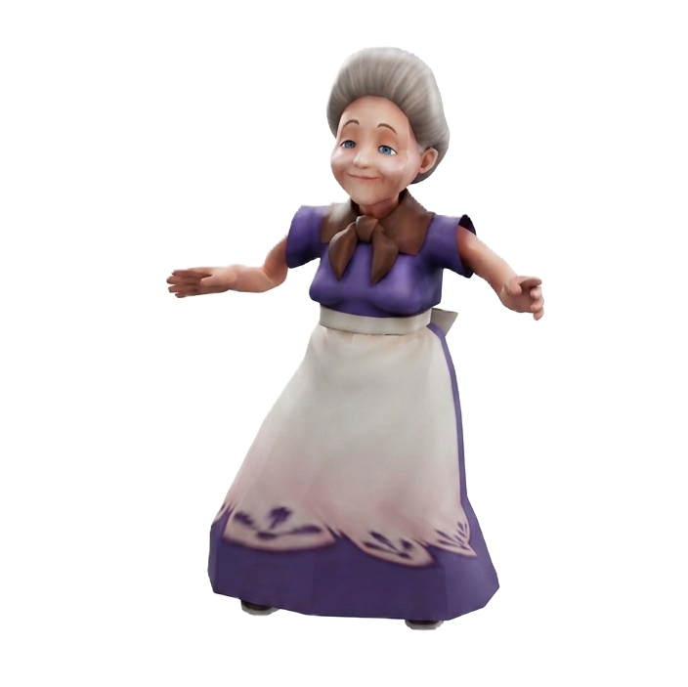
Persephonē
Thank You!

