Slide 1

Data Mining Project work
2
Author: Lorenzo Epifani
+
2
+
Association rule discovery

Slide 2
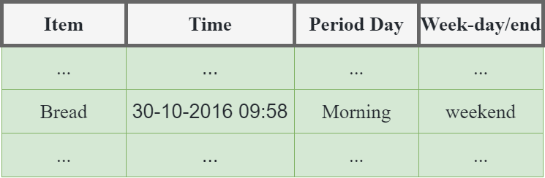
Scenario Description:
The Dataset

Slide 3
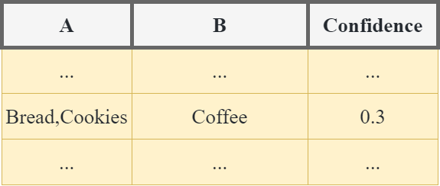
Scenario Description:
The GOAL

Slide 4
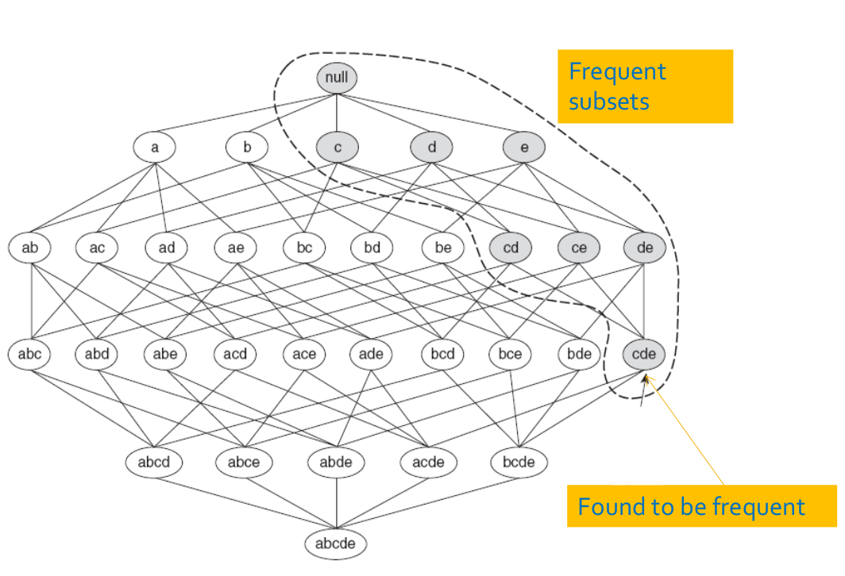
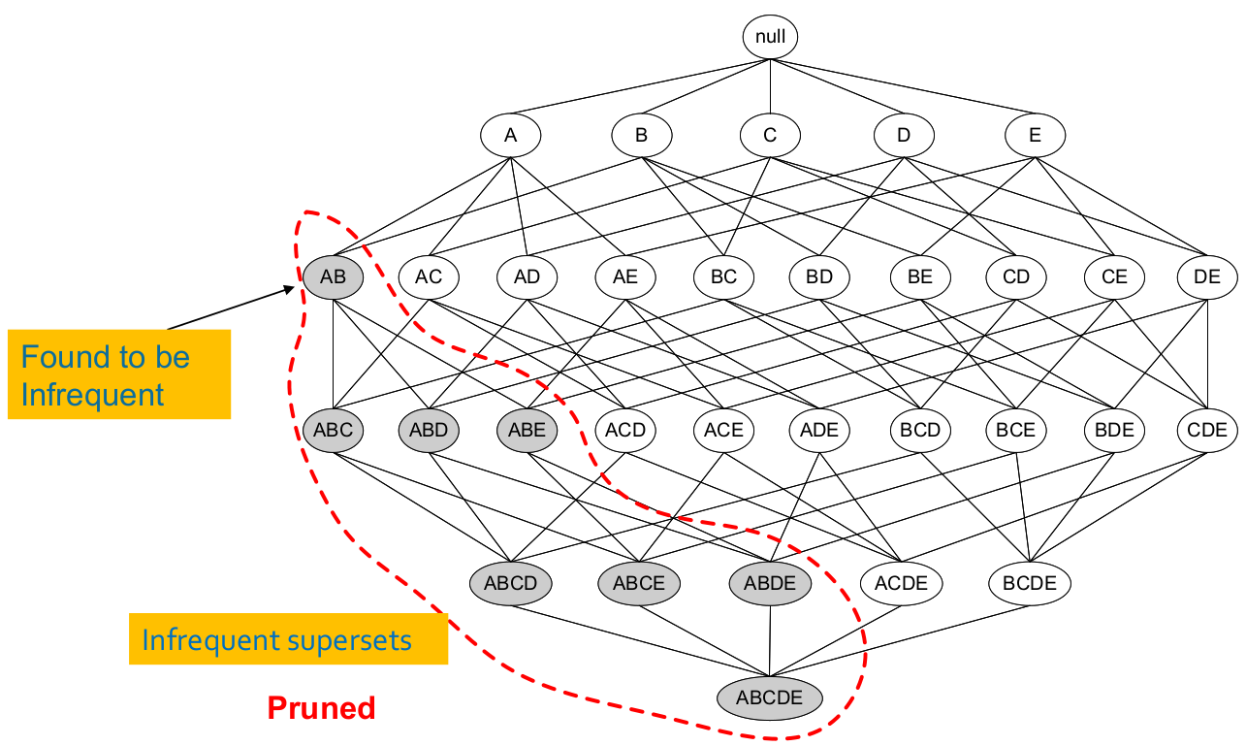
Scenario Description:
The Algorithm

Slide 5
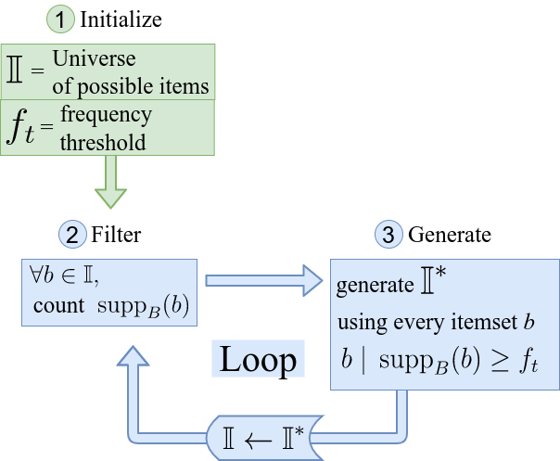
Scenario Description:
The Algorithm

Slide 6
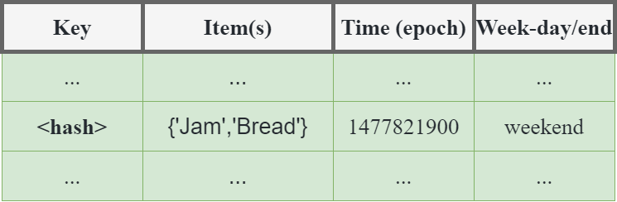
data Pre-processing

Slide 7
Configuration
{
"i_name":"dataset.csv",
"o_name":"out.csv",
"freq_th":0.005,
"conf_th":0.7,
"auto":false,
"passes":2
}
Configuration

Slide 8
Result example
IF A | THEN B | CONFIDENCE
{'Soup', 'Sandwich'} | {'Coffee'} | 0.71
{'Hot chocolate', 'Pastry'} | {'Coffee'} | 0.71
Inserire qui il contenuto | Inserire qui il contenuto | Inserire qui il contenuto
2
+

Slide 9



Future work
2
+
2
+

