Slide 1



Class Prior Estimation in Active
Positive and Unlabeled Learning
Lorenzo Perini, Vincent Vercruyssen, Jesse Davis
IJCAI-PRICAI 2020
https://people.cs.kuleuven.be/~lorenzo.perini/
@LorenzoPerini95
Notes:
Hello and welcome to the full video about the paper titled "class prior estimation in active positive and unlabeled learning". My name is Lorenzo and I am from DTAI Lab of KU Leuven in Belgium. I have worked on this paper together with Vincent and Professor Jesse Davis, from KU Leuven as well.

Slide 2


Positive and Unlabeled (PU) Data Arises Naturally.
For Example:
Task: Estimate the relevance of ads based on click data
Challenge: Ads that the user has not clicked on may still be relevant!
?
Positive (click)
Unlabeled (no click)
?
?
?
?
?
?
?
?
?
?
?
?
?
?
How can we learn from
PU data?
?
?
Notes:
Ok, let's start introducing a general PU setting, which is a special case of semi supervised learning where instead of having labels from both of the two classes, the labeled examples can only come from a single class that we call positive. PU data naturally arises in many real world scenarios and here there is an example. Assume that you are observing click data and you want to measure how relevant the ads can be for a given user. Then, every time the user clicks on an ad, you may collect it as a positive example. On the other hand, what conclusion can you draw if the user does not click on an ad? Certainly you cannot assume that the ad didn’t interest the user because it might be possible that the user simply didn’t click on it for other reasons. Therefore, you cannot label the ad as negative example and it has to be considered as unlabeled. So, in this scenario the real challenge is to exploit the unlabeled ads, which are the ones the user has not clicked on, to estimate their relevance on the user's profile. The key question here is then: how can we learn a predictive model from PU data?

Slide 3
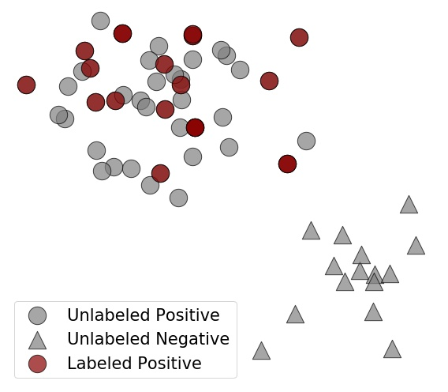
Common Approach to Learning from PU Data
Revolves around Estimating the Class Prior
Most common approaches estimate the
class prior by assuming labels are
Selected Completely At Random
(SCAR)
c: label frequency
Notes:
Well, mainly the common approach for learning from positive and unlabeled data focuses on estimating the class prior, which corresponds to the proportion of positive examples in a given dataset. However, in order to estimate the class prior we first need to make assumptions on the method generating labels. A widely used assumption is the SCAR, which states that the positive labeled sample is an i.i.d sample drawn from the positive population. Therefore, the probability that any positive example is labeled does not depend on its features and is actually a constant that we call label frequency. Then, under the SCAR assumption it turns out that the proportion of labeled examples is proportional to the class prior through the label frequency. Since the proportion of labels can be directly computed from the data, the goal of several methods for computing the class prior is to estimate accurately this constant c. However, the main issue is that the SCAR assumption does not hold in many practical cases since many times labels are not collected randomly and, as a result, we introduce a novel scenario where we assume that labels are acquired through an active learning strategy.

Slide 4
Problem Setting: How to Learn from PU Data
when Labels Are Acquired via Active Learning?
Active Learning Loop:
Train a model;
Select the most informative example;
Query the example to the user;
Collect the label, if positive.
Problem: Active learning violates SCAR assumption
GIF
Notes:
Using active learning is a way to introduce the user feedback in machine learning which consists of querying the examples that the model is more uncertain about and exploiting the collected feedback to improve the model’s performance. In this scenario, we assume to start from an unlabeled dataset where we can train an unsupervised model. Then, according to the chosen active learning strategy we select the most informative example, which is the one indicated by the big circle in the gif. Then, we query that example to the user and collect the label only if it is positive. To visualize this, you may think that the user can only recognize positive examples, while if a negative one is queried then the answer would be “I don't know the label”. By collecting labels this way, examples are no longer selected completely at random because the active learning strategy has a clear bias when selecting examples to be labeled. As a result, the label frequency c is no longer constant because the probability of collecting any label depends on the features by the chosen active learning strategy.

Slide 5
We Make 4 Contributions
Formalize the problem of estimating the class prior in a PU setting when labels are acquired via active learning;
Propose CAPe, a model for estimating the class prior in such a scenario;
Prove that the estimates of the class prior converges to the real value;
Evaluate empirically CAPe in the context of anomaly detection.
Notes:
In this paper we make 4 contributions. First, we formalize the problem of estimating the class prior, which is the proportion of positive examples, in the scenario where labels are collected through a given active learning strategy. Second, we propose CAPE, a model which can estimate the class prior in this setting by computing the contribution of any positive example and merging them together. Third, we prove that CAPe’s estimate of the class prior converges to the real expected value. Finally we evaluate CAPe on 9 anomaly detection benchmark datasets, where we consider the normal examples as positive and, consequently, the class prior is the proportion of normal examples.

Slide 6
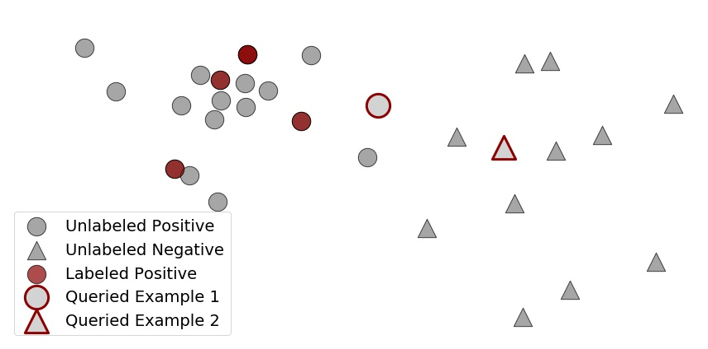





Formalizing Active Learning in a PU Setting: the
User Can Only Provide Positive Labels
S1: user only labels positive examples.
S2: user might label negative examples as positive or not label positive examples.
Scenario 1
Scenario 2
Notes:
Our first contribution is to formalize the active learning in a PU setting. Assuming that the user can only provide positive labels, we distinguish two behaviours. In Scenario 1, the user is perfect and always labels only the truly positive examples. When a negative example is queried, the user in Scenario 1 always replies 'I don't know the label' and the example remains unlabeled, whereas in case a truly positive example is queried, the correct positive label is always provided. On the other hand, in the second scenario, the user is more human and may make mistakes in two directions. When a negative example is queried, the user in Scenario 2 can either reply “I don't know” or label it wrongly as positive. Likewise, when a positive example is queried, the user in Scenario 2 can provide the correct positive label or wrongly reply 'I don't know', leaving it unlabeled. In the paper, we practically model the user’s uncertainty in scenario 2 allowing the possibility of making mistakes. So, now the question is: how to estimate the class prior in such two scenarios?

Slide 7
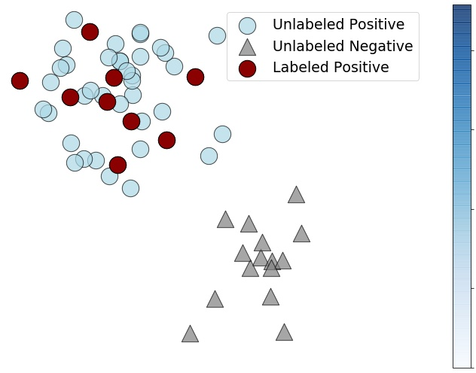
Under SCAR Assumption, Each Example Has the
Same Contribution for Computing the Class Prior
Selected Completely At Random
c: label frequency
Does the contribution change when collecting labels via active learning?
Notes:
Well, in order to estimate the class prior, the key strategy is to measure the contribution of each example in the dataset. Under the SCAR assumption, unlabeled examples have the same contribution and it equals the label frequency c. Therefore, the goal of many approaches is to measure accurately this constant c in order to derive the class prior by dividing the proportion of positive labels with respect to the full dataset by the proportion of positive labels with respect to the positive examples, which is again the label frequency. As I already said, collecting labels through the active learning strategy violates the SCAR assumption and the displayed formula can no longer be used. So the question is: Does the contribution change when collecting labels via active learning?

Slide 8
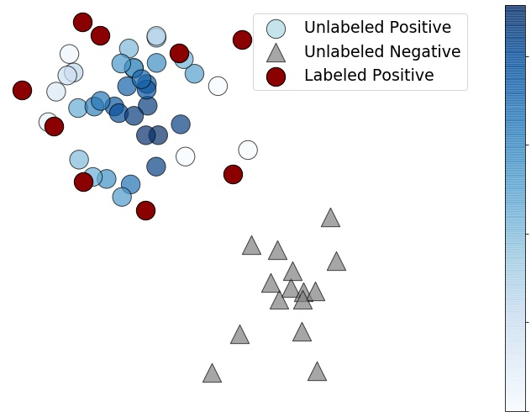
When Collecting Labels Via Active Learning,
Examples Contribute Differently According
to their Propensity Score
Propensity Score: Instance specific probability to be labeled, if positive.
High propensity score does not
mean high contribution!
How to quantify the contribution of each positive example in the dataset?
Notes:
In order to answer this question let’s introduce the propensity score, which measure how propense an example is to be labeled, in a probabilistic sense. Since this probability strictly depends on the active learning strategy, examples do not have the same propensity score. Remember that the only way to obtain an example’s label is by querying it to the user. It might be thought that the greater the propensity score, the more likely an example is positive and, as a result, the greater the contribution. This is not fully correct though, because if the model is almost certain that an example is positive, then the active learning strategy will not query that example to get its label and, consequently, it will get low propensity score. So, how to quantify the contribution of each positive example in the dataset?

Slide 9
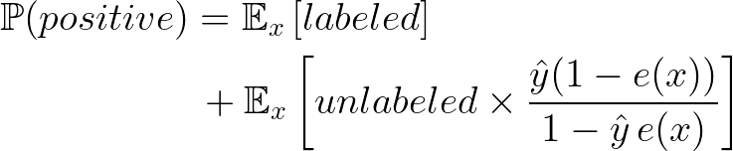
If the Propensity Score Was Known, We Could
Compute the Class Prior as a Weighted Average
Unlabeled examples contribute their probability to be positive weighted by their propensity score
Labeled examples contributes fully
e(x) is the propensity score;
;
h is a learning model.
Notes:
Let's assume for a while that the propensity score is known. Then, we can derive the class prior by weighting each example differently and taking the average as result. We distinguish the contribution of labeled and unlabeled examples. Regarding labeled positive examples, each of them contributes fully. To visualize this, suppose that we query as much as possible and that all the positive examples are labeled. Then by simply counting them and dividing by the dataset size we would get the class prior, which is exactly what the first piece of the equality claims. On the other hand, the second term contains the contribution of unlabeled examples. Assuming that the model produces accurate and calibrated probabilities y hat, unlabeled examples contribute by this probability to belong to the positive class weighted by their propensity score. How do we read this value here? Well, it represents a tradeoff between the case where the propensity score is high and the posterior probability low with the case where the posterior probability is high and therefore the propensity score is low.

Slide 10
How Can the Propensity Score Definition Be
Adapted When Using Active Learning?
Propensity Score: Instance specific probability to be labeled, if positive.
Selected Completely At Random
Labels collected randomly;
The propensity score is constant;
It equals the label frequency.
Selected by Active Learning
Labels queried based on a strategy;
The propensity score depends on how informative the example is;
It equals the probability of being queried.
How to estimate the propensity score in practice?
Notes:
As we have seen so far, the propensity score is definitely relevant for computing the class prior. So, how can the propensity score definition be adapted when using active learning? Remember that the propensity score is defined as the probability that a positive example is labeled. Under the SCAR assumption it is constant and equal to the label frequency. However, in our scenario, where labels are collected through an active learning strategy, the propensity score depends on the informativeness of the example. In addition, since the only way to get a label is by querying the example to the user, the propensity score can be seen as the probability that a positive example gets selected to be queried to the user. So, how can we estimate the propensity score in practice?

Slide 11

Propensity Score as Proportion of Times Examples
Get Queried When Drawing Different Datasets
It is certainly not queried!
It is certainly queried!
Given a dataset,
propensity score ;
We simulate different datasets by subsampling the training set;
We apply rules from combinatorics to avoid expensive loops and use the average rules.
Top k most informative examples
Dataset
Positive population
Notes:
Well, first I’d like you to realize that the propensity score is a continuous probability measure spread out across the feature space and does not sum up to one if we narrow it down to the examples in the dataset. Then, our key insight is that, for a given a dataset, the active learning strategy selects deterministically the examples to query and, as a result, the propensity score given a dataset is either 0 or 1 for each of the examples. You may see this by thinking that if we could query 5 examples, then the 5 most informative examples according to model would be selected to be queried while the remaining would not. However, the propensity score refers to the distribution of the positive class. We could tackle this issue by drawing subsamples as many times as possible from the dataset and each time we save whether each example is queried or not. Indeed, this would simulate dealing with distributions. As a result, the propensity score would be the proportion of times examples get queried when drawing subsamples. Instead, given that this procedure may be expensive, we apply combinatorics rules and use the average to approximate the probabilities. This certainly saves time, despite introducing some approximation errors. Besides, this procedure depends on whether user 1 or user 2 is involved, as in the second case we should also take the possibility of making mistakes into account.

Slide 12

Theoretical Results: Convergence Guarantees
Show that CAPe Is Unbiased to the Limit
We proved that:
We can draw countable many samples to recover the propensity score;
The propensity score estimate converges to the real function when increasing the number of samples drawn from the population;
The class prior estimate converges to the real value when the propensity score converges the the real function.
Notes:
Okay, let’s pass now to our third contribution. Theoretically, we analize the convergence of our estimates. In the paper, we proved that the number of subsamples that we should draw is actually countable, so that we can apply combinatorics rules. Then we proved that our propensity score estimate converges to the real function when increasing the number of drawn subsamples. Finally, the estimate of the class prior converges to the actual value when the propensity score gets more accurate. For further details, have a look at the paper where you can find the proofs as well.

Slide 13
Experimentally,
We Address the Empirical Questions
Can CAPe accurately estimate the true class prior?
How does user’s uncertainty affect CAPe's ability to estimate the class prior?
Does a more accurate estimate of the class prior improve the performance of an anomaly detector?
Notes:
Regarding the experiments, in the paper we addressed 3 different empirical questions: First, we show that CAPe can recover the class prior better than the baselines. Second, we test our method both in scenario 1 when the user is a perfect oracle and in scenario 2 where the use may make mistakes. And finally, we analize the difference in performance when an anomaly detector uses a more accurate estimate of the class prior. Here, I only discuss the first question but feel free to read the paper for further details.

Slide 14
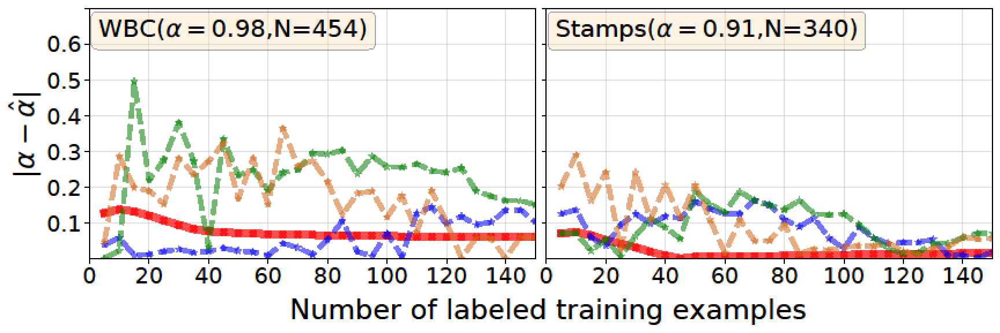
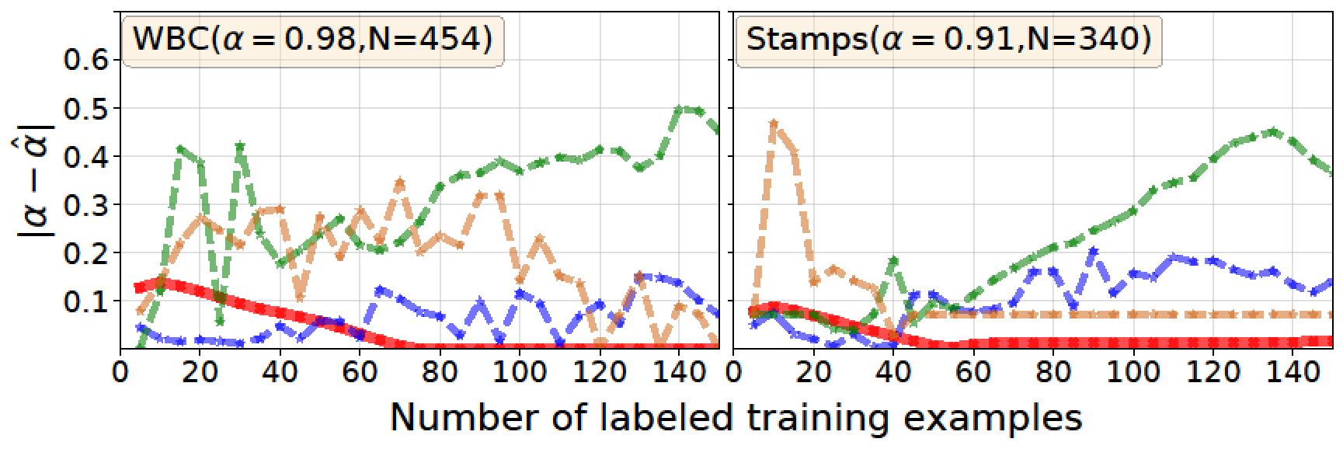
CAPe Recovers the Class Prior Accurately
When Collecting Labels Via Active Learning
Scenario 1
CAPe
TIcE
Lower = Better
Km1
Km2
Scenario 2
Notes:
About the experiments, we applied our method on anomaly detection, where the positive class is the normal one. Given an anomaly detection model, we query 5 labels at the time and at each step we estimate the propensity score and use it to derive the class prior until 150 labels are collected. The plots show the error in the class prior estimate and, as a result, the lower the better. We tested CAPe on 9 anomaly detection benchmark datasets having different values as class prior. Comparing CAPe with the state of the art baselines, it turns out that our method performs better when the user in scenario 1 is asked to provide labels, while sometimes other baselines might be preferred when the user in scenario 2 is involved. Overall, our method is certainly more stable compared to the baselines, showing less fluctuations.

Slide 15
In Conclusion, CAPe Accurately Recovers the
Class Prior in a PU Active Setting
We introduced a new scenario where labels are collected via active learning;
We proposed CAPe, a method for estimating the class prior in anomaly detection;
We proved that our estimates converge to the true values;
Empirically, CAPe recovers accurately the class prior performing better than the state of the art.
All code and experiments are available online:
https://github.com/Lorenzo-Perini/Active_PU_Learning
Notes:
In conclusion, we introduced this novel scenario where PU learning is combined with active learning. We proposed CAPe which is able to estimate the class prior. We proved theoretically that our estimate converges to the actual values and we empirically showed that CAPe accurately recovers the class prior. For testing CAPe, use the code available at my github page and have a look at the paper for further details.

Slide 16
Contact Us
Our Contribution:
Formalize the problem of estimating the class prior in a PU setting when labels are acquired via active learning;
Propose CAPe, a model for estimating the class prior in such a scenario;
Prove that the estimate of the class prior converges to the real value.
Evaluate empirically CAPe in the context of anomaly detection.
Lorenzo Perini, Vincent Vercruyssen, Jesse Davis
name.surname@kuleuven.be
IJCAI-PRICAI 2020
https://people.cs.kuleuven.be/~lorenzo.perini/
@LorenzoPerini95
Notes:
For any questions, don't hesitate and send us an email. Thanks for your attention!

