Slide 1





The Effect of Hyperparameter Tuning on the Comparative Evaluation of Unsupervised Anomaly Detection Methods
Jonas Soenen*, Elia Van Wolputte*, Lorenzo Perini, Vincent Vercruyssen, Wannes Meert, Jesse Davis and Hendrik Blockeel

Slide 2




Standard benchmarking setting
Algorithms A
Datasets D
How do algorithms A perform on datasets D?
Anomaly detection is unsupervised
How to select each algorithm's hyperparameters?

Slide 3



Out-of-the-box performance​
Tuned performance​
Peak performance​
Practitioners do nothing and use default hyperparameters
Practitioners do an honest effort to select good hyperparameters
Practitioners select
optimal hyperparameters
- Underestimates the potential
- Ambiguous and unfair
+ Realistic
+ Reproduceable, fair and sound
- Overestimates the potential
- Unsound: tuning on the test set

Slide 4
Tuned performance​
Practitioners do an honest effort to select good hyperparameters
"Honest effort" to select good hyperparameters = Tune them using a validation set​
1
Train the anomaly detector with multiple hyperparameter settings on unlabeled data
2
Select the detector with the best performance on a small labeled validation set
3
Evaluate the selected detector based on the labeled test set

Slide 5
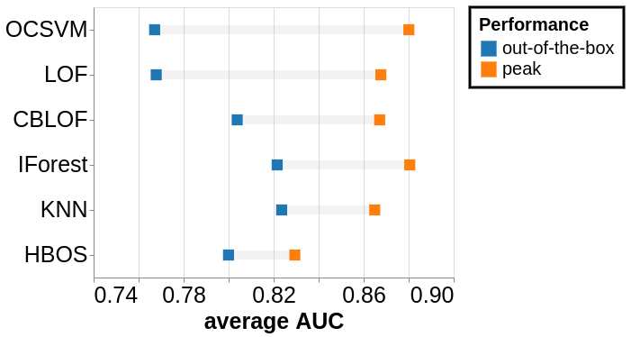
Influence of hyperparameters differs from algorithm to algorithm

Slide 6
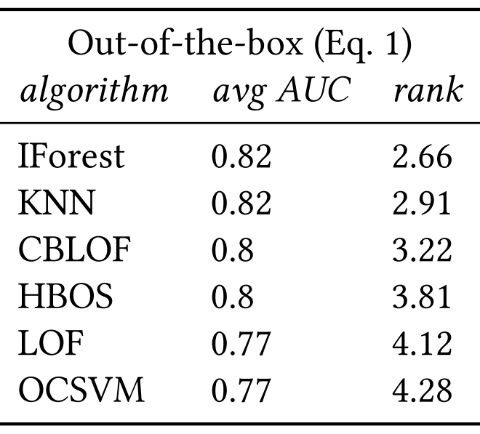
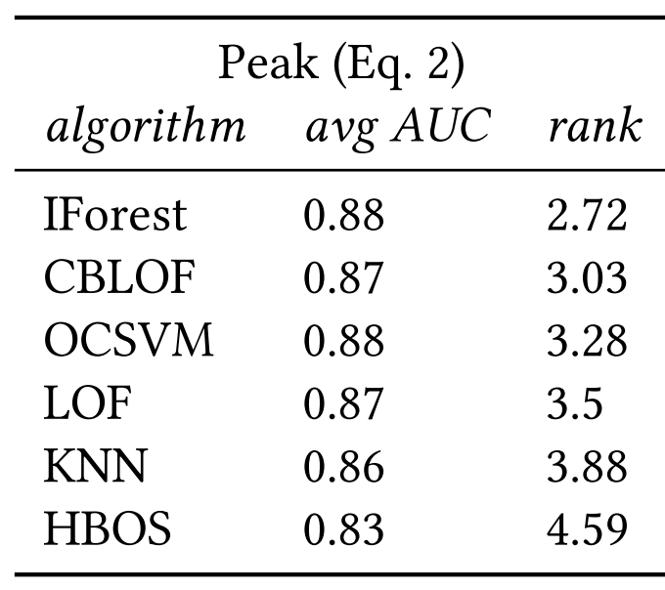
Hyperparameter selection influences algorithm ranking

Slide 8
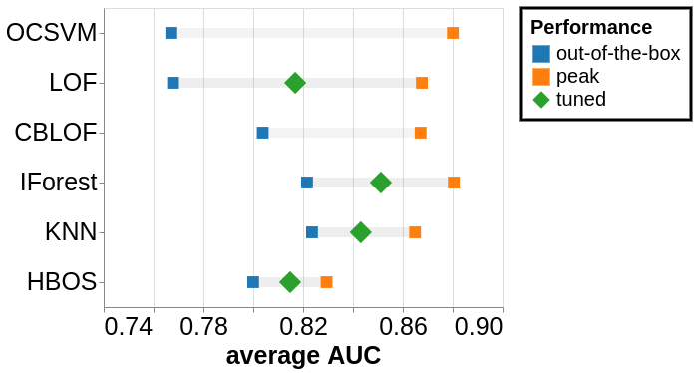
For most algorithms, tuning helps but doesn't reach peak performance

Slide 9
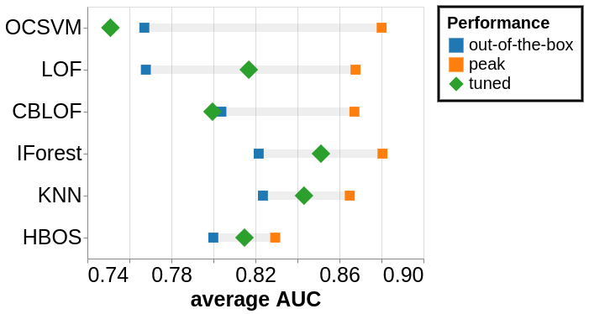
For most algorithms, tuning helps but doesn't reach peak performance
For others, tuning is counterproductive

Slide 10
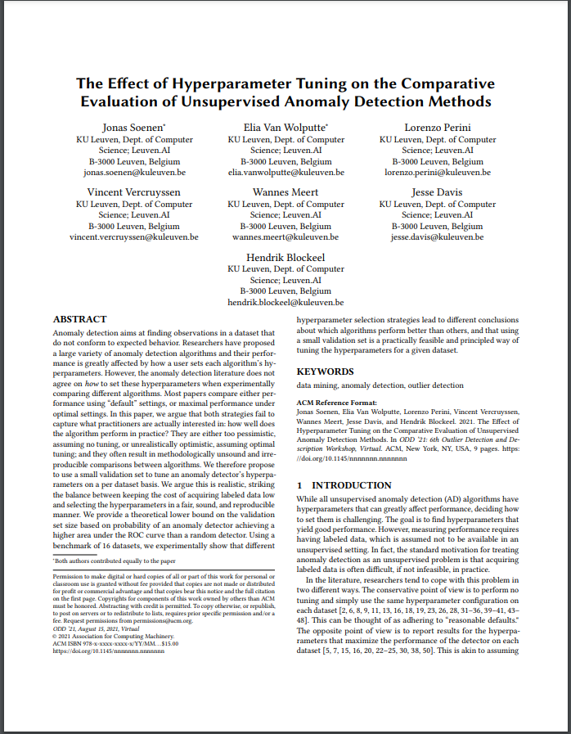
Summary
Out-of-the-box performance​
(default hyperparameters)
Tuned performance
(tu​ning on validation set)
Peak performance​
(optimal hyperparameters)
- Underestimation
- Ambiguous
+ Realistic
+ Reproduceable, fair and sound
- Overestimation
- Unsound
For details and more experiments, see the full paper

