Slide 1


A Ranking Stability Measure for Quantifying the Robustness of Anomaly Detection Methods
Lorenzo Perini, Connor Galvin, Vincent Vercruyssen
EDML 2020
https://people.cs.kuleuven.be/~lorenzo.perini/
@LorenzoPerini95

Slide 2
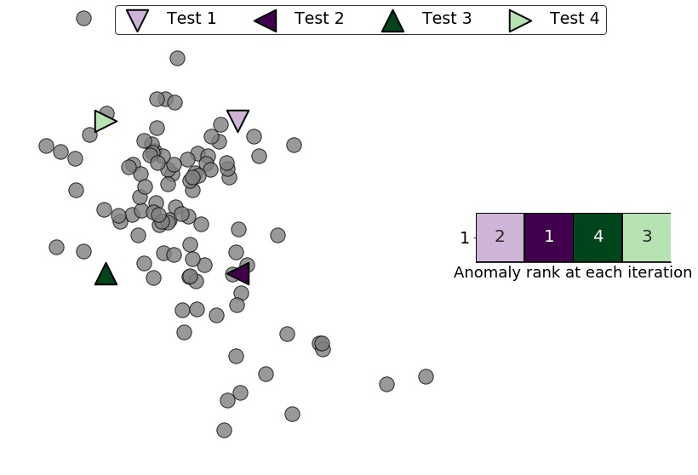
Capturing Variations in Anomaly Rankings
Dataset 1

Slide 3
Capturing Variations in Anomaly Rankings
Does the ranking change when drawing different training sets from the same distribution?
Dataset 1

Slide 4
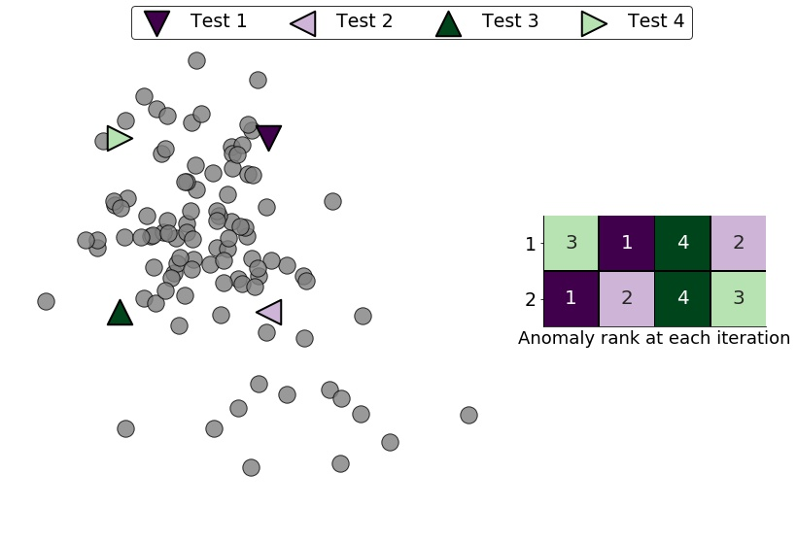
Capturing Variations in Anomaly Rankings
Does the ranking change when drawing different training sets from the same distribution?
Dataset 2

Slide 5
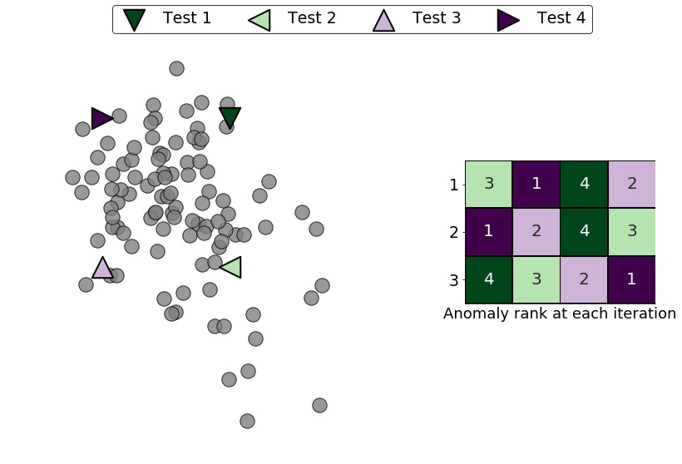
Capturing Variations in Anomaly Rankings
Dataset 3
How stable is the model in making anomaly rankings?

Slide 6
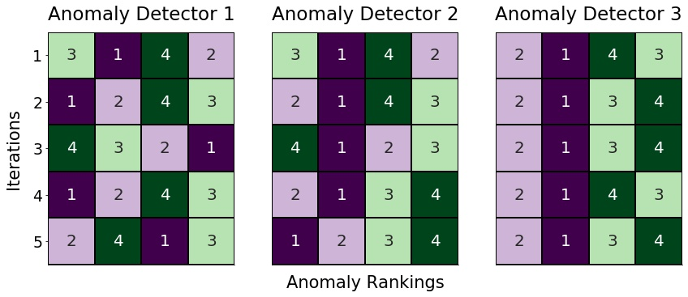
We Aim To Quantify the Robustness of Anomaly Detectors

Slide 7
We Aim To Quantify the Robustness of Anomaly Detectors
More robust than the others!

Slide 8
We Aim To Quantify the Robustness of Anomaly Detectors
Given:
Training and test sets, and an anomaly detection model;
Do:
Design a stability measure quantifying the ability of the model to rank the test examples consistently under variations in the training set.

Slide 9
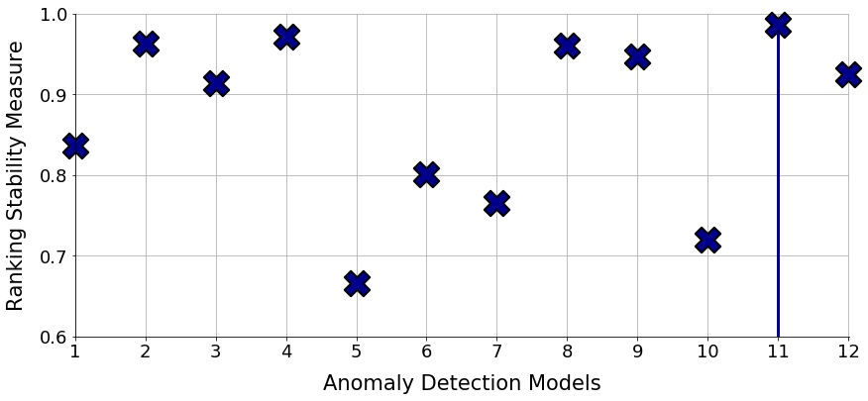
Which Model Would you Trust More?

Slide 10
How to quantify the robustness of any anomaly detector?
End of the spotlight presentation

Slide 11

3 Steps of Standard Unsupervised Anomaly Detection
Unlabeled Data

Slide 12
3 Steps of Standard Unsupervised Anomaly Detection
Anomaly Scores
s₄
s_{t}
s₁
s₆
...
s_{n}
...
s₅
Map
Unlabeled Data

Slide 13
3 Steps of Standard Unsupervised Anomaly Detection
Anomaly Scores
s₄
s_{t}
s₁
s₆
...
s_{n}
...
s₅
Anomaly Ranking
s₁
s₂
s₃
s₄
...
s_{t}
...
s_{n}
Map
Sort
yes
Unlabeled Data
no

Slide 14
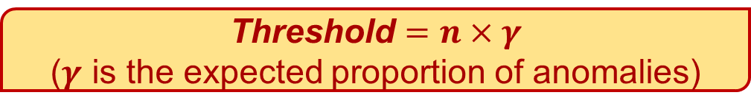
3 Steps of Standard Unsupervised Anomaly Detection
Anomaly Scores
s₄
s_{t}
s₁
s₆
...
s_{n}
...
s₅
Anomaly Ranking
s₁
s₂
s₃
s₄
...
s_{t}
...
s_{n}
Map
Sort
yes
Unlabeled Data
no

Slide 15
3 Steps of Standard Unsupervised Anomaly Detection
Anomaly Scores
s₄
s_{t}
s₁
s₆
...
s_{n}
...
s₅
Anomaly Ranking
s₁
s₂
s₃
s₄
...
s_{t}
...
s_{n}
Predicted Class
Anomaly
Anomaly
...
Anomaly
Normal
Normal
...
Normal
Map
Sort
Predict
yes
Unlabeled Data
no

Slide 16
Ranking Stability Measure A 3-step approach for estimating the robustness

Slide 17
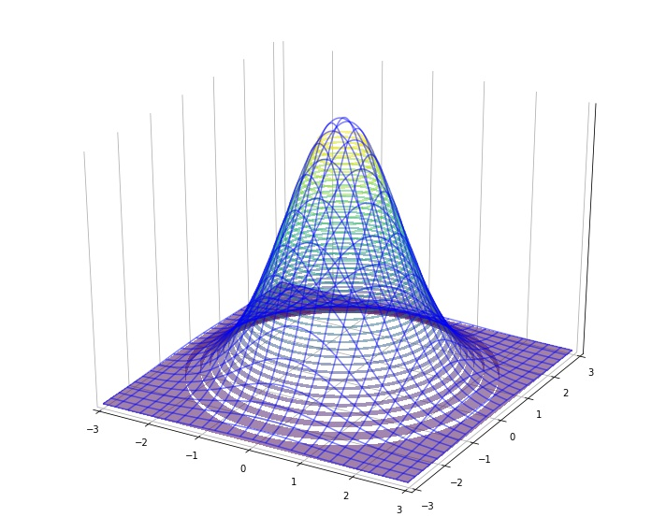
Step 1: Drawing Random Subsets to Simulate Slight Changes in the Training set

Slide 18
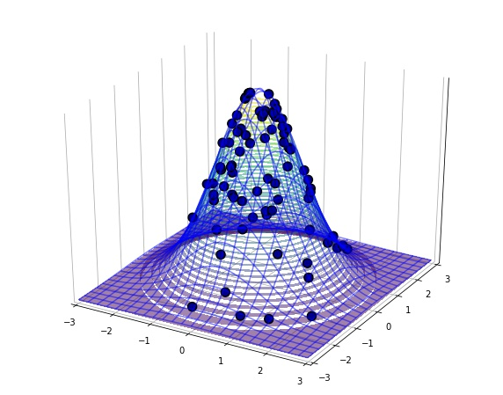
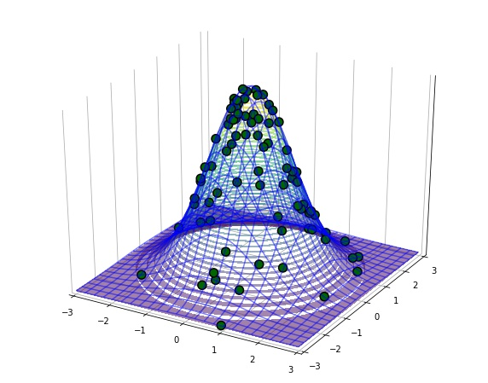
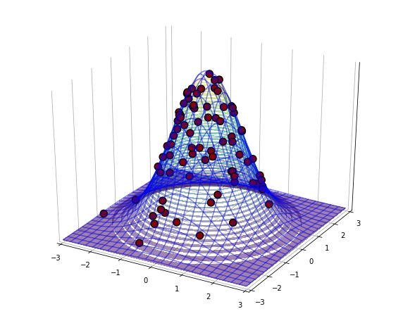
Step 1: Drawing Random Subsets to Simulate Slight Changes in the Training set
Subset 1
Subset 2
Subset 3

Slide 19
Step 1: Drawing Random Subsets to Simulate Slight Changes in the Training set
Subset 1
Train model
Use the model to make the anomaly ranking
Subset 2
Subset 3

Slide 20
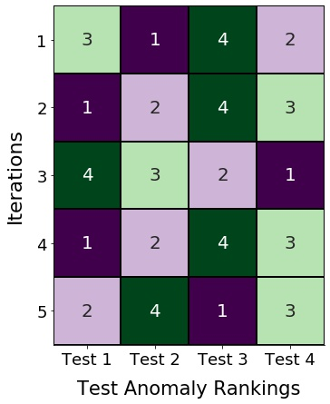
Step 2: Assigning Example-Wise Stability Scores Using the Std. Dev. and the Range of Normalized Positions

Slide 21
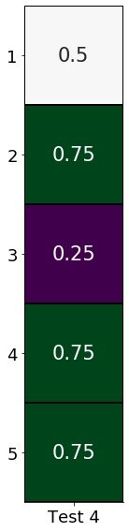
Step 2: Assigning Example-Wise Stability Scores Using the Std. Dev. and the Range of Normalized Positions

Slide 22

Step 2: Assigning Example-Wise Stability Scores Using the Std. Dev. and the Range of Normalized Positions

Slide 23
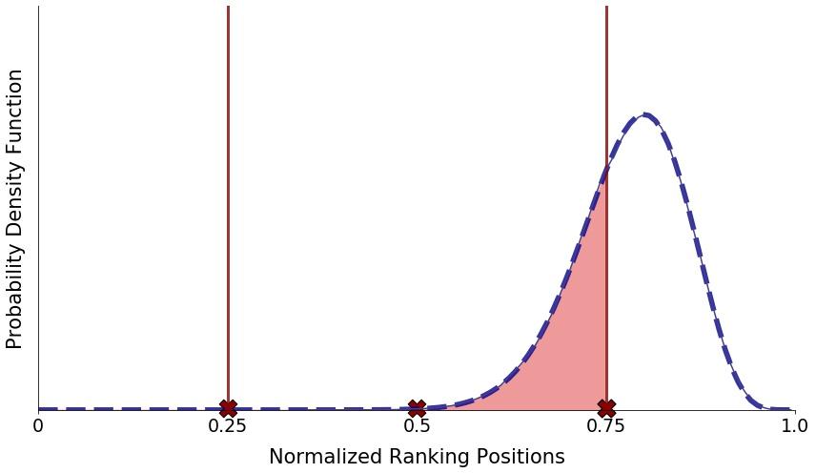
Step 2: Assigning Example-Wise Stability Scores Using the Std. Dev. and the Range of Normalized Positions

Slide 24
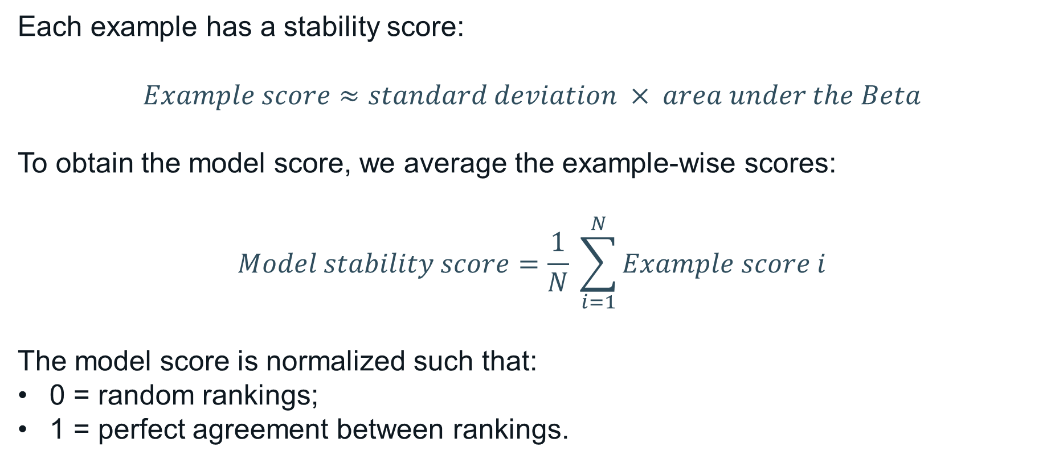
Step 3: Aggregating the Example Scores to a Model Score

Slide 25
Experiments Empirical evaluation on benchmark datasets

Slide 26
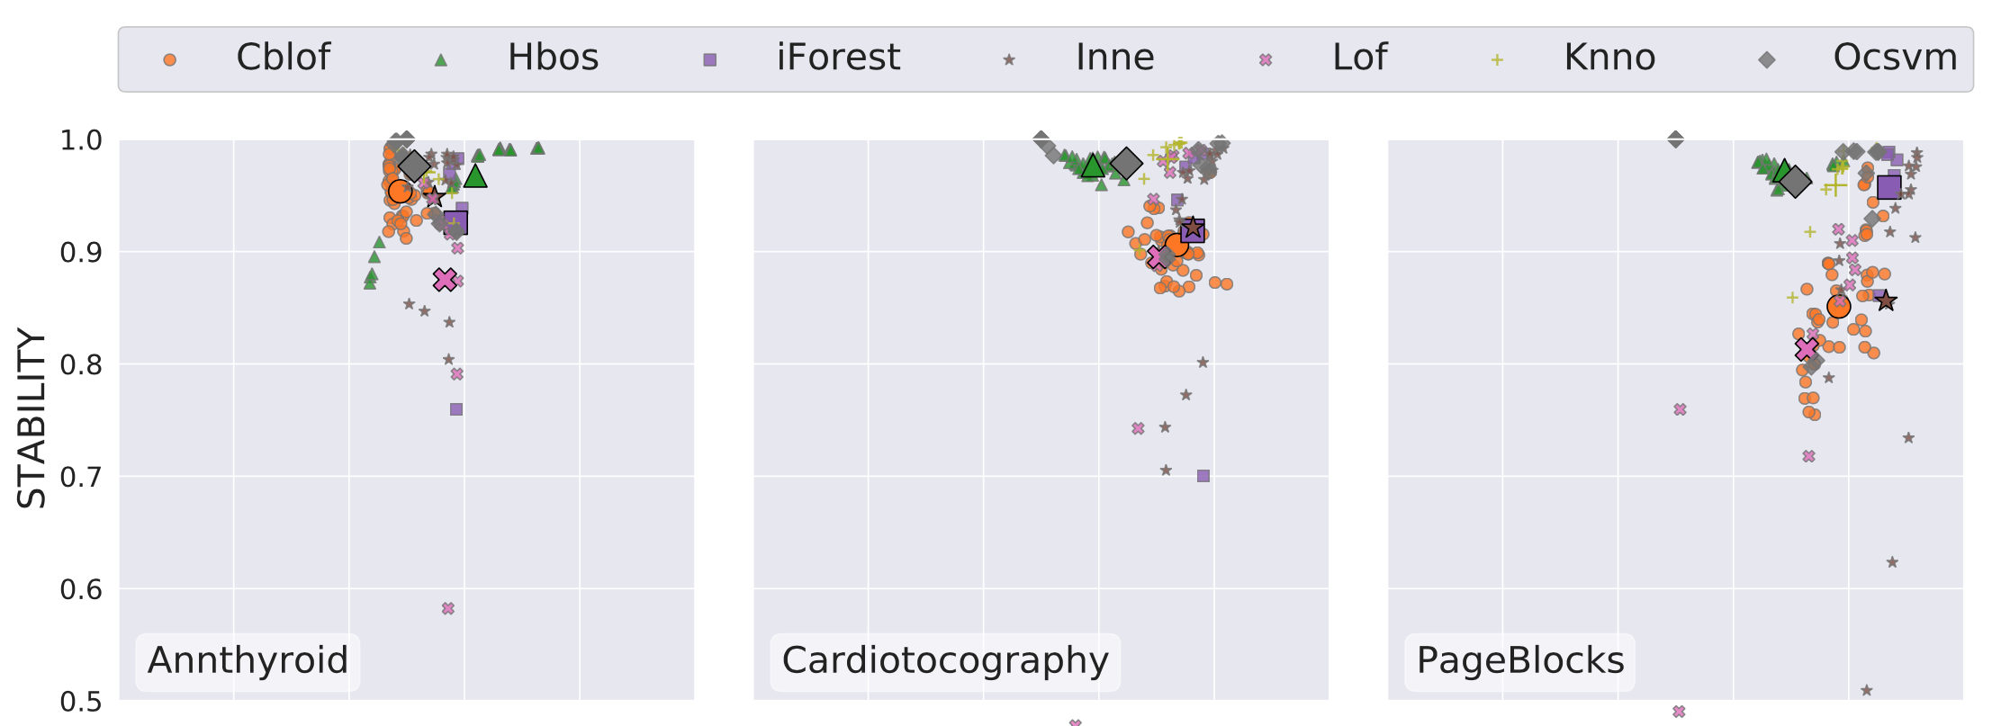
Does Stability Measure Allow Cross-Comparisons Among Anomaly Detectors, Complementing Traditional Measures?
AUROC

Slide 27
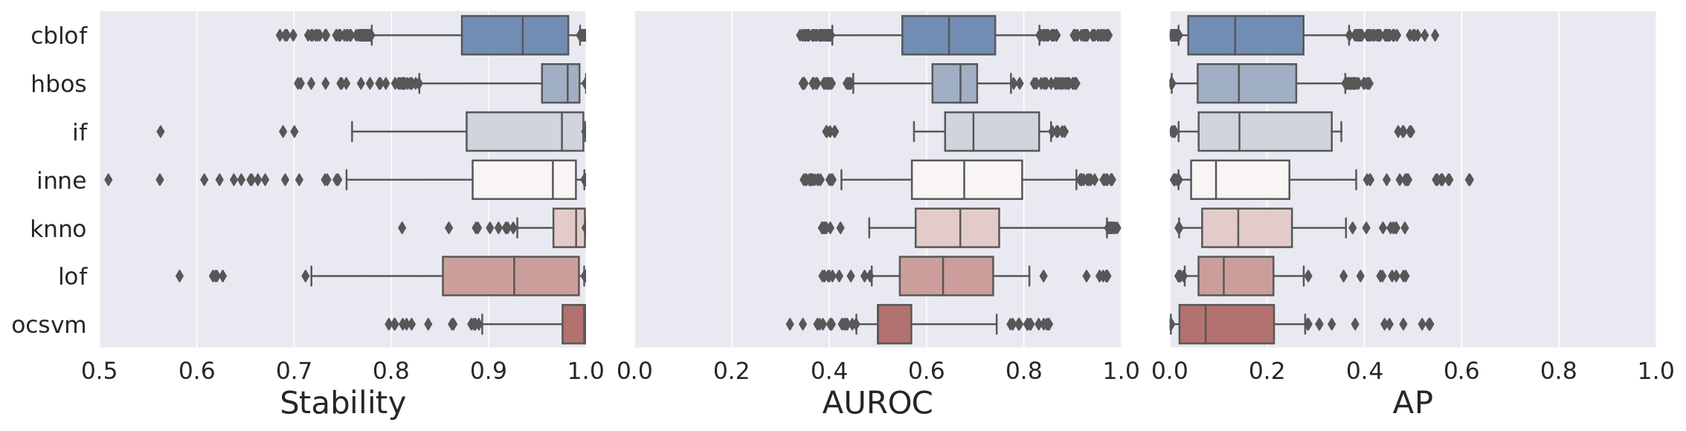
Does Stability Measure Allow Cross-Comparisons Among Anomaly Detectors, Complementing Traditional Measures?

Slide 28
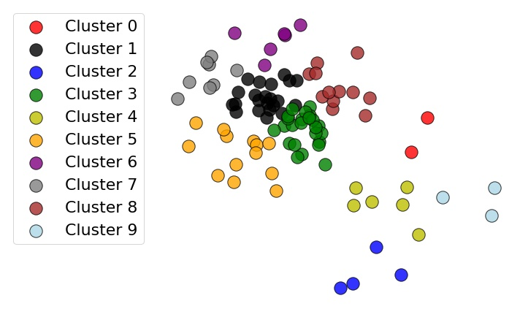
How does our Stability Measure behave when Biased Subsets are drawn?

Slide 29
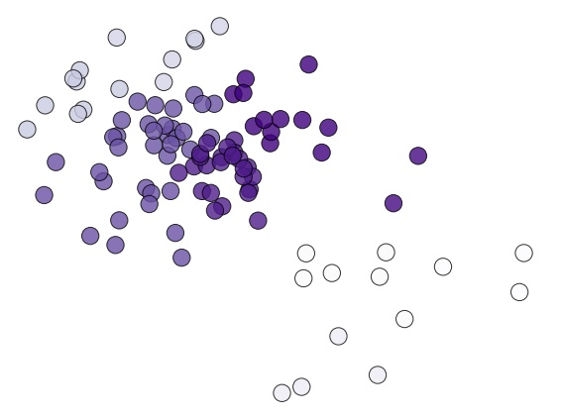
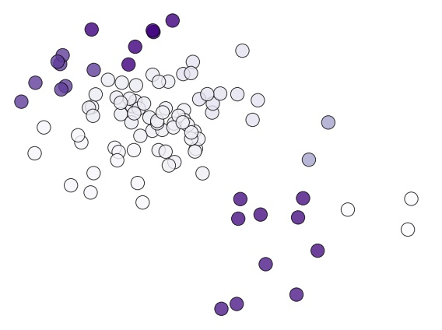
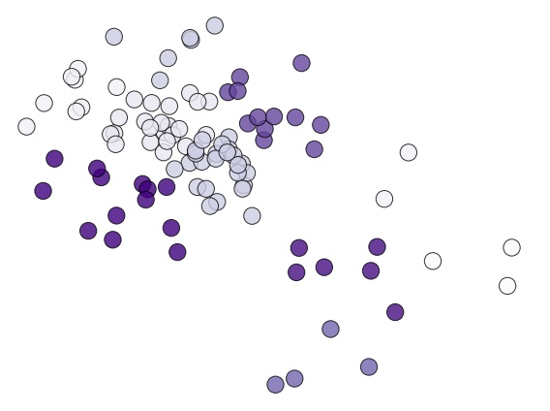
How does our Stability Measure behave when Biased Subsets are drawn?

Slide 30
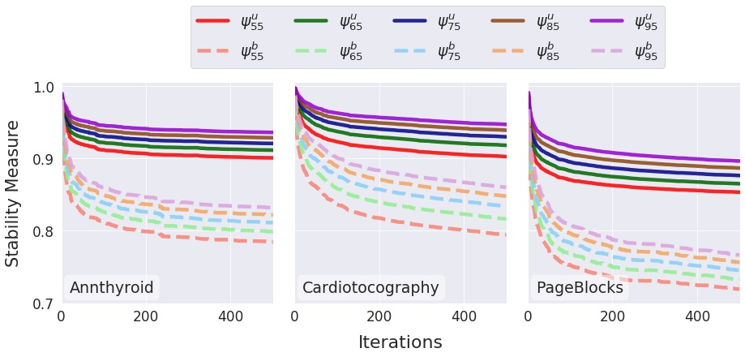
Biased Subsampling Strategies Lead to Less Stable Anomaly Detectors
Hyperparameter
Uniform Sampling
Biased Sampling

Slide 31
Stability Measure Is a Valid Alternative To Traditional Performance Measures to Quantify Models’ Behaviour
We proposed a novel stability measure to quantify the robustness of anomaly detection methods:
1. This measure allows meaningful cross-comparison of different methods;
2. This measure behaves realistically in our experiments.
All code and experiments are available online:
https://github.com/Lorenzo-Perini/StabilityRankings_AD

Slide 32
Contact us name.surname@kuleuven.be
Lorenzo Perini, Connor Galvin, Vincent Vercruyssen
EDML 2020
https://people.cs.kuleuven.be/~lorenzo.perini/
@LorenzoPerini95

