Slide 1


Slide 2

About me
Bachelor’s degree of Mathematics at Università degli studi di Firenze (2017);
Master’s degree of Mathematical Engineering at Politecnico di Torino (2019);
2nd-year PhD student in Computer Science at KU Leuven (Belgium);
Research interests: PU Learning, Active Learning, Transfer Learning,
Anomaly Detection, Uncertainty Quantification;
Supervisor: Prof. Dr. Jesse Davis, co-author: Dr. Vincent Vercruyssen.

Slide 3



About DTAI team
Declarative Languages and Artificial Intelligence
http://dtai.cs.kuleuven.be/research
11 Professors
10 Post-docs
68 PhDs
Basic Research
Probabilistic Programming
Predictive Learning and Clustering
Automated Data Science
Exploratory Data Mining
Privacy, Non-discrimination and Ethics
Constraints
Functional Programming
Knowledge Base Systems
Applications
Sports Analytics
Anomaly Detection
Robotics
Engineering and Sensors
Health
Texts and Web
Games

Slide 4
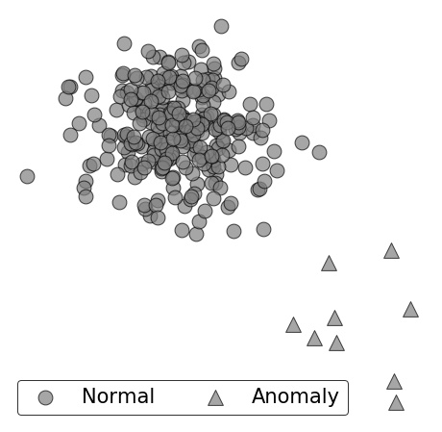
Context: Anomaly Detection Aims to Identify Examples that Do Not Correspond to Expected Normal Behaviours
Anomaly detection is tackled from an unsupervised perspective due to the costs and difficulties of acquiring labels for the anomaly class.

Slide 5

4 Steps of Standard Unsupervised Anomaly Detection
Unlabeled Data

Slide 6
4 Steps of Standard Unsupervised Anomaly Detection
Anomaly Scores
s₄
s_{t}
s₁
s₆
...
s_{n}
...
s₅
Map
Unlabeled Data

Slide 7
4 Steps of Standard Unsupervised Anomaly Detection
Anomaly Scores
s₄
s_{t}
s₁
s₆
...
s_{n}
...
s₅
Anomaly Ranking
s₁
s₂
s₃
s₄
...
s_{t}
...
s_{n}
Map
Sort
yes
Unlabeled Data
no

Slide 8
4 Steps of Standard Unsupervised Anomaly Detection
Anomaly Scores
s₄
s_{t}
s₁
s₆
...
s_{n}
...
s₅
Anomaly Ranking
s₁
s₂
s₃
s₄
...
s_{t}
...
s_{n}
Map
Sort
yes
Unlabeled Data
no
Threshold = n x γ
(γ is the expected proportion of anomalies)

Slide 9
4 Steps of Standard Unsupervised Anomaly Detection
Anomaly Scores
s₄
s_{t}
s₁
s₆
...
s_{n}
...
s₅
Anomaly Ranking
s₁
s₂
s₃
s₄
...
s_{t}
...
s_{n}
Predicted Class
Anomaly
Anomaly
Anomaly
Anomaly
...
Normal
...
Normal
Map
Sort
Predict
yes
Unlabeled Data
no
Threshold = n x γ
(γ is the expected proportion of anomalies)

Slide 10
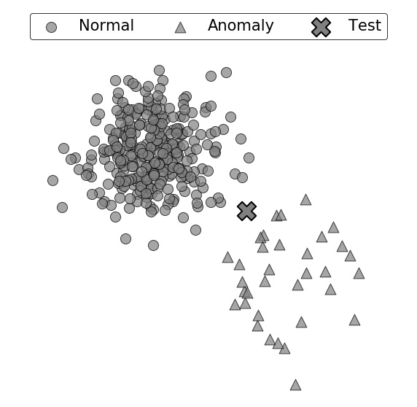
Can you Spot the Predicted Class for a Test Example?
Predicted Class: ?

Slide 11
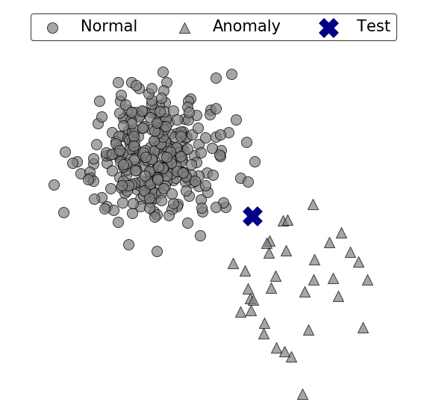
For a Given Anomaly Detector the Test Example is Normal
Predicted Class: Normal
Does the prediction change when a
different training set is drawn from the
same distribution?
How confident is the model in its prediction?

Slide 12
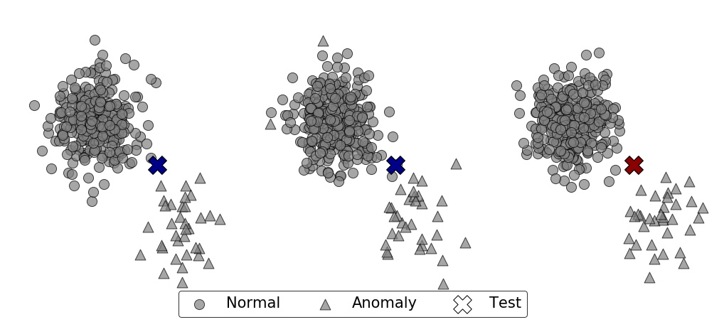
What Is the Effect of Slightly Perturbing the Training Data on Anomaly Detector’s Prediction for a Fixed Example?
Dataset 1
Dataset 2
Dataset 3
Prediction:
Normal
Anomaly

Slide 13
Our Goal Is To Capture the Uncertainty in Predictions
Out of 20 predictions:
50% Normal;
50% Anomaly.
Given:
An anomaly detector and a test example;
Do:
Estimate the detector’s confidence in predicting the same class.

Slide 14
How to estimate the confidence of a model in its example-wise predictions?

Slide 15
We Make 4 Contributions
Define the confidence in an example-wise prediction;
Propose ExCeeD, a 2-step approach for estimating the confidence:
Convert anomaly scores to outlier probabilities using a Bayesian approach;
Derive confidence scores by observing that different training sets would lead to different thresholds and, in turn, to different predictions;
Analyze the convergence behavior of our estimate;
Perform an extensive empirical evaluation on benchmark datasets.

Slide 16
Contribution 1: Defining the confidence A measure of uncertainty in class prediction

Slide 17
Do Density Estimators Capture Uncertainty in Class Prediction?
Prediction:
Normal
Anomaly
Although the predicted class changes many times, the outlier probability keeps being high

Slide 18
Confidence Is a Novel Measure of Consistency
Prediction:
Normal
Anomaly
When the class is Normal, the confidence is around 60%
When the class is Anomaly, the confidence is around 40%

Slide 19
Confidence Is NOT Outlier Probability because they measure fundamentally different things
Prediction:
Normal
Anomaly
Aleatoric Uncertainty
Epistemic Uncertainty
Outlier probability measures the probability of belonging to the anomaly class
Confidence measures the consistency in predicting the same class

Slide 20
Contribution 2: ExCeeD A two-steps approach for estimating the
example-wise confidence

Slide 21
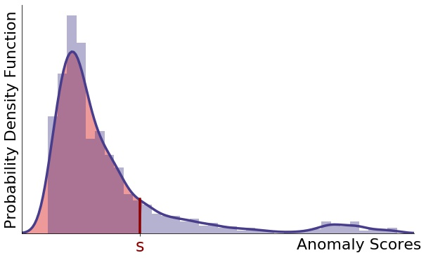
Step 1: Converting Anomaly Scores to Outlier Probabilities
The larger the number of examples with a lower anomaly score,
the more anomalous the example is.
p_{s}
Notes:
In the first step, the main goal is to pass from anomaly scores to outlier probabilities. Let's start by fixing a score s, which is the anomaly score of a fixed test example. As the higher is the score, the more anomalous is the example, what we want to do is to measure the quantity of scores that are less than s. In fact, it's easy to realize that the larger the number of examples with lower scores, the greater is the red area quantifying the anomalousness of s and, as a result, the more anomalous the score s is. So, the first step consists of estimating the red area inside the plot, which is the probability that drawing another example and computing its anomaly score, this new score will be less than our fixed value s.

Slide 22
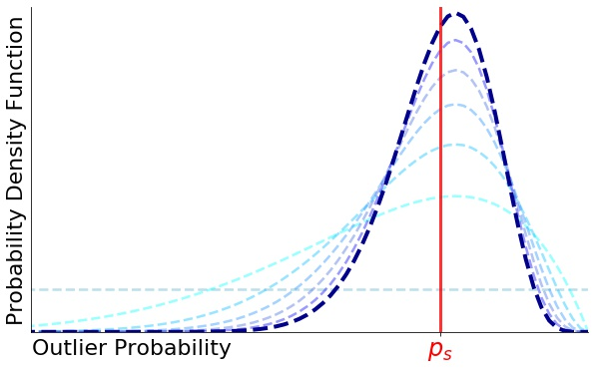
Step 1: Converting Anomaly Scores to Outlier Probabilities
The larger the number of examples with a lower anomaly score,
the more anomalous the example is.
We need a Bayesian approach because we need a smooth measurement of the area.
p_{s}
Notes:
In practice, as we do not know the actual distribution of anomaly scores, we assume that the red area is a random variable with non informative prior uniform distribution and, by considering the anomaly scores inside the dataset, we model the posterior distribution and take the mean as most likely value. The Bayesian approach allows getting smooth values of the area, as it is the same as considering the empirical distribution of anomaly scores with a correction factor.

Slide 23
Step 2: Converting Outlier Probabilities to Confidence Scores
It is only matter of whether the drawn anomaly scores are greater than s or not.
p_{s}
1 - p_{s}
p_{s}
Notes:
In the second step, we have a smooth probability value ps representing the red area, which again might be thought as the probability that drawing a new anomaly score from its true distribution, this will be less than the fixed score s. In this step we should quantify the confidence assuming that different training sets are observed. Instead of literally drawing many training sets, we just need to consider the score that the anomaly detector would assign to each drawn example. And the main key insight is that, here, we do not need the actual value of the anomaly score but only whether this is greater than s or not. In fact, it doesn't matter the distance between the threshold and the score s, but only the side of the threshold with respect to the score.

Slide 24
Step 2: Converting Outlier Probabilities to Confidence Scores
It is only matter of whether the drawn anomaly scores are greater than s or not.
p_{s}
1 - p_{s}
p_{s}
How many scores end up being
in the red area?
Notes:
What we should do to pass from the outlier probability to the confidence value is to calculate the number of examples that would end up inside the red area if we drew a different dataset with the same size as the previous one and assuming to know the previously estimated outlier probability ps.

Slide 25
Step 2: Converting Outlier Probabilities to Confidence Scores
It is only matter of whether the drawn anomaly scores are greater than s or not.
p_{s}
1 - p_{s}
p_{s}
How many scores end up being
in the red area?
ExCeeD estimates the probability that ‘enough’ examples
fall inside the red area in order to keep the same prediction
Notes:
In fact, in order to set the predictive threshold such that the fixed score s is predicted to be anomalous we just need that enough examples fall inside the red area in order to set the predictive threshold as a value lower than the score s.

Slide 26
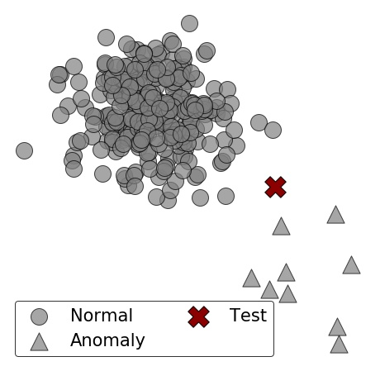
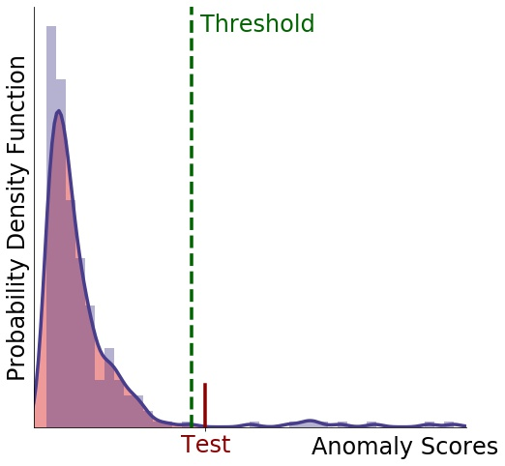
How to Derive the Confidence score
in Practice
anomaly detector

Slide 27
How to Derive the Confidence score
in Practice
# training data (n) | 300
# test data | 1
contamination factor (γ) | 10%
threshold value | 0.357
test score | 0.390
class prediction | anomaly
# lower scores (ls) | 291
anomaly detector

Slide 28
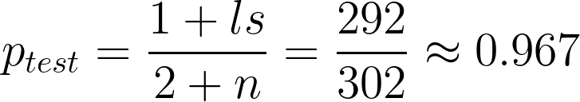
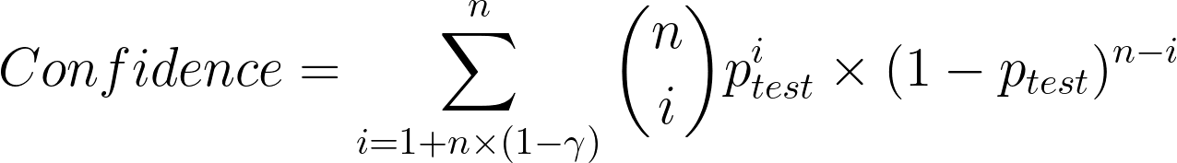
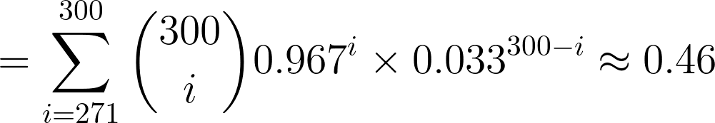
How to Derive the Confidence score
in Practice
# training data (n) | 300
# test data | 1
contamination factor (γ) | 10%
threshold value | 0.357
test score | 0.390
class prediction | anomaly
# lower scores (ls) | 291
1st Step: Outlier Probability
Likely to be anomalous
2nd Step: Confidence Score
Not so confident in its prediction

Slide 29
Contribution 3: Convergence Analysis How increasing the size of the training set affects ExCeeD’s confidence estimation

Slide 30
Convergence Behavior of Our Confidence Measure
Two cases according to γ
γ ≠ 0: training set contains anomalies
γ = 0: training set with no anomalies

Slide 31
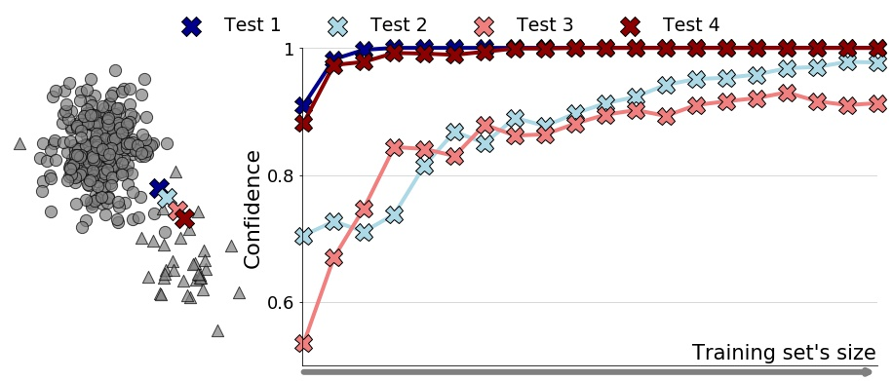
If the Training Set Contains Anomalies, the Confidence Always Converges to 1
γ ≠ 0: training set contains anomalies
Confidence converges to 1
Notes:
If a few anomalies are expected to be present, then the confidence will converge to 1 and the limit predicted class will only depend on the value of gamma. In fact, if the proportion of examples in the training set with anomaly scores greater than s is high enough compared to gamma, then the example will always be predicted as normal.

Slide 32
If the Training Set Does Not Contain Anomalies, the Confidence Limit Depends on the Predicted Class
γ = 0: training set with no anomalies
Confidence converges to 1
Confidence converges to
е⁻¹ ≃ 0.3679
Notes:
On the other hand, assuming that the training set will never contain anomalies and taking the maximum score as threshold, then the confidence either converges to 1, in case an example with greater score is observed, or, otherwise, it converges to e power to minus 1. This particular and not so high value in the second case is due to the fact that, while the training set is growing in size, it gets more likely to draw a normal example with anomaly score greater than the fixed test score s. And if eventually it happens, then as you can see from the test 2 in the plot, the predicted class will change to normal and the confidence will converge to 1 as in the first case. So for this reason, it's not very likely that the test example will end up remaining anomalous to the limit.

Slide 33
Contribution 4: Experiments An extensive empirical evaluation on benchmark datasets

Slide 34
A Large Experimental Comparison Shows that ExCeeD Recovers Confidence Matching Empirical Frequencies
We compared ExCeeD with three types of baselines
Naive Baseline, i.e. confidence always equal to 1;
Outlier Probability methods, i.e. apply existing methods instead of step 1;
Calibration methods, i.e. calibrated probabilities assuming to get a labeled dataset;
on 21 benchmark datasets and 3 anomaly detectors, and we found that:
Our outlier probability’s estimate leads to more accurate confidence scores;
ExCeeD outperforms all the baselines, no matter of the anomaly detector used.
Notes:
To empirically prove the effectiveness of ExCeeD, a large experimental comparison has been performed. We considered the error between the confidence estimates and the empirical frequencies of class predictions and we compared our method with three baselines. A first baseline consists of assuming that the model has always confidence equal to 1 in its prediction. The second baseline consists of using existing density estimation methods instead of our step 1. The third group contains the calibration methods where we actually have to assume that the training set is labeled. By involving three anomaly detectors and 21 benchmark datasets, we proved that our method ExCeeD is able to recover the empirical frequencies of class prediction better than the other baselines.

Slide 35
ExCeeD Captures Our Intuitions about How a Detector’s Confidence in Its Prediction Varies as this Example Moves
Prediction:
Normal
Anomaly
Notes:
A final example illustrates that ExCeeD is able to estimate the uncertainty in class prediction differently for slight different examples. Consider the case where an example starts moving away from a normal cluster of data towards anomalies. In this case we expect the confidence to start high and get lower while the example is getting less normal. Then, after a while the model is supposed to change its prediction from normal to anomaly and the confidence should get higher again, meaning that the point is getting more anomalous step by step. The strenght of ExCeeD is that it is able to produce smooth confidence scores which capture the variation of uncertainty behind the model even if the example's position slightly changes.

Slide 36
Take Aways
We introduced a novel definition of confidence as the probability that the predicted
class would change if a different training set was observed;
Confidence is not simply density estimation, because it captures the consistency of
any anomaly detector in making the same prediction;
ExCeeD estimates any anomaly detector’s confidence based on Bayesian learning;
Increasing the data results in the region with high uncertainty becoming narrower;
The closer to the decision boundary, the higher the uncertainty, the lower the confidence.
All code and experiments are available online: https://github.com/Lorenzo-Perini/Confidence_AD

Slide 37

Thanks for your attention!
Contact us: name.surname@kuleuven.be
Lorenzo Perini, Vincent Vercruyssen, Jesse Davis
SmartData@Polito
https://people.cs.kuleuven.be/~lorenzo.perini/
@LorenzoPerini95

